Slide 1
Apply for PyCharm Educational License
by
RAGE Uday Kiran

Slide 2


Step 1: Visiting the Site
URL: https://www.jetbrains.com/community/education/#students
Scroll down and click here

Slide 3
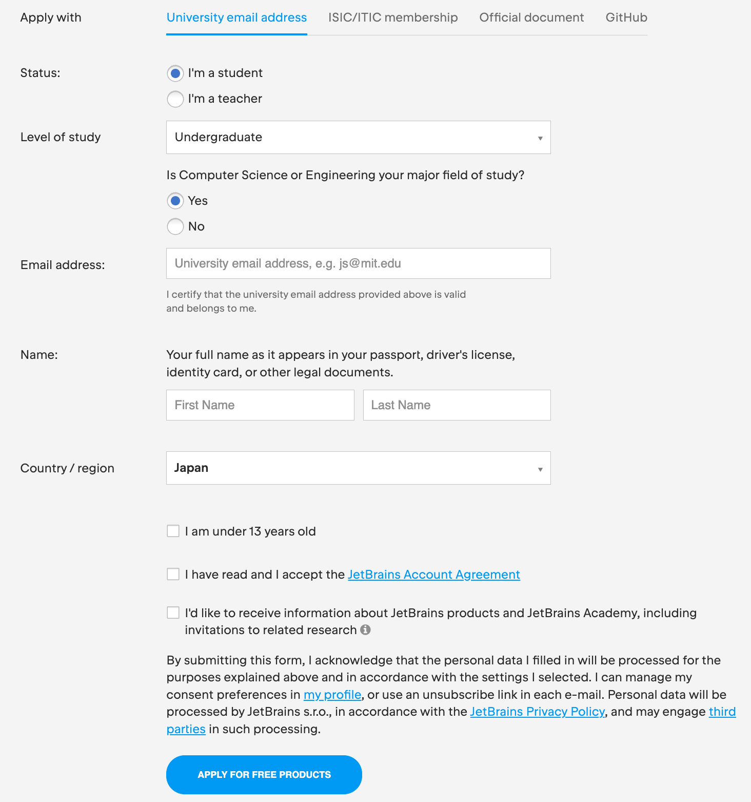
Step 2: Registration Page
Please provide your university email address.
Do not provide gmail or any generic email
Do not check this check box
check this check box
Do not check this check box
Press this button
Wait for 2 to 3 days for the confirmation

