Slide 1
Account Creation in the Computing Server

Slide 2
Step 1: Choosing a Computing Server
Recommended
Computing Servers | IP-ADDRESS | Specifications | Jupyter Hub
Skytree2 | 163.143.165.141 | CPU-server with PCIe Gen4 Storage | http://163.143.165.141:8000/
Khalifa4 | 163.143.165.143 | A6000 GPU-server with HDD storage. | http://163.143.165.143:8000/
Khalifa3 | 163.143.165.140 | A6000 GPU-server with HDD storage. | http://163.143.165.140:8000/
Click on anyone of the above URLs
Let us call the ipaddress of that machine as hostname

Slide 3
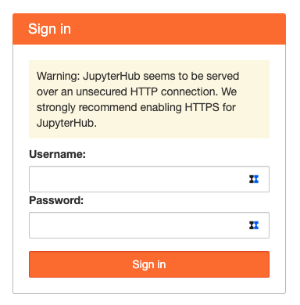
Step 2: Login Using the Super User Account
jupyter
Inquire for the password
*****************
Press the button

Slide 4
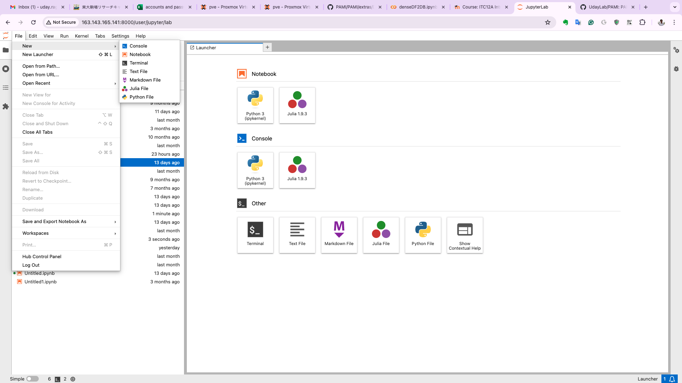
Step 3: Open the Terminal
Click: File -> New ->Terminal
Click any one

Slide 5
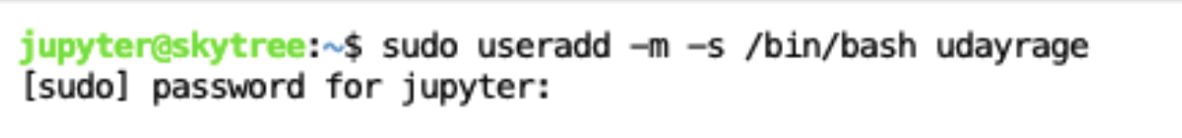
Step 4: Creating Your Account
sudo useradd -m -s /bin/bash userName
*Do not use capitals for the username
***************
Type the admin password used for login

Slide 6
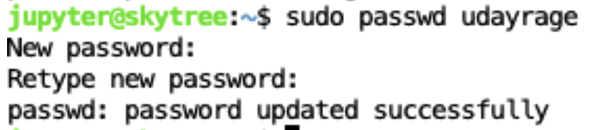
Step 5: Setting the Password for Your Account
sudo passwd userName
typeYourOwnPassword
typeYourOwnPassword
Remember this password

Slide 7
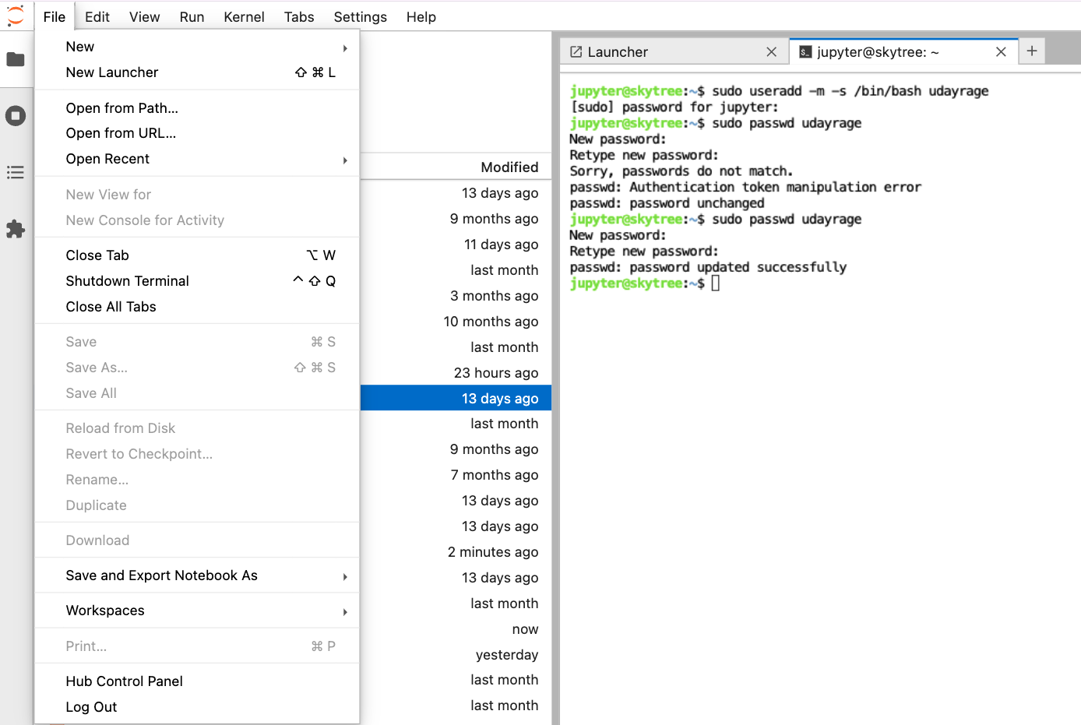
Step 6: Logout from the Super User Account
Press this button

Slide 8
Step 7: Login With Your Newly Created Account
yourUserName
type your password
****************
Press

Slide 9
Step 8: Open the Terminal
Click: File -> New ->Terminal
Click any one

Slide 10
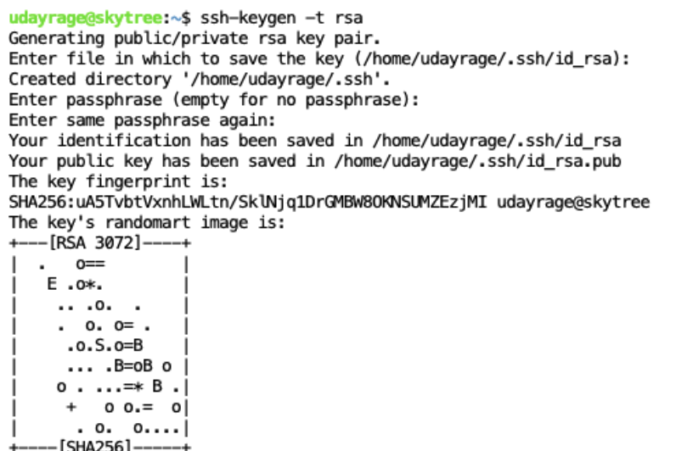
Step 9: Creation of Public and Private Keys
Execute the below command:
ssh-keygen -t rsa
Simply press Enter button

