Slide 1
Creating A Database User Account in the Course Server
By
RAGE Uday Kiran

Slide 2
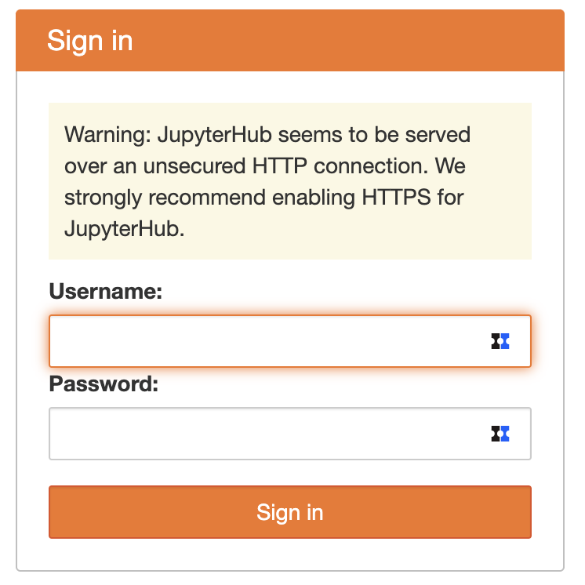
Step 1: Login into the Jupyter Hub of the Course Server
studentID
password

Slide 3
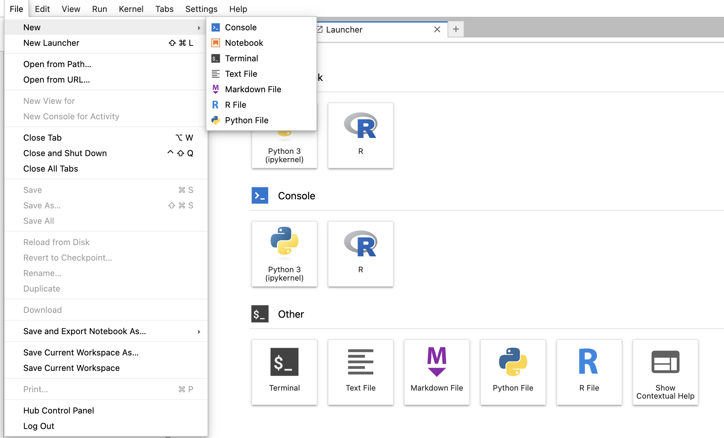
Step 2: Open Terminal
Click anyone

Slide 4
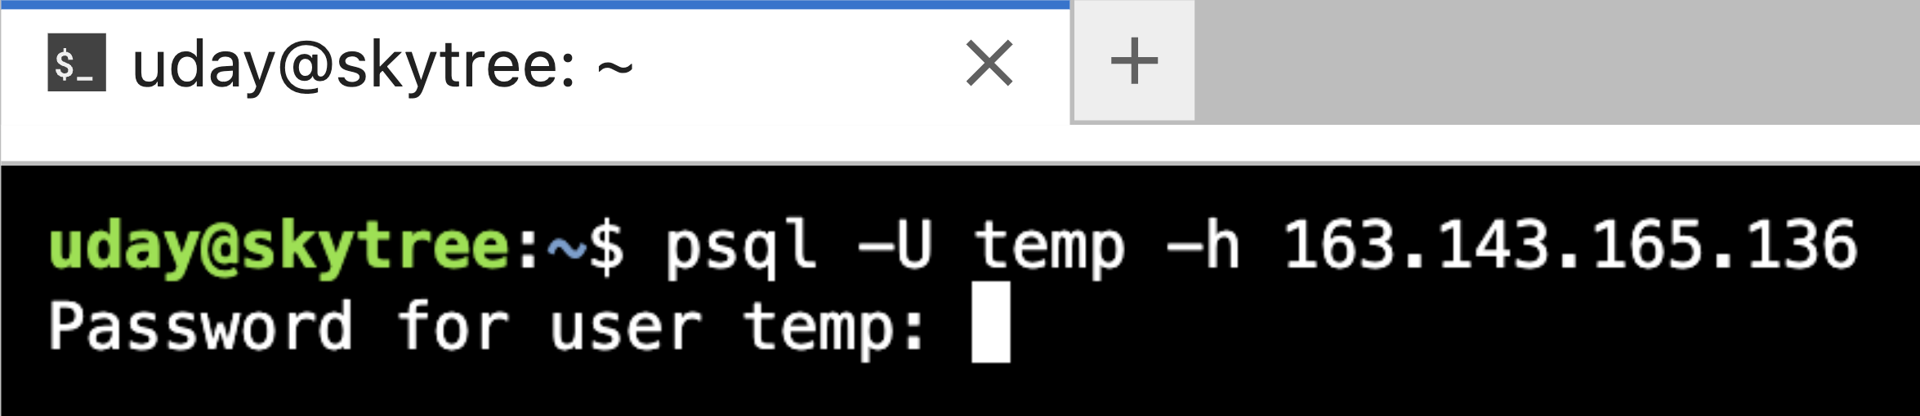
Step 3: Login into the Postgres using sudo account
Type the following command in the terminal:
psql -U temp -h 163.143.165.136
or
psql -U temp -h localhost
Type the following password: temp@14916
temp@14916

Slide 5
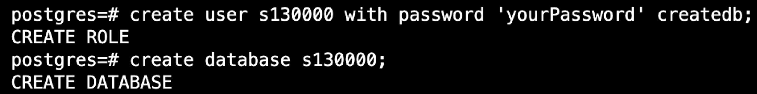
Step 4: Create your student account and database
Execute the following commands:
CREATE USER studentID WITH PASSWORD 'yourPassword' CREATEDB;
CREATE database studentID;
If you are copy pasting the text, please check the first quotation mark. It has to be single quotation.

Slide 6
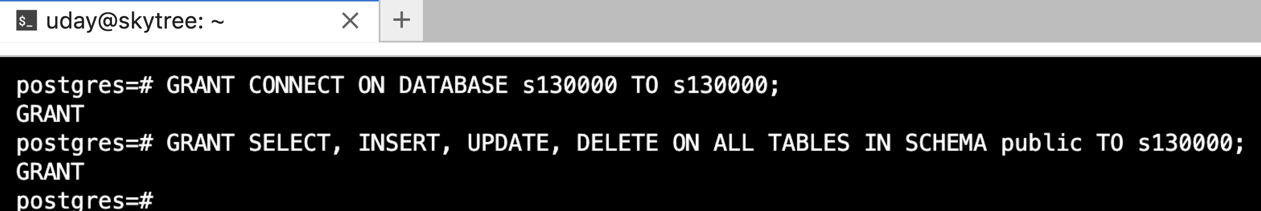
Step 5: Granting Permissions to the Student
Execute the following commands:
GRANT CONNECT ON DATABASE studentID TO studentID;
GRANT SELECT, INSERT, UPDATE, DELETE ON ALL TABLES IN SCHEMA public TO studentID;

Slide 7
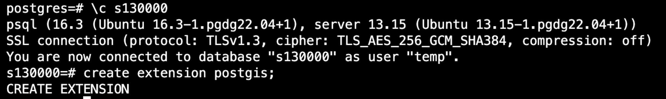
Step 6: Connecting to Student Database
Execute the following commands:
\c studentID - Connecting to your database
create extension postgis

Slide 8

Step 7: Quit from the database
Press Control + D
or
Type \q

Slide 9
Step 8: Login into your database
Execute the following command:
Replace "localhost" with the ipaddress of the database server, say 163.143.165.136
psql -U studentID -h ipaddress
type your password that specified in Step 4

Slide 10
Thank you

