Slide 1
Mounting the Remote Directory

Slide 2
Step 1: Choosing a Computing Server
Computing Servers | IP-ADDRESS | Specifications | Jupyter Hub
Skytree2 | 163.143.165.141 | CPU-server with PCIe Gen4 Storage | http://163.143.165.141:8000/
Khalifa4 | 163.143.165.143 | A6000 GPU-server with HDD storage. | http://163.143.165.143:8000/
Khalifa3 | 163.143.165.140 | A6000 GPU-server with HDD storage. | http://163.143.165.140:8000/
Click on your Computing Server URL

Slide 3
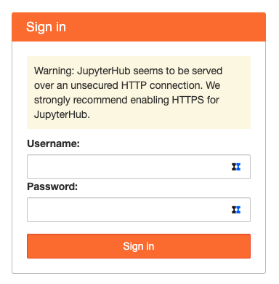
Step 2: Login With Your Account
yourUserName
type your password
****************
Press

Slide 4
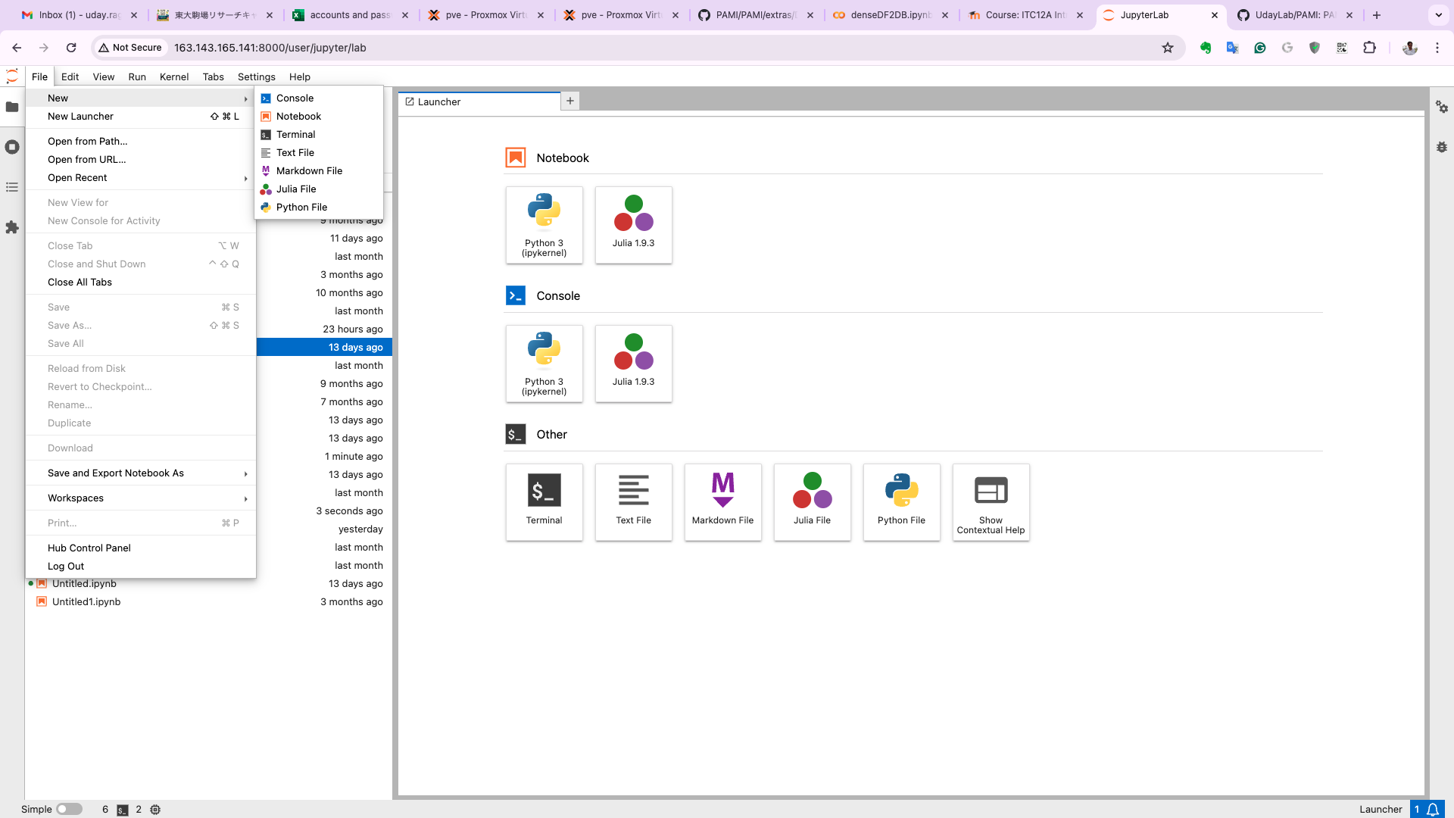
Step 3: Open the Terminal
Click: File -> New ->Terminal
Click any one

Slide 5

Step 4: Create a New Directory to Mount
Execute the below command:
mkdir remoteDir

Slide 6
Step 5: Mounting the Remote Directory
Execute the following command on the terminal:
sshfs -o allow_other,IdentityFile=~/.ssh/id_rsa username@163.143.165.145:/home/userName /home/userName/remoteDir/
Example:
sshfs -o allow_other,IdentityFile=~/.ssh/id_rsa udayrage@163.143.165.145:/home/udayrage /home/udayrage/remoteDir
save this command in a text file as you will be using it whenever the connection is broken.

Slide 7
Step 6: Creating an EMPTY File in the Remote Directory
Execute the following commands:
cd remoteDir
touch yourUserNameComputingServer.txt
E.g., touch udayRageComputingServer.txt

Slide 8
Step 7: Click on the Data Server
Computing Servers | IP-ADDRESS | Specifications | Jupyter Hub
Khalifa6 | 163.143.165.145 | CPU-server with PCIe Gen4 Storage | http://163.143.165.145:8000/
Click on anyone of the above URL
NOTE: Keeps the browsers tabs created in Step 1 and Step 2 side-by-side.

Slide 9
Step 8: Login With Your Account
yourUserName
type your password
****************
Press

Slide 10
Step 9: Open the Terminal
Click: File -> New ->Terminal
Click any one

Slide 11
Step 10: Check the File Created in Step 6
Execute the following command at the home directory: ls
If you see the file, udayRageComputingServer.txt, that was created on the computing server on the data server it means the directories have been successfully mounted.

