Slide 1
Files, Modules, Packages & Documentation
by
RAGE Uday Kiran

Slide 2
Outline
File
Modules
Packages
Code documentation
Sphynx

Slide 3
Outline
File
read
write
Modules
Packages
Code documentation
Sphynx

Slide 4
File
File handling is an important part of programming language.
open() - working with files
"r" - Read
"a" - Append
"w" - Write
"x" - Create
"t" - Text - Default value. Text mode
"b" - Binary - Binary mode (e.g., images)

Slide 5
Reading a File
The open() function returns a file object, which has a read() method for reading the content of the file.
f = open("demofile.txt", "r")
print(f.read())
f.close()
f = open("demofile.txt", "r")
print(f.readline())

Slide 6
Writing a File
Add anyone of the below parameters to write to an existing file:
"a" - Append - will append to the end of the file
"w" - Write - will overwrite any existing content
"x" - Create - will create a file, returns an error if the file exists
f = open("demofile2.txt", "a") f.write("Now the file has more content!") f.close()
# create a new file
f = open("myfile.txt", "x")
# create a new file if it does not exist
f = open("myfile.txt", "w")

Slide 7
Delete a File
To delete a file, you must import the OS module, and run its os.remove() function
To delete an entire folder, use the os.rmdir() method
import os if os.path.exists("demofile.txt"): os.remove("demofile.txt") else: print("The file does not exist")
import os os.rmdir("myfolder")

Slide 8
Outline
File
Modules
Need
Creation
Usage
Packages
Code documentation
Sphynx

Slide 9
Need for Modules
Never write an entire (long) program in a single file
It is better to split your code, classes, functions and variables thoughtfully in a separate python files.
Modular programming refers to the process of breaking a large, unwieldy programming task into separate, smaller, more manageable subtasks or modules.

Slide 10
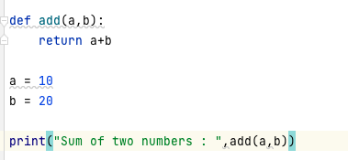
How to define a module?
A module is a python file. That is, *.py file
So you to think carefully before writing a python file
module name
Addition.py
module method

Slide 11
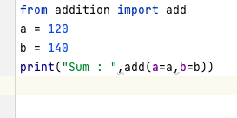
How to use a module?
We use a module using import statement
from <module_name> import <class/method names>
from <module_name> import <class/method names> as alterName
from <module_name> import * (Use it with caution. Not advisable)

Slide 12
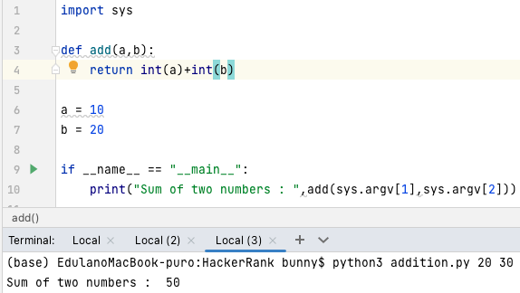
How to run a module from the terminal?
Use “Main” method to execute a module on the terminal
if __name__ == "__main__":
write your code here to run on terminal

Slide 13
Outline
File
read
write
Modules
Packages
Need
Creation
Code documentation
Sphynx

Slide 14
Packages
We often create many modules for an application
So grouping these modules based on some criterions is adviced
Python packages allow grouping of modules as directories/folders
Packages allow the hierarchical structure of the module namespace
IMAGINE: A package is a directory for Python files

Slide 15
How to create a package?
Python considers a directory of programs as a package if it contains the file __init__.py
__init__.py is generally kept empty
Otherwise, it can contain initialization code of a package

Slide 16
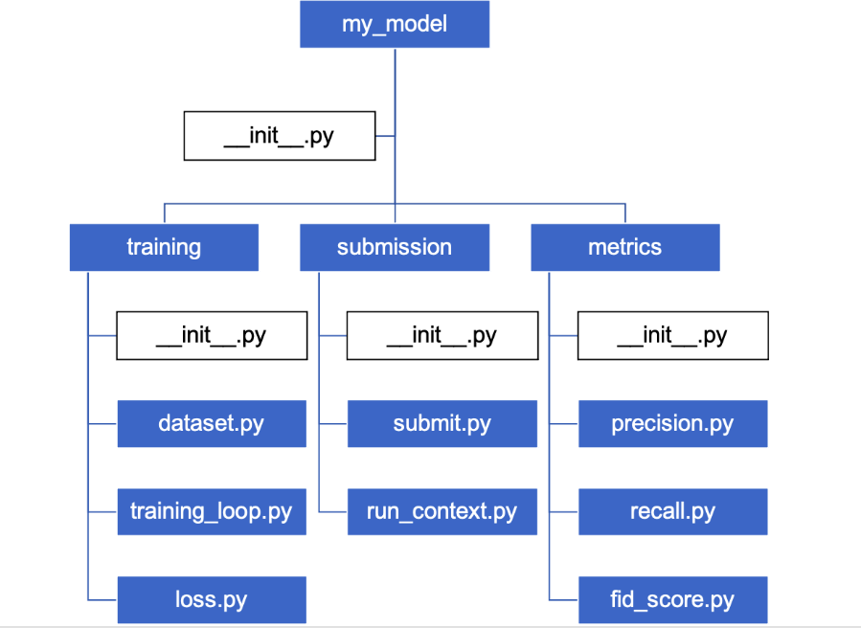
Example
Users of the package can import individual modules from the package.
import my_model.training.dataset
from my_model.training import dataset as ds

Slide 17
Outline
File
Modules
Packages
Code documentation
Comment vs. Documentation
Methods
Examples
Sphynx

Slide 18

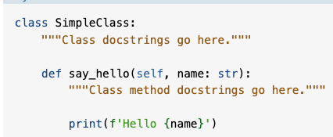
Comments vs. Documentation
Comments
Used to describe your code to developers.
Intended main audience are the maintainers and developers.
Comments are created in Python using the pound sign(#)
Comments should be brief statements
Documentation
Used to describe the usage to the users.
While documentation may be helpful in the development process, the main intended audience are the users.
Documentation is typically provided using docstrings.
By convention, docstrings use triple quotes to make them easier to read.

Slide 19
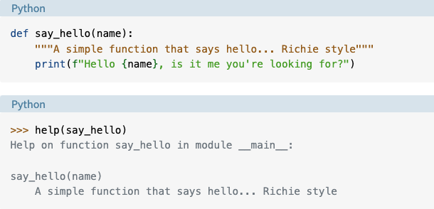
Example 1 of Documentation
help() is a inbuilt python function that prints docstring

Slide 20
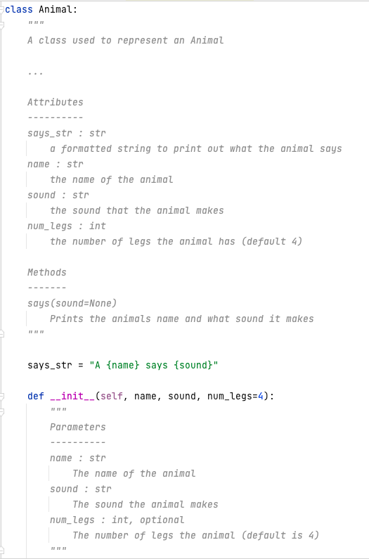
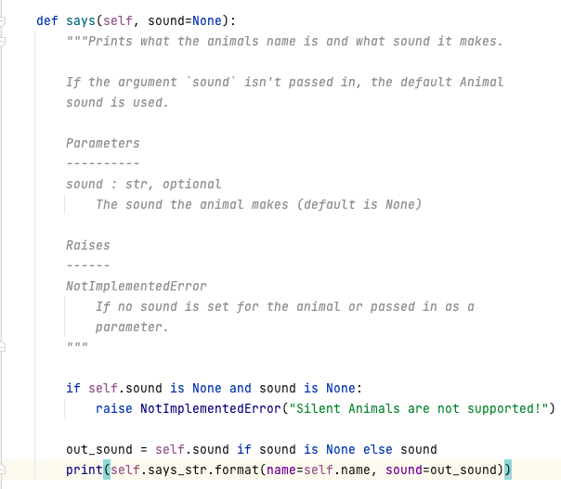
Example 2: Documenting the entire code
same size as above line
indicates bold letters

Slide 21
Docstring Formats
Google Docstrings | ReStructuredText | Numpy/Scipy docstrings
Example """Gets and Prints Args : file_loc (str): location print_cols (bool) : flag Returns : list : represent columns """ | Example """Gets and Prints :param file_loc : location :type file_loc : str :print_cols : flag :type print_cols : :returns : list of cols :rtype: list """ | """Gets and Prints Parameters --------------- file_loc : str The file location print_cols : bool, optional A flag used to print cols Returns ----------- list a list representing cols """
Google's recommended form of documentation | Official Python documentation standard, Not beginner friendly but feature rich | NumPy's combination of reStructuredText and Google Docstrings
Supported by Sphynx and no formal specification | Supported by Sphynx and has formal specification | Supported by sphynx and has formal specification

Slide 22
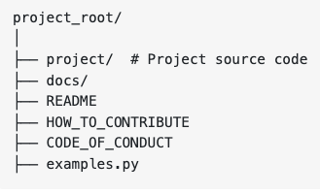
Organizing a Package and Its Documentation
Python projects come in all sorts of shapes, sizes and purposes.
The way you document your project should suit your specific situation.
The general layout of the project and its documentation should be as follows:
The Four Main Sections of the docs Folder are :
Tutorials
How to Guides
References
Explanations
License

Slide 23
Outline
File
Modules
Packages
Code documentation
Sphynx
Installation
Step-by-Step Usage

Slide 24
Installation of Sphinx
Many tools exists for creating documentation files of a code
We discuss Sphinx, which is very popular

Slide 25
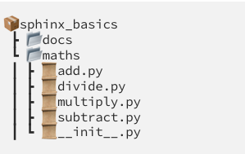
Step-by-Step Usage
Assume you are here
Step 1: Installation of sphinx
pip3 install sphinx sphinx_rtd_theme
Step 2: Create a “doc” folder in your package/project
mkdir doc
Step 3: Enter into “doc” folder
cd doc
Step 4: Execute the following command:
sphinx-quickstart
Now, you are here

Slide 26
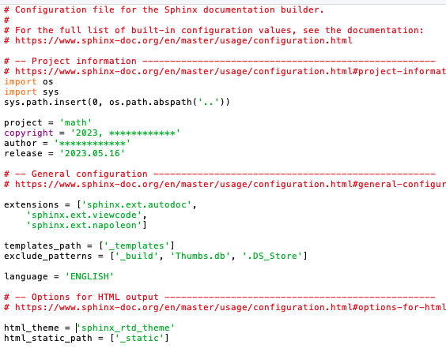
Step-by-Step Usage
Step 5: Open conf.py file using any editor
vi conf.py
Step 6: Add the following lines at the beginning
import sys
import os
sys.path.insert(0,os.path.abspath('..’))
Step 7: In the same file, go to extensions part and add the extensions given below
extensions = [
'sphinx.ext.autodoc’,
'sphinx.ext.viewcode’,
'sphinx.ext.napoleon’]
Step 8: go to the html_theme and replace 'alabaster' with 'sphinx_rtd_theme'.

Slide 27
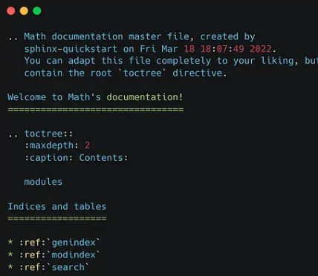
Step-by-Step Usage
Comeback to here
Step 9: Move a directory up from “doc” folder
cd ..
Step 10: Execute the following command
sphinx-apidoc –o doc folderName/
E.g., sphinx-apidoc –o doc maths/
Step 11: open index.rst file in doc add “modules” by giving 3 spaces before
cd doc
Step 12: Execute the following command to create html files
make html
Step 13: You can see the HTML files generated inside your _build

Slide 28
The END

