Slide 1
PyCharm Basics
by
RAGE Uday Kiran

Slide 2
Outline
Download and Installation
User Interface
File Creation and Compiling
Working with GitHub

Slide 3
Outline
Download and Installation
User Interface
File Creation and Compiling
Working with GitHub

Slide 4
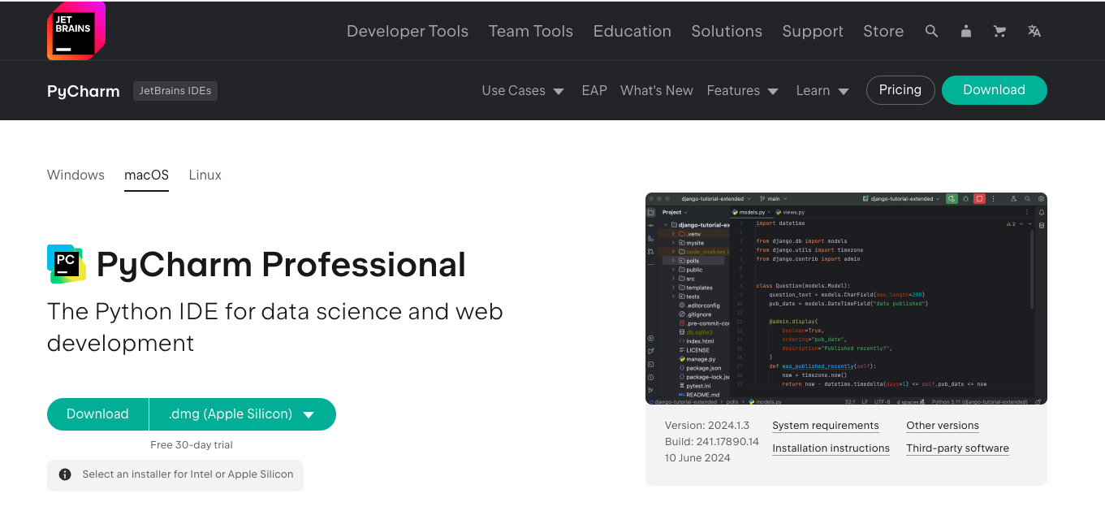
PyCharm Professional Account Download
URL: https://www.jetbrains.com/pycharm/download
Download the right version
based on your PC/Mac

Slide 5
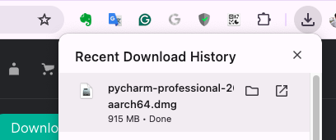
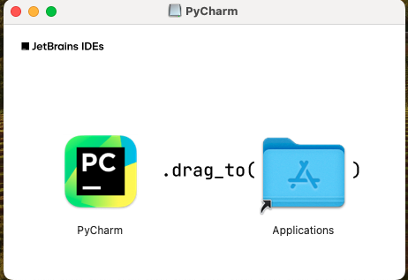
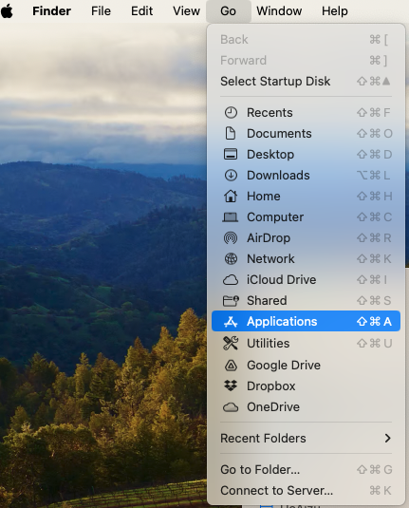
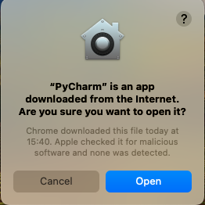
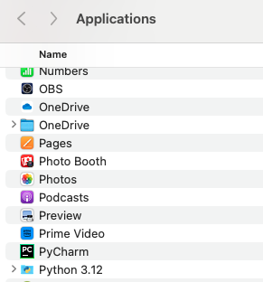
PyCharm Installation
Select, Drag and Drop into Applications Folder
Opens
Next
Click here
In windows, install by pressing “Next”, “Next”, …
you can find the installed application here.
Double click it to open
Opens
Click here

Slide 6
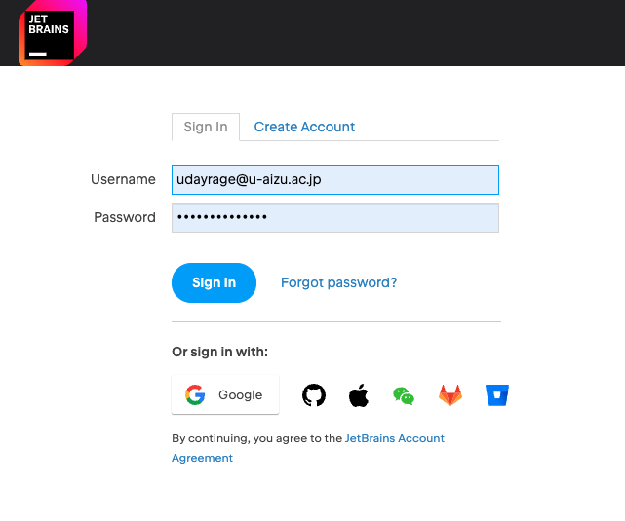
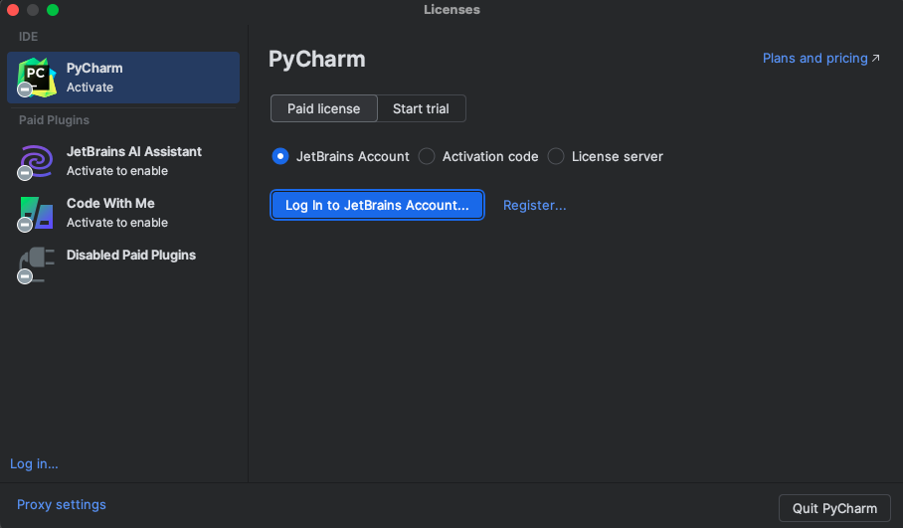
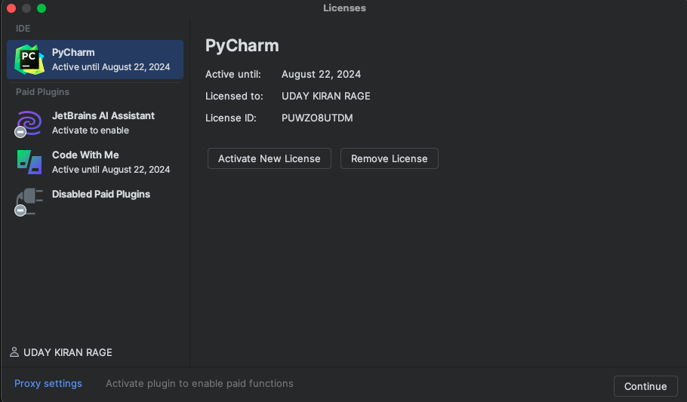
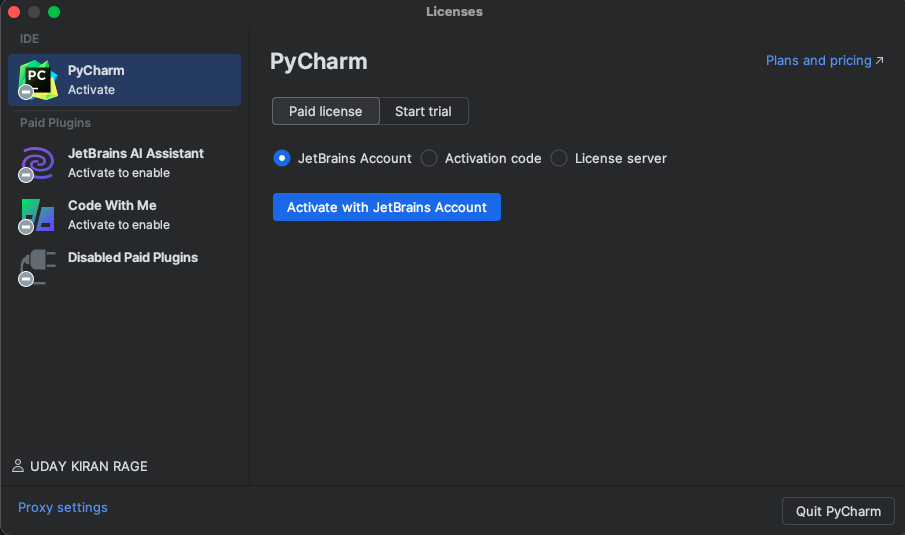
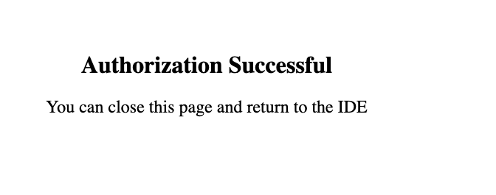
PyCharm Account Activation
Enter your login details
Click here
Click here
Click here
Click here

Slide 7
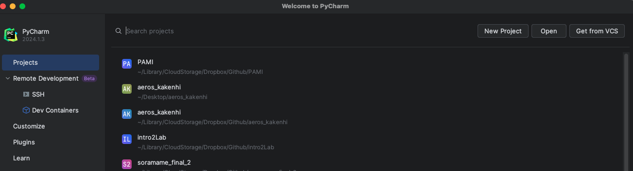
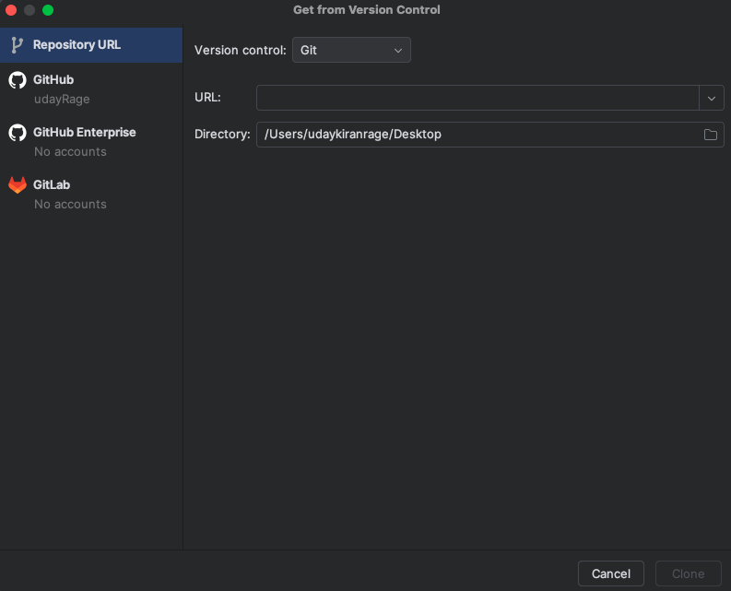
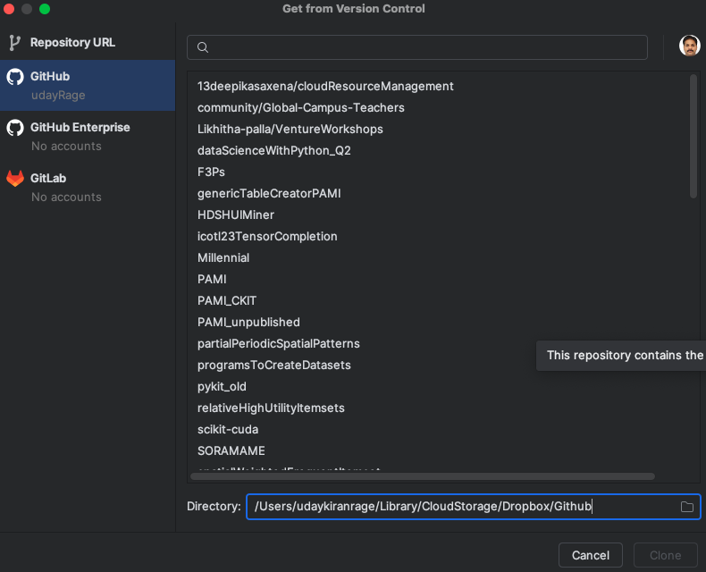
PyCharm Connecting to GitHub Account
Click here
Create a Github directory in Google Drive, OneDrive, or Dropbox
Specify that directory here
Select the Github link and double click. E.g, PAMI
Click here
and follow the
instructions
the data will be synced across the devices

Slide 8
Outline
Download and Installation
User Interface
File Creation and Compiling
Working with GitHub

Slide 9
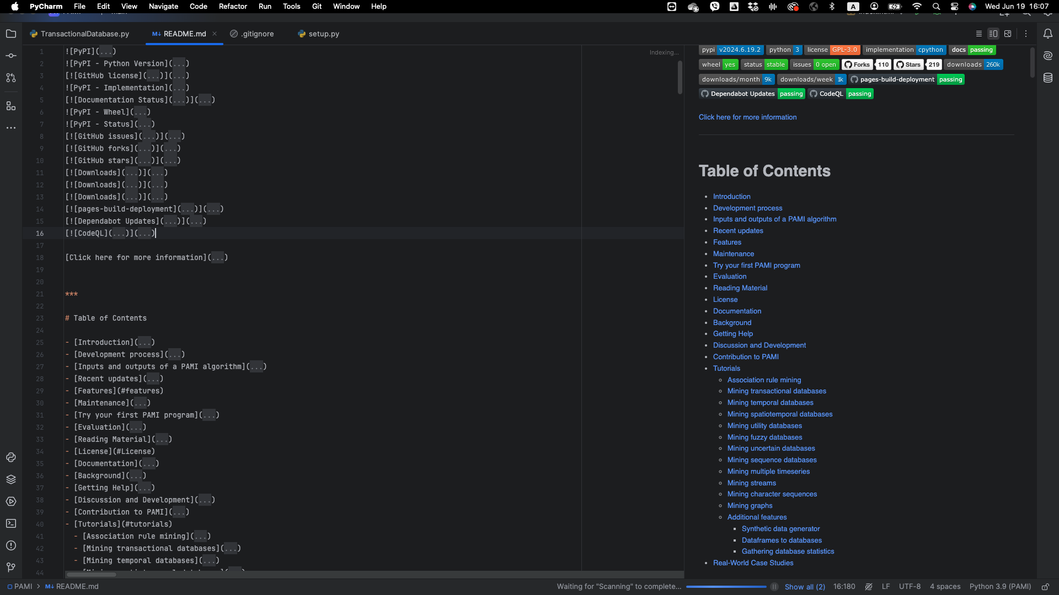
PyCharm User Interface
Left Menu
Right Menu
Left Upper Menu
Right Top Menu
Left Bottom Menu

Slide 10
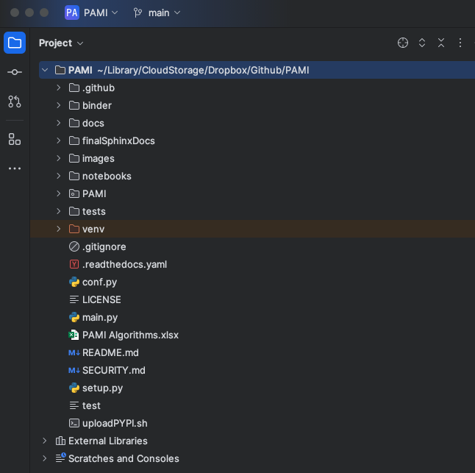
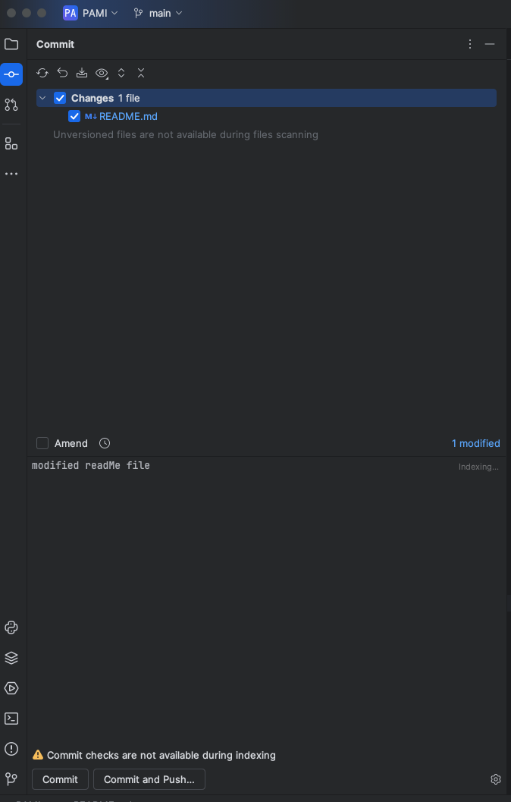
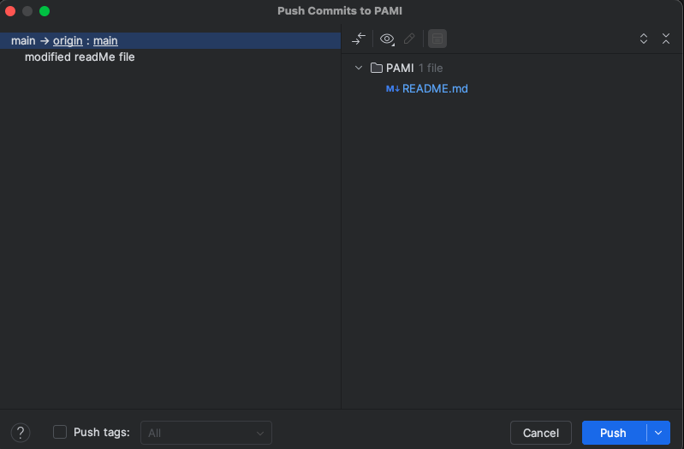
PyCharm Interface (Part-2, Left Upperside Menu)
Click here for “Project”
Click here for “Github Commit”
1) Select the files to commit
2) Write the commit message
Click here to push to Github
3) Press this button to commit and push to github
1) you will find all the files in the project
2) to commit the changes you have made in the project

Slide 11
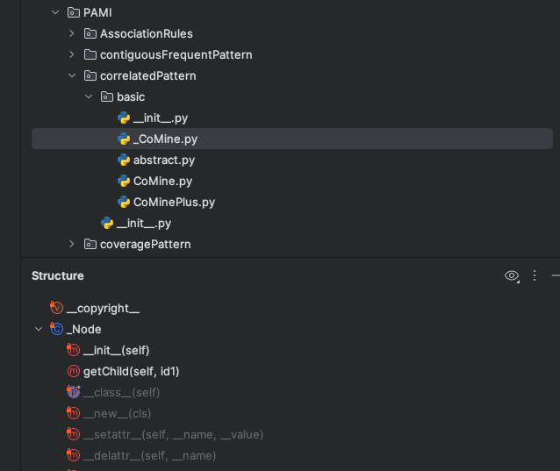
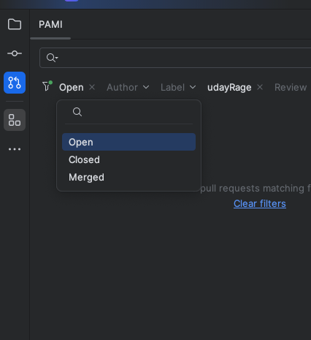
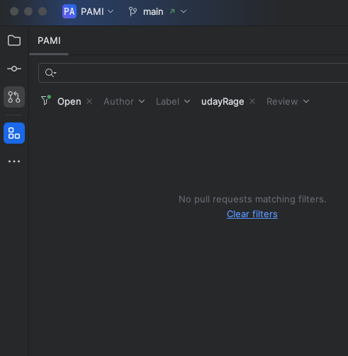
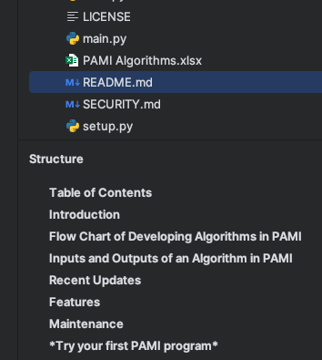
PyCharm Interface (Part-2, Left Upperside Menu)
Click here to see “pull requests”
Important (Must learn):
Click here to see “structure”
types
Python files -> displays class names and functions
Markdown files -> displays the structure of file

Slide 12
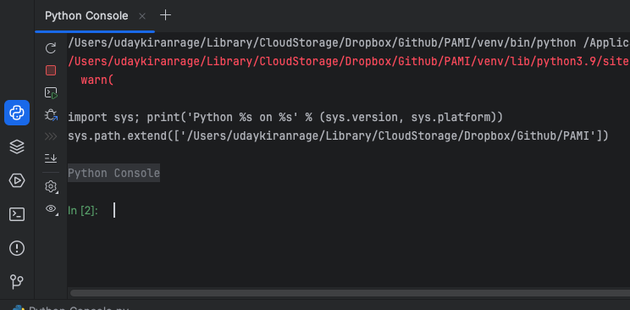
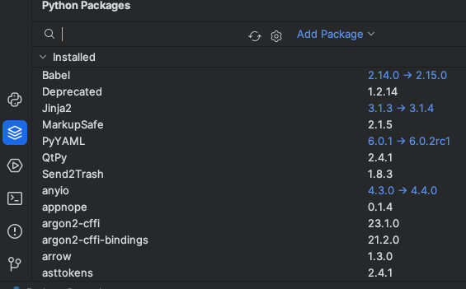
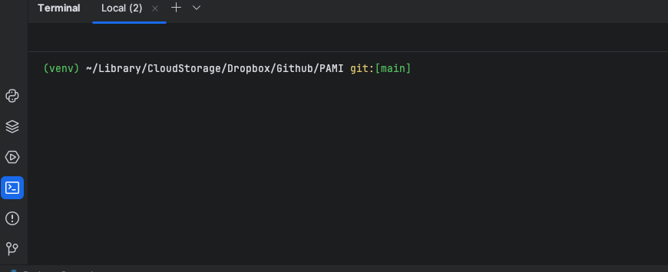
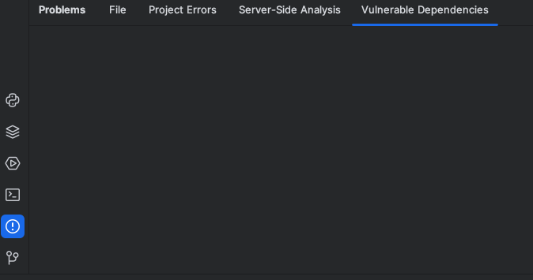
PyCharm Interface (Part-3, Left Bottom Menu)
Click here to see the Python console
Click here to check and install python packages
menu
Menu
current working directory
Click here to access the terminal
Click here to see the problems

Slide 13
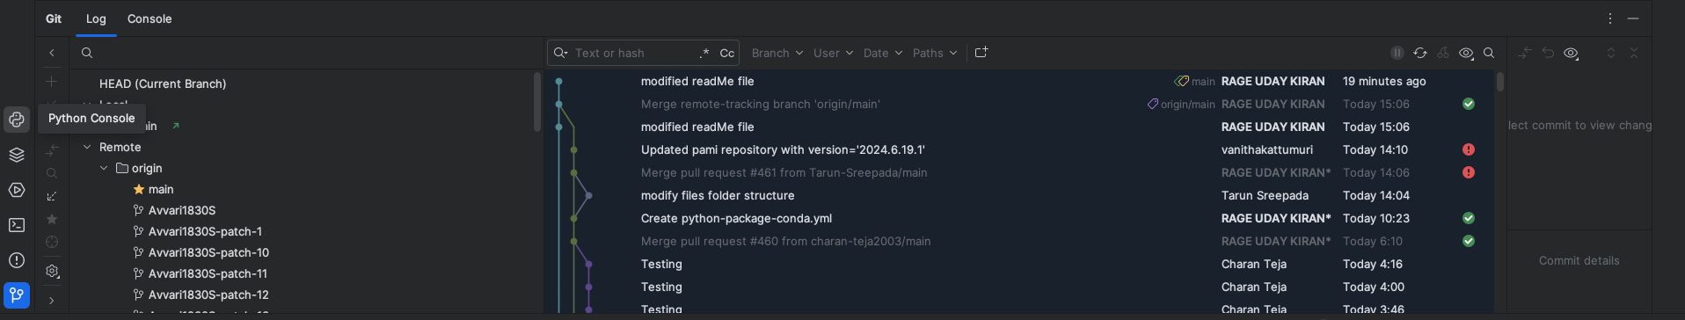
PyCharm Interface (Part-3, Left Bottom Menu)
Important (You need to master it)
Click here to access the Github
Learn the options available in this menu by yourself (easy)

Slide 14
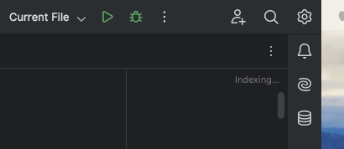
PyCharm Interface (Part-4, Right side Menu)
Important:
Collaborative coding
Multiple people can work on this project/file
Drop down menu to choose file
Debug the file
Run the file
Search
Settings
Notifications
AI for coding
Database connection

Slide 15
Outline
Download and Installation
User Interface
File Creation and Compiling
Working with GitHub

Slide 16
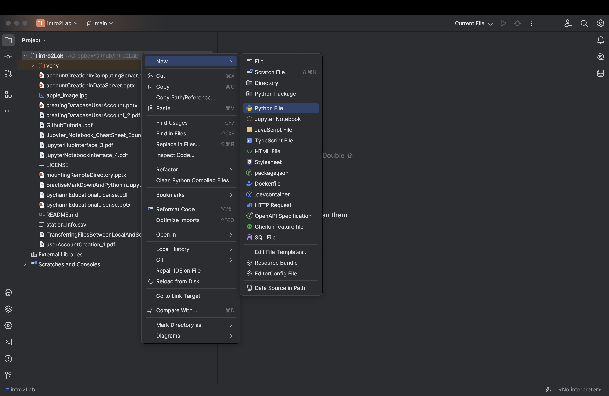
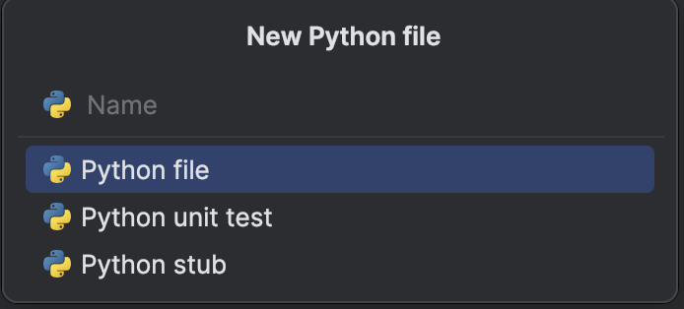
File Creation And Compiling
4) Click here
1) Click here
2) Select the location where you want to create the file
3) Right Click at the place
5) choose from the following options
E.g. Python file
5) Write the new file name
and press ENTER button

Slide 17
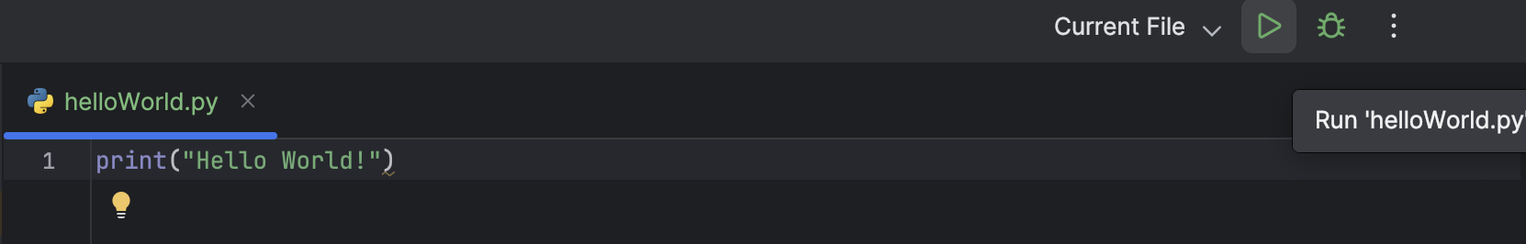
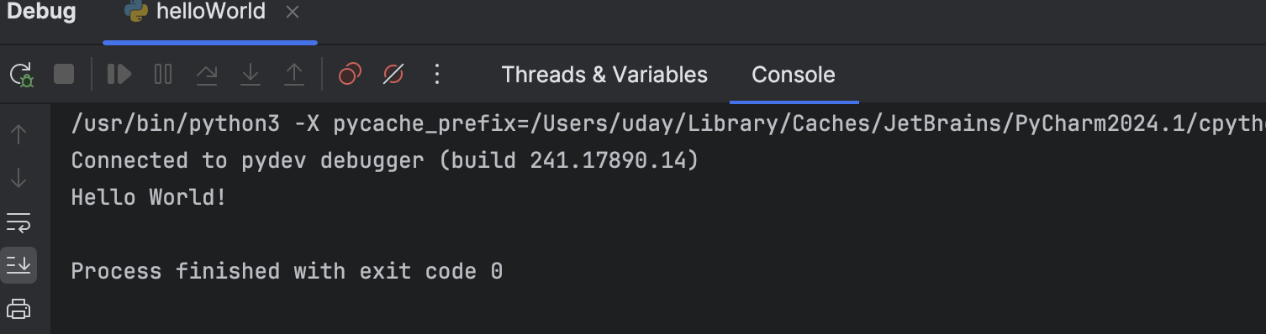
File Creation And Compiling
8) Press this button to run the file
7) Select the file from the drop down
6) Write your code
output
9) OR, Press this button to debug

Slide 18
Outline
Download and Installation
User Interface
File Creation and Compiling
Working with GitHub

Slide 19
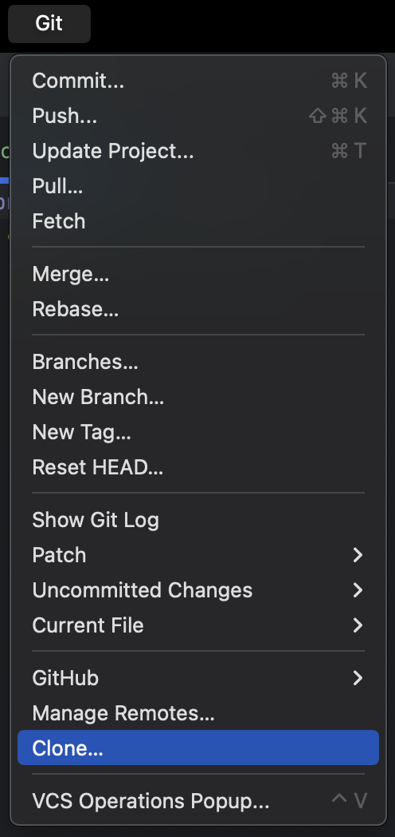
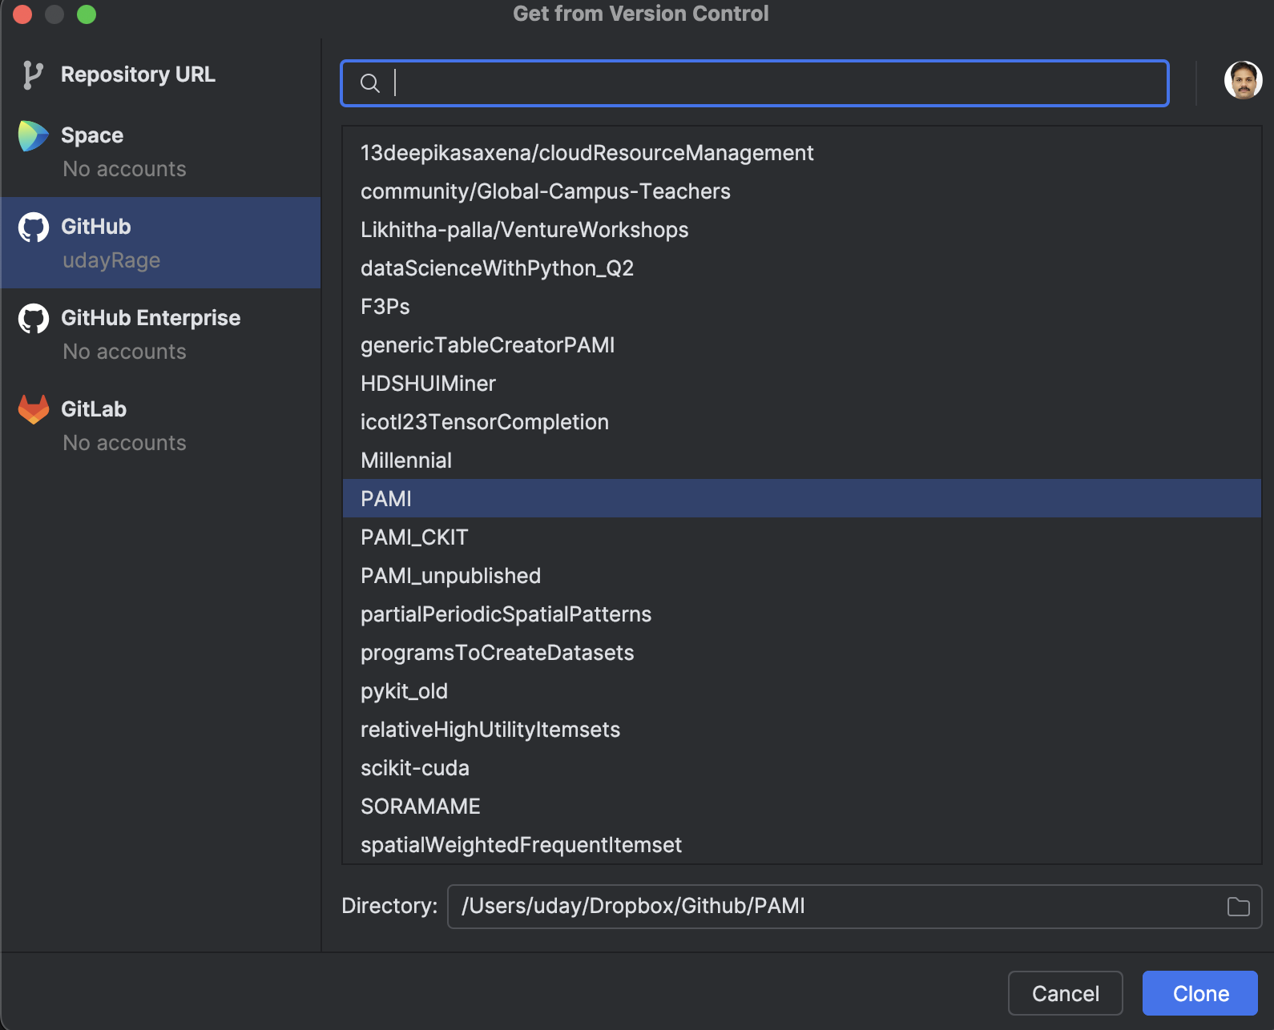
Working with GitHub
1) Click here
2) Select the repository
Menu -> Git -> Clone
PRIOR: fork or create a repository in your GitHub
3) Choose the directory location
4) Click here to clone

Slide 20
File Creation And Compiling
4) Click here
1) Click here
2) Select the location where you want to create the file
3) Right Click at the place
5) choose from the following options
E.g. Python file
5) Write the new file name
and press ENTER button

Slide 21
Topic 1: File Creation And Compiling
8) Press this button to run the file
7) Select the file from the drop down
6) Write your code
output
9) OR, Press this button to debug

Slide 22
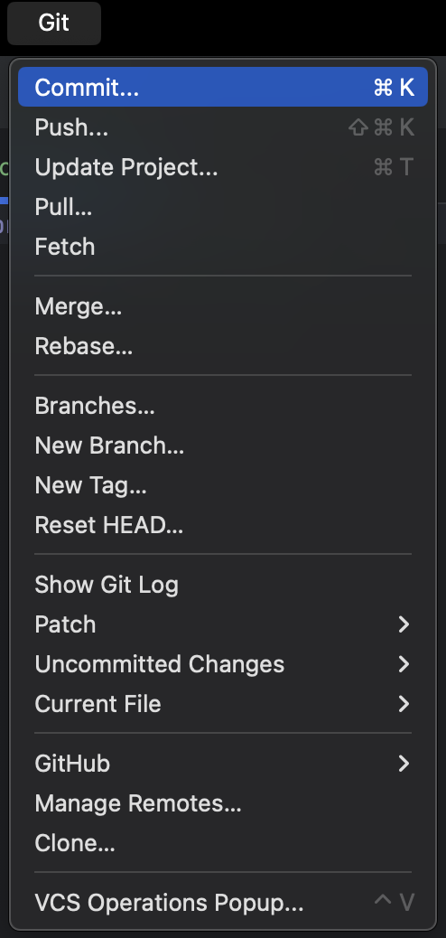
Topic 2: Commit and Push to Repository
Click here for “Github Commit”
Menu -> Git -> Commit
1) Select the files to commit
2) Write the commit message
3) Press this button to commit and push to github
2) to commit the changes you have made in the project

Slide 23
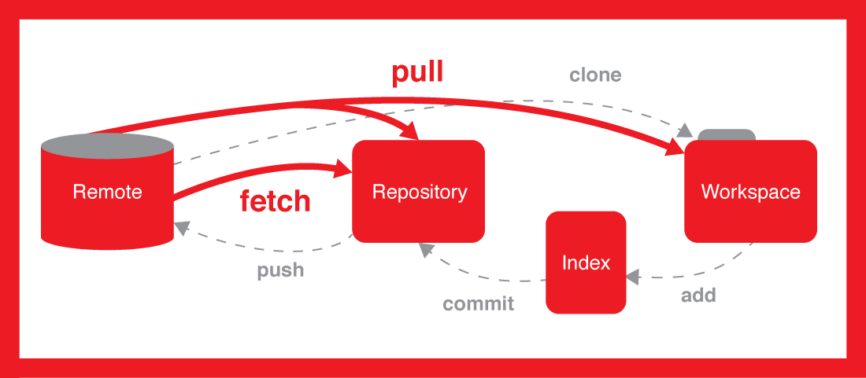
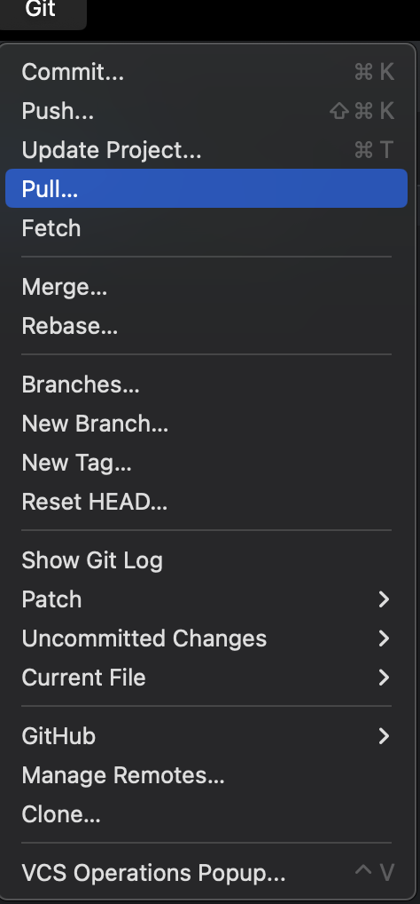
Topic 3: Fetch/Pull New Files from the Repository
Menu -> Git -> Pull or Fetch
Difference between fetch/pull

Slide 24
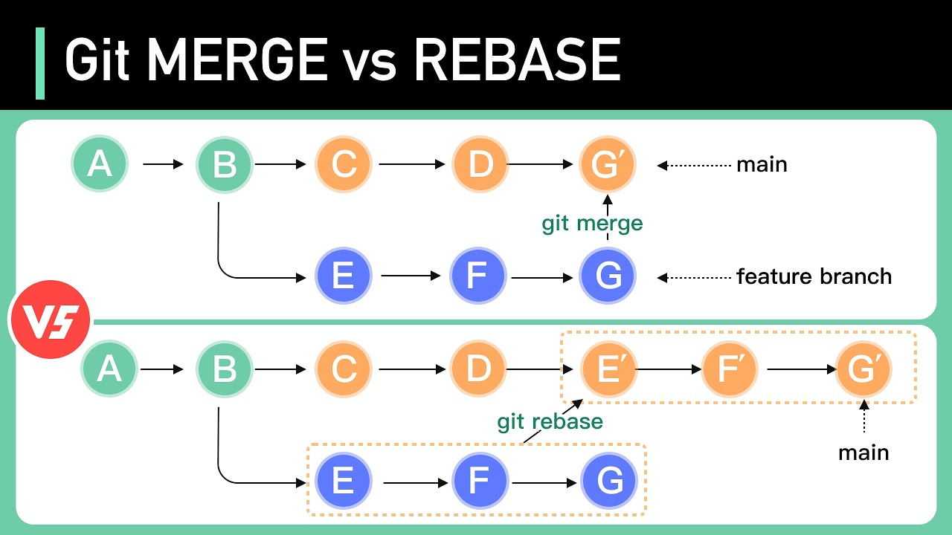
Topic 4: Handling Branches Merge/Rebase
Menu -> Git -> Merge or Rebase
More information:
https://stackoverflow.com/questions/16666089/whats-the-difference-between-git-merge-and-git-rebase

