Slide 1
Sphinx Documentation

Slide 2
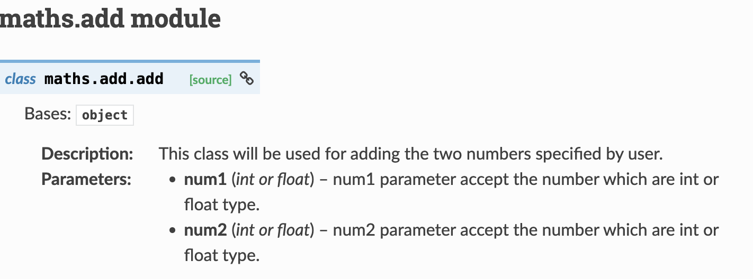
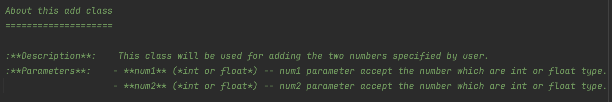

Slide 3
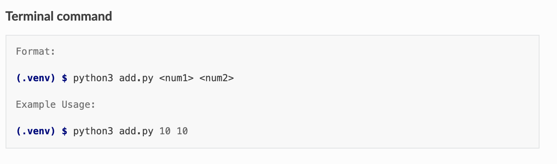
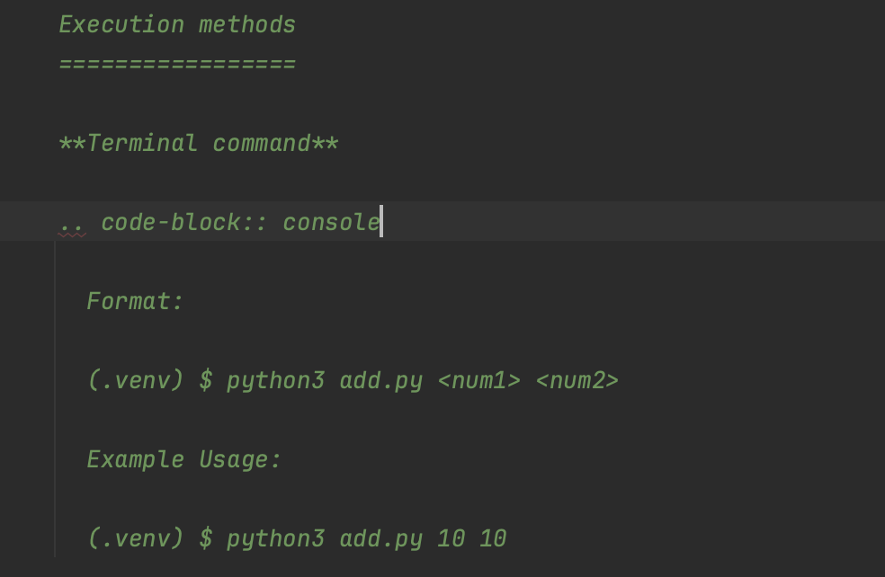

Slide 4
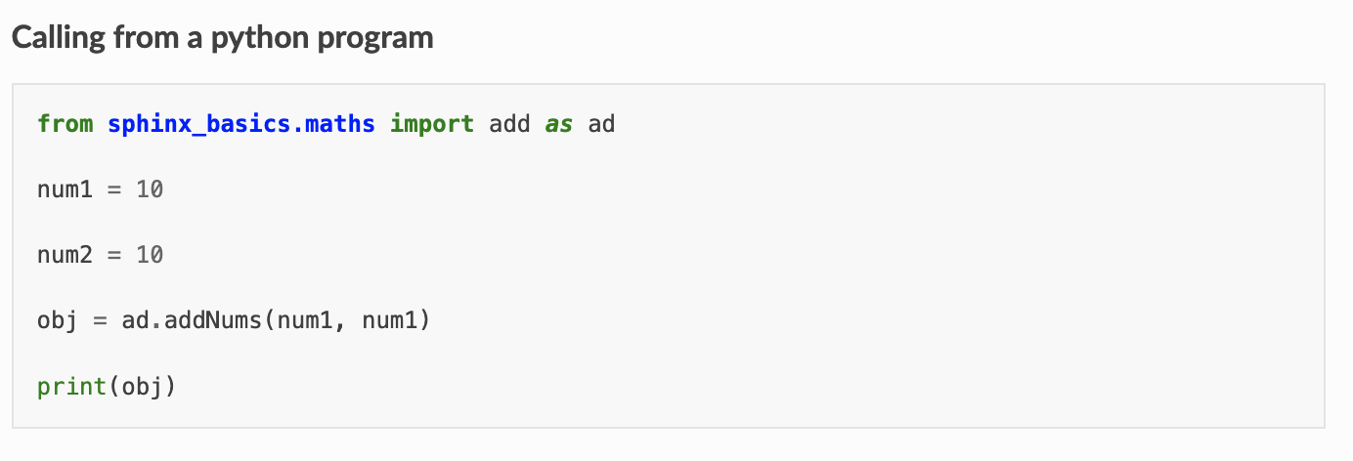
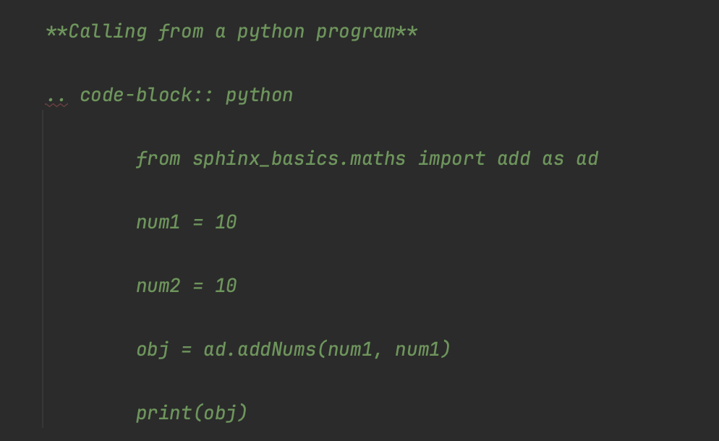

Slide 5
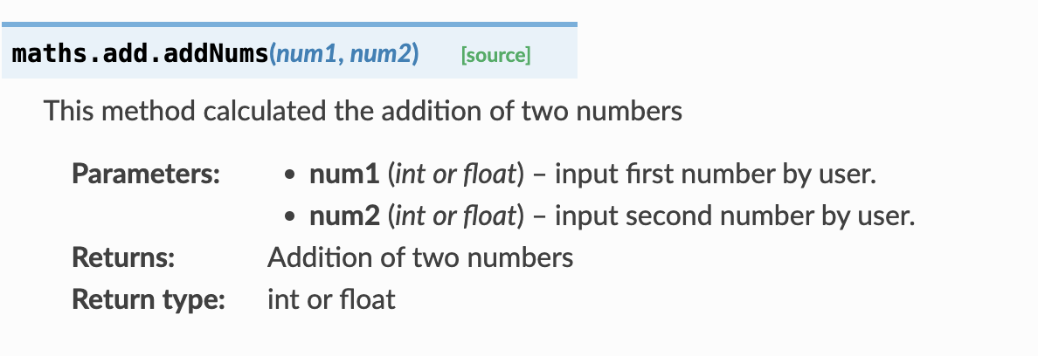
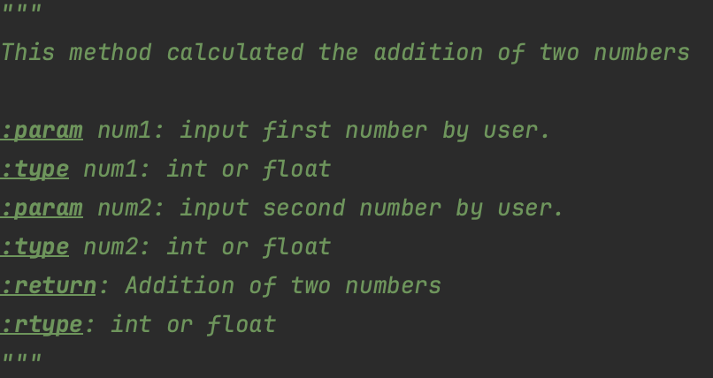

Slide 6
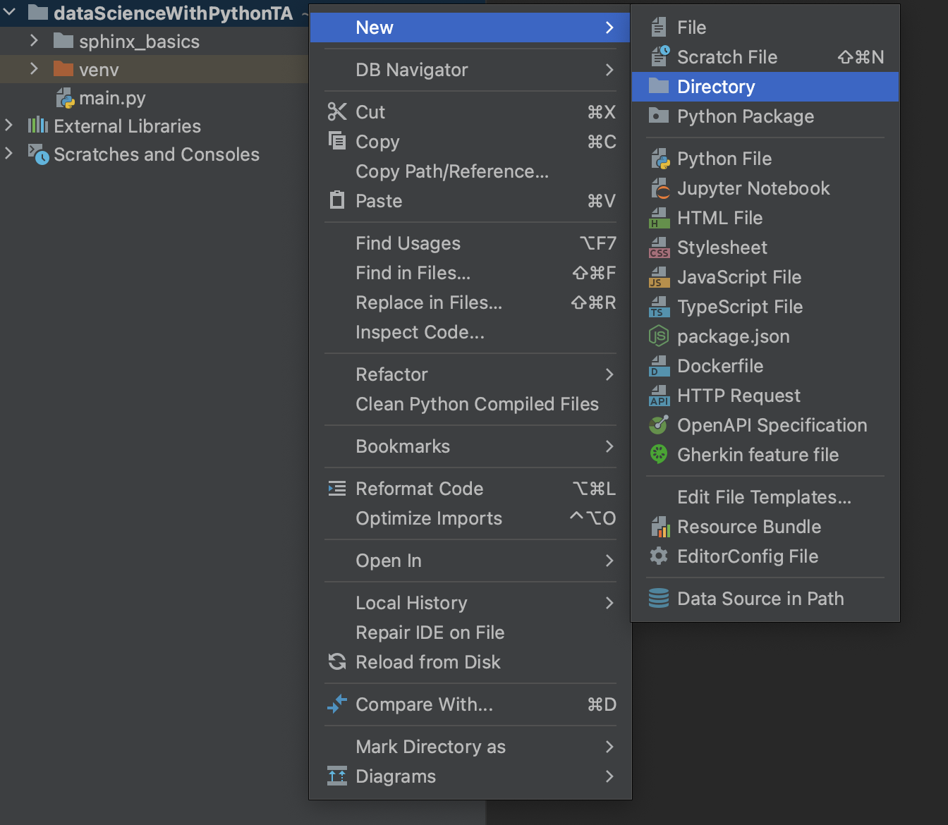
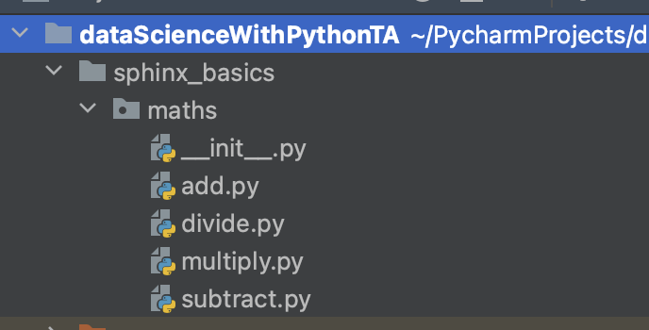
Steps to create a documenation:
Open PYCHARM
Create a new project
Enter the project name
4. Create a directory sphinx_basics
5. Create a python package maths
6. Create a four different python files under maths modules
1. add.py
2. subtract.py
3. multiply.py
4. divide.py

Slide 7
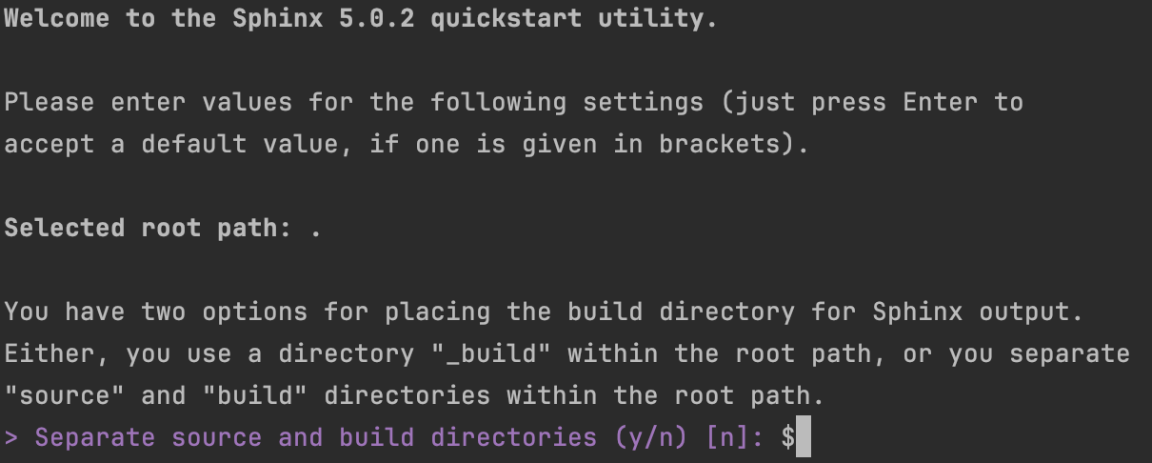
7. change into sphinx_basics directory
Command : cd sphinx_basics
8. Create a docs directory
Command : mkdir docs
9. change into a docs directory
Command : cd docs
10. By entering the below command the
Sphinx documentation starts
Command : sphinx-quickstart
Then enter
11. Press enter

Slide 8

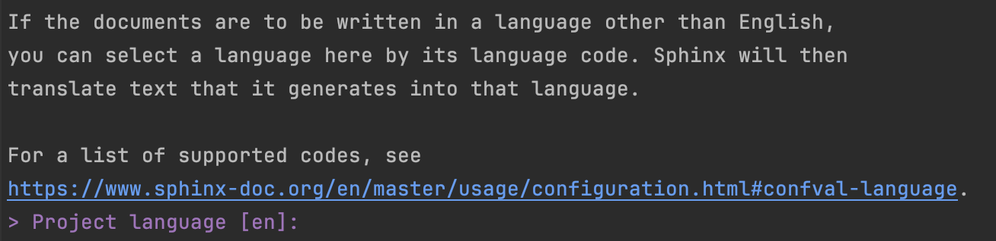
12. Type project name
Example: maths
13. Type Author name
Example: xyz
14. Type Project release
Example: 2024.06.10
15. Press enter

Slide 9
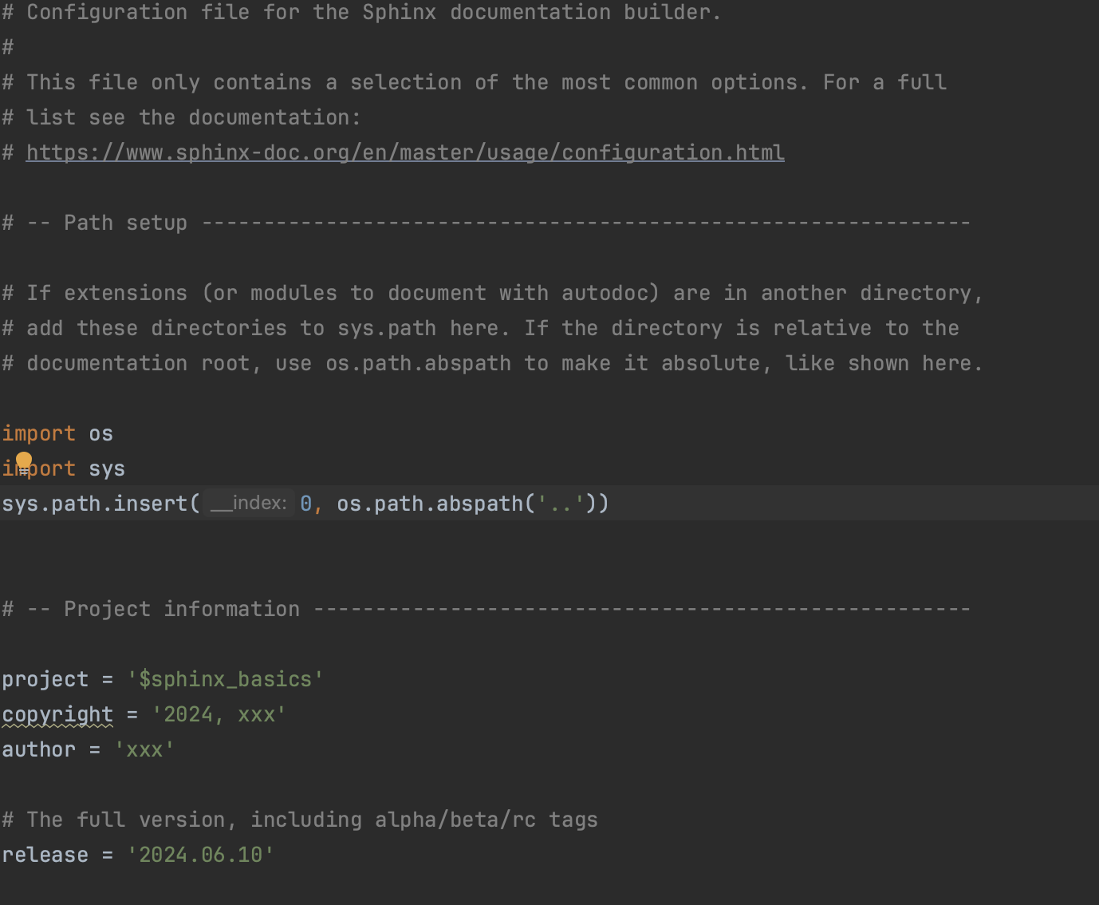
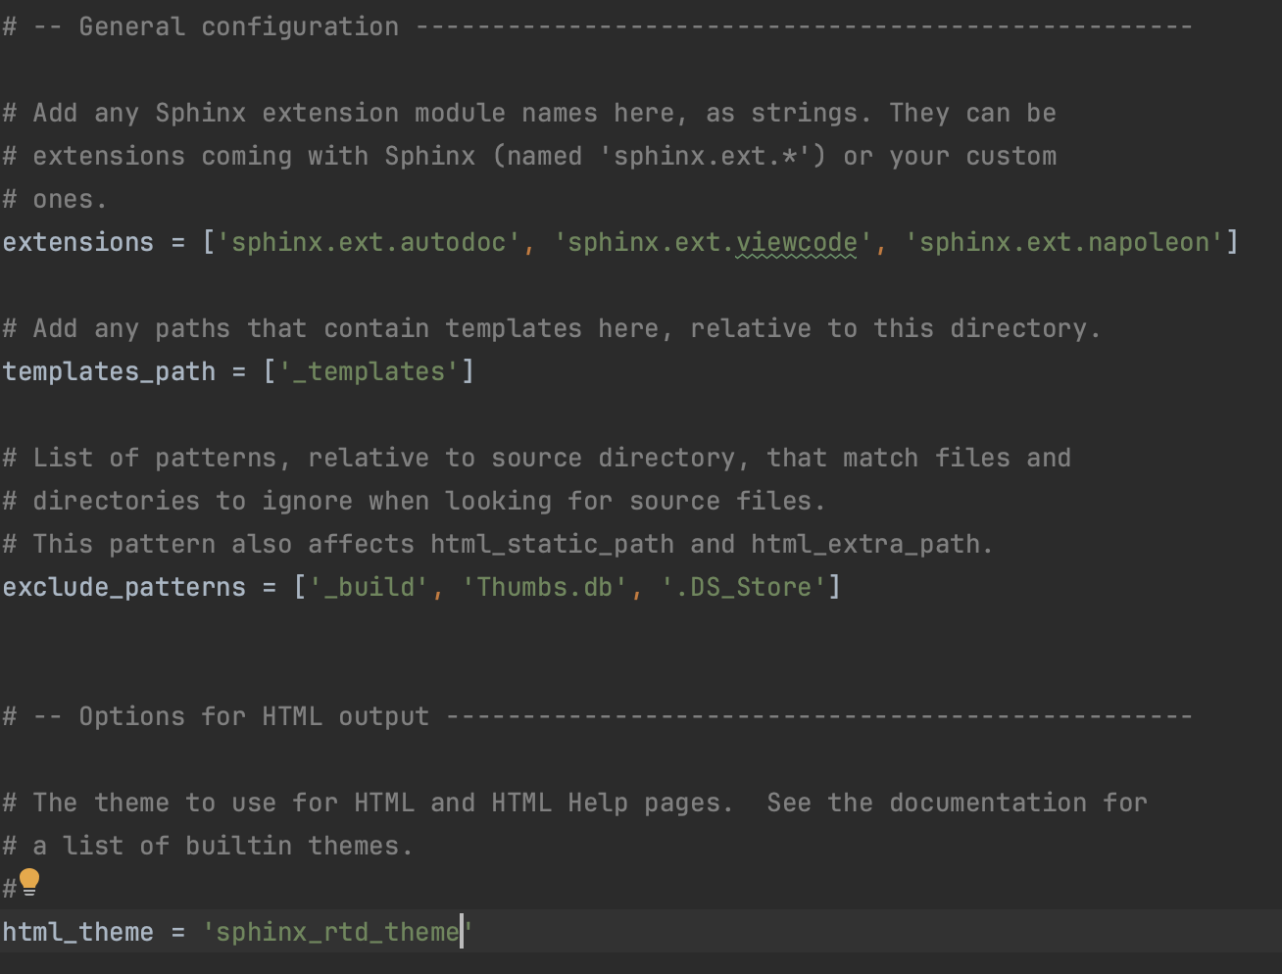
16. Open conf.py in docs directory
Remove # here
Add one more dot in abspath
17. Add the extensions
18. Change the html_theme = “sphinx_rtd_theme”

Slide 10
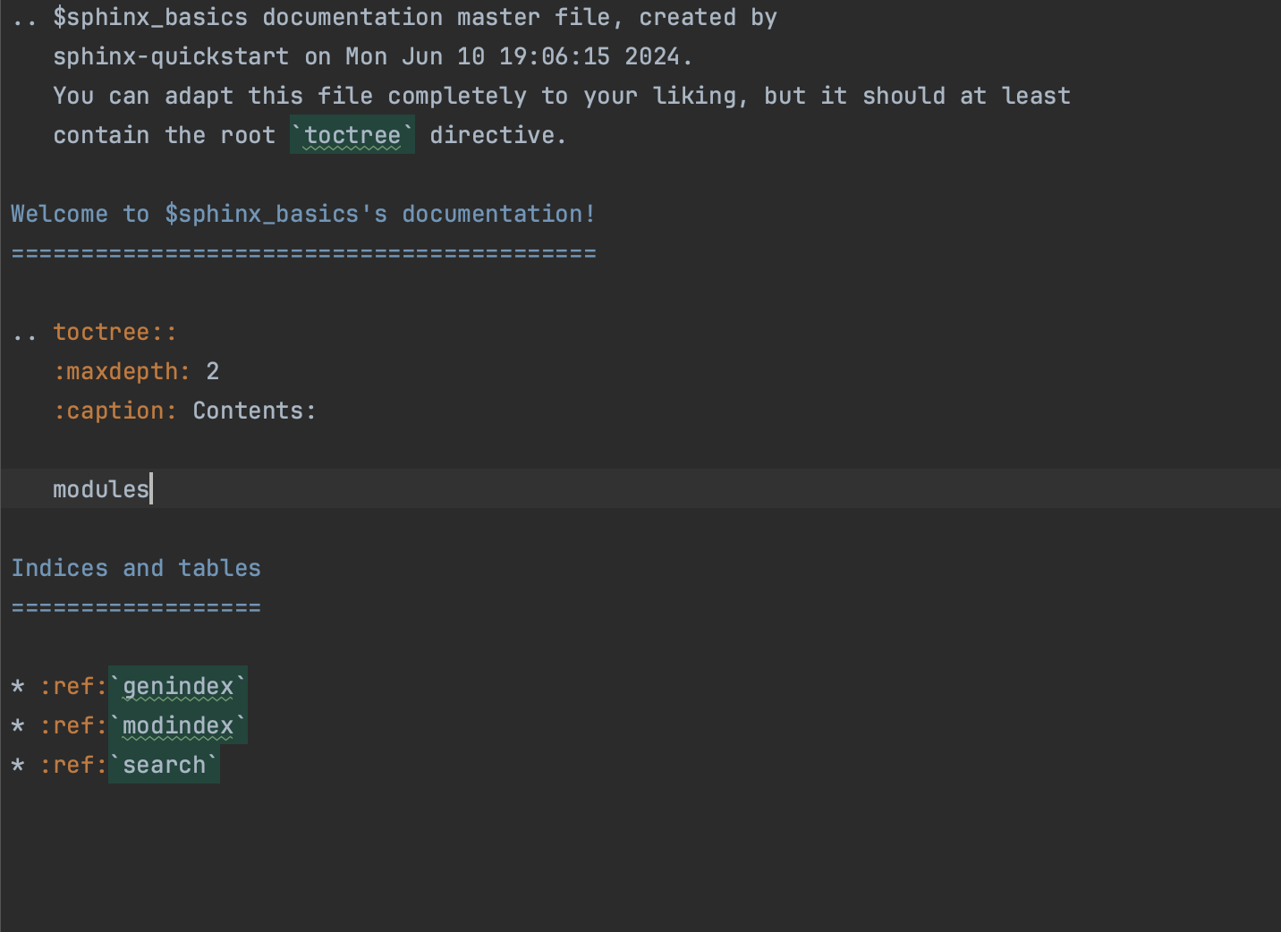
19. Change to previous directory
Command : cd ..
20. Run the below to create rst files
Command : sphinx-apidoc -o docs maths/
21. Open index.rst file under docs folder
Add modules by giving three spaces

Slide 11
22. Change directory to docs
Command: cd docs
22. To create html files
Command:make html
If you find any errors please solve
Extra step : if you did some changes to your code and now you want to rebuild that HTML
Command: make clean

Slide 12
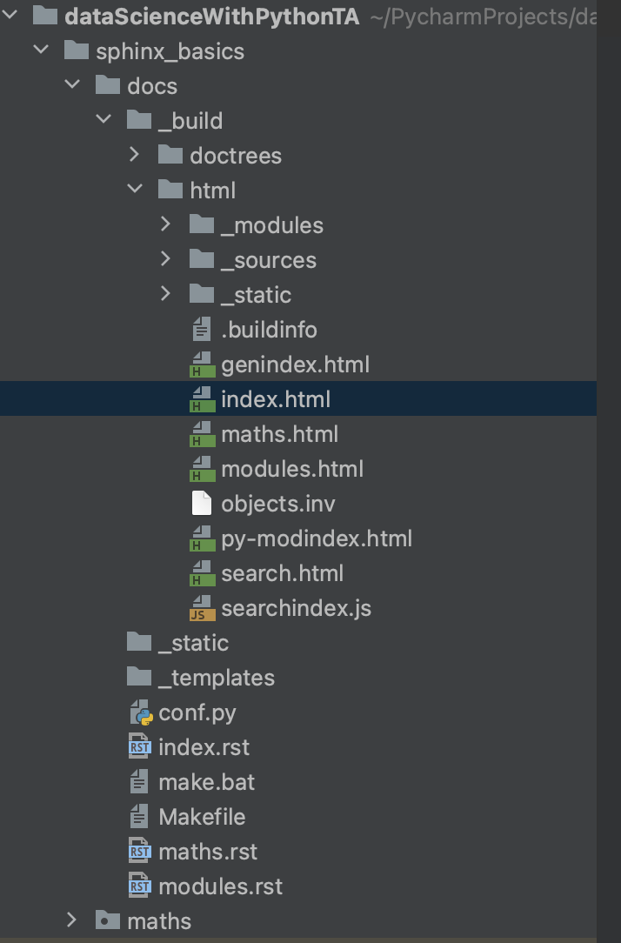
Finally open index.html to view your code documentation.

