Slide 1


Major Project Presentation
PHISHING DETECTION APPLICATION
Name of Students AKTU Roll numbers
Uday Raj Singh 2100100100182
Zoya Ashiyam 2100100100198
Md Shabi Ahmed 2100100100090
Swati Kesarwani 2200100109023
Under Supervision
Mr. Amit Roy

Slide 2
Outline
Introduction
Objectives
Methodology Used
Data Flow Diagram
Progress and Result
Future Work
Conclusion
References

Slide 3
Introduction
Many websites on the Internet pretend to be reputed websites.
Such websites steal data from users.
Such theft of data can lead to huge financial fraud or even more disastrous attacks.

Slide 4
Objectives
To protect users from such malicious websites.
To authenticate and provide more verfication to legitimate websites.
To discourage unlawful or illegitmate websites from functioning.
To make Internet a safe place.

Slide 5
Methodology Used
Read research papers
Obtain dataset
Design application
Build model
Test model
Integrate interface with model

Slide 6
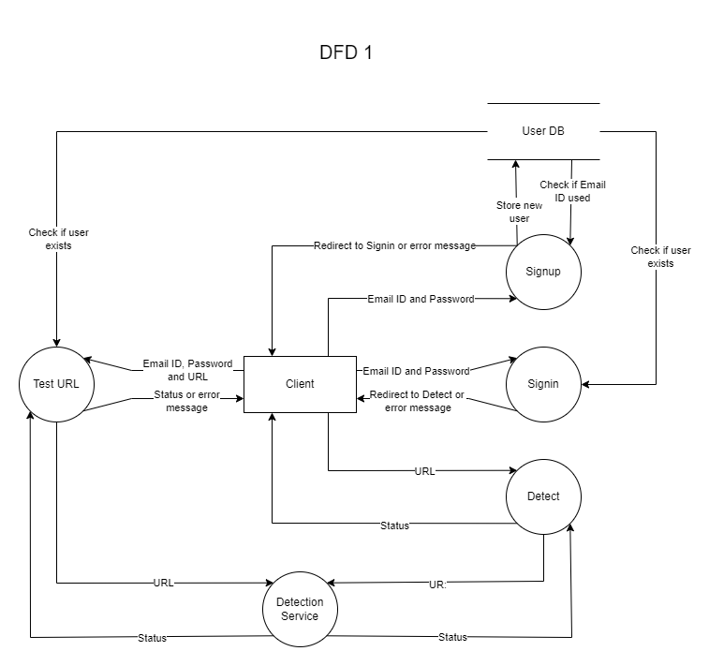
Data Flow Diagram/ER-Diagram

Slide 7
Progress & Result
URL Phishshing Model Completed
URL and HTML Feature Extraction Completed
URL Detection Service Set Up and Working
Web Application
REST API
Browser Extension

Slide 8
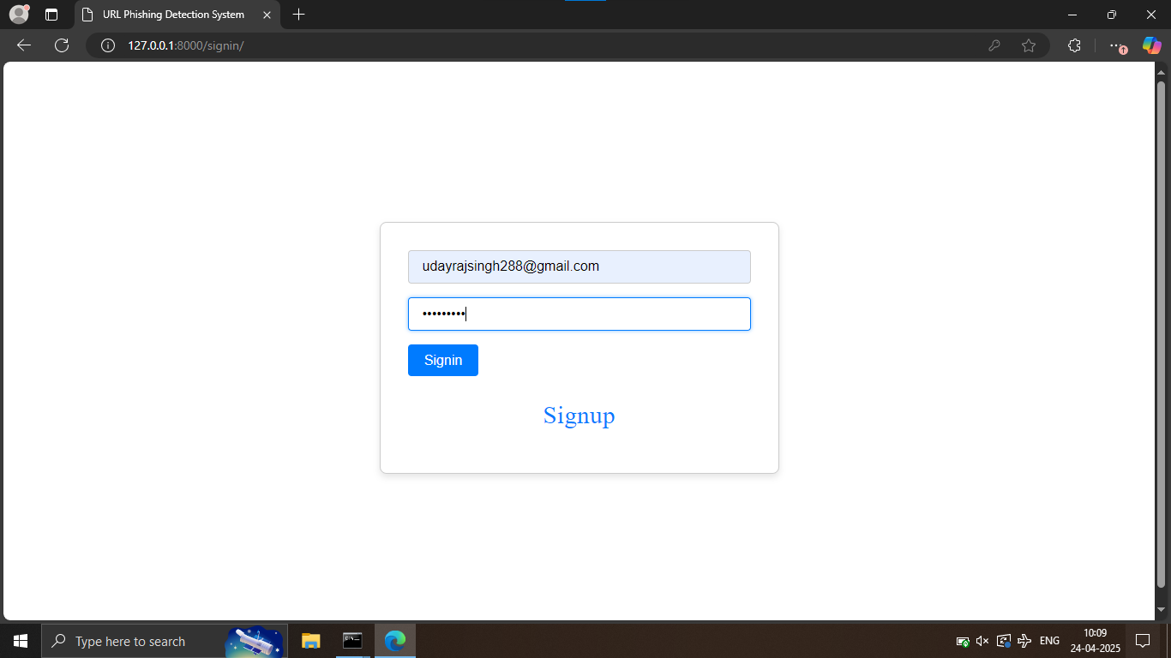
Web App In Action

Slide 9
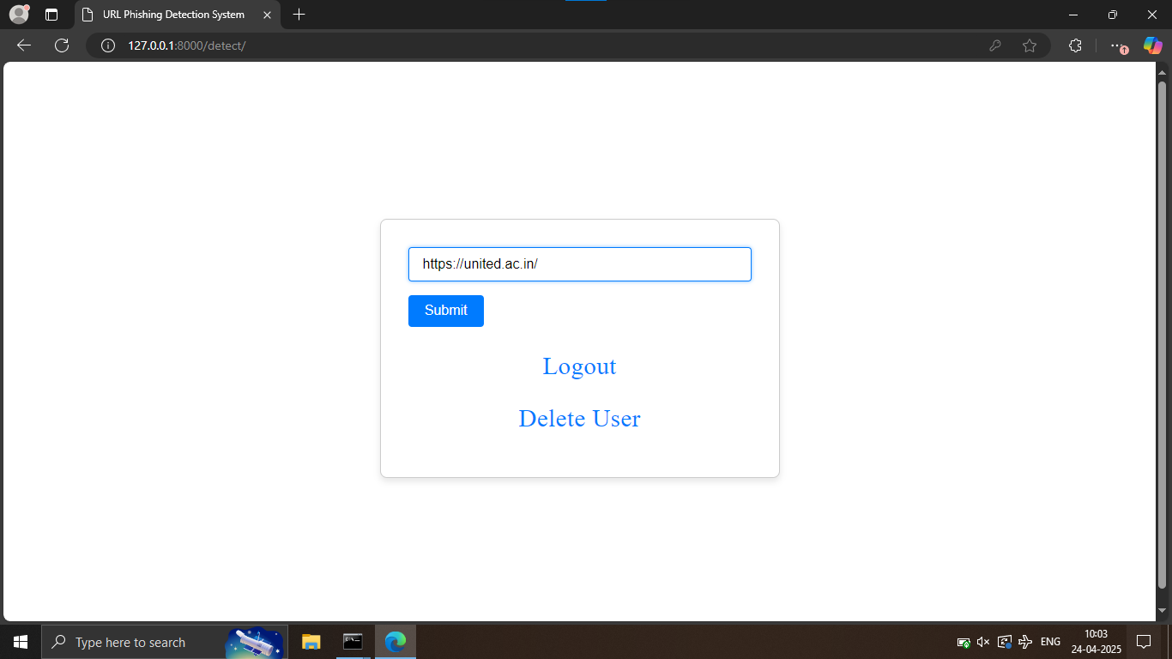
Web App In Action

Slide 10
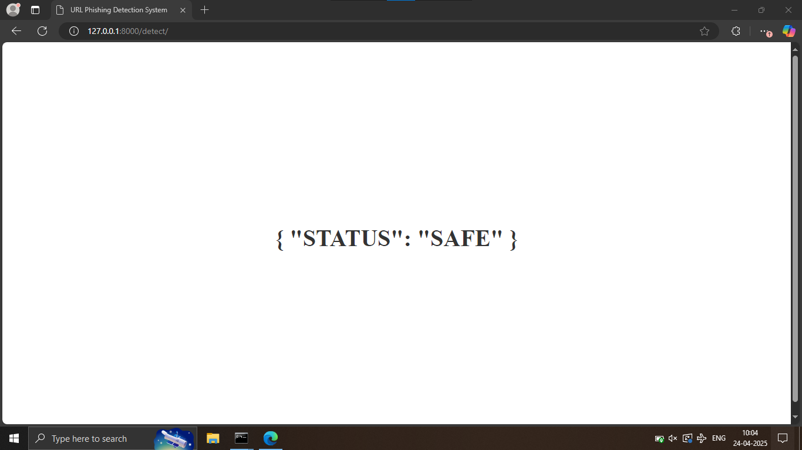
Web App In Action

Slide 11
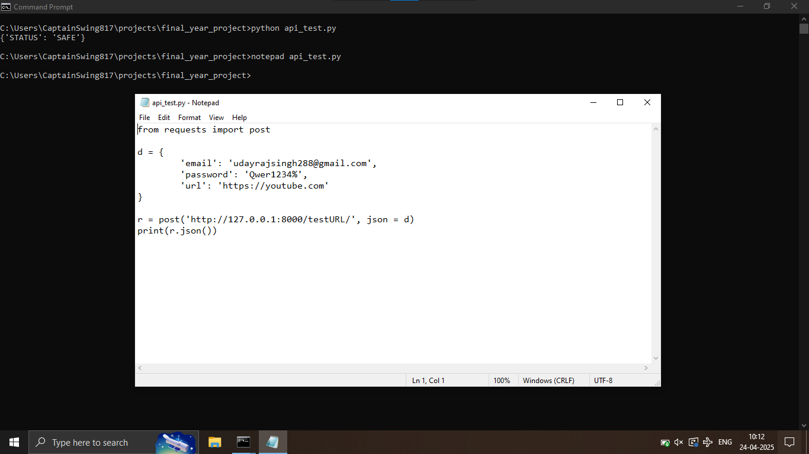
REST API In Action

Slide 12
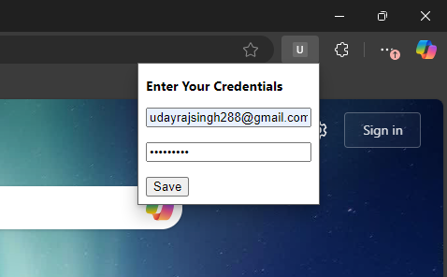
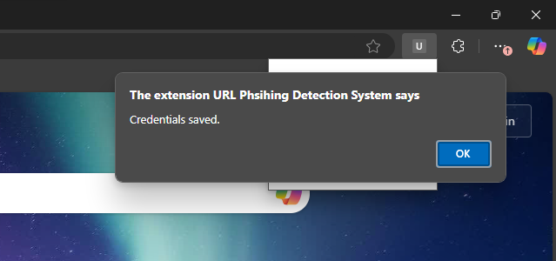
Browser Extension In Action

Slide 13
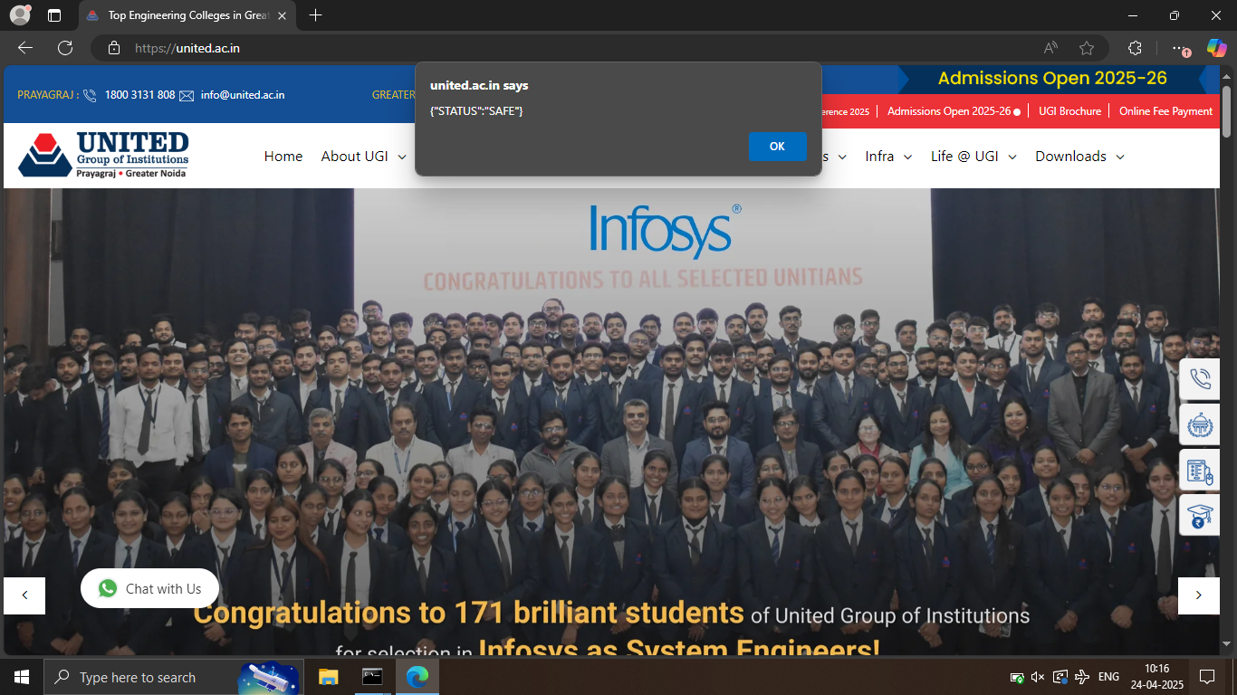
Browser Extension In Action

Slide 14
Conclusion
This application fulfils solves a critical problem in Internet Security.
It allows for a method to differntiate between legitimate and illegitimate websites.
This application helps user avoid getting targeted by unlawful or illegetimate websites.

Slide 15
References
PhiUSIIL: A diverse security profile empowered phishing URL detection framework based on similarity index
Ahammad, S.H., Kale, S.D., Upadhye, G.D., Pande, S.D., Babu, E.V., Dhumane, A.V., Bahadur, M.D.K.J., 2022. Phishing URL detection using machine learning methods. Adv. Eng. Softw. 173, 103288. https://doi .org /10 .1016 /j .advengsoft .2022 .103288.
Alani, M.M., Tawfik, H., 2022. PhishNot: a cloud-based machine-learning approach to phishing URL detection. Comput. Netw. 218, 109407. https://doi .org /10 .1016 /j .comnet .2022 .109407.
Anon, 2023a. Retrieved May, 12, 2023. https://isc .sans .edu /diary /The +zip +gTLD + Risks +and +Opportunities /29838.

