Slide 1


PHISHING DETECTION APPLICATION
Name of Students AKTU Roll numbers
Uday Raj Singh 2100100100182
Zoya Ashiyam 2100100100198
Md Shabi Ahmed 2100100100090
Swati Kesarwani 2200100109023
Under Supervision
Mr. Amit Roy

Slide 2
OUTLINE
Introduction
Objective
Data flow diagram
Relevance to real world problems
Summary of research papers

Slide 3
INTRODUCTION
Phishing attacks are a significant and growing threat to individuals and organizations.
This project aims to develop a system that can accurately detect phishing URLs.
The system will utilize a combination of URL analysis, HTML content analysis, and machine learning techniques.
Successful implementation of this system has the potential to significantly reduce the impact of phishing attacks.

Slide 4
OBJECTIVE
Develop a robust and efficient URL phishing detection system.
Implement effective feature extraction techniques from both URLs and their corresponding HTML content.
Design and implement a user-friendly interface for interacting with the detection system.
Continuously improve the system's accuracy and adaptability by incorporating new data and refining the machine learning model.

Slide 5
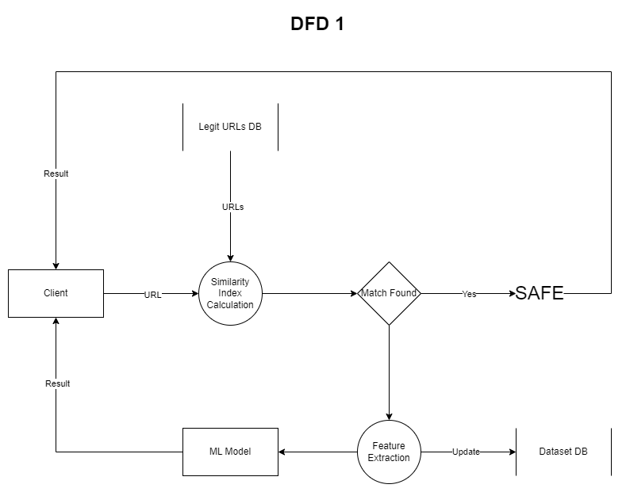
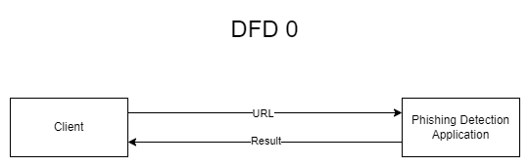
DATA FLOW DIAGRAM

Slide 6
RELEVANCE TO REAL WORLD PROBLEMS
Financial Loss Prevention: Phishing attacks can lead to significant financial losses for individuals and businesses. By accurately detecting phishing URLs, this project can help prevent identity theft, unauthorized access to accounts, and fraudulent transactions, thereby safeguarding financial assets.

Slide 7
RELEVANCE TO REAL WORLD PROBLEMS
Enhanced Cybersecurity: Phishing attacks pose a serious threat to cybersecurity. This project contributes to a safer online environment by developing a system that proactively identifies and mitigates phishing threats, helping to protect individuals and organizations from cyberattacks.

Slide 8
RELEVANCE TO REAL WORLD PROBLEMS
Improved User Trust and Confidence: The prevalence of phishing attacks can erode user trust in online services and platforms. By providing a reliable system for detecting phishing URLs, this project can help restore user confidence and promote a safer online experience, fostering a more secure and trustworthy digital ecosystem.

Slide 9
SUMMARY OF RESEARCH PAPERS
PhiUSIIL: A diverse security profile empowered phishing URL detection framework based on similarity index
Ahammad, S.H., Kale, S.D., Upadhye, G.D., Pande, S.D., Babu, E.V., Dhumane, A.V., Bahadur, M.D.K.J., 2022. Phishing URL detection using machine learning methods. Adv. Eng. Softw. 173, 103288. https://doi .org /10 .1016 /j .advengsoft .2022 .103288.
Alani, M.M., Tawfik, H., 2022. PhishNot: a cloud-based machine-learning approach to phishing URL detection. Comput. Netw. 218, 109407. https://doi .org /10 .1016 /j .comnet .2022 .109407.
Anon, 2023a. Retrieved May, 12, 2023. https://isc .sans .edu /diary /The +zip +gTLD + Risks +and +Opportunities /29838.

Slide 10
THANK YOU

