Slide 1



Exploring Reinforcement Learning in Autonomous Robot Path Planning and Obstacle Navigation
IEMENTech 2025
31st January – 2nd February 2025
Authors: Uday Sankar Mukherjee, Mousumi Laha, Piyali Datta
Institute of Engineering & Management, Kolkata
02/02/2025
IEMENTech 2025
1

Slide 2
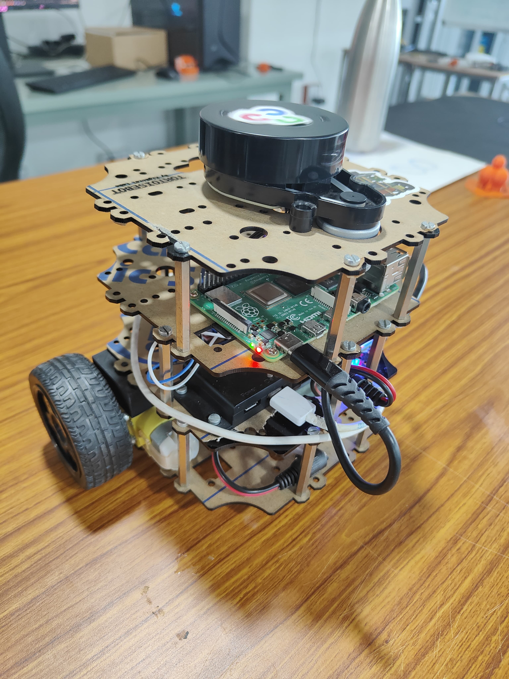
Importance & Scope
• Applications in search and rescue, warehouse logistics, and autonomous vehicles.
• Traditional motion planning struggles in unknown or changing environments.
• RL-based approaches adapt to dynamic obstacles and environments.
• Helps improve decision-making in real-time robotic applications.
02/02/2025
IEMENTech 2025
2

Slide 3
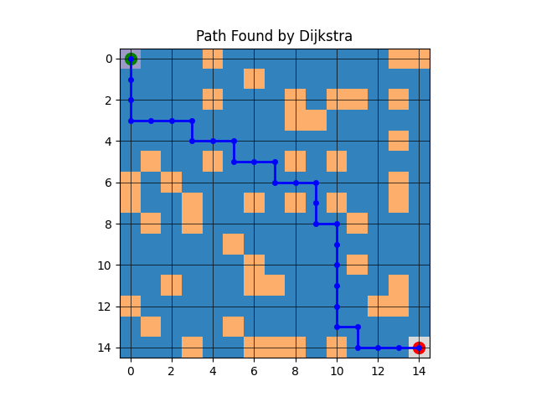
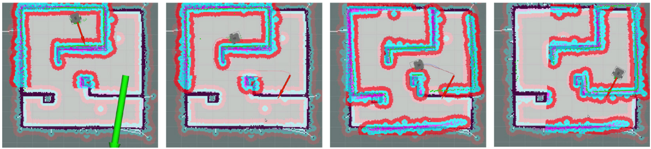
Static Obstacle Detection and Planning
For environments with static obstacles (those that do not move or change position), We utilized Dijkstra’s algorithm.
It guarantees finding the shortest path in a graph with non-negative edge weights.
It provides a predictable and reliable solution for static environments.
02/02/2025
IEMENTech 2025
3

Slide 4
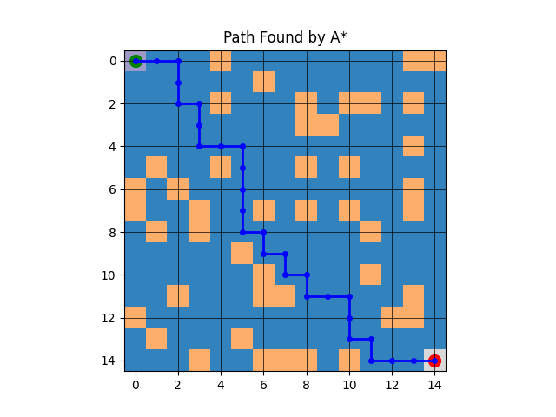
A-Star Algorithm
A* is an improvement over Dijkstra’s algorithm, incorporating a heuristic to prioritize paths that seem more promising.
It combines the cost to reach a node and an estimate of the cost to the goal
02/02/2025
IEMENTech 2025
4

Slide 5
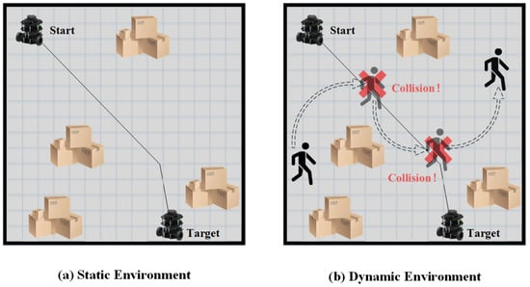
Dynamic Obstacle Detection and Planning
Obstacles move or change over time
Static planning methods like Dijkstra’s are insufficient because the environment constantly evolve. We incorporated Reinforcement Learning (RL) methods.
Why RL for Dynamic Obstacles?
RL algorithms can adapt to changes in the environment by continuously learning from interactions.
They do not rely on precomputed maps, making them ideal for real-time scenarios.
02/02/2025
IEMENTech 2025
5

Slide 6
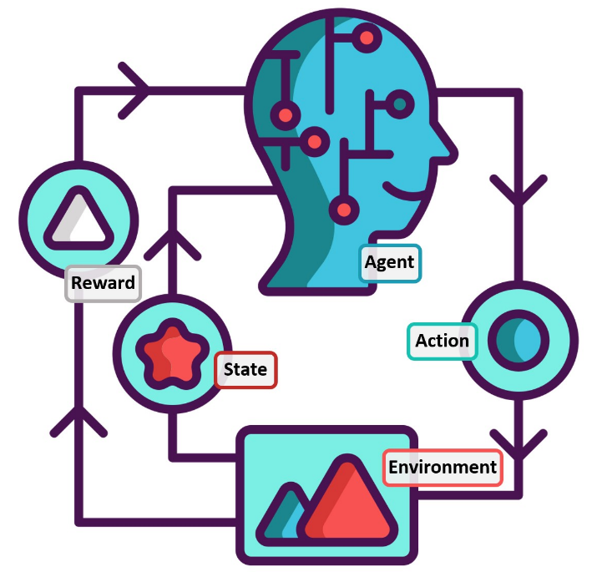
Challenges in Dynamic Environments
• Static path planning fails when obstacles move or change over time.
• Traditional algorithms require re-computation, leading to inefficiencies.
• Real-time adaptability is crucial for autonomous systems.
• Reinforcement Learning provides a solution by continuously learning from interactions.
02/02/2025
IEMENTech 2025
6

Slide 7
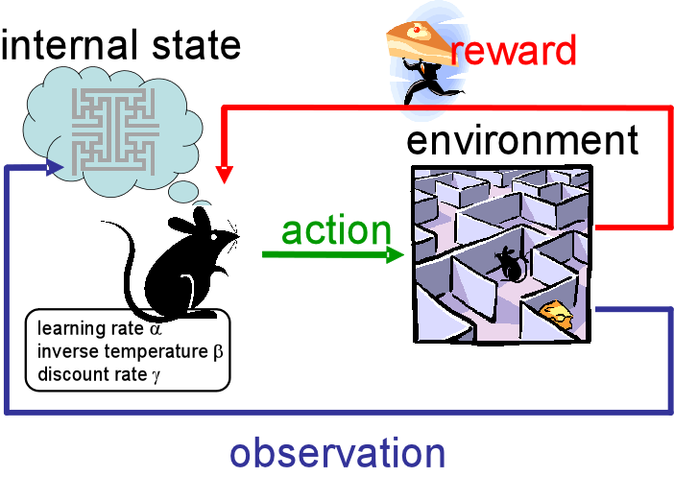
Introduction to Reinforcement Learning (RL)
• RL enables an agent (robot) to learn by interacting with the environment.
• Uses rewards and penalties to improve decision-making.
• Does not require predefined maps, making it suitable for real-time navigation.
02/02/2025
IEMENTech 2025
7

Slide 8
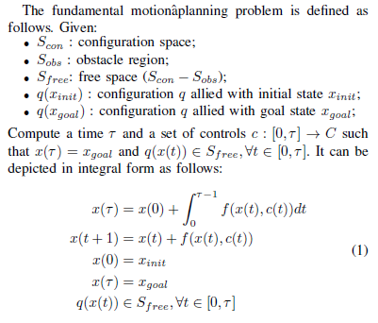
Problem Formulation
02/02/2025
IEMENTech 2025
8

Slide 9
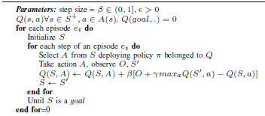
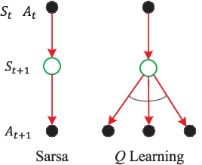
Q-Learning Algorithm
• Off-policy RL algorithm that updates action-value estimates based on maximum future reward.
• Uses the formula:
Q(s,a) ← Q(s,a) + β [r + γ max Q(s',a') - Q(s,a)]
• Finds an optimal policy for robot navigation through trial and error
02/02/2025
IEMENTech 2025
9

Slide 10
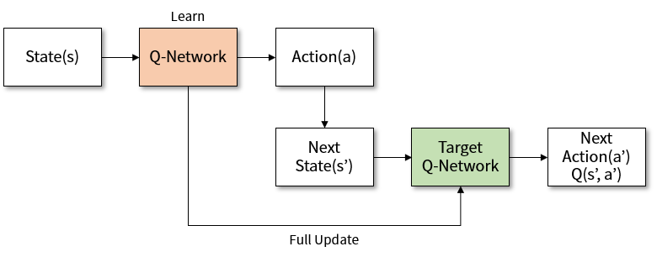
Deep Q-Learning Algorithm (DQN)
• Extends Q-learning using deep neural networks for function approximation.
• Addresses the challenge of large state spaces and continuous environments.
• Uses experience replay and target networks for stable learning.
• Outperforms SARSA and Q-learning in complex environments by reducing training time.
02/02/2025
IEMENTech 2025
10

Slide 11
State-Action-Reward-State-Action (SARSA)
• On-policy RL algorithm that updates action-value estimates based on the policy currently being followed.
• Uses the formula:
Q(s,a) ← Q(s,a) + β [r + γ Q(s',a') - Q(s,a)]
• Balances exploration and exploitation more consistently.
• Adapts to policy changes during learning, making it more stable in certain scenarios.
grid of sizes 30 × 30 (in (a)) and 40 × 40 (in (b)), respectively
02/02/2025
IEMENTech 2025
11

Slide 12
Experimental Results
Exemplifying the path finding by Q-learning, SARSA, and DQN for grid of sizes 30×30 (in (a)) and 40×40 (in (b)), respectively.
02/02/2025
IEMENTech 2025
12

Slide 13
Experimental Results (contd.)
Variation in the accumulated rewards with respect to the number of episodes (#Episodes) for (a) SARSA and (b) DQN.
02/02/2025
IEMENTech 2025
13

Slide 14
IEMENTech 2025
31st January – 2nd February 2025
Conclusion
• RL-based path planning surpasses traditional algorithms in dynamic scenarios.
• DQN proves to be the most effective method, offering faster and more efficient navigation.
• The study highlights the potential of RL in real-time robotic applications.
02/02/2025
IEMENTech 2025
14

