Slide 1

CRM
Customer Relationship Management
Customer
Team members:
Udyavara Uday Shankar
G Nijamuddin
K Vignesh
G Anil kummar
Clients
Mangement

Slide 2
CONTENTS
PROBLEM STATEMENT
PROJECT OVERVIEW
EXISTING SYSTEMS
PROPOSED SYSTEM
TECHNOLOGIES USED
FEATURES
CONCLUSION

Slide 3
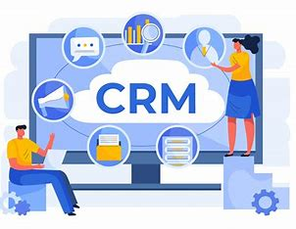
Customer Relationship Management
01
Problem Statement
The project addresses inefficiencies in fragmented CRM systems where customer data is scattered across multiple platforms, leading to missed opportunities and poor customer experiences. Existing tools are ineffective, resulting in lost sales and weakened loyalty. A unified, scalable, and user-friendly CRM solution is crucial to resolve these issues.

Slide 4
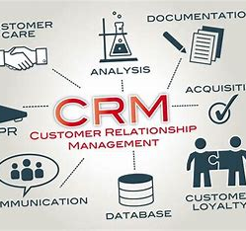
Project Overview
A comprehensive solution designed to streamline customer management and enhance business efficiency.
Aimed at providing a unified platform for managing customer relationships, invoicing, and sales processes.
Developed using modern web technologies for a responsive and user-friendly interface.
Customer
Relationship
Management

Slide 5
Existing System & Proposed System
Existing System
Proposed System
Manual tracking of customer interactions and sales data.
A fully integrated CRM system that centralizes customer data, invoicing, and sales management.
Disconnected systems leading to data loss.
Real-time data updates and notifications for improved decision-making.
High potential for human error in invoice processing and payment tracking.
Automated invoice generation and tracking, reducing the likelihood of errors.
Limited insights into customer engagement and sales performance.
Enhanced customer engagement tracking through detailed analytics and reporting.

Slide 6

Technologies Used
Frontend:
Backend:
React.js for building dynamic user interfaces.
Node.js and Express.js for server-side logic and API development.
Database:
Others:
MongoDB for scalable and flexible data storage.
Integration with third-party APIs for extended functionality.
Real-time data processing for up-to-date information.

Slide 7
Features
Dashboard Overview:
Notifications and Alerts:
Centralized dashboard displaying key metrics like invoices, proforma invoices, offers, and unpaid amounts.
Visual representation of customer activity and invoice statuses for quick assessment.
Real-time alerts for overdue invoices, pending payments, and other critical actions.
User-Friendly Interface:
Intuitive navigation with a sidebar for easy access to various modules (Customers, Companies, Products, etc.).
Responsive design ensuring compatibility across different devices.
Invoice Management:
Track invoice statuses (Draft, Pending, Unpaid, etc.) with real-time updates.
Generate proforma invoices and manage offers efficiently.
Analytics and Reporting:
Customer Management:
In-built analytics to track customer engagement, sales performance, and financial health.
Reporting features to generate custom reports based on various criteria, aiding in strategic decision-making.
Monitor new and active customers with a clear visual gauge.
Easy access to customer information and interaction history.

Slide 8
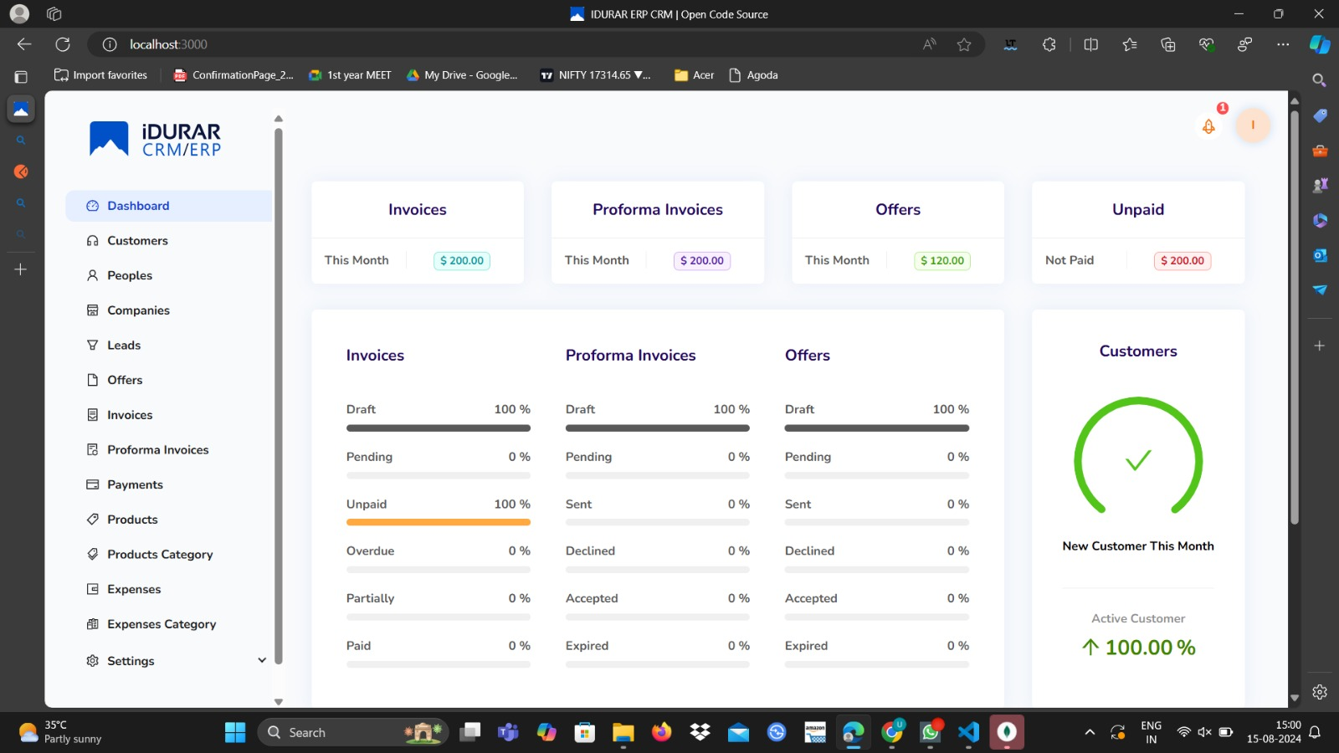

Slide 9
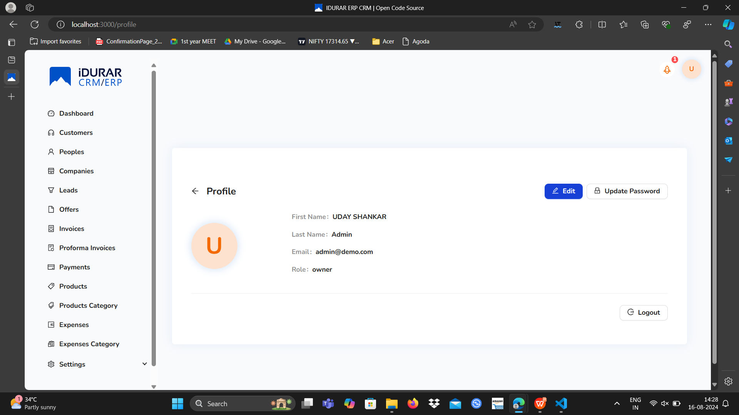

Slide 10
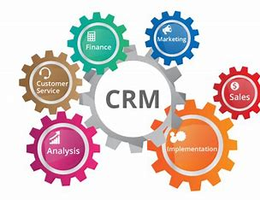
Conclusion
Impact:
Improved efficiency in customer management and invoicing.
Enhanced ability to make data-driven decisions.
Streamlined workflow, reducing the time spent on manual processes.
Future Enhancements:
Potential integration with AI for predictive analytics.
Expansion of features to include more modules like Inventory Management, HRM, etc.

Slide 11
THANK
YOU

