Slide 1
Hostel Accommodation and Student Services Management System
Database Management Systems (DBMS) - Course Project
T. Sindhu (25wu0102316)
Uday Soni (25wu0101148)
Woxsen University | 2026-27

Slide 2
Problem Description
Problem Statement
Objectives
Hostels track rooms, payments and complaints in registers or spreadsheets
Causes double allocation, lost records and slow complaint handling
Design a normalized database up to 3NF
Prevent room over-allocation
Track fee payments and service requests
Build a UI to insert, delete and view records
Scope and Users
Warden, hostel, room, student, allocation, payment, service request
Users: warden and admin office; students view and request

Slide 3
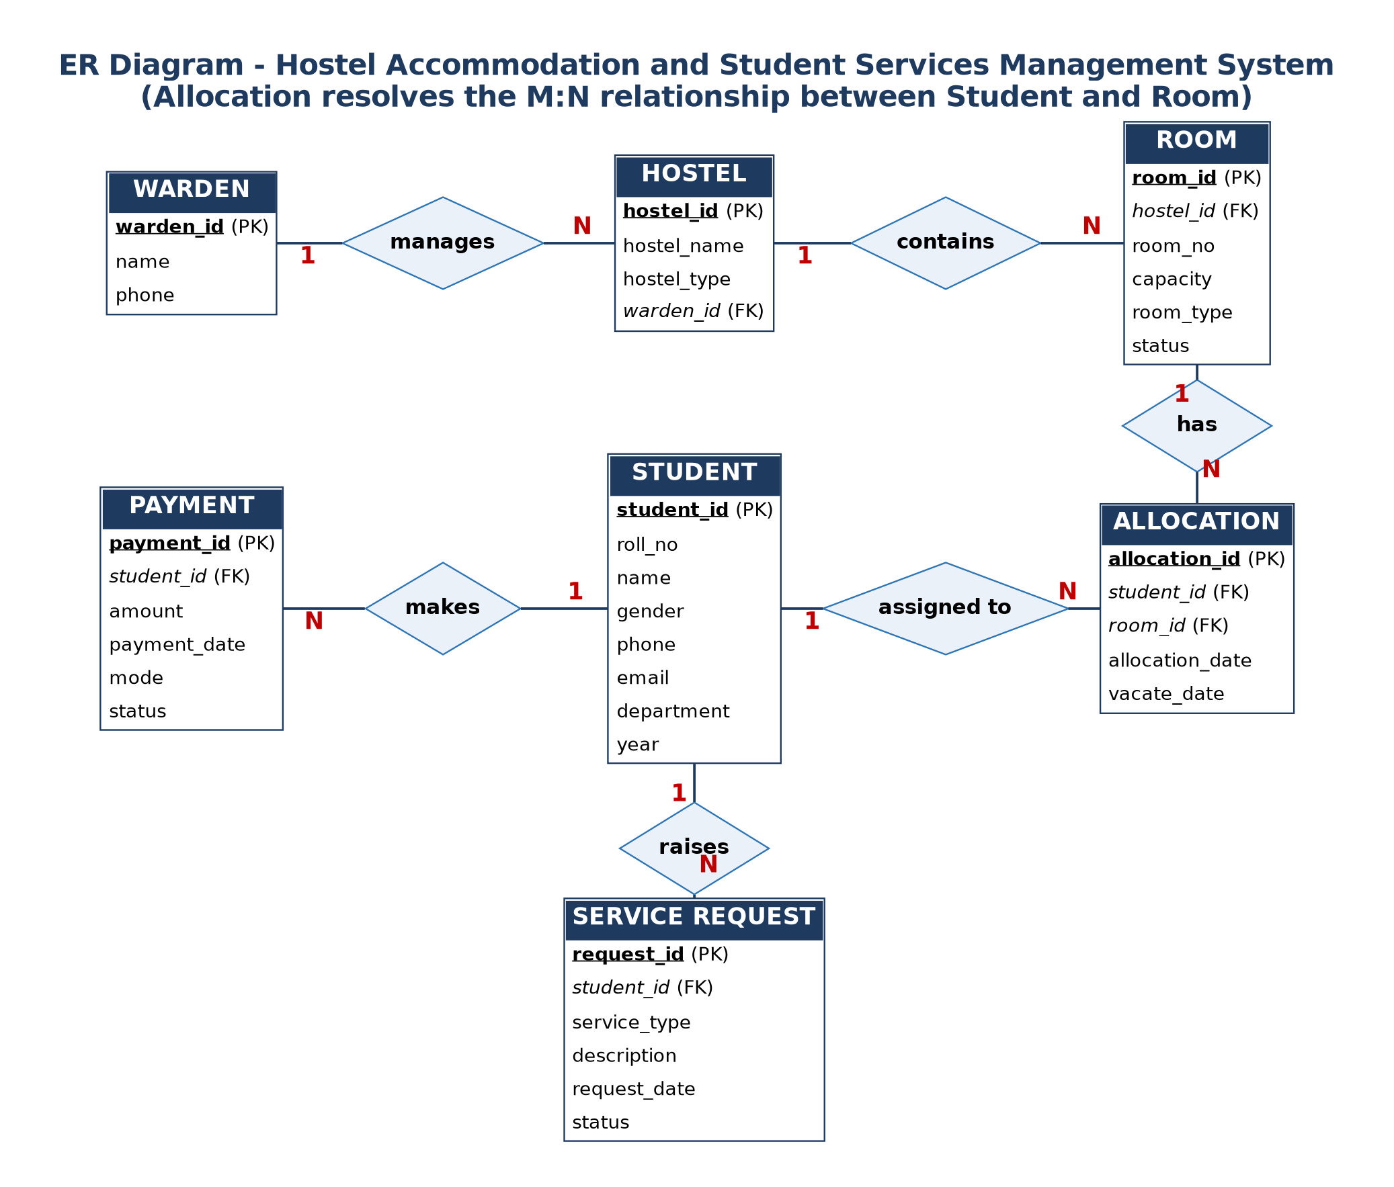
ER Diagram
Entities
Warden, Hostel, Room, Student, Allocation, Payment, Service_Request
Relationships
Warden - Hostel: 1 : N
Hostel - Room: 1 : N
Student - Room (via Allocation): M : N
Student - Payment: 1 : N
Student - Service Request: 1 : N

Slide 4
Relational Schema and Normalization
Schema (PK underlined, FK marked)
Normalization to 3NF
WARDEN(warden_id, name, phone)
HOSTEL(hostel_id, hostel_name, hostel_type, warden_id FK)
ROOM(room_id, hostel_id FK, room_no, capacity, room_type, status)
STUDENT(student_id, roll_no, name, gender, phone, email, department, year)
ALLOCATION(allocation_id, student_id FK, room_id FK, allocation_date, vacate_date)
PAYMENT(payment_id, student_id FK, amount, payment_date, mode, status)
SERVICE_REQUEST(request_id, student_id FK, service_type, description, request_date, status)
1NF: atomic values, no repeating groups
2NF: single-column primary keys, no partial dependency
3NF: no transitive dependency; M:N Student-Room resolved by Allocation table

Slide 5
Database and Table Creation
CREATE DATABASE hostel_db
7 tables with primary keys, foreign keys and constraints
UNIQUE: roll_no, email
CHECK: capacity > 0, amount > 0, hostel_type
DEFAULT: room status, request status
ON DELETE CASCADE on student foreign keys
5+ records inserted in every table (INSERT, UPDATE, DELETE)
-- DDL
CREATE DATABASE hostel_db; USE hostel_db;
CREATE TABLE Student (
student_id INT PRIMARY KEY AUTO_INCREMENT,
roll_no VARCHAR(15) UNIQUE NOT NULL,
name VARCHAR(50) NOT NULL,
department VARCHAR(30) NOT NULL,
year INT NOT NULL
);
CREATE TABLE Allocation (
allocation_id INT PRIMARY KEY AUTO_INCREMENT,
student_id INT NOT NULL,
room_id INT NOT NULL,
allocation_date DATE NOT NULL,
FOREIGN KEY (student_id) REFERENCES Student(student_id)
ON DELETE CASCADE,
FOREIGN KEY (room_id) REFERENCES Room(room_id)
);
-- DML
INSERT INTO Student (roll_no,name,department,year) VALUES
('25wu0101148','Uday Soni','CSE',1);
UPDATE Service_Request SET status='Resolved'
WHERE request_id=1;
DELETE FROM Service_Request WHERE request_id=5;

Slide 6
SELECT Queries
1
JOIN: students with their room and hostel
-- 1 JOIN
SELECT s.name, h.hostel_name, r.room_no FROM Student s
JOIN Allocation a ON s.student_id=a.student_id
JOIN Room r ON a.room_id=r.room_id
JOIN Hostel h ON r.hostel_id=h.hostel_id;
-- 2 GROUP BY + COUNT
SELECT h.hostel_name, COUNT(a.allocation_id) AS occupied
FROM Hostel h JOIN Room r ON h.hostel_id=r.hostel_id
LEFT JOIN Allocation a ON r.room_id=a.room_id
GROUP BY h.hostel_name;
-- 3 SUM
SELECT s.name, SUM(p.amount) AS total_paid FROM Student s
JOIN Payment p ON s.student_id=p.student_id GROUP BY s.name;
-- 4 HAVING
SELECT r.room_no, r.capacity, COUNT(a.allocation_id) AS occupied
FROM Room r LEFT JOIN Allocation a ON r.room_id=a.room_id
GROUP BY r.room_id, r.room_no, r.capacity
HAVING occupied < r.capacity;
-- 5 WHERE
SELECT s.name, sr.service_type FROM Service_Request sr
JOIN Student s ON sr.student_id=s.student_id
WHERE sr.status='Pending';
-- 6 AVG / MAX / MIN
SELECT AVG(amount), MAX(amount), MIN(amount) FROM Payment;
2
GROUP BY + COUNT: occupancy per hostel
3
SUM: total fees paid per student
4
HAVING: rooms that still have vacancy
5
WHERE: pending service requests
6
AVG / MAX / MIN: payment statistics

Slide 7
User Interface Demo
Insert
View
Delete
Add a new student in the form, then show the new row in MySQL
Display all records in a table on the screen
Remove a record, then show it gone from the database
Every change is shown reflected in the MySQL database (before and after).
Python (Tkinter) UI connected to MySQL using mysql-connector

Slide 8
Thank You
T. Sindhu (25wu0102316) | Uday Soni (25wu0101148)

