Slide 1



Key Features of
Budget 2025-2026
ºtiªtàt`ct Vtªtit`
February, 2025

Slide 3






Journey of Development
The fuel: Reforms
Engines of development
Agriculture
MSME
Guiding spirit: Inclusivity
Investment
Exports
Destination: Viksit Bharat
A country is not just its soil, a country is its people.
Accelerate Growth
Secure Inclusive Development
Enhance Spending Power Of India’s Rising
Middle Class
Invigorate Private Sector Investments
Uplift Household Sentiments
Aspiration for
Viksit Bharat

Slide 4

Development measures focusing on
Garib, Youth, Annadata and Nari
Spurring Agricultural Growth & Building Rural Prosperity
Prime Minister Dhan-Dhaanya Krishi Yojana - Developing Agri Districts Programme
To cover 100 districts and likely to help 1.7 crore farmers.
Enhanced Credit through KCC
Facilitate short term loans for 7.7 crore farmers,
03
Mission for Cotton Productivity
5-year mission to facilitate
improvements in
fishermen, and dairy farmers with enhanced loan of ₹5 lakh.
02
04
productivity and sustainability of cotton
farming.
01
05
National Mission on High Yielding Seeds
Targeted development and propagation of seeds with high yield, pest resistance and climate resilience.
Makhana Board in Bihar
To be set up to improve production, processing, value addition, and marketing and organisation of FPOs.
Aatmanirbharta in Pulses
India Post as a Catalyst for the Rural Economy
Launch a 6-year Mission with special focus on Tur, Urad and Masoor, emphasising
Rural community hub co-
Development and commercial availability of climate resilient seeds
Enhancing protein content
Increasing productivity
Improving post-harvest storage and management, assuring remunerative prices to the farmers.
location
Institutional account services;
DBT, cash out and EMI pick- up
Credit services to micro
enterprises
Insurance; and
Assisted digital services.

Slide 5




Development measures focusing on
Garib, Youth, Annadata and Nari
Supporting MSMEs & Furthering Make in India
Credit Cards for Micro Enterprises: Customised Credit Cards with a ₹ 5 lakh limit for micro enterprises registered on Udyam portal. In the first year, 10 lakh such cards will be issued.
Scheme for first time Entrepreneurs: For 5 lakh first-time entrepreneurs, including women, Scheduled Castes and Scheduled Tribes, a new scheme, to be launched, to provide term loans up to ₹ 2 crore during the next 5 years.
Manufacturing mission with the mandate to focus on
Measures for Labour Intensive Sectors
Ease and cost of doing business;
Future ready workforce for in- demand jobs;
A vibrant and dynamic MSME
sector;
Availability of technology;
Quality products;
Clean tech manufacturing for climate-friendly development.
Focus Product Scheme for Footwear & Leather Sectors: scheme is expected to facilitate employment for 22 lakh persons, generate turnover of ₹ 4 lakh crore and exports of over ₹ 1.1 lakh crore.
Measures for the Toy Sector: To focus on development of clusters, skills, and a manufacturing ecosystem that will create
high-quality, unique, innovative, and
sustainable toys to represent the 'Made in India' brand.
Support for Food Processing: Establishment
of a National Institute of Food Technology in Bihar, enhanced income for the farmers and skilling, entrepreneurship and employment opportunities for the youth.
Significant enhancement of credit
availability with guarantee cover
₹ in Crore | Credit guarantee cover
 | Current | Revised
MSEs | 5 | 10
Startups | 10 | 20
Exporter MSMEs | For Term Loans Up To ` 20 Crore
Revision in classification criteria for MSMEs
₹ in Crore | Investment |  | Turnover
 | Current | Revised | Current | Revised
Micro Enterprises | 1 | 2.5 | 5 | 10
Small Enterprises | 10 | 25 | 50 | 100
Medium Enterprises | 50 | 125 | 250 | 500

Slide 6

Development measures focusing on
Garib, Youth, Annadata and Nari
Investing in people, economy and innovation
Saksham Anganwadi and Poshan 2.0
Expansion of Capacity in IITs
Day Care Cancer Centres in all District Hospitals
Bharatiya Bhasha Pustak Scheme: provide digital- form Indian language books for school and higher education.
05 National Centres of Excellence for skilling to be set up with global expertise and partnerships.
Atal Tinkering Labs: 50 Thousand Labs to be set up in government schools in next 5 years.
Centre of Excellence in Artificial Intelligence for education with a total outlay of ₹500 crore.
Broadband connectivity to be provided to all government secondary schools and primary health centres in rural areas.
Expansion of medical education: 10,000 additional seats with the goal of adding 75,000 seats in the next 5 years.
PM SVANidhi: To be revamped with enhanced loans from banks, UPI linked credit cards and capacity building support.
Welfare of Online Platform Workers: Registration on the e-Shram portal & healthcare under PM Jan Arogya Yojana.

Slide 7
Development measures focusing on
Garib, Youth, Annadata and Nari
Investing in people, economy and innovation
Power Sector Reforms: Incentivize
Support to States for Infrastructure: With an outlay of ₹ 1.5 lakh crore, 50-year interest free loans to states for capital expenditure and incentives for reforms.
Jal Jeevan Mission: To achieve 100 % coverage, the mission extended till 2028 with an enhanced total outlay.
distribution reforms and augmentation of intra-state transmission. Additional borrowing of 0.5 % of GSDP to states, contingent on these reforms.
Asset Monetization Plan 2025-30: launched to plough back capital of ₹ 10 lakh crore in new projects.
Urban Challenge Fund
₹ 1 lakh crore to implement the proposals for
‘Cities as Growth Hubs’, ‘Creative Redevelopment
of Cities’ and ‘Water &Sanitation’.
Maritime Development Fund with a corpus of ₹25,000 crore for long-term financing with up to 49 % contribution by the government.
Nuclear Energy Mission for Viksit Bharat: Amendments to the Atomic Energy Act and the Civil Liability for Nuclear Damage Act will be taken up for active partnership with the private sector.
UDAN: Regional connectivity to 120 new destinations and carry 4 crore passengers in the next
10 years.
Future needs of Bihar
Greenfield airports, Financial support for the Western Koshi Canal ERM Projecs.
SWAMIH Fund-2
₹ 15,000 crore for expeditious completion of one lakh dwelling units through blended finance.
Tourism for employment-led growth
Top 50 tourist destination sites to be developed in partnership with states
Performance-linked incentives to states
Introducing streamlined e-visa facilities
MUDRA loans for homestays
Intensive skill-development programmes for our youth
Ease of travel and connectivity to tourist destinations

Slide 8




Development measures focusing on
Garib, Youth, Annadata and Nari
Investing in people, economy and innovation
PM Research Fellowship
To provide ten thousand fellowships for technological research in IITs and IISc.
Research, Development & Innovation
Allocating ₹ 20,000 crore to implement private sector driven Research, Development and Innovation initiative.
Gene Bank for Crops Germplasm
The 2nd Gene Bank with 10 lakh germplasm lines to be set up for future food and nutritional security.
National Geospatial
Mission
To develop foundational
geospatial infrastructure and data. Using PM Gati Shakti, facilitation of modernization of land records, urban planning, and design of infrastructure projects.
Gyan Bharatam Mission
Documentation and conservation of our manuscript heritage to cover more than 1 crore manuscripts.
National Digital Repository of
Indian knowledge systems for knowledge sharing to be set up.
Promoting Exports
Export Promotion Mission: With sectoral and ministerial targets to facilitate easy access to export credit, cross-border factoring support, and support to MSMEs to tackle non-tariff measures in overseas markets.
BharatTradeNet: A digital public infrastructure, ‘BharatTradeNet’ (BTN) for international trade will be set-up as a unified platform for trade documentation and financing solutions. Support for integration with Global Supply Chains.
National Framework for GCC: As guidance to states for promoting Global Capability Centres in emerging tier 2 cities.
Warehousing facility for air cargo: To facilitate upgradation of infrastructure and warehousing for air cargo including high value perishable horticulture produce.

Slide 9



Reforms as the fuel
Financial Sector Reforms and Development
‘Grameen Credit Score’ framework to serve the credit needs of SHG members and people in rural areas.
NaBFID to set up a ‘Partial Credit Enhancement Facility’ for corporate bonds for infrastructure.
Revamped Central KYC registry to be rolled out in 2025.
Rationalisation of requirements and procedures for speedy approval of company mergers.
FDI limit for the insurance sector will be raised from 74 to 100 per cent.
Tax Reforms
Changes in direct taxes and proposal to introduced the
New Income Tax Bill
Regulatory Reforms
Light-touch regulatory framework based on principles
and trust to unleash productivity and employment
High Level Committee for Regulatory Reforms
Investment Friendliness Index of States
FSDC Mechanism: to evaluate impact of the current financial regulations and subsidiary instructions along with a framework to enhance their responsiveness and development of the financial sector.
Jan Vishwas Bill 2.0: to decriminalize more than 100 provisions in various laws.

Slide 10






Indirect Tax proposals
Rationalisation of Customs Tariff Structure for Industrial Goods
₹
Apply equivalent cess to maintain effective duty incidence on most items and lower cess on certain items.
Removal of 07 tariff rates.
Apply not more than one cess or surcharge.
Sector specific proposals
Make in India- Exemption to open cell for LED/LCD TV, looms for textiles, capital goods for lithium ion battery of mobile phones and EVs.
Promotion of MRO – exemption for 10 years on goods for ship building and ships for breaking, extension of time limit for export of railway goods imported for repairs.
Export promotion – duty free inputs for handicraft and leather
sectors.
Trade Facilitation: Time limit fixed for finalisation of provisional assessment; new provision for voluntary declaration of material facts post clearance and duty payment with interest but without penalty; IGCR Rules amended to extend time limit to 1 year and file quarterly statement instead of monthly.
Improved access to
lifesaving medicines
Addition of:
36 lifesaving drugs/medicines in exempted list;
6 medicines in 5% duty list;
37 medicines and 13 new patient assistance programmes in exempt list.
(Medicines for rare diseases, cancer, severe chronic diseases)

Slide 11

Direct Tax proposals
Introduction of a scheme for
determining arm's
Personal Income Tax reforms with
special focus on the middle class
Ease of doing business
length price of
30%
international transaction for a
25%
block period of three years.
20%
10%
15%
Expansion of scope of safe harbour rules to reduce litigation and provide certainty in international taxation.
5%
Nil
₹0- ₹4
lakh
₹4- ₹8
lakh
₹8- ₹12 ₹12- ₹16 ₹16- ₹20 ₹20- ₹24
lakh lakh lakh lakh
> ₹24
lakh
Tax deduction limit for senior citizens doubled from ₹ 50,000 to ₹ 1 lakh.
The annual limit of ₹2.40 lakh for TDS on rent increased to ₹ 6 lakh.
Rationalization of TDS/TCS for easing
difficulties
Encouraging voluntary compliance
Extension of time-limit to file updated returns,
from the current limit of two years, to four years.
Reduced compliance for small charitable trusts/institutions by increasing their period of registration from 5 years to 10 years.
Tax payers to be allowed to claim the annual value of 02 self occupied properties (previously 01) without any conditions (previously conditions attached).
Reducing compliance burden
Employment
and investment
Tax certainty for electronics manufacturing Schemes
Tonnage Tax Scheme for Inland Vessels
Extension for incorporation by 5 years of Start-Ups
Specific benefits to ship-leasing units, insurance offices and treasury centres of global companies which are set up in IFSC
Certainty of taxation to Category I and category II AIFs, undertaking investments in infrastructure and other such sectors, on the gains from securities.

Slide 12



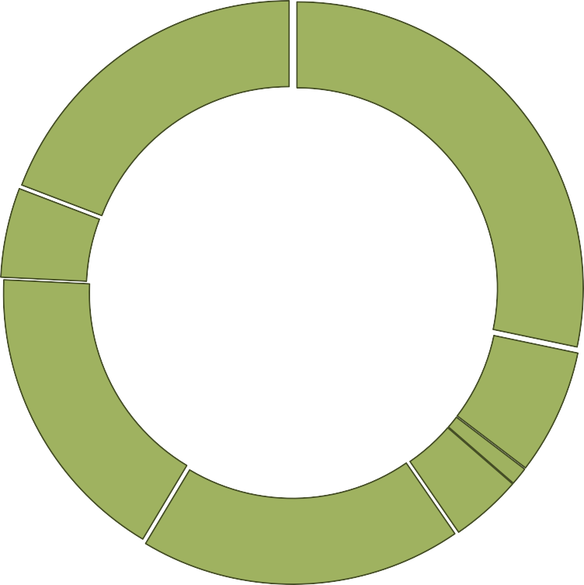
























































































Rupee Comes From
Rupee Comes From
Income Tax
(22%)
22%
Borrowing and Other
_{24%} Liabilities (24%)
Union Excise
Duties (5%)
₹
17%
5%
18%
9%
Non-Tax Receipts (9%)
GST & other taxes (18%)
1%
4%
Non-Debt Capital Receipts (1%)
Customs (4%)
Corporation tax (17%)
Rupee Goes To
Other Expenditure (8%)
Pensions (4%)
8%
4%
Interest Payments (20%)
Centrally Sponsored Scheme (8%)
20%
8%
₹
8%
Finance Commission and other transfers (8%)
8%
Central Sector Scheme (excluding capital outlay on Defence and Subsidy) (16%)
16%
22%
6%
States' share of Taxes and Duties (22%)
Major Subsidies (6%)
Defence (8%)

Slide 13




Receipts
Revenue Receipts
Capital Receipts
40
18
31.3
30.9
34.2
17.1
30
27.3
17
16.9
₹ lakh crore
₹ lakh crore
16.4
16.3
20
16
10
15
0
2023-24
(Actuals)
2024-25 (BE)
2024-25 (RE)
2025-26 (BE)
14
2023-24 2024-25 2024-25 2025-26 (Actuals) (BE) (RE) (BE)
Expenditure
Effective Capital Expenditure
Revenue Expenditure
15.5
40
39.4
16
15.0
12.5
13.2
38
37.1
12
37.0
₹ lakh crore
₹ lakh crore
36
8
34.9
4
34
0
2023-24 2024-25 2024-25 2025-26 (Actuals) (BE) (RE) (BE)
32
2023-24 2024-25 2024-25 2025-26 (Actuals) (BE) (RE) (BE)

Slide 14
Robust Economic Foundations
Deficit Trends
2021-22
2022-23
2023-24
2024-25 (RE)
2025-26 (BE)
8
6.7
6
As % of GDP
4.4
4.4
4
3.3
3.3
2
1.5
0.3
0.8
0
Fiscal Deficit
Revenue Deficit
Effective Revenue
Deficit
Primary Deficit
Trend in Net Receipt of the Centre
Total Transfers to States & UTs
Net Centre's Tax Revenue Non Tax Revenue
Non-debt Capital Receipt (RHS)
27
25.60
40
1
0.8
0.8
24
22.76
₹ lakh crore
28.4
0.6
₹ lakh crore
₹ lakh crore
21
20.65
20
0.4
18.65
5.8
0.2
18
17.06
0
2021-22
2022-23
2024-25 (RE)
2025-26 (BE)
0
15
2023-24
2021-22
2022-23
2023-24
2024-25
(RE)
2025-26 (BE)

Slide 15










Expenditure of Major Items
Defence
4,91,732
Rural Development
2,66,817
Home Affairs
2,33,211
Agriculture and Allied Activities
1,71,437
Education
1,28,650
Health
98,311
Urban Development
96,777
IT and Telecom
95,298
Energy
81,174
Commerce & Industry
65,553
Social Welfare
60,052
Scientific Departments
55,679
in ₹ Crore

Slide 16


