Slide 1
PromptCapsule
Lossless Prompt Packaging & Retrieval · v0.1.5
C-Batch · Hybrid packaging · Agent handoff · Security-hardened
pip install promptcapsule==0.1.5 · github.com/UdayaNirogi/promptcapsule

Slide 2
1 · The Problem
Teams need exact prompt reuse — not lossy “semantic compression.”
Share exact prompts
Shrink the handle
Prove integrity
Same system prompt across apps,
PRs, and environments
Multi-KB prompts → short,
portable capsule string
SHA-256 verification on
every reconstruct
Two things people confuse
Type 1 — True compression: entropy-limited; good for small text; no storage.
Type 2 — Key-based retrieval: short ID → full prompt from a vault; solves long prompts.
PromptCapsule does BOTH, automatically, with checksums.
PromptCapsule · C-Batch · 2/8

Slide 3
2 · What Exactly Is This?
Abstract: PromptCapsule turns LLM prompt text into a portable capsule and reconstructs it byte-for-byte. Inline (≤500 bytes): zlib+Base85. Vault (>500 bytes): short key into a shared store. Limits: 10 MiB max prompt/zlib. Default decompress is fail-closed. Suite: 81 automated tests.
500 B
10 MiB
SHA-256
Inline threshold
Max prompt / zlib
Fail-closed verify
81
4
0.1.5
Automated tests
Pluggable backends
Current release
PromptCapsule · C-Batch · 3/8

Slide 4
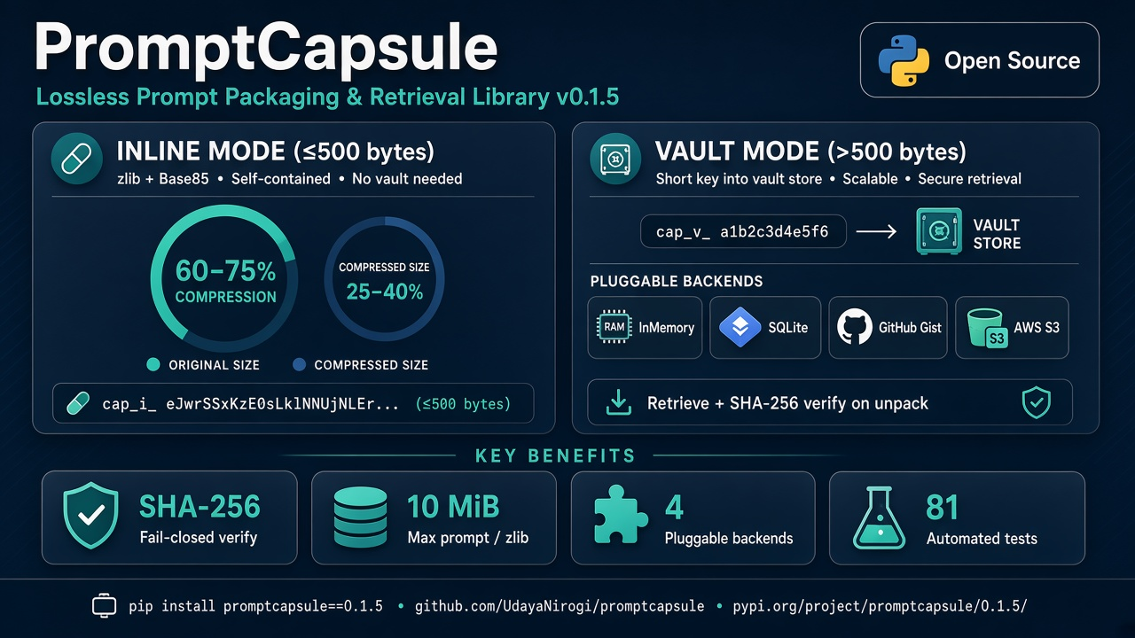
3 · Product Infographic
PromptCapsule · C-Batch · 4/8

Slide 5
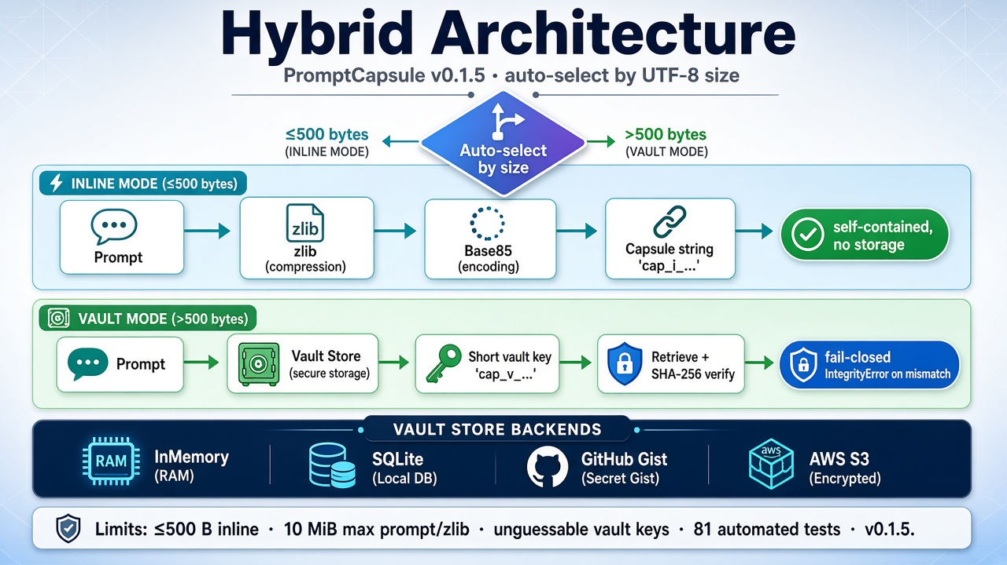
4 · Technical Design — Hybrid Architecture
PromptCapsule · C-Batch · 5/8

Slide 6
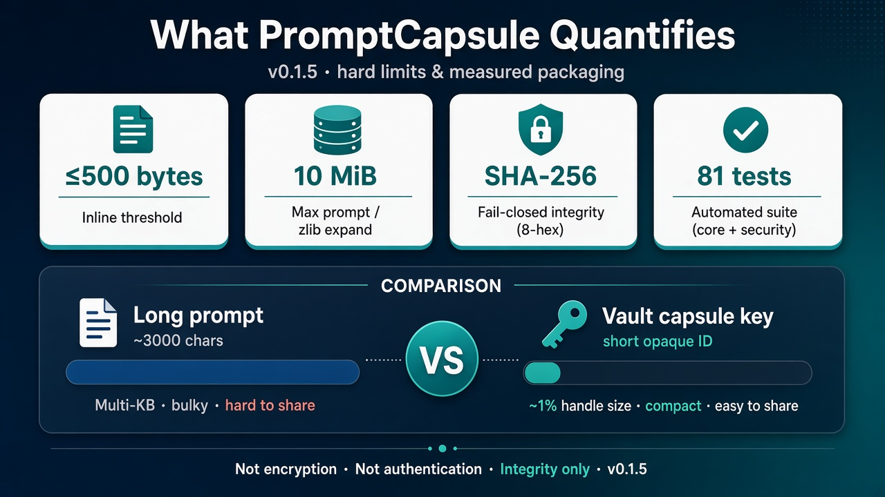
5 · Limits & Security
Hardening summary
Limits:
• Inline ≤ 500 bytes
• Max size 10 MiB
Fixed in library:
• Fail-closed IntegrityError
• Invalid prefixes rejected
• zlib expansion capped
• Unguessable vault keys
• No vault plaintext leak
• Base85 junk rejected
• S3 prefix + Gist owner
Still limitations:
• Not encryption
• Not authentication
• Not a full MAC
• Demo HTTP bus OOS
81 automated tests
PromptCapsule · C-Batch · 6/8

Slide 7
6 · Agent-to-Agent Communication
Potential: agents pass a capsule, then reconstruct the exact prompt with a checksum.
1 Agent A
2 Message
3 Agent B
Packs context
compress(prompt)
Sends only the
capsule string
Unpacks + checks
decompress → verified
Inline capsule
Vault capsule
Integrity gate
Self-contained. No shared store.
Best for short instructions between agents.
Shared backend = shared memory.
Long context stays in SQLite / Gist / S3.
strict=True → IntegrityError on fail.
Vault bind failure returns empty text.
v0.1.5: packaging + retrieval — not encryption / not auth. Gist require_owner by default.
Both agents must share the same vault for vault-mode. Inline capsules travel alone.
Automated test suite: 81 tests (core + security).
PromptCapsule · C-Batch · 7/8

Slide 8
7 · Takeaways & Next Steps
→ PromptCapsule = lossless packaging + vault retrieval + fail-closed integrity
→ Limits: ≤500B inline · 10 MiB max · unguessable keys · 81 automated tests
→ Open limitations: not encryption, not auth, 8-hex checksum is not a MAC
→ Agent pattern: decompress(strict=True); reject on IntegrityError
Resources
pip install promptcapsule==0.1.5
https://github.com/UdayaNirogi/promptcapsule
https://pypi.org/project/promptcapsule/0.1.5/
Docs: ABSTRACT.md · TECHNICAL_DESIGN.md · README (limits & security)
PromptCapsule · C-Batch · 8/8

