Slide 1

Correlation, Covariance and PCA

Slide 2
Covariance & Correlation
It is important to know whether two variables are related
Covariance and correlation are metrics for uncovering that
Covariance measures the direction of the relationship
Correlation in addition to the direction also measures the strength of the relationship by normalizing the variables
Note, the variables could be either categorical or quantitative
2

Slide 3
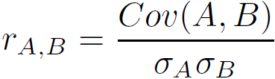
Covariance (Numeric Data)
Covariance is like correlation
where n is the number of tuples, and are the respective mean or expected values of A and B, σ_{A} and σ_{B} are the respective standard deviation of A and B.
Positive covariance: If Cov_{A,B} > 0, then A and B both tend to be larger than their expected values.
Negative covariance: If Cov_{A,B} < 0 then if A is larger than its expected value, B is likely to be smaller than its expected value.
Independence: Cov_{A,B} = 0 but the converse is not true:
Some pairs of random variables may have a covariance of 0 but are not independent. Only under some additional assumptions (e.g., the data follow multivariate normal distributions) does a covariance of 0 imply independence
Correlation coefficient:

Slide 4

Co-Variance: An Example
It can be simplified in computation as
Suppose two stocks A and B have the following values in one week: (2, 5), (3, 8), (5, 10), (4, 11), (6, 14).
Question: If the stocks are affected by the same industry trends, will their prices rise or fall together?
E(A) = (2 + 3 + 5 + 4 + 6)/ 5 = 20/5 = 4
E(B) = (5 + 8 + 10 + 11 + 14) /5 = 48/5 = 9.6
Cov(A,B) = (2×5+3×8+5×10+4×11+6×14)/5 − 4 × 9.6 = 4
Thus, A and B rise together since Cov(A, B) > 0.

Slide 5
Correlation (viewed as linear relationship)
Correlation measures the linear relationship between objects
To compute correlation, we standardize data objects, A and B, and then take their dot product

Slide 6
Correlation Analysis (Numeric Data)
Correlation coefficient (also called Pearson’s product moment coefficient)
where n is the number of tuples, and are the respective means of A and B, σ_{A} and σ_{B} are the respective standard deviation of A and B, and Σ(a_{i}b_{i}) is the sum of the AB cross-product.
If r_{A,B} > 0, A and B are positively correlated (A’s values increase as B’s). The higher, the stronger correlation.
r_{A,B} = 0: independent; r_{AB} < 0: negatively correlated

Slide 7
Correlation Analysis
Correlation analysis could be performed on both categorical and quantitative data
Example
Are they correlated?
 | Male | Female | Sum (row)
fiction | 250 | 200 | 450
Non-fiction | 50 | 1000 | 1050
Sum(col.) | 300 | 1200 | 1500

Slide 8
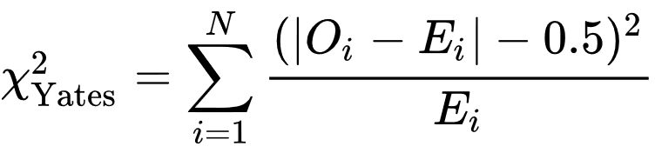
Correlation Analysis (Nominal Data)
Χ² (chi-square) test
The larger the Χ² value, the more likely the variables are related
The cells that contribute the most to the Χ² value are those whose actual count is very different from the expected count
Correlation does not imply causality
# of hospitals and # of car-theft in a city are correlated
Both are causally linked to the third variable: population

Slide 9
Chi-Square Calculation: An Example
Χ² (chi-square) calculation (numbers in parenthesis are expected counts calculated based on the data distribution in the two categories)
It shows that fiction and gender are correlated in the group
 | Male | Female | Sum (row)
fiction | 250 (90) | 200 (360) | 450
Non-fiction | 50 (210) | 1000 (840) | 1050
Sum(col.) | 300 | 1200 | 1500
$$χ^{2}=\frac{(250−90)^{2}}{90}+\frac{(50−210)^{2}}{210}+\frac{(200−360)^{2}}{360}+\frac{(1000−840)^{2}}{840}=507.94$$

Slide 10
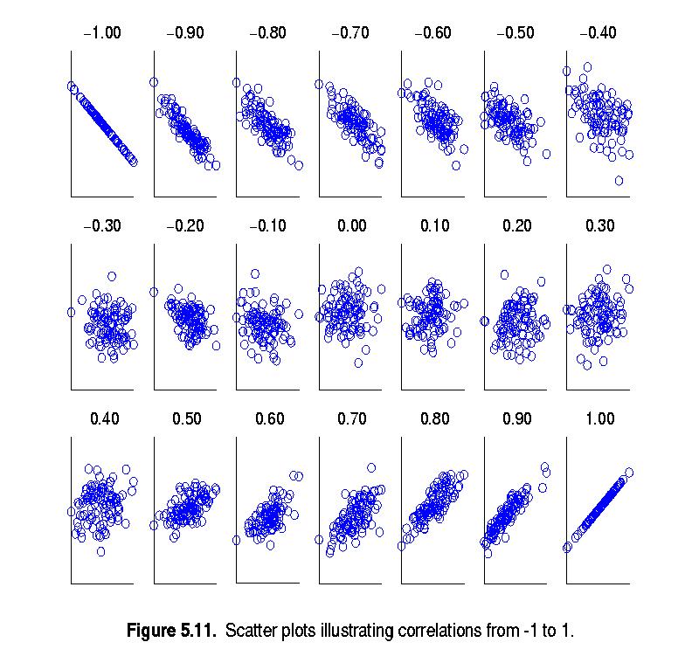
Visually Evaluating Correlation
Scatter plots showing the similarity from –1 to 1.

Slide 11



Data reduction

Slide 12
Data Reduction
Data reduction: Obtain a reduced representation of the data set that is much smaller in volume but yet produces the same (or almost the same) analytical results
Why data reduction? — A database/data warehouse may store terabytes of data. Complex data analysis may take a very long time to run on the complete data set.

Slide 13
Data Reduction Strategies
Dimensionality reduction, e.g., remove unimportant attributes or select attributes that are relevant and provides important insight
Wavelet transforms
Principal Components Analysis (PCA)
Feature subset selection, feature creation
Numerosity reduction (some simply call it: Data Reduction) Instead of using the whole data set use a subset of the dataset that still gives the same information
Regression and Log-Linear Models
Histograms, clustering, sampling
Data cube aggregation
Data compression Obtain reduced or compressed data

Slide 14
Data Reduction 1: Dimensionality Reduction
Curse of dimensionality
When dimensionality increases, data becomes increasingly sparse
Density and distance between points, which is critical to clustering, outlier analysis, becomes less meaningful
The possible combinations of subspaces will grow exponentially
Let us look at this distant wise –
We can easily observe as i increases, if everything else remains same distance increases, unless added attribute has exactly the same value
Notes:
14

Slide 15
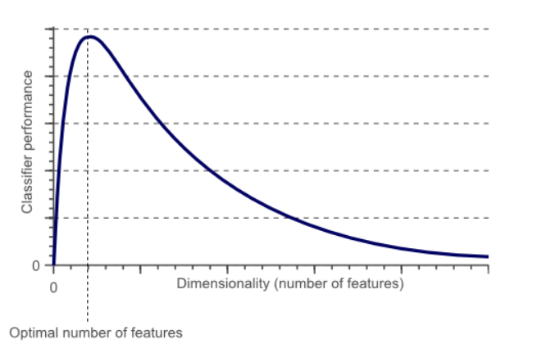
Hughes Phenomenon

Slide 16
Data Reduction 1: Dimensionality Reduction
Dimensionality reduction
Avoid the curse of dimensionality
Help eliminate irrelevant features and reduce noise
Reduce time and space required in data mining
Allow easier visualization
Dimensionality reduction techniques
Wavelet transforms
Principal Component Analysis
Supervised and nonlinear techniques (e.g., feature selection)
Notes:
16

Slide 17
Principal Components Analysis

Slide 18
Introduction
Let us consider that there are k variables. We capture the greatest variance by creating a linear combination of variables that shows the maximum variance.
So we do that using coordinate transformation
The new coordinate system is built in such a way that they are orthogonal and hence the new variables are not correlated

Slide 19
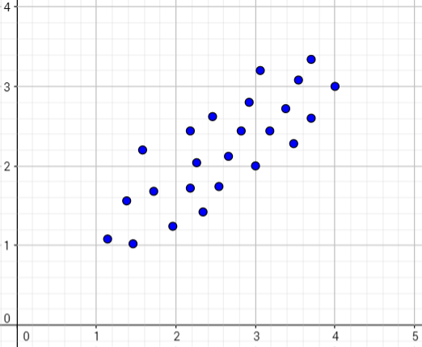
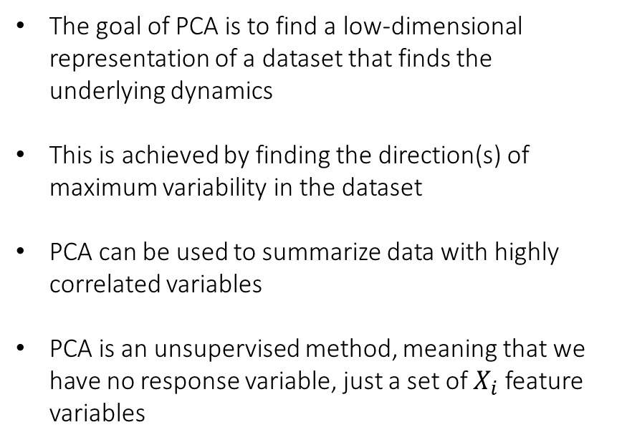
Principal Components Analysis Finding the Direction of Maximum Variability in Data
The goal of PCA is to find a low-dimensional representation of a dataset that finds the underlying dynamics
This is achieved by finding the direction(s) of maximum variability in the dataset
PCA can be used to summarize data with highly correlated variables
PCA is an unsupervised method, meaning that we have no response variable, just a set of $X_{i}$ feature variables

Slide 20
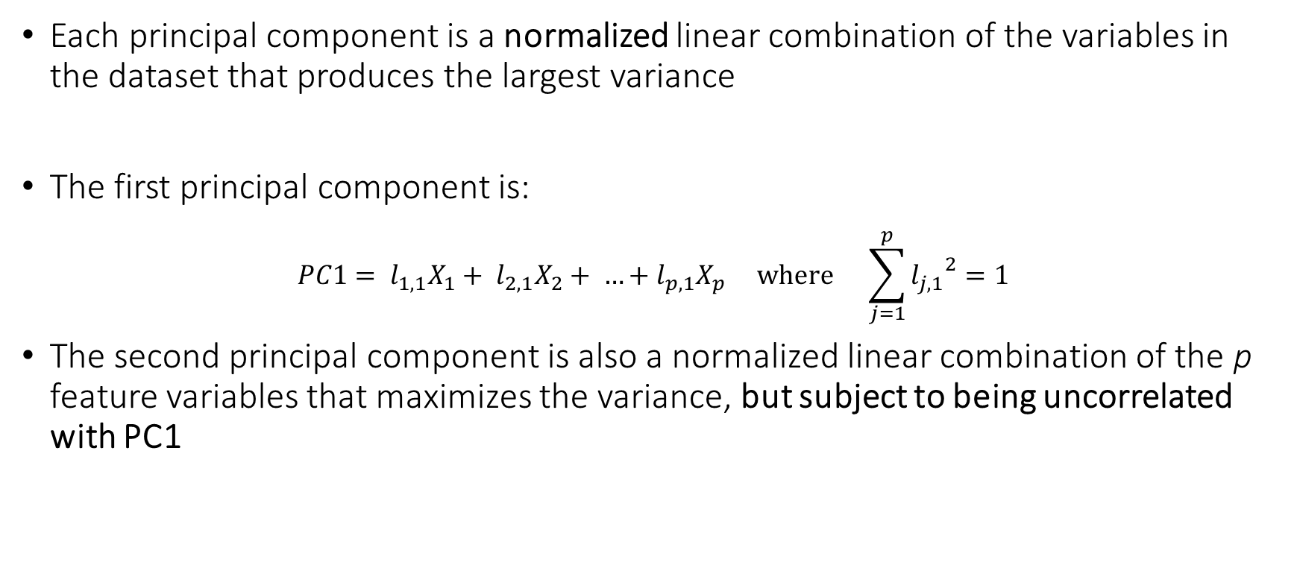
Principal Components Analysis Calculation of Components
Each principal component is a normalized linear combination of the variables in the dataset that produces the largest variance
The first principal component is:
$$PC1= l_{1,1}X_{1}+ l_{2,1}X_{2}+ …+l_{p,1}X_{p} where \sum_{j=1}^{p}{{l_{j,1}}^{2}=1}$$
The second principal component is also a normalized linear combination of the p feature variables that maximizes the variance, but subject to being uncorrelated with PC1

Slide 21
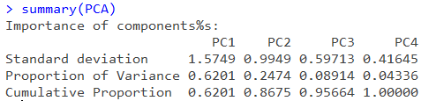
Principal Components Analysis Proportion of Total Variance Explained
Each principal component explains a certain percentage of the overall variance in the dataset
The goal of a principal component analysis is to find a small set of components (less than the number of original variables) that explain the majority of the variance

Slide 22
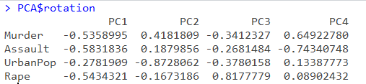

Principal Components Analysis Principal Component Loadings
The $l_{i,j}$ in each of the principal components are known as the loadings
They represent the correlation between the original variables and the principal components. The larger in magnitude, the more related these two quantities are to each other.

Slide 23
Principal Component Analysis (Steps)
Given N data vectors from n-dimensions, find k ≤ n orthogonal vectors (principal components) that can be best used to represent data
Normalize input data: Each attribute falls within the same range
Compute k orthonormal (unit) vectors, i.e., principal components
Each input data (vector) is a linear combination of the k principal component vectors
The principal components are sorted in order of decreasing “significance” or strength
Since the components are sorted, the size of the data can be reduced by eliminating the weak components, i.e., those with low variance (i.e., using the strongest principal components, it is possible to reconstruct a good approximation of the original data)
Works for numeric data only

Slide 24
Attribute Subset Selection
Another way to reduce dimensionality of data
Redundant attributes
Duplicate much or all of the information contained in one or more other attributes
E.g., purchase price of a product and the amount of sales tax paid
Irrelevant attributes
Contain no information that is useful for the data mining task at hand
E.g., students' ID is often irrelevant to the task of predicting students' GPA

Slide 25
Heuristic Search in Attribute Selection
There are 2^{d} possible attribute combinations of d attributes
Typical heuristic attribute selection methods:
Best single attribute under the attribute independence assumption: choose by significance tests
Best step-wise feature selection:
The best single-attribute is picked first
Then next best attribute condition to the first, ...
Step-wise attribute elimination:
Repeatedly eliminate the worst attribute
Best combined attribute selection and elimination
Optimal branch and bound:
Use attribute elimination and backtracking

