Slide 1
Introduction to Relational Database
Abhijit Dutt

Slide 2
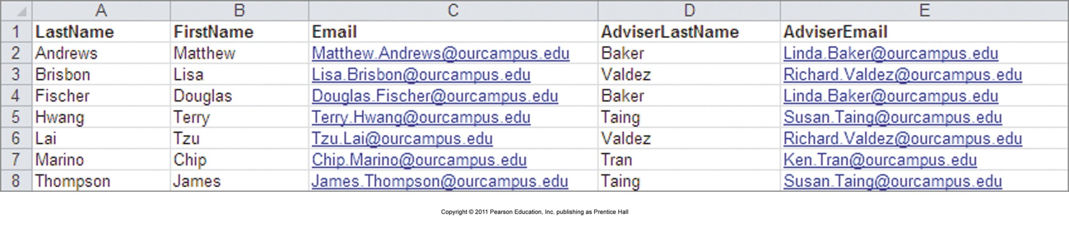
Storing Information using List
A list of student and adviser data
Any problem when deleting, updating and inserting information on this list?

Slide 3
Relational Databases
A relational database stores information in tables.
Each informational topic is stored in its own table
In essence, a relational database will break-up a list into several parts.
One part for each theme in the list
The Student List would be divided into
a STUDENT Table,
a ADVISER Table, and
a DEPARTPENT Table

Slide 4
Relational Database - Concepts
Primary key – In a table (also called entity), identify a column that is unique for each row. If you cannot find any, then create one. Every table needs a primary key.
Relationship – As you have divided the list into table, you need to somehow connect them together. To connect two tables, you add the primary key of one table as foreign key to another table. However, in which table the addition should happen? You have two choices and that depends on the type of relationship.
Foreign key – In a table, when you add a column that is primary key of another table then it is called foreign key.

Slide 5
Relationships
Different types
Degree
Unary (Recursive)
Binary
Ternary
Cardinality
One to One
One to many
Many to Many

Slide 6
Putting the Pieces Back Together
In our relational database we broke apart our list into several tables. Somehow the tables must be joined back together
In a relational database, tables are joined together using the value of the data
If a STUDENT has a ADVISER, the AdviserLastName (assume no two advisers have the same last name) is stored as a column in the STUDENT table. The value stored in this column can be used to retrieve specific adviser information from the ADVISER table

Slide 7
Is database worth it?
A relational database is more complicated than a list
However, a relational database minimizes data redundancy, preserves complex relationships among topics, and allows for partial data
Furthermore, a relational database provides a solid foundation for user forms and reports
When designing and implementing Relational database, what is the most important activity that we have to do?
Normalization

Slide 8
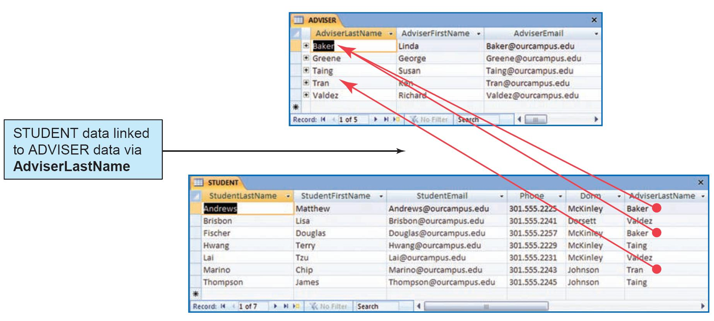
Relational Database Example

Slide 9
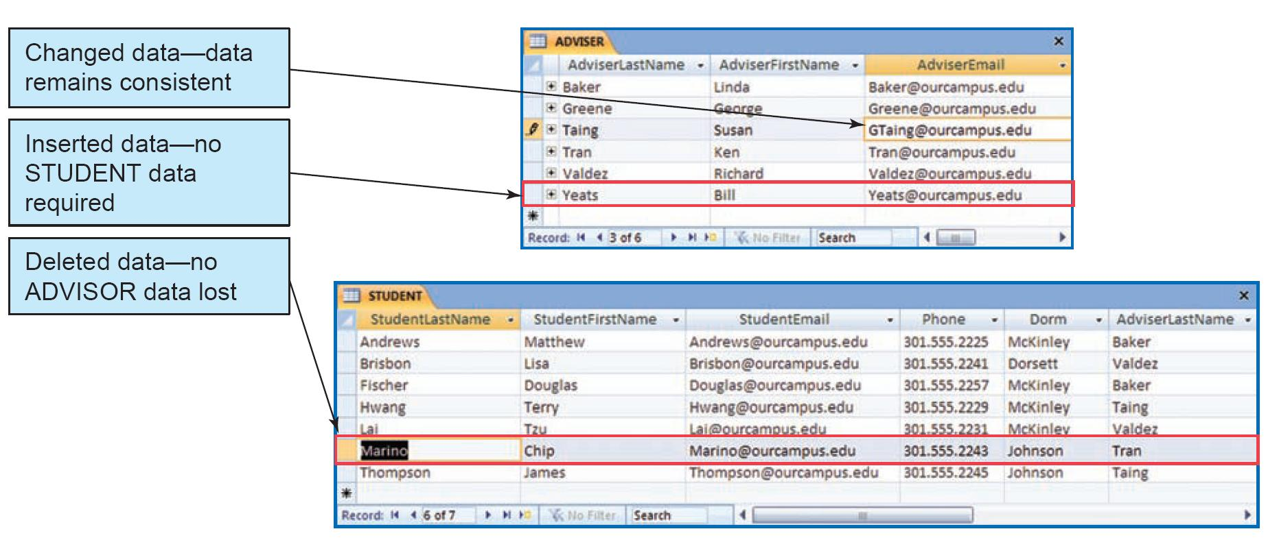
A Relational Database Solves the Problems of Lists

Slide 10
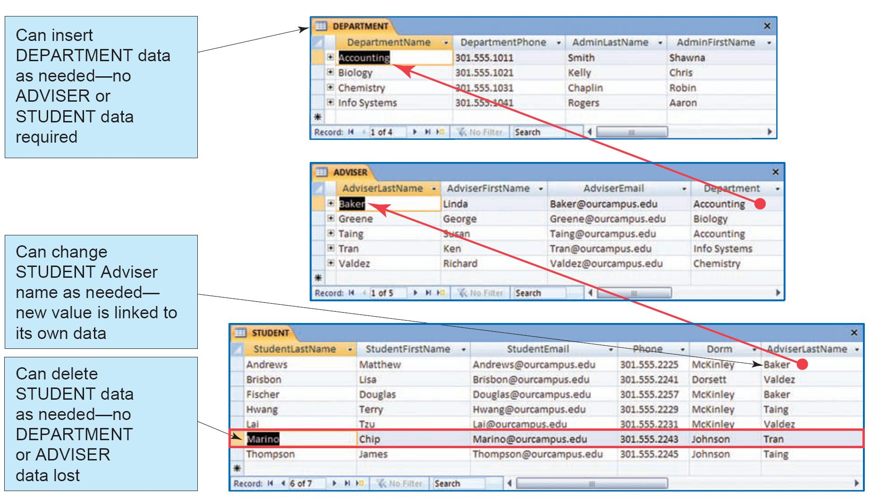
The Department, Advisor and Student Tables

Slide 11
Transaction & OLTP
Transaction
A complete set of closely related update commands either all the commands are executed or none of the commands are executed so that the database remains in a valid state
Online Transaction Processing (OLTP)
Relational databases are mainly used for this purpose. Only small part of the database is updated; hence update is quick.

Slide 12
Relational Database (Summary)
Data stored in Tables that are related
Cannot handle multi-valued attribute
Need extra table (or entity) to handle many to many relationships
ACID (Probably since 1973)

Slide 13
Relational Databases & ACID properties
Execution of DB code blocks (aka transactions) ensure
Atomicity: either all instructions or none of them are executed
Consistency: at the end, it leaves database in consistent state
Isolation: oblivious to other concurrent manipulations of database
Durability: upon completion, modifications to DB are permanent
Notes:
In most cases, changes in database occur in steps. Scenario – transfer of money from checking to savings. Either both the changes need to occur or none of the changes. If there is partial update then database will be in an inconsistent state – also known as strong consistency.

