Slide 1
NoSQL Databases
An Overview

Slide 2
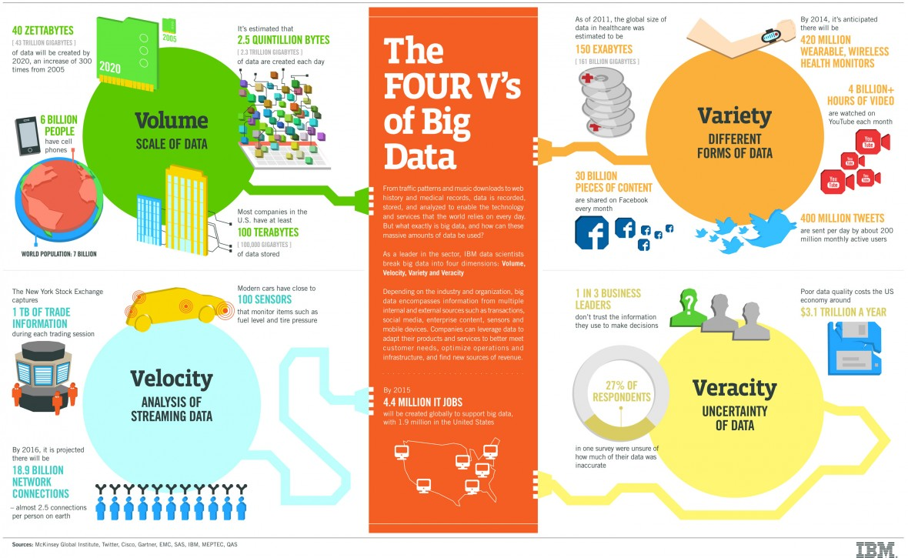
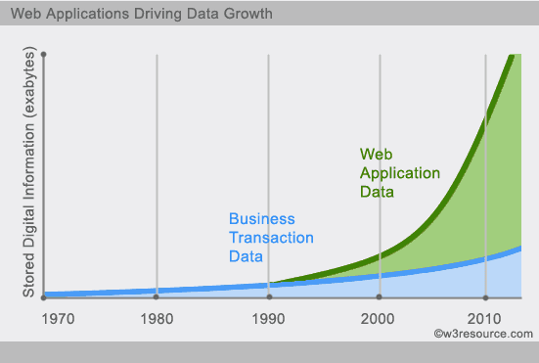
Recall - The need of Big Data

Slide 3
Big Data
Why it is different?
We have lot of data, so we can afford to lose some?
Let us think two scenarios-
Your medical record
Fitbit record
BASE instead of ACID
Do we still need transaction?

Slide 4
Scaling Relational Databases for Big Data?
Vertically (or up)
Can be achieved by hardware upgrades (e.g., faster CPU, more memory, or larger disks)
Limited by the amount of CPU, RAM and disk that can be configured on a single machine
Horizontally (or out)
Can be achieved by adding more machines
Requires database sharding and probably replication
Limited by the Read-to-Write ratio and communication overhead
ACID requirements constrain scalability
Notes:
Isn’t replication bad?

Slide 5
NoSQL
Means Not Only SQL
Scale horizontally on clusters
Concept of Aggregate
Explicit storage of a rich structure of closely related data that is accessed as a unit
Using this concept, we can divide databases into
Aggregate-ignorant
Aggregate-oriented

Slide 6
From – Rashhed et al, Intl. J of Computer Science and Network Security, 2019

Slide 7
NoSQL databases
Four categories found in NoSQL databases
Key –value (Aggregate-oriented)
Document (Aggregate-oriented)
Column-family (Aggregate-oriented)
Graph(Aggregate-ignorant)

Slide 8
Horizontal Scaling
Could be performed along two dimensions –
Across Functional areas
Within functional areas to different nodes

Slide 9
Data Sharding
Data is typically sharded (or striped) to allow for parallel and simultaneous accesses
The best case scenario – if we can figure out which user is going to use which part of data and then partition the data accordingly and put them in different server
Facebook?

Slide 10
Data Sharding
Parallel access could be good too
Amdahl’s Law gives the speedup due to sharding
Real speedup is less due to communication overhead and workload imbalance
Input data: A large file
Machine 1
Machine 2
Machine 3
Chunk1 of input data
Chunk3 of input data
Chunk5 of input data
Chunk2 of input data
Chunk4 of input data
Chunk5 of input data
E.g., parallel access to chunks 1, 3 and 5

Slide 11

Data Replication
Replicating data across servers helps
Avoid performance bottlenecks
Avoid single point of failures
Enhance scalability and availability
Main Server
Replicated Servers

Slide 12
Various Consistency types
Strong Consistency or Read Consistency
any subsequent access after an update will return the same updated value. Idea of transaction in SQL databases
Eventual Consistency
if no new updates are made, eventually all accesses will return the last updated value
Update consistency
Pessimistic Approach
Prevent conflicts from occurring
Optimistic Approach
Let conflicts happen, figure it out and take care of it later

Slide 13
The CAP Theorem
“Of three properties of a shared data system: data consistency, system availability and tolerance to network partitions, only two can be achieved at any given moment.”
Conjectured by Eric Brewer (2000) and proven by Nancy Lynch and Seth Gilbert (2002)
“CAP prohibits only a tiny part of the design space: perfect availability and consistency in the presence of partitions, which are rare.” (Eric Brewer, 2012)
Consistency:
All nodes should see the same data at the same time (strict consistency) (Transactions?)
Availability:
Node failures do not prevent survivors from continuing to operate
Partition-tolerance:
The system continues to operate despite network partitions (Possibility of scalability)
Necessary to decide between C and A for very large systems since almost certainly we have to partition the data
Off course “Partition tolerance” is only relevant in case of distributed systems

Slide 14
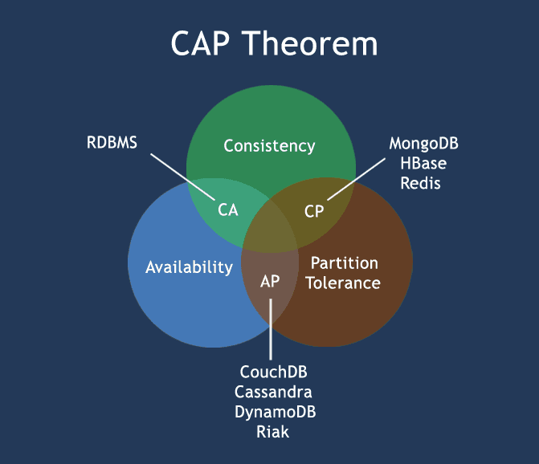
CAP and databases

Slide 15
Distributed Databases & ACID
Consistency in distributed relational databases is often done using 2-phase commit protocol (2PC) that is a type of Atomic Commitment Protocol (ACP) – discussed later
When sharding and replicating relational databases, ensuring consistency is costly since real-life distributed systems are unreliable
even worse, when network partitions
ACP are relatively easier to support in distributed systems

Slide 16
BASE antidote to ACID
Basically Available: indicates that the system does guarantee availability
Soft state indicates that the state of the system may change over time, even without input.
Eventual consistency indicates that the system will become consistent over time, when input ceases during that time.
Most NoSQL databases relax ACID and adopt BASE
What does this mean for a user?
Consistency has to be guaranteed by the developer.
NoSQL database guarantees consistency at the Aggregate level
See: https://dl.acm.org/doi/10.1145/1394127.1394128
Notes:
So, it is very important to remember that with NoSQL database it is possible to develop a system that supports ACID. However, it is developer’s job to do that

Slide 17
BASE – Key points
Optimistic (BASE) versus pessimistic (ACID)
database consistency will be in a state of flux
BASE supports partial failures versus total system failures
How to implement BASE –
From a business perspective identify where strict consistency could be relaxed

Slide 18
2-Phase Commit protocol (2PC)
An Atomic Commitment Protocol
Distributed Algorithm
Two Phases-
Coordinator sends out requests asking each database to indicate whether commit is possible. If all databases agree that the commit can proceed, then phase 2 begins.
Once phase 2 begins, a NO vote from a single node will eventually abort the transaction

Slide 19

2-Phase Commit protocol (2PC)
Phase I: Voting
1. VOTE_REQUEST
2. VOTE_COMMIT
Participant 1
DB Server 1
DB Server 2
Coordinator
Participant 2
Phase II: Commit
3. GLOBAL_COMMIT
DB Server 3
Participant 3
4. LOCAL_COMMIT

Slide 20
Map-Reduce
Designed to index the Internet, talk about it later
A way to organize processing in such a way as to take advantage of multiple machines on a cluster while keeping as much processing and the data it needs together on the same machine
Map – A function whose input is a single aggregate and whose output is a bunch of key value pairs. So, it has multiple outputs.
Reduce – Combine the key-value pairs. So, reduce operation takes multiple map outputs corresponding to one key uses those as its inputs and combines them to a single output.

Slide 21
Taxonomy of NoSQL (Not-only SQL) databases
Key-Value Stores
Lookup a single value for a key
Amazon’s DynamoDB
Document Stores
Access data by key or by search of “document” data.
MongoDB
CouchDB
Column Stores
Column-wise storage of tabular data
Google’s BigTable
Facebook’s Cassandra
Graph Stores
Native graph storage, efficient graph algorithms
Neo4j
Google’s Pregel

Slide 23
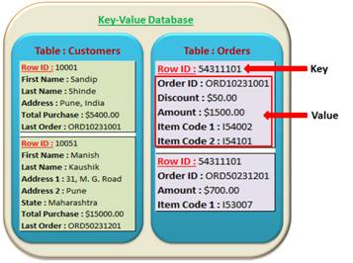
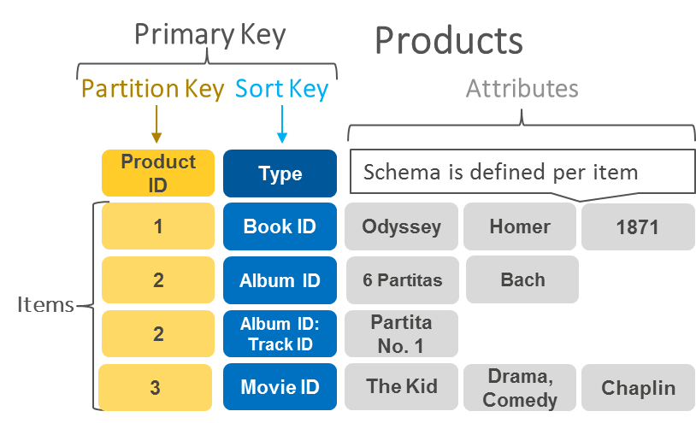
Key-Value Stores
DynamoDB Data Model
In this case, you can only access the whole aggregate
Mandatory
Key-value access pattern
Determines data distribution
Optional
Models 1:N relationships
Enables rich queries

Slide 24
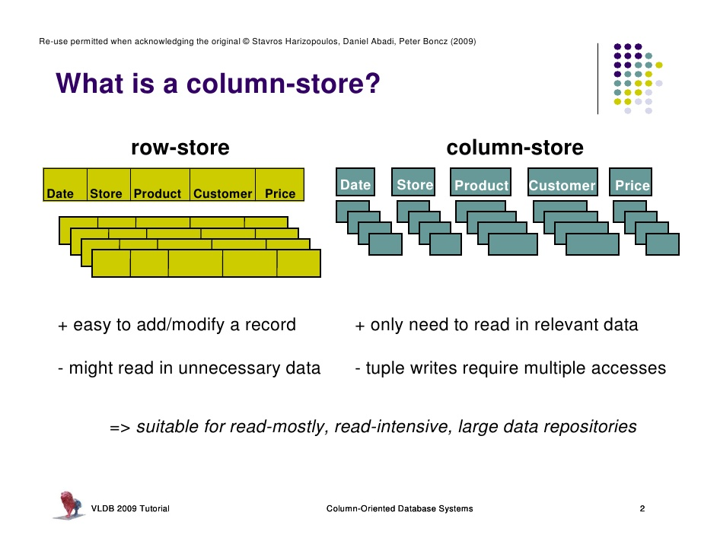
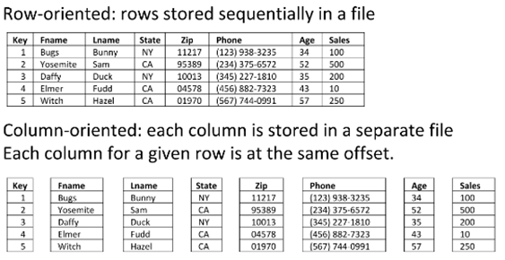
Column Stores

Slide 25
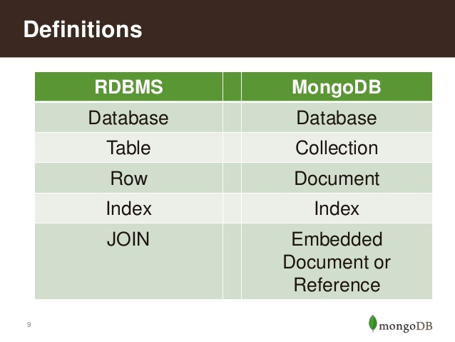
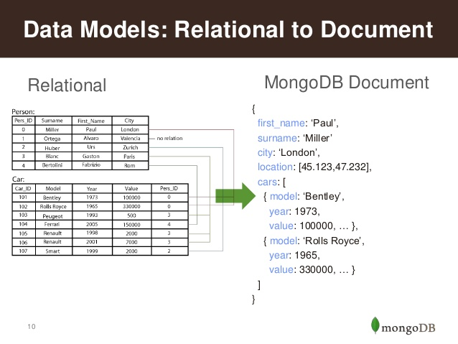
Document Stores
in JSON/BSON

Slide 26
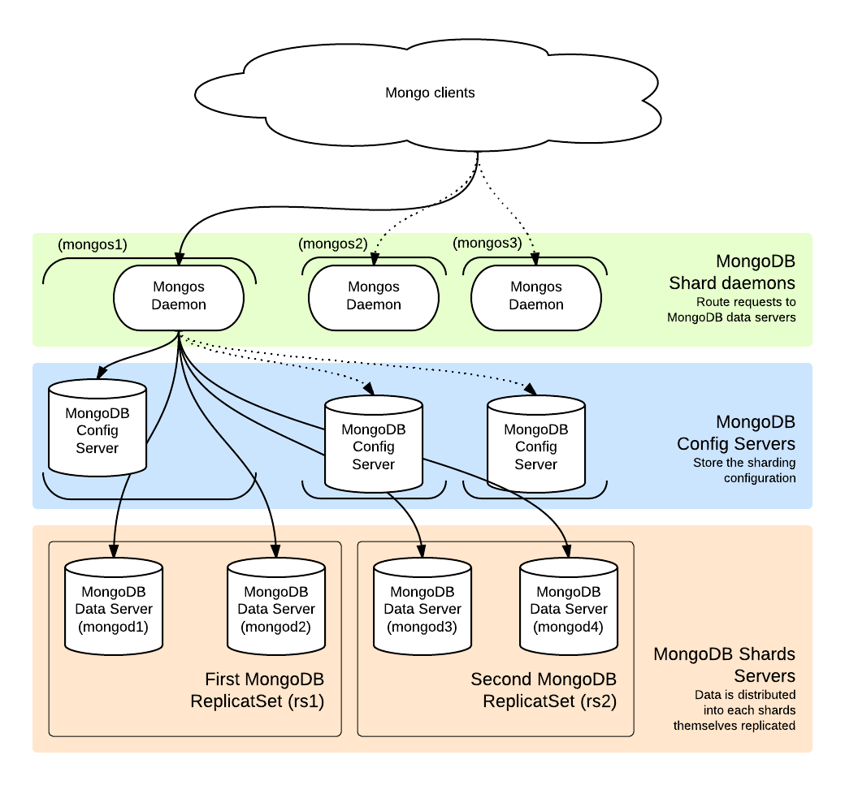
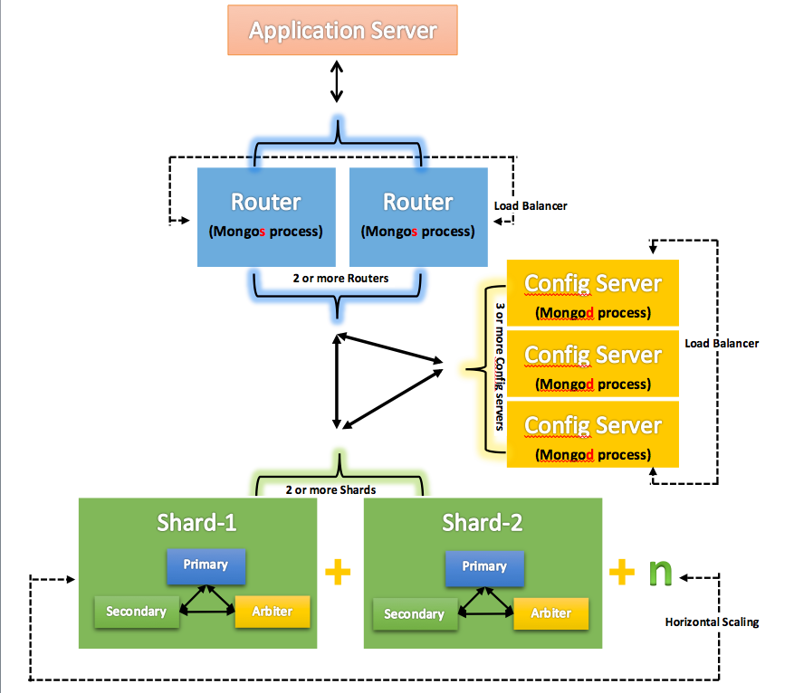
MongoDB Architecture

Slide 27
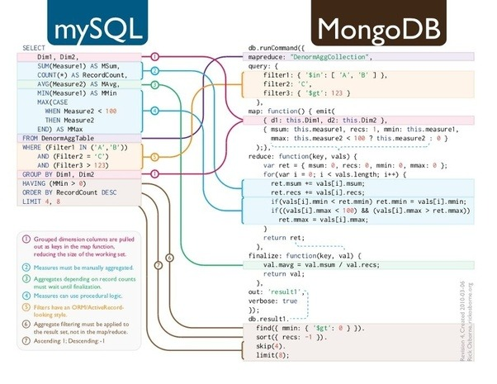
Queries

Slide 28
Graph Stores – neo4j
Graph Stores
vs

Slide 29
Prons/Cons of NoSQL
Advantages :
High elastic scalability
Lower cost
Schema flexibility, semi-structured data
Disadvantages
No standardization
Less mature
Limited query capabilities
Programming with eventual consistent is counter-intuitive

Slide 30


Slide 31
NewSQL
A DBMS that delivers the scalability and flexibility promised by NoSQL while retaining the support for SQL queries and/or ACID, or to improve performance for appropriate workloads.
NewSQL databases have
SQL as the primary interface.
ACID support for transactions
Non-locking concurrency control.
High per-node performance.
Parallel, shared-nothing architecture.
Matt Aslett – “How Will The Database Incumbents Respond To NoSQL And NewSQL?”
https://www.451research.com/report-short?entityId=66963
Properties | Traditional SQL | NoSQL | NewSQL
ACID | Y | N | Y
In-memory DB | N | Y | Y
Big Data | N | Y | Y
RDBMS | Y | N | Y
Michael Stonebraker- “New SQL: An Alternative to NoSQL and Old SQL for New OLTP Apps”
http://cacm.acm.org/blogs/blog-cacm/109710

