Slide 1
Discussion on Readings
Abhijit Dutt

Slide 2
NoSQL Overview paper
Not Only SQL
CAP Theorem
Key – Value database? Twitter??
Twitter-ID

Slide 3
Key-Value Database

Slide 5
Graph Databases
Graphs have unique properties

Slide 6
Document Database
Document-oriented model is used to store data as a record with its linked data as a single data structure called a document

Slide 7
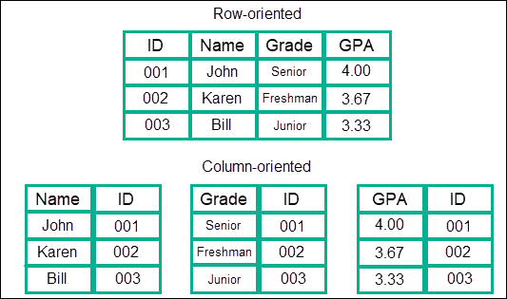
Column Database

Slide 8
BASE versus ACID
What did you get?
ACID focuses on consistency, BASE focuses on parallelizability (Partition tolerance) and availability
2PC (two-phase commit) for providing ACID guarantees across multiple database instances.
Functional partitioning
Consistency across functional groups is easier to relax than within functional groups. The example schema has two functional groups: users and transactions.

Slide 9
Document Database??
Flexible schema – allows data model to evolve (Very important)
Horizontal scaling
No Foreign Key

Slide 10
Graph database
It is not essential that relations are both ways
Very rich in relationship

Slide 11
Key Value Pair
Faster to access using hashing
Easy to manage

Slide 12
Column databases
Flexibility
Better for more reads and less write

Slide 13
CAP Theorem
The papers that I have asked you to read spans about 20 years
Four Papers-
Lessons from Giant-Scale Services (2001)
CAP Twelve Years Later: How the “Rules” Have Changed (Brewer, 2012)
Perspectives on the CAP Theorem (Gilbert Lynch, 2012)
Reflecting on CAP (Grier, 2020)
I wanted you to get some insights into the changes in environment

Slide 14
Lessons from Giant-Scale Services
Published in 2001
Importance of high availability
Some metrics – I do not expect that you would memorize those; however take a look at the approach
Replication versus partitioning

Slide 15
CAP Twelve Years Later: How the “Rules” Have Changed (Brewer, 2012)
2 of 3 is misleading
They are not binary
Availability is specifically on a continuum – 0 to 100%

Slide 16

Perspectives on the CAP Theorem (Gilbert Lynch, 2012)
Networking and Database (two perspectives)
Why is it important
In a network subject to communication failures, it is impossible for any Web service to implement an atomic read/write shared memory that guarantees a response to every request. (Page 31, first column near bottom).
The also agree with Brewer (2012) that it is more of a continuum
A social networking site might similarly try to partition its users to ensure high availability among groups of friends.

Slide 17
Reflecting on CAP (Grier, 2020)
Scenario in 1999
The network group assumed that partitions were likely and wanted to ensure that their systems were available in the presence of partitions.
By contrast, the database community discounted the possibility of partitions and designed systems that relied on full connectivity to provide consistency and availability.
The first approach Brewer called “AP” and the second “AC.” (Page 89, Column 1)
Eric Brewer’s influential Computer article encouraged designers to think on a broader scale.

