Slide 1
Map-Reduce

Slide 2
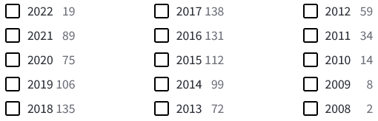
MapReduce
I did a search on MapReduce in the title in Web of Science. It returned 1093 articles.

Slide 3
MapReduce!
Introduced in 2004 (Key points from the paper)
It is a programming model
Allows processing of large data parallelly
The system takes care of the parallelization so that it “allows programmers without any experience with parallel and distributed systems to easily utilize the resources of a large distributed system”

Slide 4
MapReduce!
A programming model for processing data
Contains two phases!
Map
Perform a map function on key/value pairs
Reduce
Perform a reduce function on key/value groups
Groups are created by sorting map output
Operations on key/value pairs open the door for very parallelizable algorithms

Slide 5
Example – Log Files
Apr 15 23:27:14 hostname.local ./generate-log.sh[17580]: INFO: Login ...
Apr 15 23:27:14 hostname.local ./generate-log.sh[17580]: INFO: Login ...
Apr 15 23:27:15 hostname.local ./generate-log.sh[17580]: WARNING: Login failed...
Apr 15 23:27:16 hostname.local ./generate-log.sh[17580]: INFO: Login ...

Slide 6
Pseudo-Code
map( "Log Record" )
Parse Date and Time
Emit Date and Time as the key with a value of 1
(Apr 15 23:27:14, 1)
(Apr 15 23:27:14, 1)
(Apr 15 23:27:15, 1)
(Apr 15 23:27:16, 1)

Slide 7
Output from Map
(Apr 15 23:27:14, (1, 1))
(Apr 15 23:27:15, 1)
(Apr 15 23:27:16, 1)

Slide 8
Reduce
reduce( Key, Values )
sum = 0
for each Value:
sum = sum + value
emit (Key, sum)

Slide 9
Reduce Output
The reduce procedure will generate a single line with the key and sum for each key as follows:
Apr 15 23:27:14 2
Apr 15 23:27:15 1
Apr 15 23:27:16 1
...

Slide 10
Map-Reduce Example

Slide 11
Hadoop MapReduce
Automatic parallelization and distribution of tasks
Framework handles scheduling task and repeating failed tasks
Developer can code many pieces of the puzzle
Framework handles a Shuffle and Sort phases between map and reduce tasks.
Developer need only focus on the task at hand, rather than how to manage where data comes from and where it goes

Slide 12
MRv1 and MRv2
Both manage compute resources, jobs, and tasks
Job API similar
MRv1
JobTracker / TaskTrackers
MRv2 released on 2012
YARN (Yet Another Resource Negotiator) is a generic platform for developing distributed applications https://www.cloudera.com/documentation/enterprise/5-3-x/topics/cdh_ig_mapreduce_to_yarn_migrate.html#concept_sxx_1my_xl

Slide 13
MapReduce versus parallel databases
MapReduce provides fine-grain fault tolerance for large jobs; failure in the middle of a multi-hour execution does not require restarting the job from scratch

Slide 14
MapReduce
Two main components
JobTracker
TaskTracker

Slide 15
MRv1 - JobTracker
Monitors job and task progress
Issues task attempts to TaskTrackers
Re-tries failed task attempts
Four failed attempts of same task = one failed job
Default scheduler is FIFO order
CapacityScheduler or FairScheduler is preferred
Single point of failure for MapReduce

Slide 16
MRv1 – TaskTrackers
Runs on same node as DataNodes
Sends heartbeats and task reports to JT
Configurable number of map and reduce slots
Runs map and reduce task attempts in a separate JVM

Slide 17
How MapReduce Works
Client submits job to JobTracker
JobTracker submits
tasks to TaskTrackers
JobTracker reports metrics
Job output is written to
DataNodes w/replication
Notes:
Client submits a job to the JobTracker for processing
JobTracker uses the input of the job to determine where the blocks are located (through the NameNode), and then distributed task attempts to the task trackers
TaskTrackers coordinate the task attempts and data output is written back to the datanodes, which is distributed and replicated as normal HDFS operations
Job statistics – not output – is reported back to the client upon job completion

Slide 18
How MapReduce Works - Failure
JobTracker assigns task to different node
Notes:
Client submits a job to the JobTracker for processing
JobTracker uses the input of the job to determine where the blocks are located (through the NameNode), and then distributed task attempts to the task trackers
TaskTrackers coordinate the task attempts and data output is written back to the datanodes, which is distributed and replicated as normal HDFS operations
Job statistics – not output – is reported back to the client upon job completion

Slide 19
Map Input
Map Output
Reducer Input Groups
Reducer Output
Notes:
Uses key value pairs as input and output to both phases
Highly parallelizable paradigm – very easy choice for data processing on a Hadoop cluster
Why do we need Shuffle and Sort ? - Multiple reducers could work on that.

Slide 20
Example -- Word Count
Count the number of times each word is used in a body of text
Uses TextInputFormat and TextOutputFormat
map(byte_offset, line)
foreach word in line
emit(word, 1)
reduce(word, counts)
sum = 0
foreach count in counts
sum += count
emit(word, sum)

Slide 21
Mapper Code
public class WordMapper
extends Mapper<LongWritable, Text, Text, IntWritable> {
private final static IntWritable ONE = new IntWritable(1);
private Text word = new Text();
public void map(LongWritable key, Text value, Context context) {
String line = value.toString();
StringTokenizer tokenizer = new StringTokenizer(line);
while (tokenizer.hasMoreTokens()) {
word.set(tokenizer.nextToken());
context.write(word, ONE);
}
}
}

Slide 22
Shuffle and Sort
Mapper outputs
to a single
partitioned file
Reducers copy
their parts
Reducer
merges
partitions
Notes:
Mapper outputs data to a single file that is logically partitioned by key
Reducers copy their partition over to the local machine – “shuffle”
Each reducer then sorts their partitions into a single sorted local file for processing

Slide 23
Reducer Code
public class IntSumReducer
extends Reducer<Text, IntWritable, Text, IntWritable> {
public void reduce(Text key, Iterable<IntWritable> values,
Context context) {
int sum = 0;
for (IntWritable val : values) {
sum += val.get();
}
context.write(key, new IntWritable(sum));
}
}

Slide 24
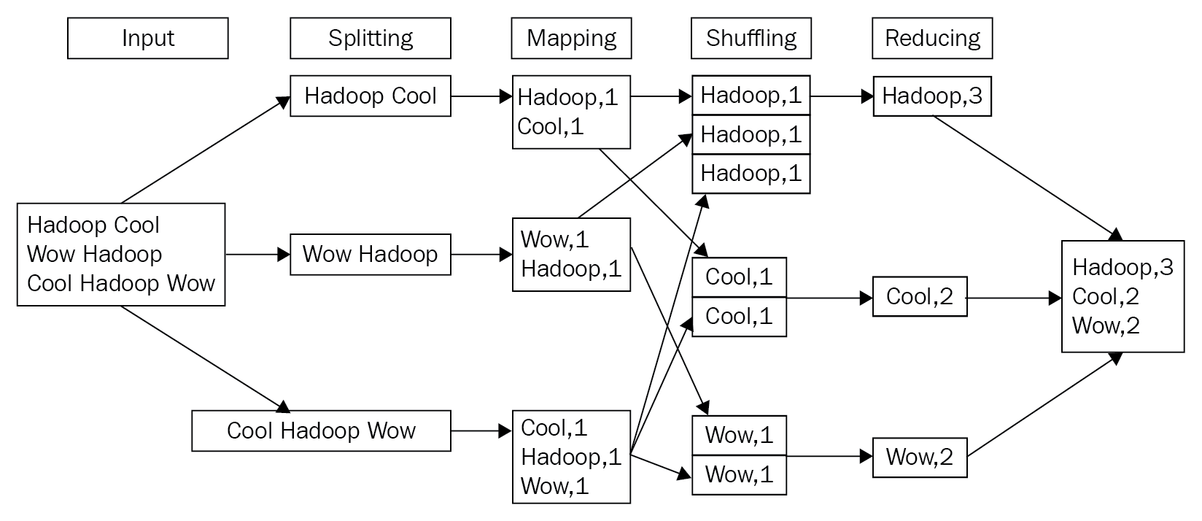

Slide 25
MRv2
Split into two components
Cluster resource management & MapReduce
JobTracker has been split into three components
NodeManager

Slide 26
