Slide 1
Introduction to Spark
Abhijit Dutt

Slide 2
Apache Spark
“ Unified analytics engine for big data processing, with built-in modules for streaming, SQL, machine learning and graph processing”
Research project at UC Berkeley in 2009
APIs: Scala, Java, Python, R, and SQL
Built by more than 1,200 developers from more than 200 companies

Slide 3
Spark History
Research project at the University of California, Berkeley, AMPLab in 2009
Their goal was to reduce inefficiencies in Hadoop MapReduce framework
In 2014, Daytona GraySort contest, Databricks claimed Spark could sort 100 TB of data three times faster using ten times fewer resources than the previous world record set by Hadoop MapReduce
MapReduce is specifically deficient in the following areas-
Iterative jobs - Many machine learning algorithms apply a function repeatedly to the same dataset to optimize a parameter (e.g., through gradient descent). Needs reloading of data from disk.
Interactive analytics - each query incurs significant latency (tens of seconds) because it runs as a separate MapReduce job and reads data from disk

Slide 4
Spark Core Concepts and Architecture
Spark clusters and
https://spark.apache.org/faq.html
Resource management system
cluster manager and worker
The master knows where the slaves are located, how much memory, and the number of CPU cores each one has. One of the main responsibilities of the cluster manager is to orchestrate work by assigning work to workers.
Each worker offers resources (memory, CPU, etc.) to the cluster manager and performs the assigned work. An example of this type of work is to launch a particular process and monitor its health.

Slide 5
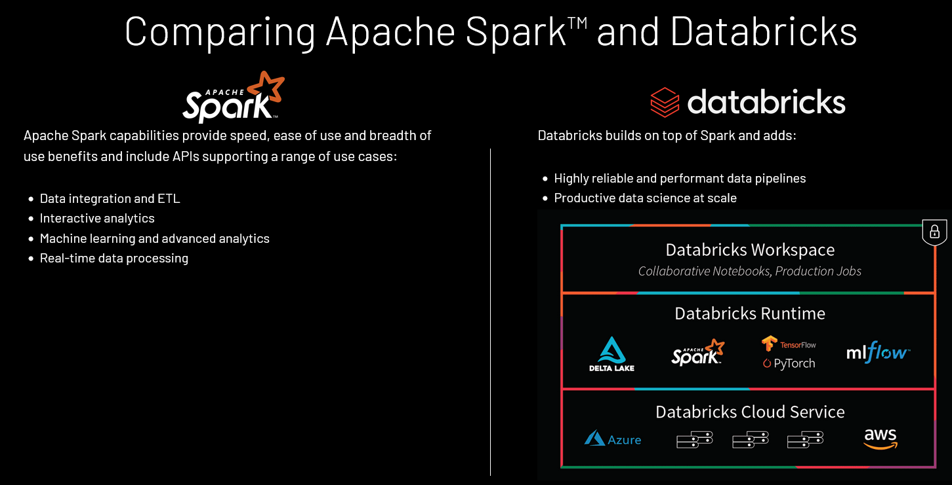

Slide 6
Spark Core Concepts and Architecture
Spark applications
Data processing logic using Spark APIs,
Spark drivers
A Spark driver is effectively the central coordinator of a Spark application to interact with a cluster manager to figure out which machines to run the data processing logic. For each of those machines, a driver requests a cluster manager to launch a process known as an executor
Spark executors

Slide 8
Spark & Databricks
https://databricks.com/resources
https://databricks.com/spark/comparing-databricks-to-apache-spark
https://databricks.com/product/data-lakehouse
https://databricks.com/spark/getting-started-with-apache-spark

Slide 9
Apache Spark components and API stack

Slide 10
Apache Spark components and architecture

Slide 11
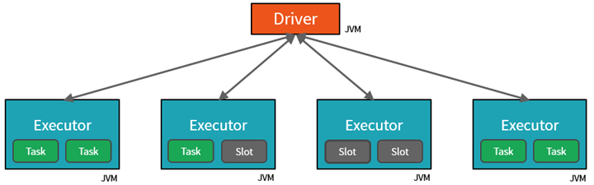
Spark Cluster
One Driver and many Executor JVMs

Slide 12
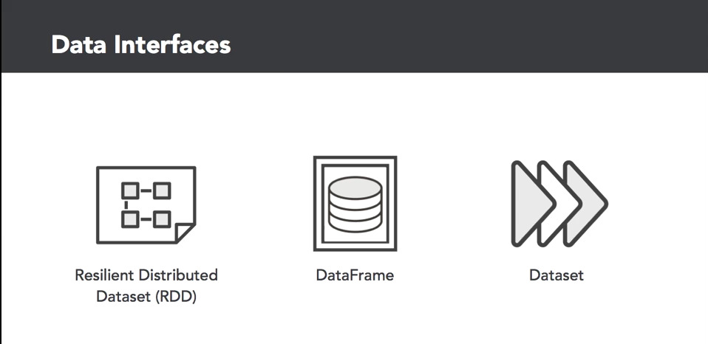

Slide 13
Structured APIs in Apache Spark

Slide 14
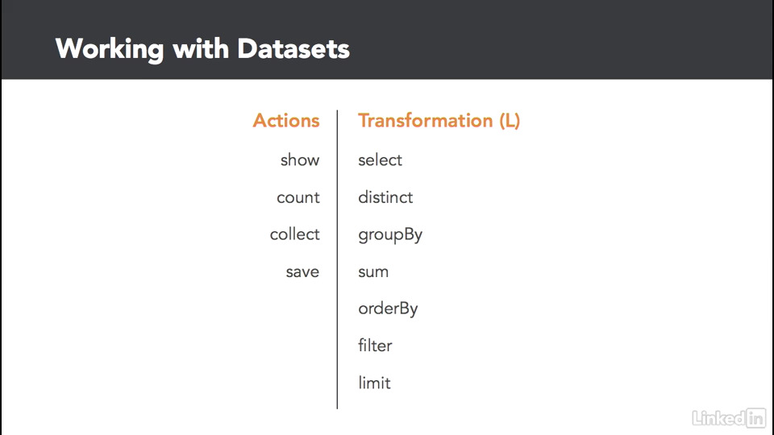

Slide 15
SparkContext
First thing that a Spark program does is create a SparkContext object, which tells Spark how to access a cluster
In the shell for either Scala or Python, this is the sc variable, which is created automatically
Other programs must use a constructor to instantiate a new SparkContext
Then in turn SparkContext gets used to create other variables
Example:
data = sc.textFile(path) # use the sc context to read in a text file

Slide 16
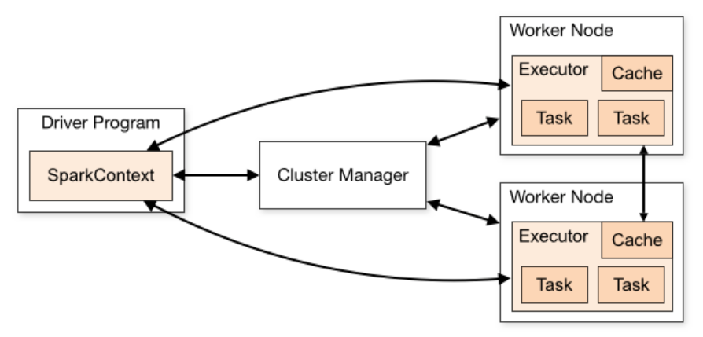
Spark Essentials: Master
http://spark.apache.org/docs/latest/cluster-overview.html

Slide 17


Spark Essentials: Master
connects to a cluster manager which allocate resources across applications
acquires executors on cluster nodes – worker processes to run computations and store data
sends app code to the executors
sends tasks for the executors to run
Worker Node
Exectuor
cache
task
task
Driver Program
Cluster Manager
SparkContext
Worker Node
Exectuor
cache
task
task

Slide 18
Cluster Manager Types
Standalone – a simple cluster manager included with Spark that makes it easy to set up a cluster.
Apache Mesos – a general cluster manager that can also run Hadoop MapReduce and service applications. (Deprecated)
Hadoop YARN – the resource manager in Hadoop 2.
Kubernetes – an open-source system for automating deployment, scaling, and management of containerized applications.

Slide 19
Resilient (Fault Tolerant) Distributed (Computed across multiple nodes) Datasets (Collection of partitioned data) RDD--- the primary abstraction in Spark – a fault-tolerant collection of elements that can be operated on in parallel
Spark Essentials: RDD
Immutable once constructed
Track lineage information
Operations on collection of elements in parallel

Slide 20




Spark Essentials: RDD
Spark can create RDDs from any file stored in HDFS or other storage systems supported by Hadoop, e.g., local file system, Amazon S3, Hypertable, HBase, etc.
Spark supports text files, SequenceFiles, and any other Hadoop InputFormat, and can also take a directory or a glob (e.g. /data/201404*)
RDD
RDD
RDD
RDD
transformations
action
value

Slide 21
Spark Essentials: RDD
two types of operations on RDDs: transformations and actions
transformations are lazy (not computed immediately)
the transformed RDD gets recomputed when an action is run on it (default)
So a user creates a RDD by transformations operation
however, an RDD can be persisted into storage in memory or disk
RDDs are ephemeral

Slide 22
Spark Essentials: RDD
Scala:
scala> val data = Array(1, 2, 3, 4, 5)
data: Array[Int] = Array(1, 2, 3, 4, 5)
scala> val distData = sc.parallelize(data)
distData: spark.RDD[Int] = spark.ParallelCollection@10d13e3e
Python:
>>> data = [1, 2, 3, 4, 5]
>>> data
[1, 2, 3, 4, 5]
>>> distData = sc.parallelize(data)
>>> distData
ParallelCollectionRDD[0] at parallelize at PythonRDD.scala:229

Slide 23
Spark Essentials: RDD
Scala:
scala> val distFile = sc.textFile("README.md") distFile: spark.RDD[String] = spark.HadoopRDD@1d4cee08
Python:
>>> distFile = sc.textFile("README.md")
14/04/19 23:42:40 INFO storage.MemoryStore: ensureFreeSpace(36827) with curMem=0, maxMem=318111744
called
14/04/19 23:42:40 INFO storage.MemoryStore: Block broadcast_0 stored as values to memory (estimated size 36.0 KB, free 303.3 MB)
>>> distFile
MappedRDD[2] at textFile at NativeMethodAccessorImpl.java:-2

Slide 24
Spark Essentials: Transformations
Transformations create a new dataset from an existing one
All transformations in Spark are lazy: they do not compute their results right away – instead they remember the transformations applied to some base dataset
optimize the required calculations
recover from lost data partitions

Slide 25
Spark Essentials: Transformations
transformation | description
map(func) | return a new distributed dataset formed by passing each element of the source through a function func
filter(func) | return a new dataset formed by selecting those elements of the source on which func returns true
flatMap(func) | similar to map, but each input item can be mapped to 0 or more output items (so func should return a Seq rather than a single item)
sample(withReplacement, fraction, seed) | sample a fraction fraction of the data, with or without replacement, using a given random number generator seed
union(otherDataset) | return a new dataset that contains the union of the elements in the source dataset and the argument
distinct([numTasks])) | return a new dataset that contains the distinct elements of the source dataset

Slide 26
Spark Essentials: Transformations
transformation | description
groupByKey([numTasks]) | when called on a dataset of (K, V) pairs, returns a dataset of (K, Seq[V]) pairs
reduceByKey(func,[numTasks]) | when called on a dataset of (K, V) pairs, returns a dataset of (K, V) pairs where the values for each key are aggregated using the given reduce function
sortByKey([ascending], [numTasks]) | when called on a dataset of (K, V) pairs where K implements Ordered, returns a dataset of (K, V) pairs sorted by keys in ascending or descending order, as specified in the boolean ascending argument
join(otherDataset, [numTasks]) | when called on datasets of type (K, V) and (K, W), returns a dataset of (K, (V, W)) pairs with all pairs of elements for each key
cogroup(otherDataset, [numTasks]) | when called on datasets of type (K, V) and (K, W), returns a dataset of (K, Seq[V], Seq[W]) tuples – also called groupWith
cartesian(otherDataset) | when called on datasets of types T and U, returns a dataset of (T, U) pairs (all pairs of elements)

Slide 27
Scala:
Spark Essentials: Transformations
val distFile = sc.textFile("README.md") distFile.map(l => l.split(" ")).collect()
distFile is a collection of lines
distFile.flatMap(l => l.split(" ")).collect()
Python:
distFile = sc.textFile("README.md") distFile.map(lambda x: x.split(' ')).collect() distFile.flatMap(lambda x: x.split(' ')).collect()

Slide 28
Scala:
Spark Essentials: Transformations
val distFile = sc.textFile("README.md") distFile.map(l => l.split(" ")).collect() distFile.flatMap(l => l.split(" ")).collect()
closures
Python:
distFile = sc.textFile("README.md") distFile.map(lambda x: x.split(' ')).collect() distFile.flatMap(lambda x: x.split(' ')).collect()

Slide 29
Scala:
Spark Essentials: Transformations
val distFile = sc.textFile("README.md") distFile.map(l => l.split(" ")).collect() distFile.flatMap(l => l.split(" ")).collect()
closures
Python:
distFile = sc.textFile("README.md") distFile.map(lambda x: x.split(' ')).collect() distFile.flatMap(lambda x: x.split(' ')).collect()
looking at the output, how would you compare results for map() vs. flatMap() ?

Slide 30
Spark Essentials: Actions
action | description
reduce(func) | aggregate the elements of the dataset using a function func (which takes two arguments and returns one), and should also be commutative and associative so that it can be computed correctly in parallel
collect() | return all the elements of the dataset as an array at the driver program – usually useful after a filter or other operation that returns a sufficiently small subset of the data
count() | return the number of elements in the dataset
first() | return the first element of the dataset – similar to take(1)
take(n) | return an array with the first n elements of the dataset – currently not executed in parallel, instead the driver program computes all the elements
takeSample(withReplacement, fraction, seed) | return an array with a random sample of num elements of the dataset, with or without replacement, using the given random number generator seed

Slide 31
Spark Essentials: Actions
action | description
saveAsTextFile(path) | write the elements of the dataset as a text file (or set of text files) in a given directory in the local filesystem, HDFS or any other Hadoop-supported file system. Spark will call toString on each element to convert it to a line of text in the file
saveAsSequenceFile(path) | write the elements of the dataset as a Hadoop SequenceFile in a given path in the local filesystem, HDFS or any other Hadoop-supported file system. Only available on RDDs of key-value pairs that either implement Hadoop's Writable interface or are implicitly convertible to Writable (Spark includes conversions for basic types like Int, Double, String, etc).
countByKey() | only available on RDDs of type (K, V). Returns a `Map` of (K, Int) pairs with the count of each key
foreach(func) | run a function func on each element of the dataset – usually done for side effects such as updating an accumulator variable or interacting with external storage systems

Slide 32
Spark Essentials: Actions
Scala:
val f = sc.textFile("README.md")
val words = f.flatMap(l => l.split(" ")).map(word words.reduceByKey(_ + _).collect.foreach(println)
=> (word, 1))
Python:
from operator import add
f = sc.textFile("README.md")
words = f.flatMap(lambda x: x.split(' ')).map(lambda words.reduceByKey(add).collect()
x: (x, 1))

Slide 33
Spark Essentials: Persistence
Spark can persist (or cache) a dataset in memory across operations
Each node stores in memory any slices of it that it computes and reuses them in other actions on that dataset – often making future actions more than 10x faster
The cache is fault-tolerant: if any partition of an RDD is lost, it will automatically be recomputed using the transformations that originally created it

Slide 34
Spark Essentials: Persistence
transformation | description
MEMORY_ONLY | Store RDD as deserialized Java objects in the JVM. If the RDD does not fit in memory, some partitions will not be cached and will be recomputed on the fly each time they're needed.This is the default level.
MEMORY_AND_DISK | Store RDD as deserialized Java objects in the JVM. If the RDD does not fit in memory, store the partitions that don't fit on disk, and read them from there when they're needed.
MEMORY_ONLY_SER | Store RDD as serialized Java objects (one byte array per partition).This is generally more space-efficient than deserialized objects, especially when using a fast serializer, but more CPU-intensive to read.
MEMORY_AND_DISK_SER | Similar to MEMORY_ONLY_SER, but spill partitions that don't fit in memory to disk instead of recomputing them on the fly each time they're needed.
DISK_ONLY | Store the RDD partitions only on disk.
MEMORY_ONLY_2, MEMORY_AND_DISK_2, etc | Same as the levels above, but replicate each partition on two cluster nodes.

Slide 35
Spark Essentials: Persistence
Scala:
val f = sc.textFile("README.md")
val w = f.flatMap(l => l.split(" ")).map(word w.reduceByKey(_ + _).collect.foreach(println)
=> (word, 1)).cache()
Python:
from operator import add
f = sc.textFile("README.md")
w = f.flatMap(lambda x: x.split(' ')).map(lambda w.reduceByKey(add).collect()
x: (x, 1)).cache()

Slide 36
Spark Essentials: Broadcast Variables
Broadcast variables let programmer keep a read-only variable cached on each machine rather than shipping a copy of it with tasks
For example, to give every node a copy of a large input dataset efficiently
Spark also attempts to distribute broadcast variables using efficient broadcast algorithms to reduce communication cost

Slide 37
Spark Essentials: Broadcast Variables
Scala:
val broadcastVar = sc.broadcast(Array(1, broadcastVar.value
2, 3))
Python:
broadcastVar = sc.broadcast(list(range(1, broadcastVar.value
4)))

Slide 38
Spark Essentials: Accumulators
Accumulators are variables that can only be “added” to through an associative operation
Used to implement counters and sums, efficiently in parallel
Spark natively supports accumulators of numeric value types and standard mutable collections, and programmers can extend for new types
Only the driver program can read an accumulator’s value, not the tasks

Slide 39
Spark Essentials: Accumulators
Scala:
val accum = sc.accumulator(0) sc.parallelize(Array(1, 2, 3,
4)).foreach(x => accum += x)
accum.value
Python:
accum = sc.accumulator(0)
rdd = sc.parallelize([1, 2, 3, 4])
def f(x):
global accum accum += x
rdd.foreach(f) accum.value

Slide 40
Scala:
Spark Essentials: Accumulators
val accum = sc.accumulator(0) sc.parallelize(Array(1, 2, 3,
4)).foreach(x => accum += x)
accum.value
driver-side
Python:
accum = sc.accumulator(0)
rdd = sc.parallelize([1, 2, 3, 4])
def f(x):
global accum accum += x
rdd.foreach(f) accum.value

Slide 41
Spark Essentials: (K,V) pairs
Scala:
val pair = (a, b)
pair._1 // => a
pair._2 // => b
Python:
pair = (a, b)
pair[0] # => a
pair[1] # => b
Java:
Tuple2 pair = new Tuple2(a, b);
pair._1 | // => | a
pair._2 | // => | b

Slide 42
Spark - Advanced
%fs
%scala
%python
%sh

Slide 43
Streaming
https://databricks.com/spark/getting-started-with-apache-spark/streaming
How to compute a result continuously while data is being added

