Slide 1
Sampling

Slide 2
Sampling
Sampling: obtaining a small sample (subset of the population) s to represent the whole data set (also known as population) N
Allow a mining algorithm to run in complexity that is potentially sub-linear to the size of the data
Key principle: Choose a representative subset of the data
Simple random sampling may have very poor performance in the presence of skew
Develop adaptive sampling methods, e.g., stratified sampling:

Slide 3
Why Sampling?
It is not possible to study the whole population
Proper sampling methods provide good estimates
Sampling could be either from a finite population or an infinite population
However, if possible studying whole population will always give you the best results

Slide 4
Types of Sampling
Simple random sampling
There is an equal probability of selecting any particular item
Sampling without replacement
Once an object is selected, it is removed from the population
Sampling with replacement
A selected object is not removed from the population
Stratified sampling:
Partition the data set, and draw samples from each partition (proportionally, i.e., approximately the same percentage of the data)
Used in conjunction with skewed data

Slide 5
Sampling: With or without Replacement
SRSWOR
(simple random
sample without
replacement)
SRSWR
Raw Data

Slide 6
Sampling: Cluster or Stratified Sampling
Raw Data
Cluster/Stratified Sample

Slide 7
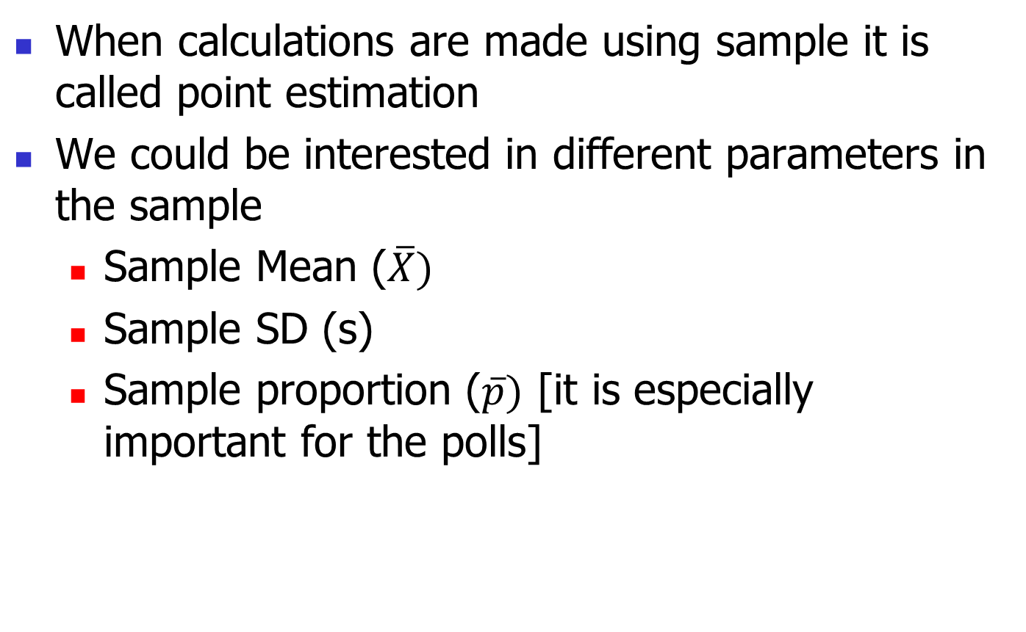
Point Estimation
When calculations are made using sample it is called point estimation
We could be interested in different parameters in the sample
Sample Mean ($\overline{X})$
Sample SD (s)
Sample proportion ($\overline{p})$ [it is especially important for the polls]

Slide 8
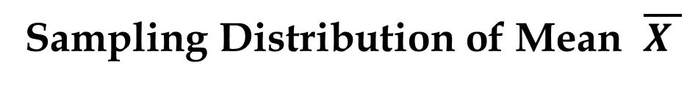
Sampling Distribution of Mean $\overline{X }$
Process of Statistical Inference
Population
with mean
μ = ?
A simple random sample
of n elements is selected
from the population.
The value of is used to
make inferences about
the value of μ.
The sample data
provide a value for
the sample mean .

Slide 9
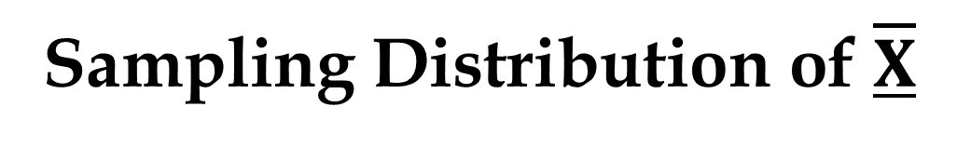
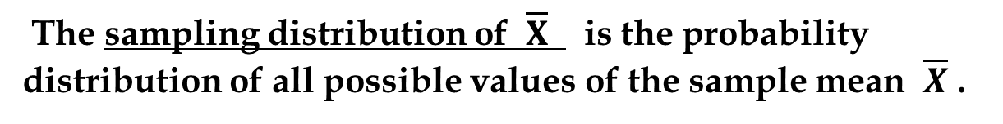
Sampling Distribution of $\overline{X}$
The sampling distribution of $\overline{X}$ is the probability distribution of all possible values of the sample mean $\overline{X}$ .
Expected Value of
E( ) = μ
where: μ = the population mean
When the expected value of the point estimator
equals the population parameter, we say the point
estimator is unbiased.

Slide 10
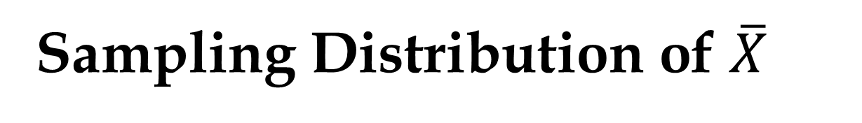
Sampling Distribution of $\overline{X}$
Standard Deviation of
We will use the following notation to define the
standard deviation of the sampling distribution of .
σ = the standard deviation of
= the standard deviation of the population
s = the standard deviation of the sample
n = the sample size
N = the population size

Slide 11
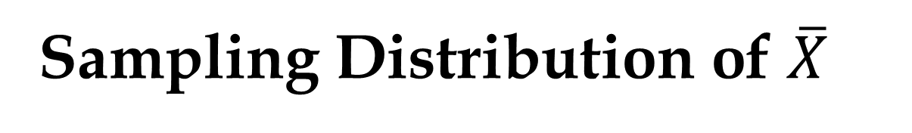
Sampling Distribution of $\overline{X}$
Standard Deviation of
Finite Population
Infinite Population
A finite population is treated as being
infinite if n/N < .05.
is the finite population
correction factor.
is referred to as the standard error of the
mean.

Slide 12
An Example
Let us that you had chosen a sample size of 100. You calculated mean 10.3 and standard deviation 2.5.
Using the assumption that the point estimator follows normal distribution with mean 10.3 and standard error 2.5/10, we can deduce that 95% of the time the actual mean will be between 10.3+1.96*.25 and 10.3 – 1.96*.25. So, it will be between 10.79 & 9.81.

Slide 13
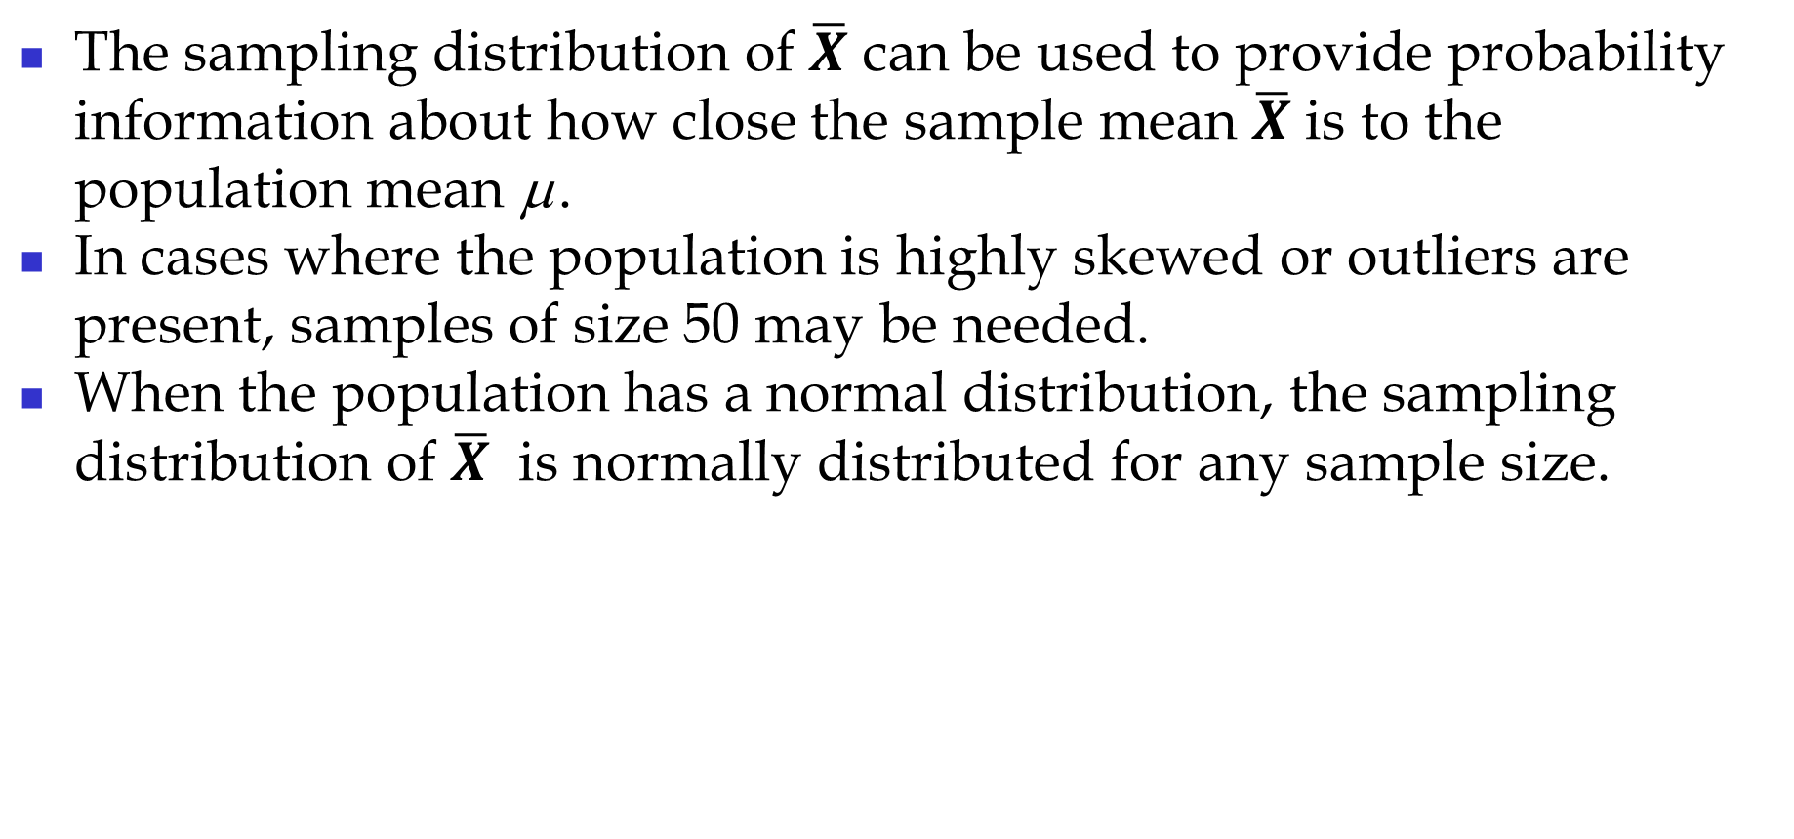

Sampling Distribution of $\overline{X}$
The sampling distribution of $\overline{X}$ can be used to provide probability information about how close the sample mean $\overline{X}$ is to the population mean μ .
In cases where the population is highly skewed or outliers are present, samples of size 50 may be needed.
When the population has a normal distribution, the sampling distribution of $\overline{X}$ is normally distributed for any sample size.

Slide 14
Central Limit Theorem
The sample average (which is a random variable) has a CDF converging to the CDF of a Gaussian.
Therefore, if we want to evaluate probabilities associated with the sample average, we can approximate the probability by the probability of a Gaussian.
In many scenarios, people make a mistake that PDF of sample average is same as pdf of a Normal distribution – it is not so.

Slide 15
Central Limit Theorem
When the population from which we are selecting a random sample does not have a normal distribution, the central limit theorem is helpful in identifying the shape of the sampling distribution of
In selecting random samples of size n from a population, the sampling distribution of the sample mean can be approximated by a normal distribution as the sample size becomes large.

Slide 16
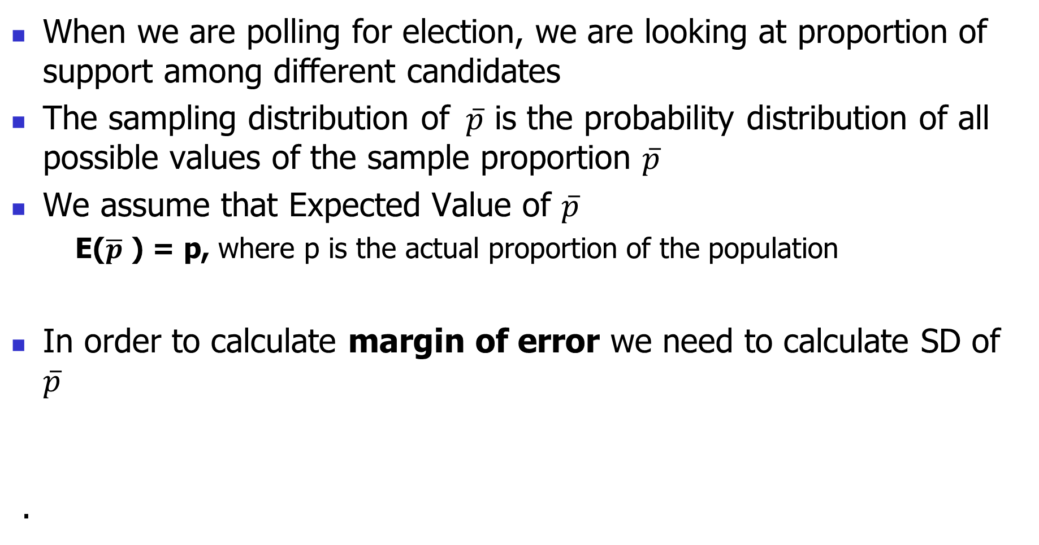
Sample Distribution of proportion 𝑝 ̅
When we are polling for election, we are looking at proportion of support among different candidates
The sampling distribution of $\overline{p}$ is the probability distribution of all possible values of the sample proportion $\overline{p}$
We assume that Expected Value of $\overline{p}$
E($\overline{p}$ ) = p, where p is the actual proportion of the population
In order to calculate margin of error we need to calculate SD of $\overline{p}$
.

Slide 17
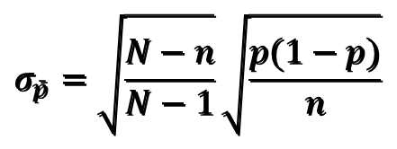

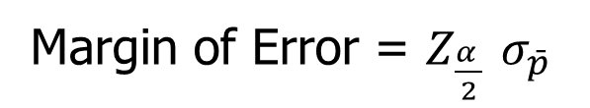
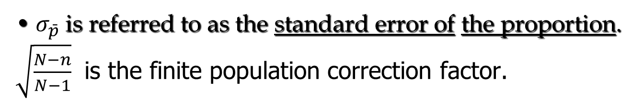
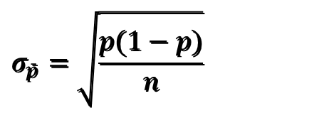
Sample Distribution of $\overline{p}$ and Margin of Error
Finite Population
Infinite Population
$$σ_{\bar{p}}=\sqrt{\frac{N−n}{N−1}}\sqrt{\frac{p(1−p)}{n}}$$
$$σ_{\bar{p}}=\sqrt{\frac{p(1−p)}{n}}$$
$σ_{\bar{p}}$is referred to as the standard error of the proportion.
$\sqrt{\frac{N−n}{N−1}}$ is the finite population correction factor.
Margin of Error = $Z_{\frac{α }{2}}$ $σ_{\bar{p}}$

Slide 18
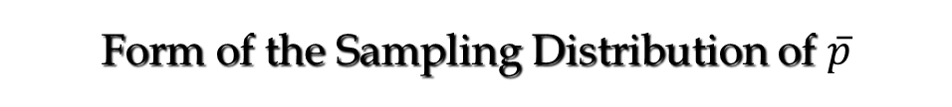
Form of the Sampling Distribution of $\overline{p}$
The sampling distribution of can be approximated
by a normal distribution whenever the sample size
is large enough to satisfy the two conditions:
. . . because when these conditions are satisfied, the
probability distribution of x in the sample proportion,
= x/n, can be approximated by normal distribution
(and because n is a constant).
np > 5
and
n(1 – p) > 5

