Slide 1
Multiple Regression
Abhijit Dutt

Slide 2
Multiple Regression Model
Multiple Regression Model describes how the dependent variable y is related to the independent variables x₁, x₂, . . . x_{p} and an error term is:
y = β₀ + β₁x₁ + β₂x₂ + . . . + β_{p}x_{p} + ε
where:
β_{0,} β₁, . . . β_{p} are the parameters, and ε is a random variable called the error term
Note: Dependent (Response) and Independent (Predictor) variables

Slide 3
Multiple Regression Equation
E(y) = β₀ + β₁x₁ + β₂x₂ + . . . + β_{p}x_{p}
If we know β_{0,} β₁, . . . β_{p,}
given x_{1,} x₂, . . . x_{p} we can calculate E (y)

Slide 4
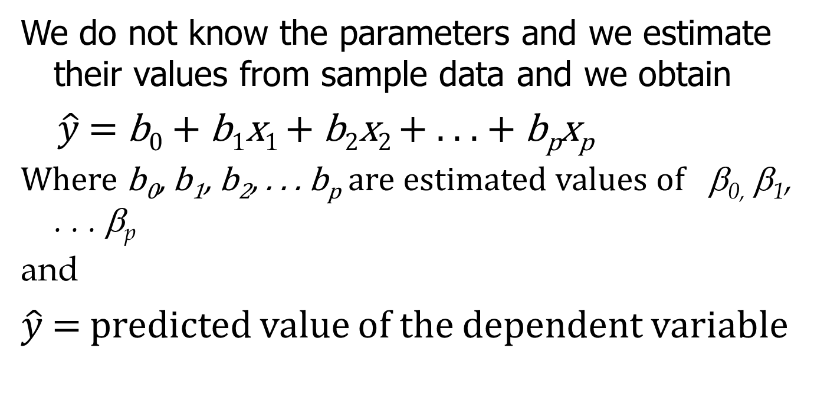
Estimated Multiple Regression Equation
We do not know the parameters and we estimate their values from sample data and we obtain
$\hat{y}$= b₀ + b₁x₁ + b₂x₂ + . . . + b_{p}x_{p}
Where b₀, b₁, b₂, . . . b_{p} are estimated values of β_{0,} β₁, . . . β_{p}
and
$\hat{y}$= predicted value of the dependent variable

Slide 5
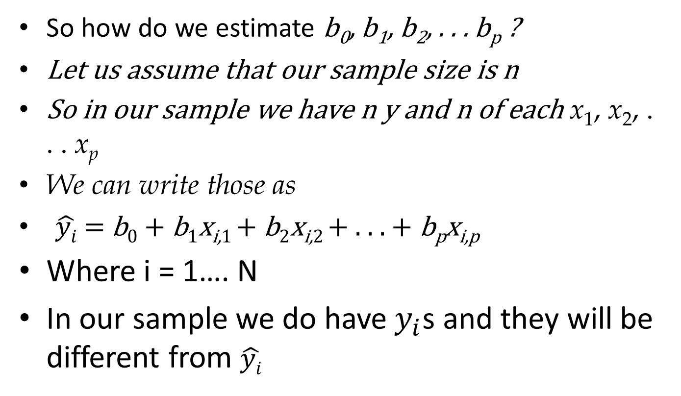
Fitting
So how do we estimate b₀, b₁, b₂, . . . b_{p} ?
Let us assume that our sample size is n
So in our sample we have n y and n of each x₁, x₂, . . . x_{p}
We can write those as
$\hat{yi}$= b₀ + b₁x_{i,1} + b₂x_{i,2} + . . . + b_{p}x_{i,p}
Where i = 1…. N
In our sample we do have $y_{i}$s and they will be different from $\hat{yi}$

Slide 6
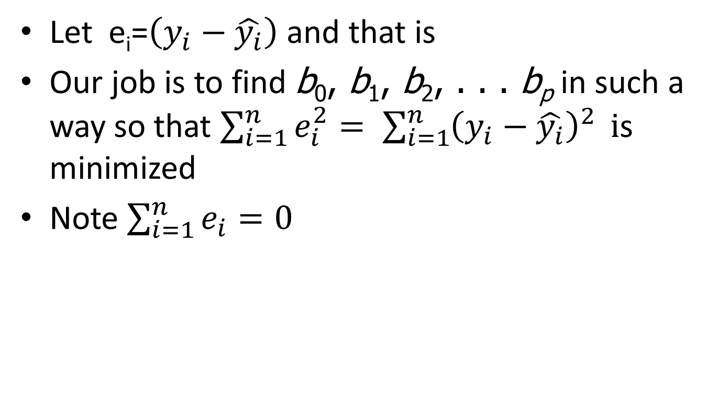
Least Squares Method
Let e_{i}=$\left(y_{i}−\hat{y_{i}}\right)$ and that is
Our job is to find b₀, b₁, b₂, . . . b_{p} in such a way so that $\sum_{i=1}^{n}{e_{i}^{2}}= \sum_{i=1}^{n}{{\left(y_{i}−\hat{y_{i}}\right)}^{2}} i$s minimized
Note $\sum_{i=1}^{n}{e_{i}=0}$

Slide 7
Computation of Coefficient Values
The formulas for the regression coefficients
b₀, b₁, b₂, . . . b_{p} involve the use of matrix algebra.
We will rely on computer software packages such as R to perform the calculations.
The emphasis will be on how to interpret the computer output.

Slide 8
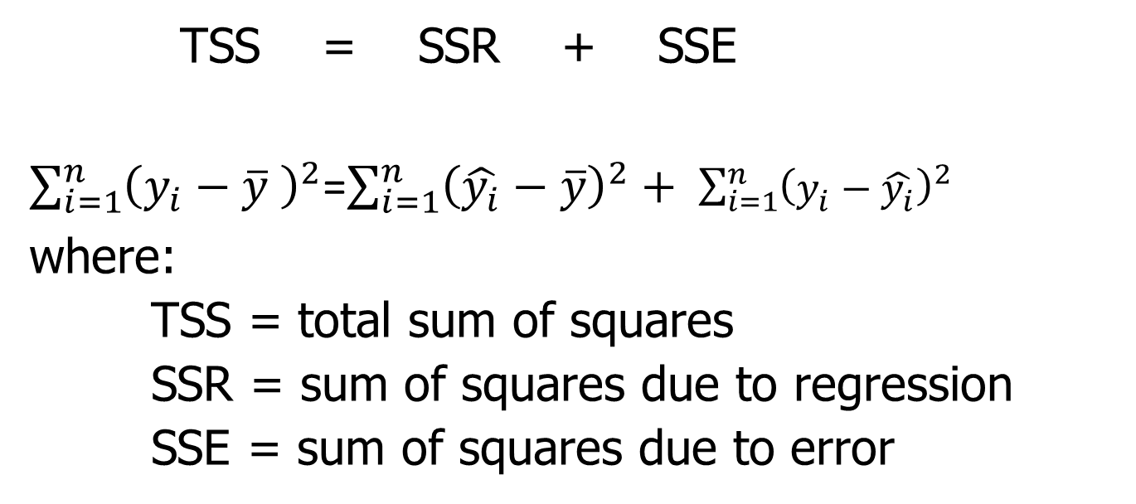
Multiple Coefficient of Determination
TSS = SSR + SSE
$\sum_{i=1}^{n}{{\left(y_{i}−\overline{y} \right)}^{2}}$=$\sum_{i=1}^{n}{{\left(\hat{y_{i}}−\overline{y}\right)}^{2}}+ \sum_{i=1}^{n}{{\left(y_{i}−\hat{y_{i}}\right)}^{2}}$
where:
TSS = total sum of squares
SSR = sum of squares due to regression
SSE = sum of squares due to error
R² = SSR/TSS

Slide 9
Adjusted Multiple Coefficient of Determination
Adding independent variables, even ones that are not statistically significant, causes the prediction errors to become smaller, thus reducing the sum of squares due to error, SSE.
Because SSR = TSS – SSE, when SSE becomes smaller, SSR becomes larger, causing R² = SSR/TSS to increase.
The adjusted multiple coefficient of determination compensates for the number of independent variables in the model.

Slide 10
Assumptions About the Error Term
The error ε is a random variable with mean of zero.
The variance of ε , denoted by σ ², is the same for all
values of the independent variables.
The values of ε are independent.
The error ε is a normally distributed random variable
reflecting the deviation between the y value and the
expected value of y given by β₀ + β₁x₁ + β₂x₂ + . . + β_{p}x_{p}.

Slide 11
Testing for Significance
In simple linear regression, the F and t tests provide
the same conclusion.
In multiple regression, the F and t tests have different
purposes.

Slide 12
Testing for Significance: F Test
The F test is used to determine whether a significant
relationship exists between the dependent variable
and at least one of the independent variables.
The F test is referred to as the test for overall
significance.

Slide 13
Testing for Significance: t Test
If the F test shows an overall significance, the t test is
used to determine whether each of the individual
independent variables is significant.
A separate t test is conducted for each of the
independent variables in the model.
We refer to each of these t tests as a test for individual
significance.

Slide 14
Testing for Significance: F Test
Hypotheses
H₀: β₁ = β₂ = . . . = β_{p} = 0
H_{a}: One or more of the parameters
is not equal to zero.
Test Statistic
F = MSR/MSE
Rejection Rule
Reject H₀ if p-value < α or if F > F_{α} ,
where F_{α} is based on an F distribution
with p d.f. in the numerator and
n - p - 1 d.f. in the denominator.

Slide 15
F Test for Overall Significance
Hypotheses
H₀: β₁ = β₂ = 0
H_{a}: One or both of the parameters
is not equal to zero.
For α = .05 and d.f. = 2, 17; F_{.05} = 3.59
Reject H₀ if p-value < .05 or F > 3.59
Rejection Rule

Slide 16
Testing for Significance: Multicollinearity
The term multicollinearity (Page 102) refers to the correlation among the independent variables.
When the independent variables are highly correlated (say, |r | > .7), it is not possible to determine the separate effect of a specific independent variable on the dependent variable.
If the estimated regression equation is to be used only for predictive purposes, multicollinearity is usually not a serious problem.
(However, that is not useful in data science. Here we want to know the effect of each independent variable. So, if there is multicollinearity, we cannot figure out the individual effect of each independent variable on the dependent variable)
Every attempt should be made to avoid including independent variables that are highly correlated.

Slide 17
Using the Estimated Regression Equation for Estimation and Prediction
The procedures for estimating the mean value of y
and predicting an individual value of y in multiple
regression are similar to those in simple linear regression.
We substitute the given values of x₁, x₂, . . . , x_{p} into
the estimated regression equation and use the
corresponding value of y as the point estimate.

Slide 18
Categorical Variable
In regression we can also handle categorical variables, one of the way to do that by using indicator variable.
Depending on the value of the predictor variable it is either 0 or 1.
We can also think that we are creating different equations based on the level of the categorical variable.

