Slide 1
Classification
Abhijit Dutt

Slide 2
Classification: Definition
When the dependent variable is categorical
Given a collection of records (training set )
Each record contains a set of attributes, one of the attributes is the class.
Find a model for class attribute as a function of the values of other attributes.
Goal: previously unseen records should be assigned a class as accurately as possible.
A test set is used to determine the accuracy of the model. Usually, the given data set is divided into training and test sets, with training set used to build the model and test set used to validate it.
Why not linear regression
No order

Slide 3
Classifier- Two types
Rule Based Classifier
Come up with series of mutually exclusive rules (build a model) from the training set that will enable one to classify a new record (e.g. decision tree, induction and rule-based systems)
Instance Based Classifier
Training data set is stored. Classification for a new record is performed by comparing with similar records in the dataset

Slide 4
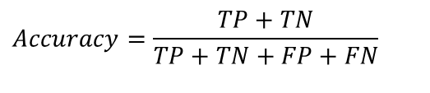
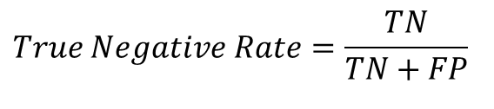
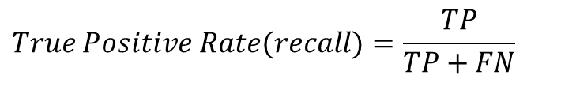
Accuracy of Classification Models
In classification problems, the primary source for accuracy estimation is the confusion matrix
$$Accuracy=\frac{TP+TN}{TP+TN+FP+FN}$$
$$True Positive Rate(recall)=\frac{TP}{TP+FN}$$
$$True Negative Rate=\frac{TN}{TN+FP}$$

Slide 5

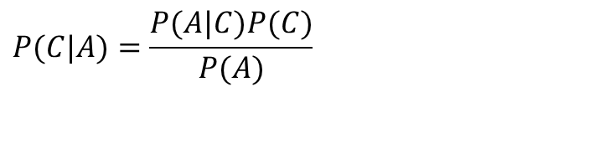
Bayes Classifier
A probabilistic framework for solving classification problems
Conditional Probability:
Bayes theorem:
$$P(C|A)=\frac{P(A,C)}{P(A)} \\ P(A|C)=\frac{P(A,C)}{P(C)}$$
$$P(C|A)=\frac{P(A|C)P(C)}{P(A)}$$

Slide 6
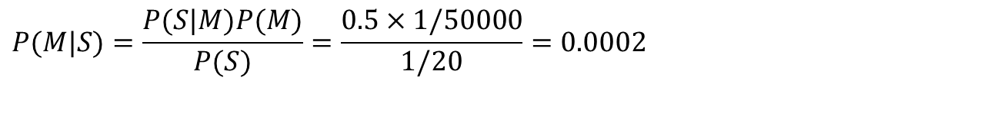
Example of Bayes Theorem
Given:
A doctor knows that meningitis causes stiff neck 50% of the time
Prior probability of any patient having meningitis is 1/50,000
Prior probability of any patient having stiff neck is 1/20
If a patient has stiff neck, what’s the probability he/she has meningitis?
$$P(M|S)=\frac{P(S|M)P(M)}{P(S)}=\frac{0.5×1/50000}{1/20}=0.0002$$

Slide 7
Bayesian Classifiers
Consider each attribute and class label as random variables
Given a record with attributes (A₁, A₂,…,A_{n})
Goal is to predict class C
Specifically, we want to find the value of C that maximizes P(C| A₁, A₂,…,A_{n} )
Can we estimate P(C| A₁, A₂,…,A_{n} ) directly from data?

Slide 8
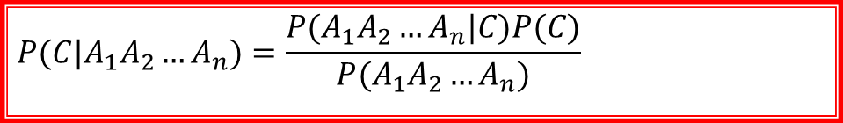
Bayesian Classifiers
Approach:
compute the posterior probability P(C | A₁, A₂, …, A_{n}) for all values of C using the Bayes theorem
Choose value of C that maximizes P(C | A₁, A₂, …, A_{n})
Equivalent to choosing value of C that maximizes P(A₁, A₂, …, A_{n}|C) P(C)
How to estimate P(A₁, A₂, …, A_{n} | C )?
$$P(C|A_{1}A_{2}…A_{n})=\frac{P(A_{1}A_{2}…A_{n}|C)P(C)}{P(A_{1}A_{2}…A_{n})}$$

Slide 9
Naïve Bayes Classifier
Assume independence among attributes A_{i} when class is given:
P(A₁, A₂, …, A_{n} |C) = P(A₁| C_{j}) P(A₂| C_{j})… P(A_{n}| C_{j})
Can estimate P(A_{i}| C_{j}) for all A_{i} and C_{j}.
New point is classified to C_{j} if P(C_{j}) Π P(A_{i}| C_{j}) is maximal.

Slide 10
How to Estimate Probabilities from Data?
Class: P(C) = N_{c}/N
e.g., P(No) = 7/10, P(Yes) = 3/10
For discrete attributes: P(A_{i} | C_{k}) = |A_{ik}|/ N_{c}
where |A_{ik}| is number of instances having attribute A_{i} and belongs to class C_{k}
Examples:
P(Status=Married|No) = 4/7 P(Refund=Yes|Yes)=0
k

Slide 11
How to Estimate Probabilities from Data?
For continuous attributes:
Discretize the range into bins
one ordinal attribute per bin
violates independence assumption
Two-way split: (A < v) or (A > v)
choose only one of the two splits as new attribute
Probability density estimation:
Assume attribute follows a normal distribution
Use data to estimate parameters of distribution (e.g., mean and standard deviation)
Once probability distribution is known, can use it to estimate the conditional probability P(A_{i}|c)
k

Slide 12
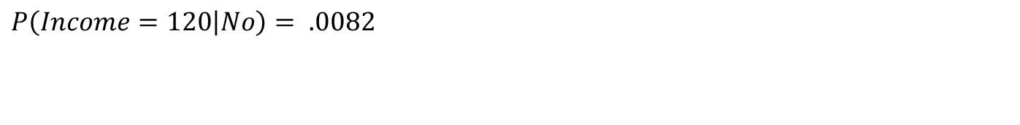
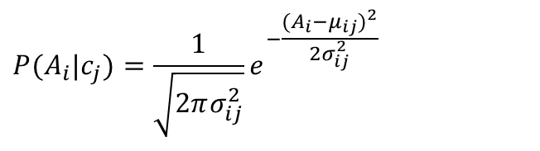
How to Estimate Probabilities from Data?
Normal distribution pdf:
One for each (A_{i},c_{i}) pair
For (Income, Class=No):
If Class=No
sample mean = 110
sample variance = 2975
$$P(A_{i}|c_{j})=\frac{1}{\sqrt{2πσ_{ij}^{2}}}e^{−\frac{(A_{i}−μ_{ij})^{2}}{2σ_{ij}^{2}}}$$
$$P\left(Income=120 | No\right)= .0082$$

Slide 13
Example of Naïve Bayes Classifier
Given a Test Record:
$$X=(\text{Refund}=\text{No}\text{,}\text{Married}\text{,}\text{Income}=\text{120}\text{K})$$
P(X|Class=No) = P(Refund=No|Class=No) × P(Married| Class=No) × P(Income=120K| Class=No) = 4/7 × 4/7 × 0.0072 = 0.0024
P(X|Class=Yes) = P(Refund=No| Class=Yes) × P(Married| Class=Yes) × P(Income=120K| Class=Yes) = 1 × 0 × 1.2 × 10⁻⁹ = 0
Since P(X|No)P(No) > P(X|Yes)P(Yes)
Therefore P(No|X) > P(Yes|X) => Class = No

Slide 14

Naïve Bayes Classifier
If one of the conditional probability is zero, then the entire expression becomes zero
Probability estimation:
$$\text{Original}\text{: }P(A_{i}|C)=\frac{N_{ic}}{N_{c}} \\ \text{Laplace}\text{:}P(A_{i}|C)=\frac{N_{ic}+1}{N_{c}+c} \\ \text{m}\text{−}\text{estimate}\text{:}P(A_{i}|C)=\frac{N_{ic}+mp}{N_{c}+m}$$
c: number of classes
p: prior probability
m: parameter

Slide 15
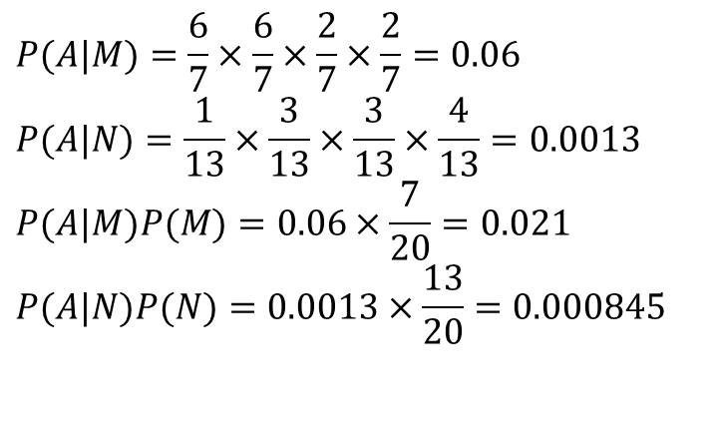
Example of Naïve Bayes Classifier
A: attributes
M: mammals
N: non-mammals
$$P(A|M)=\frac{6}{7}×\frac{6}{7}×\frac{2}{7}×\frac{2}{7}=0.06 \\ P(A|N)=\frac{1}{13}×\frac{3}{13}×\frac{3}{13}×\frac{4}{13}=0.0013 \\ P(A|M)P(M)=0.06×\frac{7}{20}=0.021 \\ P(A|N)P(N)=0.0013×\frac{13}{20}=0.000845$$
P(A|M)P(M) > P(A|N)P(N)
=> Mammals

Slide 16
Naïve Bayes (Summary)
Robust to isolated noise points
Handle missing values by ignoring the instance during probability estimate calculations
Robust to irrelevant attributes
Independence assumption may not hold for some attributes
Use other techniques such as Bayesian Belief Networks (BBN)

