Slide 1

Classification

Slide 2

Instance-Based Classifiers
Store the training records
Use training records to predict the class label of unseen cases

Slide 3
Instance Based Classifiers
Examples:
Rote-learner
Memorizes entire training data and performs classification only if attributes of record match one of the training examples exactly
Nearest neighbor
Uses k “closest” points (nearest neighbors) for performing classification

Slide 4
Nearest Neighbor Classifiers
Basic idea: (P. 39 in the book)
If it walks like a duck, quacks like a duck, then it’s probably a duck
Compute Distance
Test Record
Training Records
Choose k of the “nearest” records

Slide 5
Nearest-Neighbor Classifiers
Requires three things
The set of stored records
Distance Metric to compute distance between records
The value of k, the number of nearest neighbors to retrieve
To classify an unknown record:
Compute distance to other training records
Identify k nearest neighbors
Use class labels of nearest neighbors to determine the class label of unknown record (e.g., by taking majority vote)

Slide 6
Definition of Nearest Neighbor
K-nearest neighbors of a record x are data points that have the k smallest distance to x

Slide 7
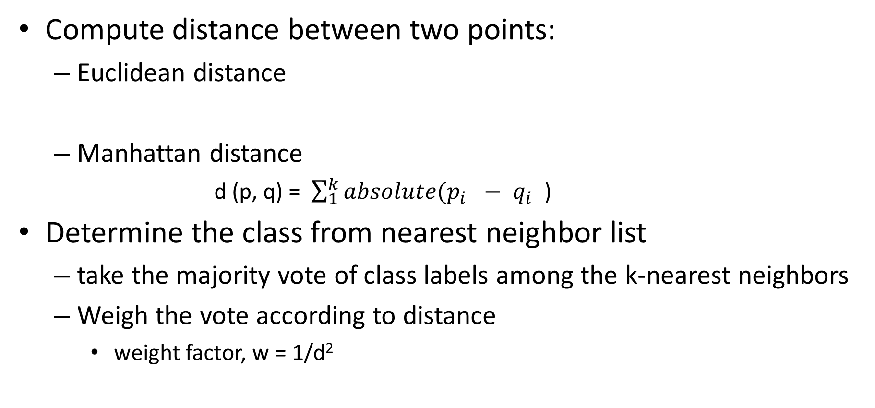
Nearest Neighbor Classification
Compute distance between two points:
Euclidean distance
Manhattan distance
d (p, q) = $\sum_{1}^{k}{absolute(p_{i }}− q_{i }$)
Determine the class from nearest neighbor list
take the majority vote of class labels among the k-nearest neighbors
Weigh the vote according to distance
weight factor, w = 1/d²

Slide 8
Nearest Neighbor Classification…
Choosing the value of k:
If k is too small, sensitive to noise points
If k is too large, neighborhood may include points from other classes

Slide 9
Nearest Neighbor Classification…
Scaling issues
Attributes may have to be scaled (e.g. Normalization) to prevent distance measures from being dominated by one of the attributes
Example:
height of a person may vary from 1.5m to 1.8m
weight of a person may vary from 90lb to 300lb
income of a person may vary from $10K to $1M

Slide 10
Nearest neighbor Classification…
k-NN classifiers are lazy learners
It does not build models explicitly
Unlike eager learners such as decision tree induction and rule-based systems
Classifying unknown records are relatively expensive

Slide 11
Logistic Regression
Although linear regression is used with qualitative variables, however if the dependent variable is a qualitative variable it is not possible to use regression.
In many cases the response (dependent) variable is binary. As an example whether a person would default on a loan
Instead of modeling the dependent variable directly, we calculate the probability that the dependent variable belongs to one of the categories

Slide 12
Logistic regression
As an example - whether a person would default on a loan
In that case we are interested in the probability of default. Let us assume that we code default as 1 and not default as 0
So our equation becomes instead of
E(y) = β₀ + β₁x₁ + β₂x₂ + . . . + β_{p}x_{p}
to
p(y=1) = β₀ + β₁x₁ + β₂x₂ + . . . + β_{p}x_{p} (in case of multiple regression)
However, we have to set all β_{i} s, such that p(y=1) is always between 0 and 1.
Next, we define
p(X) = Pr(Y = 1|X)

Slide 13

Logistic regression
However, we know that p(X) needs to be between 0 and 1
Instead of using a linear equation, we use the following (showing only for one independent variable)
p (X) = $\frac{e^{\text{(}\text{β}\text{0}\text{ + }\text{β}\text{1}\text{x}}\text{)}}{1+ e^{\text{(}\text{β}\text{0}\text{ + }\text{β}\text{1}\text{x}}\text{)}}$

Slide 14
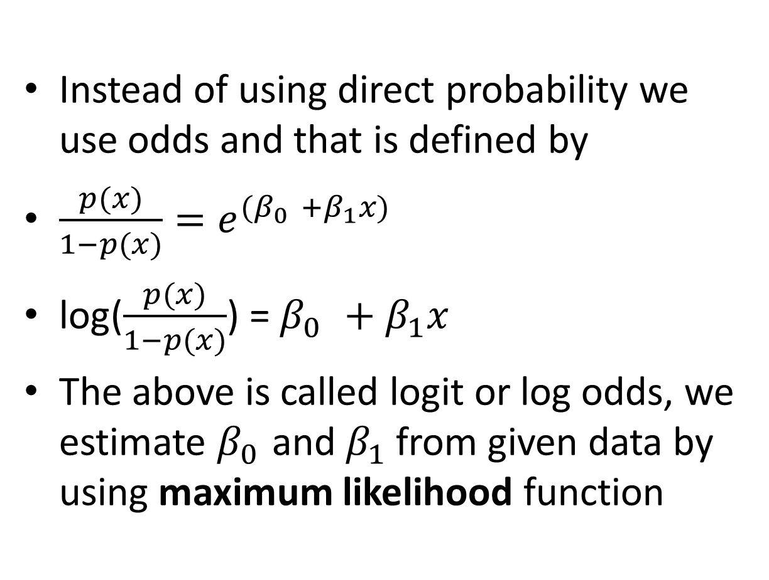
Logistic regression
Instead of using direct probability we use odds and that is defined by
$\frac{p(x)}{1−p(x)}=e^{{(β}_{0 }+β_{1}x)}$
log($\frac{p(x)}{1−p(x)}$) = $β_{0 }+β_{1}x$
The above is called logit or log odds, we estimate $β_{0 }$and $β_{1}$ from given data by using maximum likelihood function

Slide 15
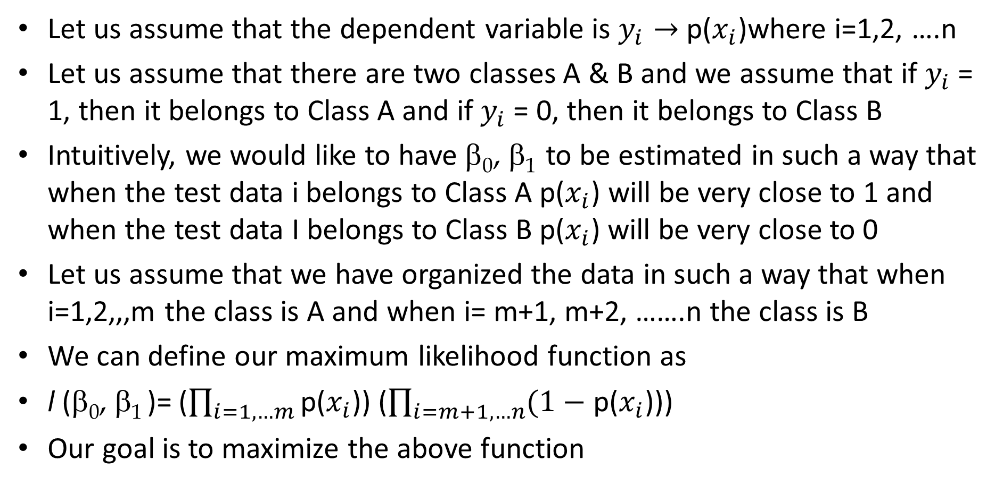
Maximum Likelihood Function (P. 135)
Let us assume that the dependent variable is $y_{i}→$ p($x_{i}$)where i=1,2, ….n
Let us assume that there are two classes A & B and we assume that if $y_{i}$ = 1, then it belongs to Class A and if $y_{i}$ = 0, then it belongs to Class B
Intuitively, we would like to have $\text{}\text{0}\text{,} \text{β}\text{1}$to be estimated in such a way that when the test data i belongs to Class A p($x_{i}$) will be very close to 1 and when the test data I belongs to Class B p($x_{i}$) will be very close to 0
Let us assume that we have organized the data in such a way that when i=1,2,,,m the class is A and when i= m+1, m+2, …….n the class is B
We can define our maximum likelihood function as
l ($\text{}\text{0}\text{,} \text{β}\text{1}$)= ($\prod_{i=1, …m}{\text{p}\text{(}x_{i}\text{)}\text{)}}$ ($\prod_{i=m+1, …n}{(1−\text{p}\text{(}x_{i}\text{)}\text{)}\text{)}}$
Our goal is to maximize the above function

Slide 16
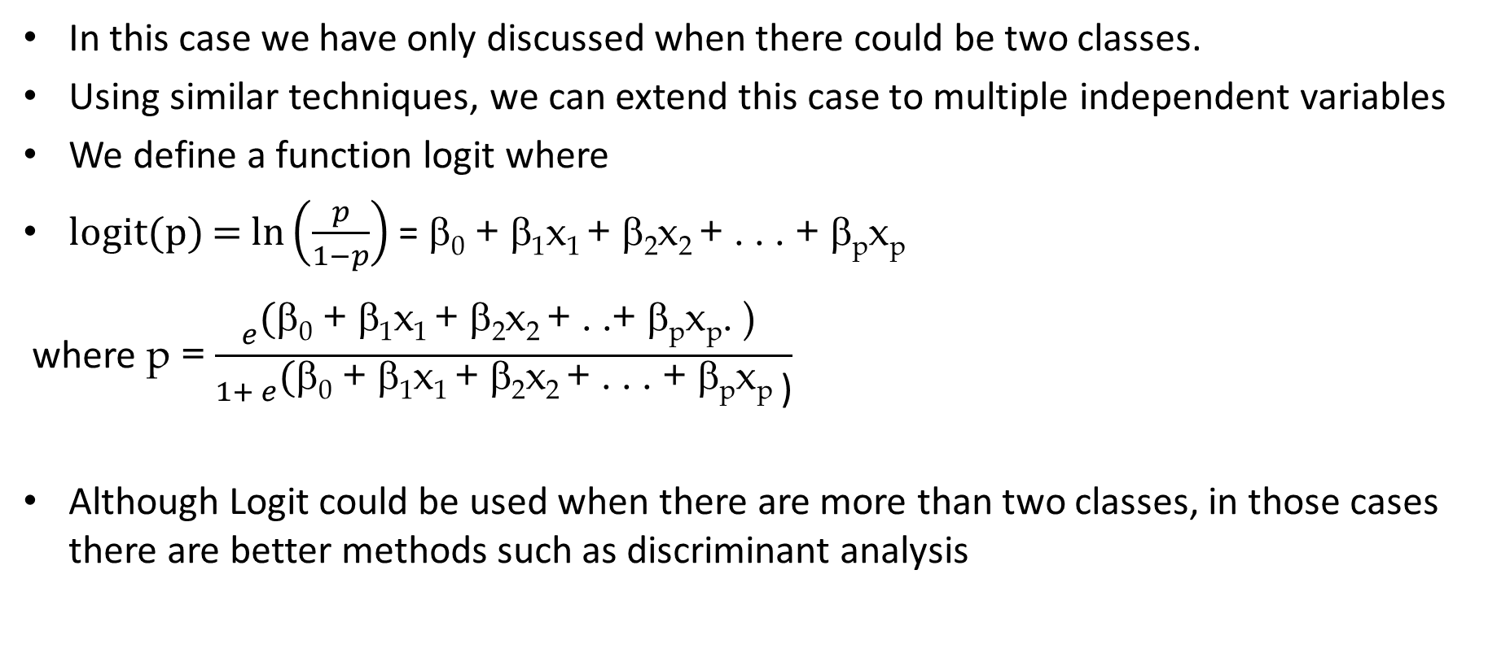
Logistic Regression
In this case we have only discussed when there could be two classes.
Using similar techniques, we can extend this case to multiple independent variables
We define a function logit where
logit(p) = $\ln\left(\frac{p}{1−p}\right)$ = $\text{}\text{0}\text{ + }\text{β}\text{1}\text{x}\text{1 }\text{+ }\text{β}\text{2}\text{x}\text{2 }\text{+ . . . + }\text{β}\text{p}\text{x}\text{p}$
where p = $\frac{e^{\text{(}\text{}\text{0}\text{ + }\text{}\text{1}\text{x}\text{1 }\text{+ }\text{}\text{2}\text{x}\text{2 }\text{+ . .+ }\text{}\text{p}\text{x}\text{p}\text{. ) }}}{1+ e^{\text{(}\text{}\text{0}\text{ + }\text{}\text{1}\text{x}\text{1 }\text{+ }\text{}\text{2}\text{x}\text{2 }\text{+ . . . + }\text{}\text{p}\text{x}\text{p} }\text{)}}$
Although Logit could be used when there are more than two classes, in those cases there are better methods such as discriminant analysis

Slide 17
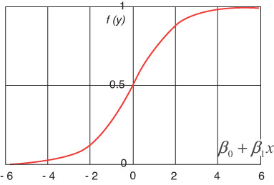
Logistic function

Slide 18
Logit Contd.
logit(p) is the log odds (that is, the logarithm of the odds) of success for the given values of the explanatory variables.
So logit (p) could vary between -∞ to +∞ as p varies from 0 to 1 and logit (p) = 0 when p=.5
Usually, if the predicted value of p is greater or equal to .5 then prediction is considered as success

Slide 19
How to evaluate Logit model
Akaike Information Criteria (AIC)
Lower the AIC better the model
Null Deviance & Residual Deviance
Lower the Null Deviance & Residual Deviance is better the model
Confusion matrix
The best metric
Receiver Operator Characteristic (ROC)
ROC is plotted between True Positive Rate (Y axis) and False Positive Rate (X Axis).

Slide 20
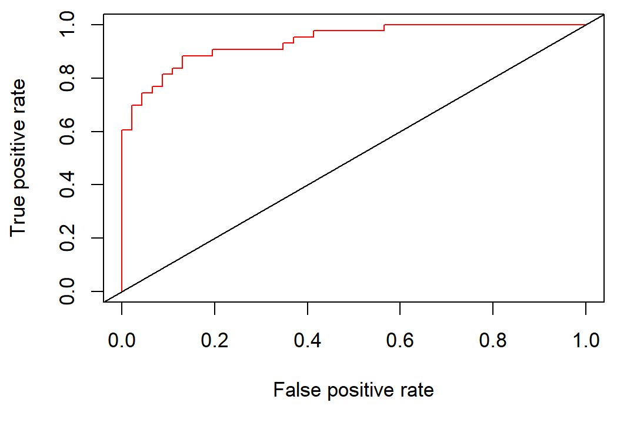
ROC (Receiver Operating Characteristics)
It is a metric for measuring how accurate or effective a classification model is
It could only be used to measure the performance of a binary classifier.

Slide 21

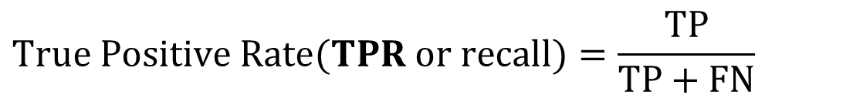
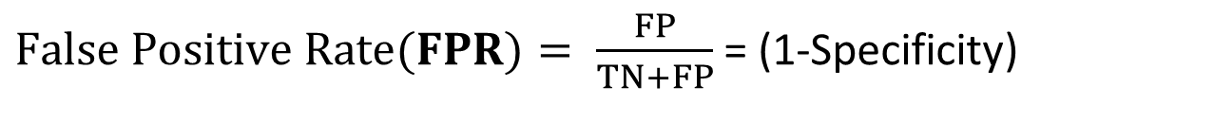
ROC
Let’s recall two metrics that were introduced before
$$True Positive Rate(TPR or recall)=\frac{TP}{TP+FN}$$
$$True Negative Rate(Specificity)=\frac{TN}{TN+FP}$$
$False Positive Rate(FPR)= \frac{FP}{TN+FP}$ = (1-Specificity)

Slide 22
TPR & FPR
TPR measures how accurately a model detects the actual positive cases. (True Positive + False Negative) is the actual total positive cases in the test data set. The highest value could be 1.
FPR estimates the error a model makes. (False Positive + True Negative) is the actual total negative cases in the test data set. So false positive shows the error a model is making while predicting a case as positive. An ideal model will have it as 0.

Slide 23
ROC curve
ROC curve is drawn by plotting on the Y axis TPR and on the X axis.
Based on the Test data, the probabilities are calculated and then they are sorted from minimum to maximum
Using all the different n probabilities, in each case TPR and FPR are calculated and then plotted
The curve should be tilted towards the left. In other words, as the threshold probability increases both TPR and FPR will increase.
However, for a good model TPR should increase more rapidly
The area under the curve (AUC) measures the efficacy of a model. A value greater than .8 is acceptable.

