Slide 1
Unsupervised Learning:

Slide 2
Unsupervised Learning
Unlike supervised learning there is no test data set, hence it is very challenging
There is no specific method to test the model
We investigate whether data tells a story or there is a pattern in the data
Frequent patterns
Association rules
In some way, association rules are like classification rules

Slide 3
Association Rule Mining (Market Basket Analysis)
Given a set of transactions, find rules that will predict the occurrence of an item based on the occurrences of other items in the transaction
Market-Basket transactions
Example of Association Rules
{Diaper} → {Beer}, {Milk, Bread} → {Eggs,Coke}, {Beer, Bread} → {Milk},
Implication means co-occurrence, not causality!

Slide 4
Definition: Frequent Itemset
Itemset
A collection of one or more items
Example: {Milk, Bread, Diaper}
k-itemset
An itemset that contains k items
Support count (σ)
Frequency of occurrence of an itemset
E.g. σ({Milk, Bread,Diaper}) = 2 (How many times the itemset occurs in the transaction list)
Support
Fraction of transactions that contain an itemset
E.g. s({Milk, Bread, Diaper}) = 2/5
Frequent Itemset
An itemset whose support is greater than or equal to a minimum support (minsup) threshold

Slide 5
Definition: Association Rule
Association Rule
An implication expression of the form X → Y, where X and Y are itemsets
Example: {Milk, Diaper} → {Beer}
Rule Evaluation Metrics
Support (s)
Fraction of transactions that contain both X and Y
Confidence (c)
Measures how often items in Y appear in transactions that contain X
Example:

Slide 6
Association Rule Mining Task
Given a set of transactions T, the goal of association rule mining is to find all rules having
support ≥ minsup threshold
confidence ≥ minconf (minimum confidence) threshold
Brute-force approach:
List all possible association rules
Compute the support and confidence for each rule
Prune rules that fail the minsup and minconf thresholds
⇒ Computationally prohibitive!

Slide 7
Mining Association Rules
Example of Rules:
{Milk,Diaper} → {Beer} (s=0.4, c=0.67) {Milk,Beer} → {Diaper} (s=0.4, c=1.0)
{Diaper,Beer} → {Milk} (s=0.4, c=0.67)
{Beer} → {Milk,Diaper} (s=0.4, c=0.67) {Diaper} → {Milk,Beer} (s=0.4, c=0.5)
{Milk} → {Diaper,Beer} (s=0.4, c=0.5)
Observations:
All the above rules are binary partitions of the same itemset: {Milk, Diaper, Beer}
Rules originating from the same itemset have identical support but can have different confidence
Thus, we may decouple the support and confidence requirements

Slide 8
Frequent Itemset Generation Strategies
Reduce the number of candidates (M)
Complete search: M=2^{d}
Use pruning techniques to reduce M
Reduce the number of transactions (N)
Reduce size of N as the size of itemset increases
Used by DHP (Direct Hashing & Pruning) and vertical-based mining algorithms
Reduce the number of comparisons (NM)
Use efficient data structures to store the candidates or transactions
No need to match every candidate against every transaction

Slide 9
Apriori Algorithm
R. Agrawal and R. Srikant in 1994
Based on “reduce the number of candidates”
Apriori principle:
If an itemset I is not frequent (P(I) < min_sup), then if another item A is added to I then the itemset {I, A} cannot be frequent either
Also occurrence of itemset {I, A} is less than occurrence of I or occurrence of A
It has two steps –
Frequent itemset generation
Rule generation

Slide 10
Reducing Number of Candidates
So we can mathematically describe apriori principle as
Support of an itemset never exceeds the support of its subsets
This is known as the anti-monotone property of support
Algorithm:
Join and Prune

Slide 11
Join & Prune
Join
You start with individual items and then you create itemsets as shown in next figure and readings.
We need to make sure that we don’t create any duplicate such as AB & BA
Prune
As soon as we observe an itemset that doesn’t have the minimum support, we prune it and we don’t create any additional itemset containing that particular itemset
Notes:
During Prune remember as we add more items to an itemset the support will keep on decreasing.

Slide 12
Illustrating Apriori Principle
Note: First you start from the Top and then generate all the frequent itemsets
Found to be Infrequent
Pruned supersets
Notes:
AB is infrequent, so we can prune it. Also we go in one direction – we do AB not BA because A left of B

Slide 13
Illustrating Apriori Principle
Items (1-itemsets)
Pairs (2-itemsets)
(No need to generate candidates involving Coke or Eggs)
Minimum Support = 3
Triplets (3-itemsets)
If every subset is considered,
⁶C₁ + ⁶C₂ + ⁶C₃ = 41
With support-based pruning,
6 + 6 + 1 = 13

Slide 14
Apriori Algorithm
Method:
Let k=1
Generate frequent itemsets of length 1
Repeat until no new frequent itemsets are identified
Generate length (k+1) candidate itemsets from length k frequent itemsets
Prune candidate itemsets containing subsets of length k that are infrequent
Count the support of each candidate by scanning the DB
Eliminate candidates that are infrequent, leaving only those that are frequent

Slide 15
Rule Generation
After finding the frequent itemset the rule generation depends on the minimum confidence
Given a frequent itemset L, find all non-empty subsets f ⊂ L such that f → L – f satisfies the minimum confidence requirement
If {A,B,C,D} is a frequent itemset, candidate rules:
ABC →D, ABD →C, ACD →B, BCD →A, A →BCD, B →ACD, C →ABD, D →ABC AB →CD, AC → BD, AD → BC, BC →AD, BD →AC, CD →AB,
If |L| = k, then there are 2^{k} – 2 candidate association rules (ignoring L → ∅ and ∅ → L)

Slide 16
Rule Generation for Apriori Algorithm
Lattice of rules
Low Confidence Rule
Pruned Rules

Slide 17
Use of Apriori algorithm in other cases
Outlook | Temp | Humidity | Windy | Play Outside
Sunny | Hot | High | FALSE | No
Sunny | Hot | High | TRUE | No
Overcast | Hot | High | FALSE | Yes
Rainy | Mild | High | FALSE | Yes
Rainy | Cool | Normal | FALSE | Yes
Rainy | Cool | Normal | TRUE | No
Overcast | Cool | Normal | TRUE | Yes
Sunny | Mild | High | FALSE | No
Sunny | Cool | Normal | FALSE | Yes
Rainy | Mild | Normal | FALSE | Yes
Sunny | Mild | Normal | TRUE | Yes
Overcast | Mild | High | TRUE | Yes
Overcast | Hot | Normal | FALSE | Yes
Rainy | Mild | High | TRUE | No
Not just market basket, association rule could be used in almost every other cases as long as variables are categorical
Let’s take an example with the well known play dataset
Notes:
We can see Outlook = Sunny (5), Outlook = Overcast (4), Outlook = Rainy (5)
Temp = Hot (4), Temp = Mild (6), Temp = Cool (4) …….. Next we build Two-item sets
Outlook = Sunny & Temp = Hot (2), ……………………..

Slide 18
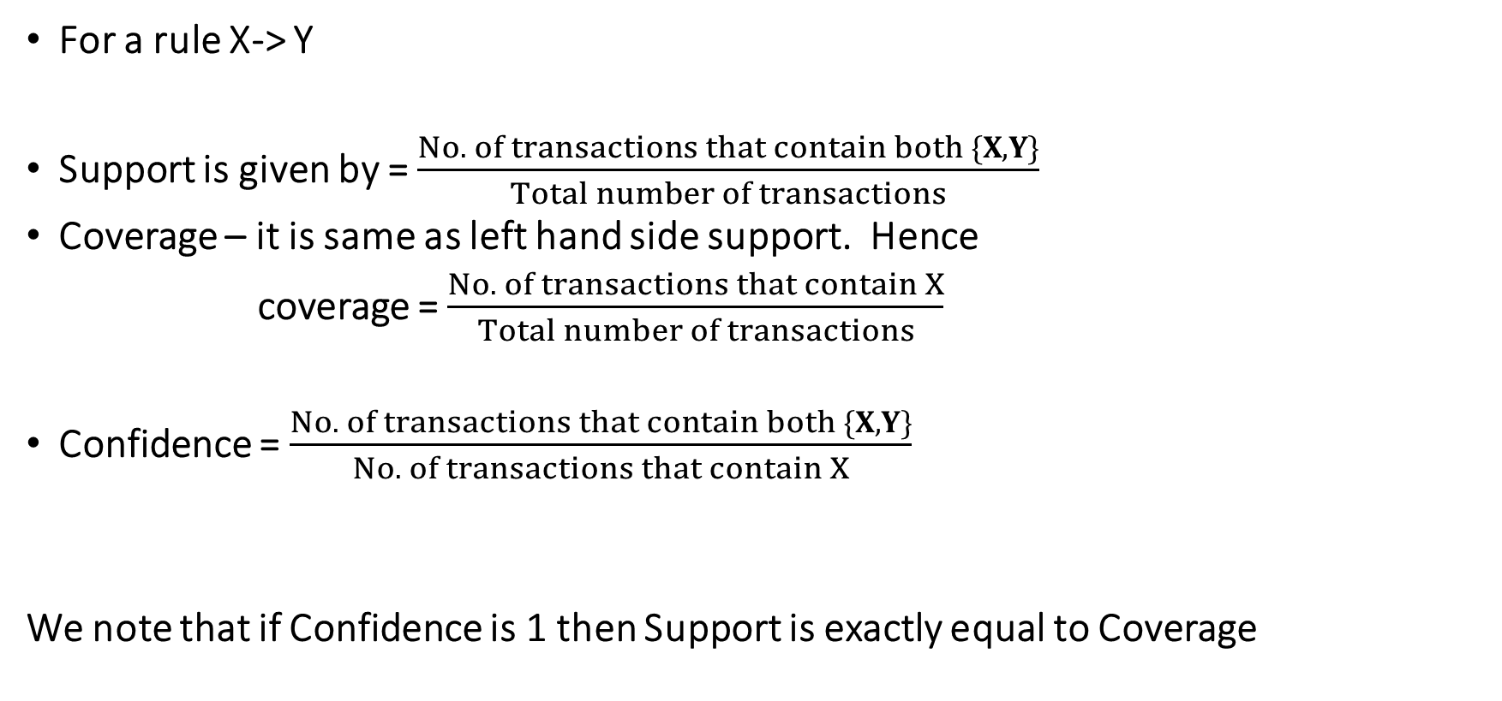
Metrics
For a rule X-> Y
Support is given by = $\frac{No. of transactions that contain both \{X, Y\}}{Total number of transactions}$
Coverage – it is same as left hand side support. Hence
coverage = $\frac{No. of transactions that contain X}{Total number of transactions}$
Confidence = $\frac{No. of transactions that contain both \{X, Y\}}{No. of transactions that contain X}$
We note that if Confidence is 1 then Support is exactly equal to Coverage

Slide 19
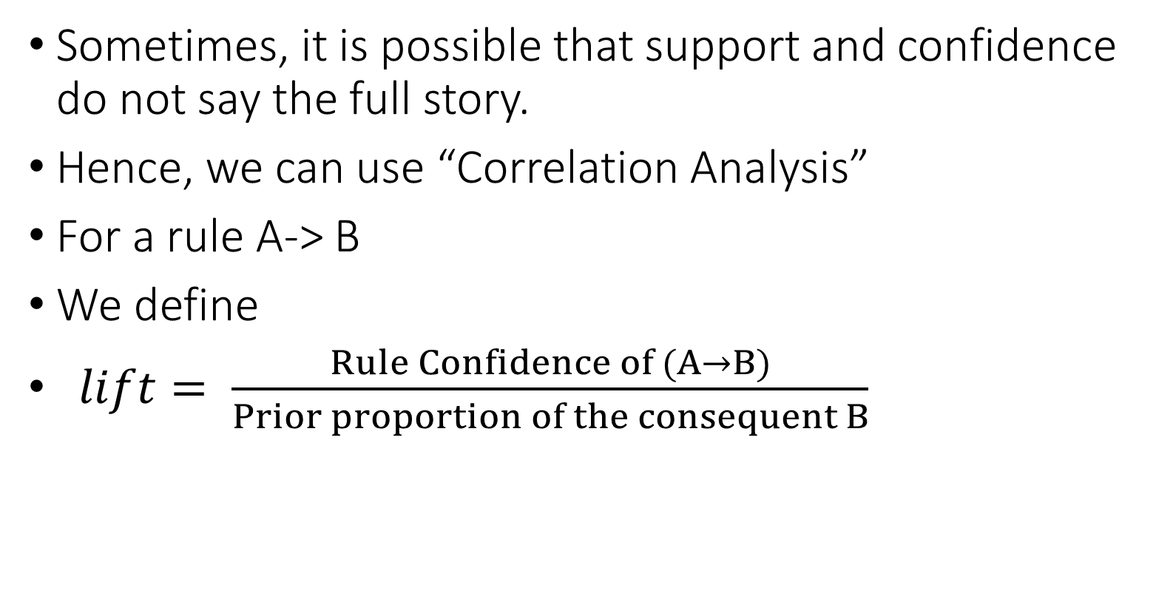
Correlation Analysis
Sometimes, it is possible that support and confidence do not say the full story.
Hence, we can use “Correlation Analysis”
For a rule A-> B
We define
$lift= \frac{Rule Confidence of (A→B)}{Prior proportion of the consequent B}$
Notes:
This says how likely item Y is purchased when item X is purchased, while controlling for how popular item Y is. In Table 1, the lift of {apple -> beer} is 1,which implies no association between items. A lift value greater than 1 means that item Y is likely to be bought if item X is bought, while a value less than 1 means that item Y is unlikely to be bought if item X is bought.

Slide 20
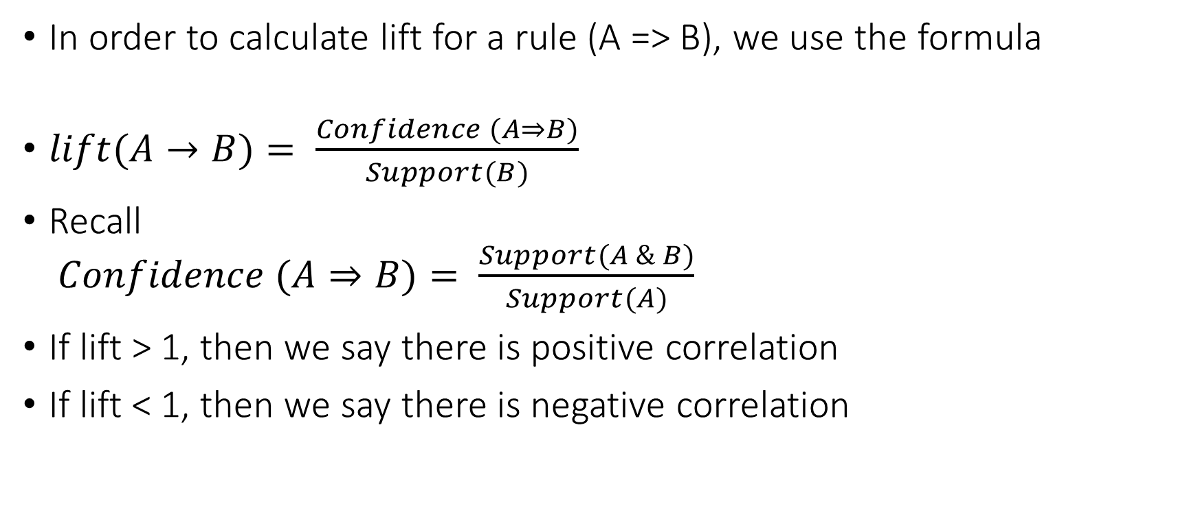
Lift (cont)
In order to calculate lift for a rule (A => B), we use the formula
$lift(A→B)= \frac{Confidence (A⇒B)}{Support(B)}$
Recall $Confidence (A⇒B)= \frac{Support(A \& B)}{Support(A)}$
If lift > 1, then we say there is positive correlation
If lift < 1, then we say there is negative correlation

