Slide 1

Aqua Air Insight: Air-Water Quality Prediction ASANSOL ENGINEERING COLLEGE Department of Information Technology
UNDER THE GUIDANCE OF
MR. SUDIP KUMAR DE
Submitted by:
Shreyansh Shekhar(10800220006)
Rishika Singh(10800220008)
Udayan Choudhary(10800220035)
Sumit Kumar Mihirachariya(10800220042)

Slide 2
What is Aqua-Air Insight?
Aqua-Air Insight is like weather predictors , this predictor gives real time predictions of air and water. It tells us whether the water is portable or not and air we are breathing is safe or not. Aqua-Air insight uses advanced algorithm and large dataset to monitor and identify patterns to predict pollution level in both air and water which prevents ecological damage and ensure sustainable living.

Slide 3
Water quality prediction
Water is an essential part of human life. Nowadays due to increase in toxicity, water around us has been polluted. Water quality refers to the condition and characteristics of water that determine its suitability for various uses and the health of aquatic ecosystems. It checks the chemical, physical, and biological properties of water and the presence of contaminants and pollutants. In this project we are going to check for its quality and find whether it is suitable for drinking or not.

Slide 4
Types of pollutants present in water and their harmful effects
ph: it checks for the acidity/basicity of water
Hardness: amount of dissolved calcium and magnesium in water
Solids: Total solids are dissolved solids plus suspended and settleable solids
chloramines: most commonly used chloramines to treat drinking water.
Sulfate: Sulfate levels above 250 mg/L may make the water taste bitter or like medicine.
Conductivity: Conductivity is a measure of the ability of water to pass an electrical current
Organic carbon: the amount carbon atoms tied up in organic compounds in a water sample, and it is a non-specific indicator of water quality
Trihalomethanes : byproduct of the water treatment process
Turbidity : Turbidity is a measure of water clarity.
potability : water that is suitable for human consumption

Slide 5
Air quality prediction
Air is necessary for every living thing on Earth to breathe. prediction of air quality is significant for improving the health of living beings. Advanced models, like machine learning and atmospheric simulations, analyze these inputs to forecast levels of pollutants such, SO2, NO2, RSPM and SPM. Accurate predictions help in planning health advisories, regulatory actions, and mitigating the impact of poor air quality on public health.

Slide 6
Types of pollutants present in air and their harmful effects
SO2-Sulfur dioxide (SO2) in air quality is primarily from fossil fuel combustion and industrial activities.
NO2-Nitrogen dioxide (NO2) is a key air pollutant from vehicle emissions and industrial activities.
RSPM-Respirable Suspended Particulate Matter (RSPM), or PM10, consists of airborne particles smaller than 10 micrometers
SPM-Suspended Particulate Matter (SPM) consists of tiny solid or liquid particles in the air, including dust, soot, and smoke.

Slide 7
OUR APPPROACH
Aqua air insight is an real time predictor which predicts the quality of water and early detection of air quality. Our web interface ensures efficient, accessible, easy to use and accurate predictions.

Slide 8
How does Aqua-Air Insight works ?
1. Data is fetched to in form of Datasets.
2. Data is pre-processed which means data is cleaned, integrated, dimensionality is reduced.
3. Splitting of datasets in 80-20 proportion and trained the 80% and tested the 20%.
4. Model is achieved and performance of the model is tested.

Slide 9
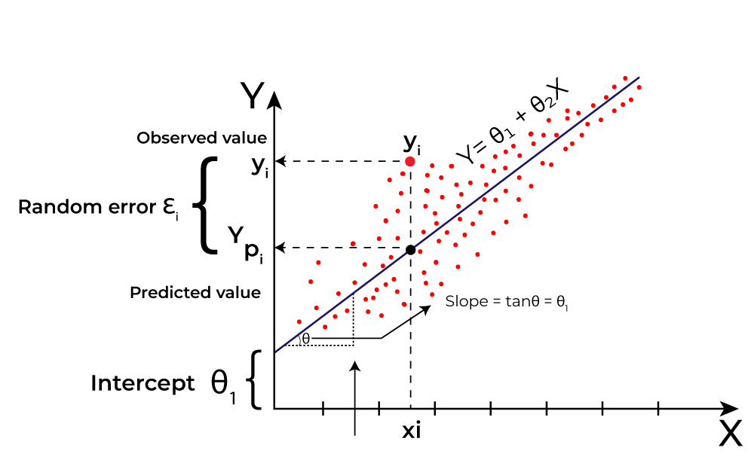
MODELS
Linear regression :-
Linear regression is a type of supervised machine learning algorithm that computes the linear relationship between the dependent variable and one or more independent features by fitting a linear equation to observed data. This model is used to predict the quality of air in the project.

Slide 10
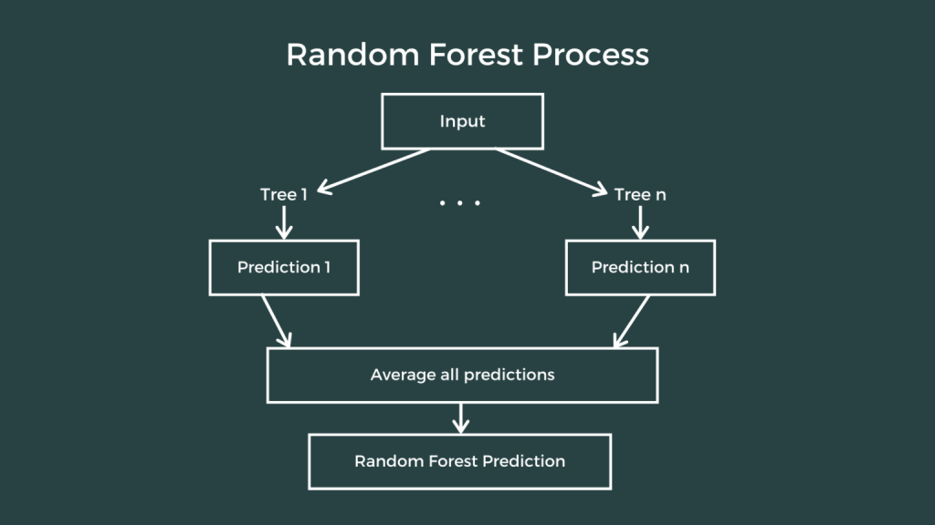
MODELS
Random forest :-
Random Forest Regression in machine learning is an ensemble technique capable of performing both regression and classification tasks with the use of multiple decision tree. It is a versatile technique which predicts numerical values. It combines the predictions of multiple decision trees to reduce overfitting and improve accuracy.

Slide 11
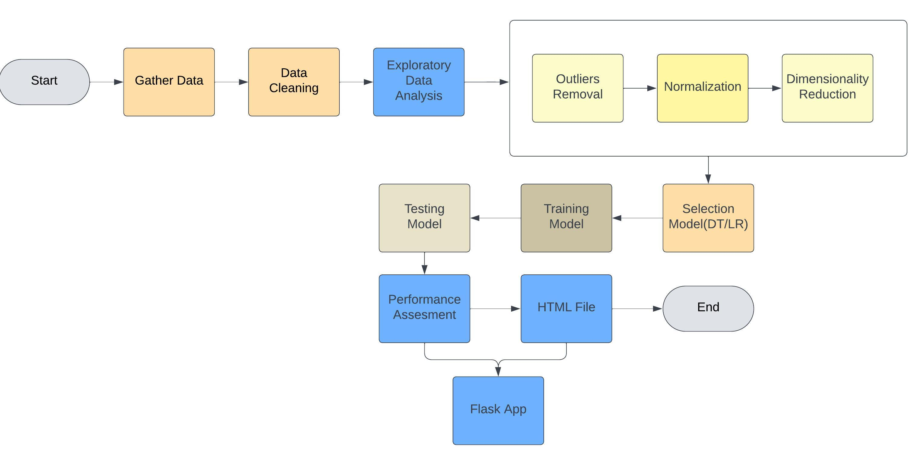
Workflow diagram of water-air quality prediction

Slide 12
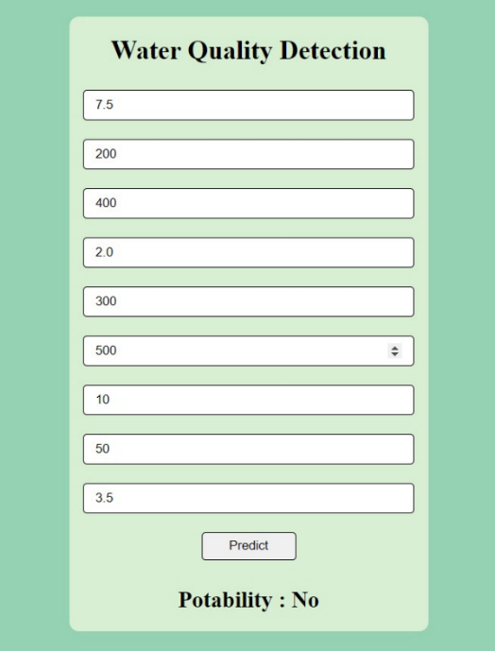
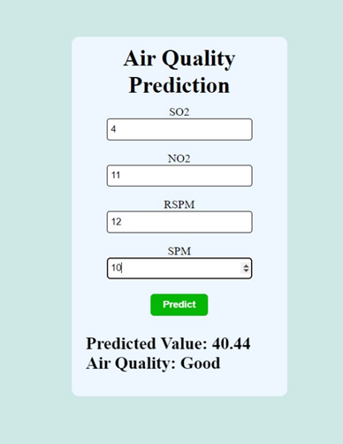
USER INTERFACE
Takes input of parameters present
Predicts the water and air quality index

Slide 13
OUTCOMES
AQUA AIR INSIGHT: WATER AIR PREDICTOR
REAL TIME MONITORING SYSTEM
ACCURATE FORECASTING
DISEASE PREVENTION
EARLY WARNING SYSTEM

Slide 14
FUTURE SCOPE
The future scope of water and air quality prediction will be combined for better accuracy with hyper parameter tuning and complex and large dataset will be used to enhance model accuracy through diverse data sources, hyperparameter optimization, and combining algorithms, will yield more sophisticated models.

Slide 15
Thank you!!

