Slide 1
QUIZ
Anaadya Shetty
Anagha Sethu
Udayasri Chandrika
Teena Pawar

Slide 2
Introduction
Our project involved building a series of web pages that can deliver quizzes that a student can take and view their scores afterwards and an administrator should be able to observe the grades of all students
In this project, we have created an online quiz using Angular and Spring Boot. This quiz will allow users to test their knowledge on a variety of topics. The quiz will be composed of multiple choice questions and the quizzes, questions and answers will be stored in a database.

Slide 3
Approach
First we planned for the database and entity relations.
Breakdown the requirements in three parts Login, Student, Admin.
Created entity in Spring Boot on required.
Created tables to store values for the entity.
Created Rest APIs
Developed frontend screens.
Integrated backend with frontend.

Slide 4
Learnings
Webpage designing
Testing the functionality of the code and debugging the observed errors and faults
Reusability of API calls
Integration of front and backend in order to deploy a project

Slide 5
Constraints
We have used plaintext passwords to get a proof-of-concept working and will implement the encryption module at a later point in development.
Making scorecard for each student after completing quiz.
Associating the tables based on the problem statement.
Ensuring the quiz logic is correct.

Slide 6
Technologies Used
Java 8
Spring boot 2.5.10
MySQL
Angular

Slide 7
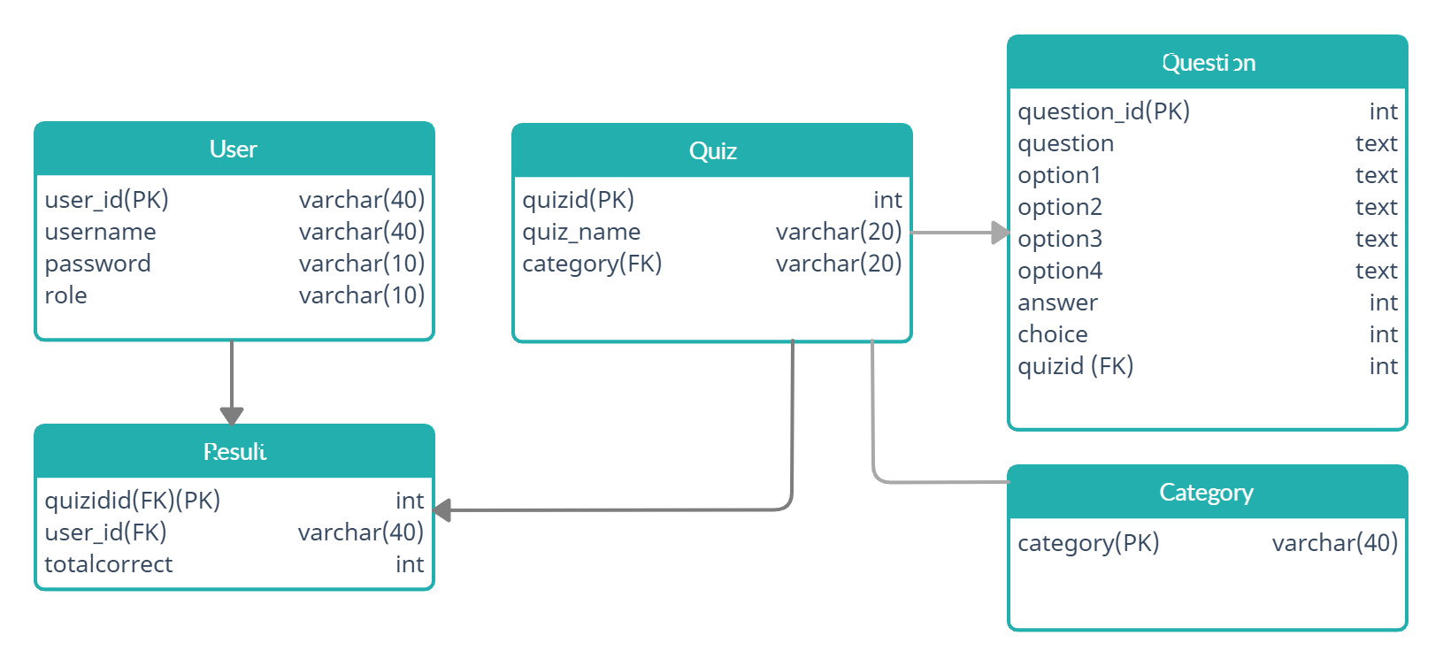
Database architecture
quizname
varchar(20)

Slide 8
Rest API details
Sl no | API name | Method | Path | Description
1 | Get quiz | GET | http://localhost:8080/api/getquiz | Fetch questions for quiz
2 | Submit Quiz | POST | https://localhost:8080/api/submit | Submit the quiz
3 | Get Result Gradebook | GET | https://localhost:8080/api/getresultgradebook | Fetch result of all quizzes of particular student
4 | Get Result Category | GET | https://localhost:8080/api/getresultcategory | Fetch result of all quizzes of particular category of a student
5 | Get Overall Result | GET | https://localhost:8080/api/getresultoverall | Fetch overall result of a student

Slide 9
Rest API details
Sl no | API name | Method | Path | Description
6 | Get Instant result | GET | https://localhost:8080/api/getresultbyquizid | Fetch result of quiz completed
7 | Get all students result | GET | https://localhost:8080/api/getallstudentresult | Fetch all students and their result
8 | Get quizzes | GET | https://localhost:8080/api/getallquiz | Fetch all quizzes

Slide 10
Statistics
No. of Entities : 5
No. of Components : 13

Slide 11
List of components
Components | Use
login | For login
studenthomepage | Student home page
student | Display categories
quiztest | Display the quizzes of that category
quiz | Take the quiz
resultfail | Result page -> if fails
resultpage | Result page -> if passes
gradebook | Display the grades of all quizzes
adminhomepage | Admin home page
studentlist | List of all students
studentperformance | Grades of the selected student
quizlist | List of quizzes
quizquestions | Questions in that selected quiz

Slide 12
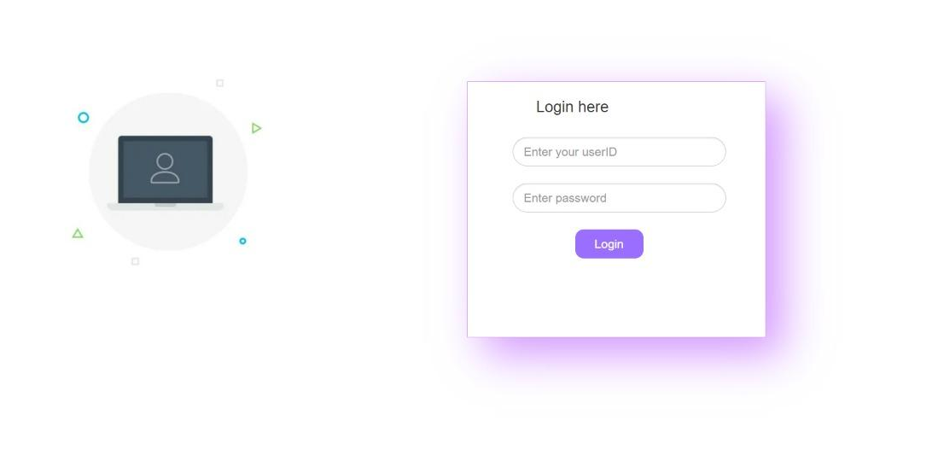
Front-end Views for Student

Slide 13
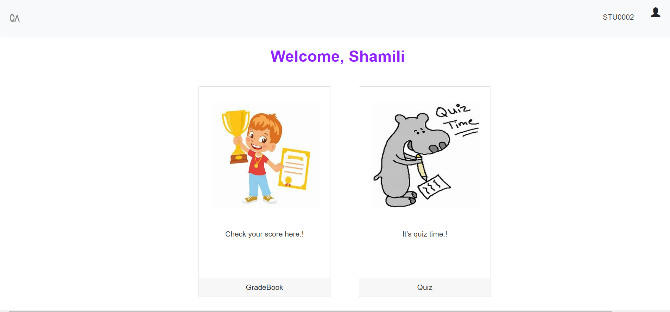

Slide 14
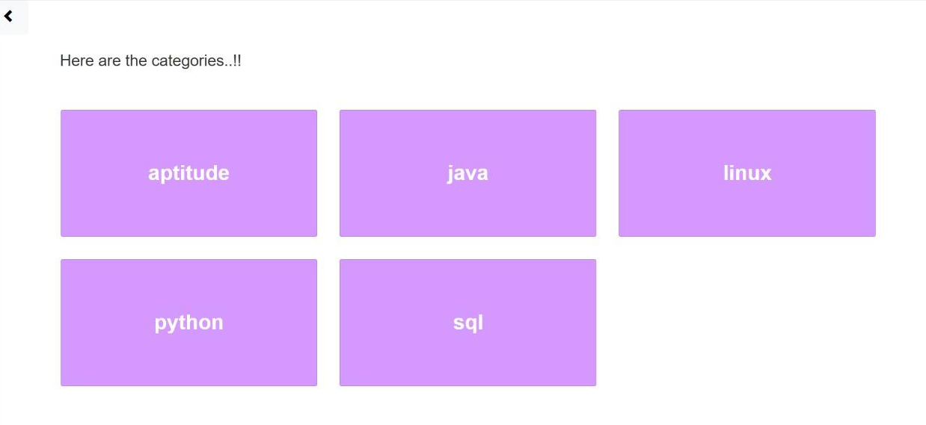

Slide 15
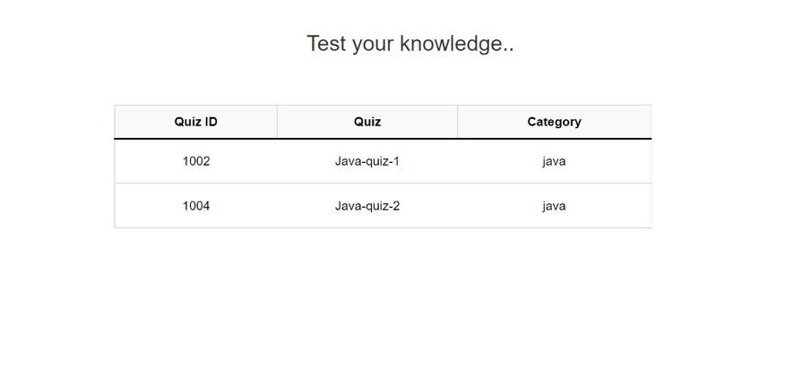

Slide 16
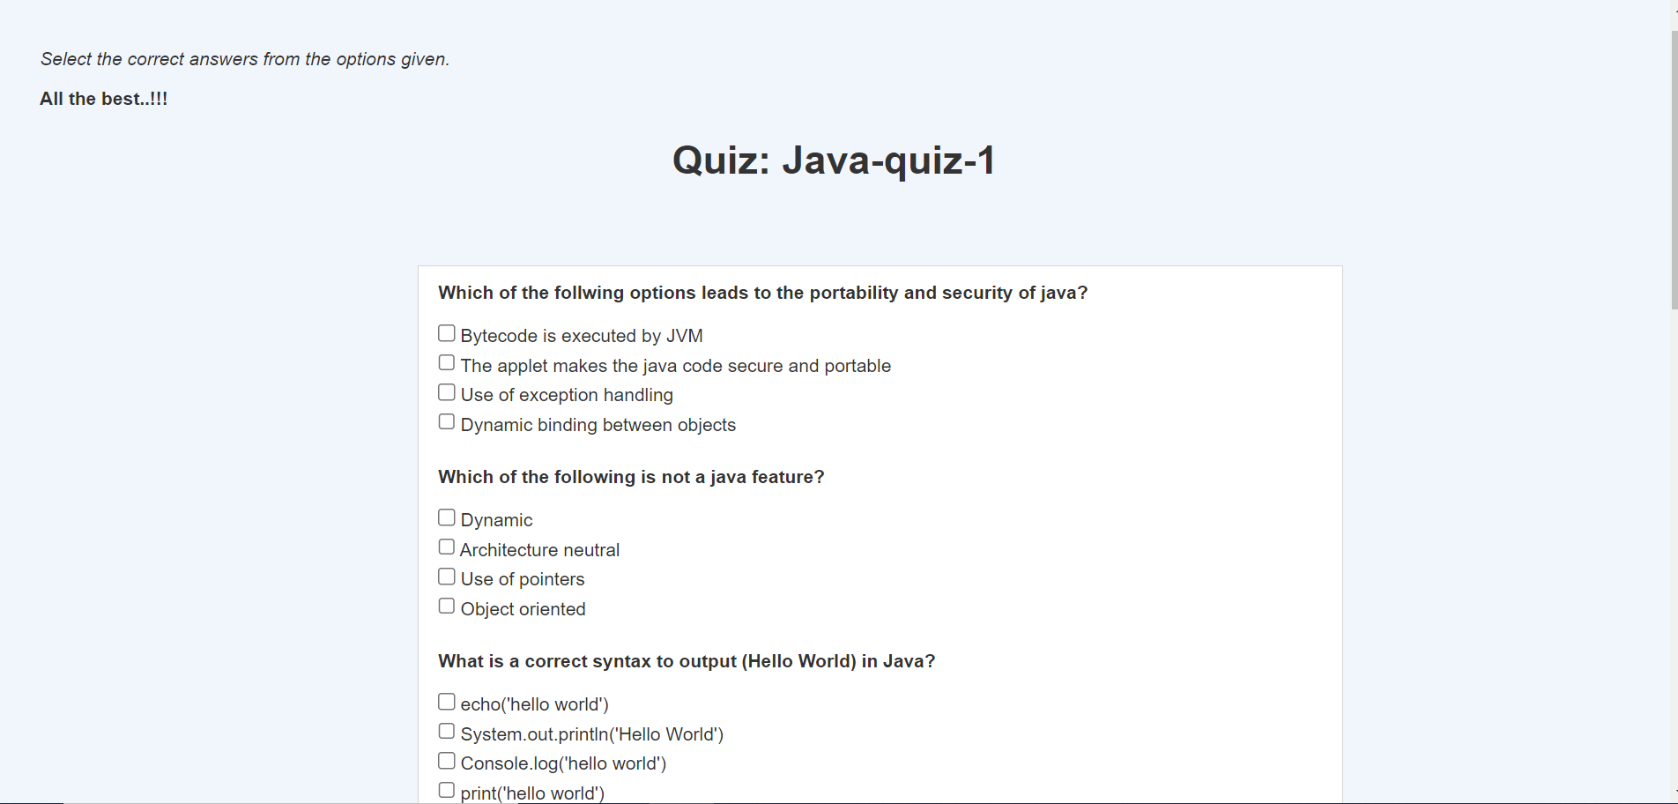

Slide 17
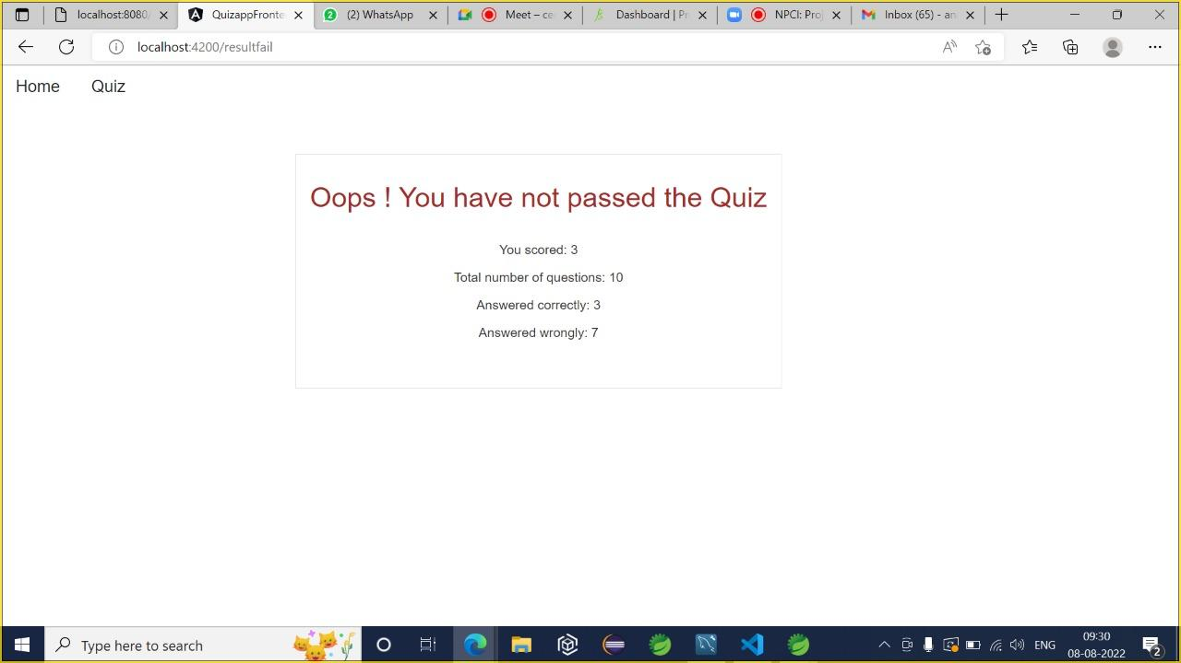

Slide 18
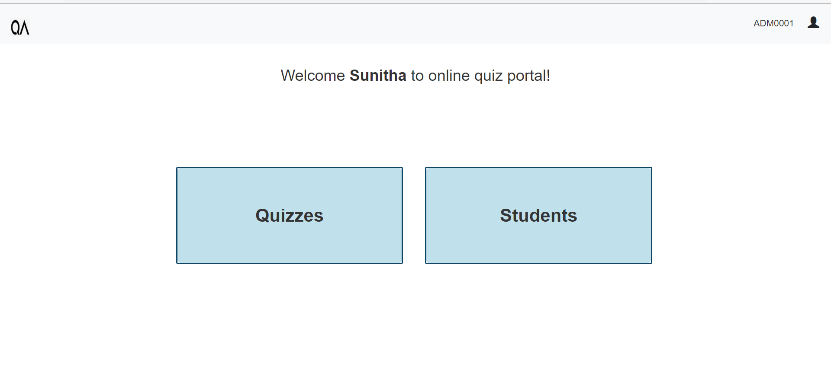
Front-end Views for Admin

Slide 19
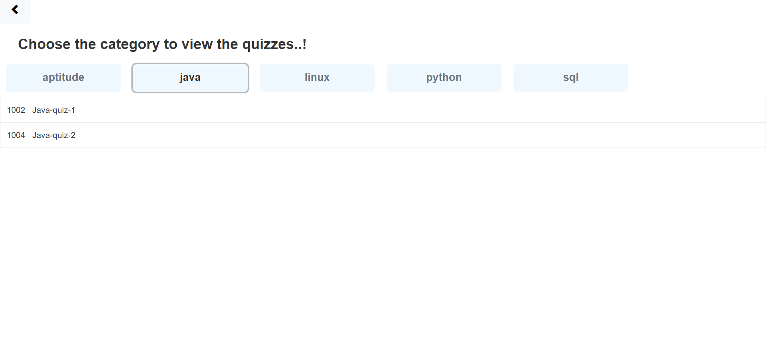

Slide 20
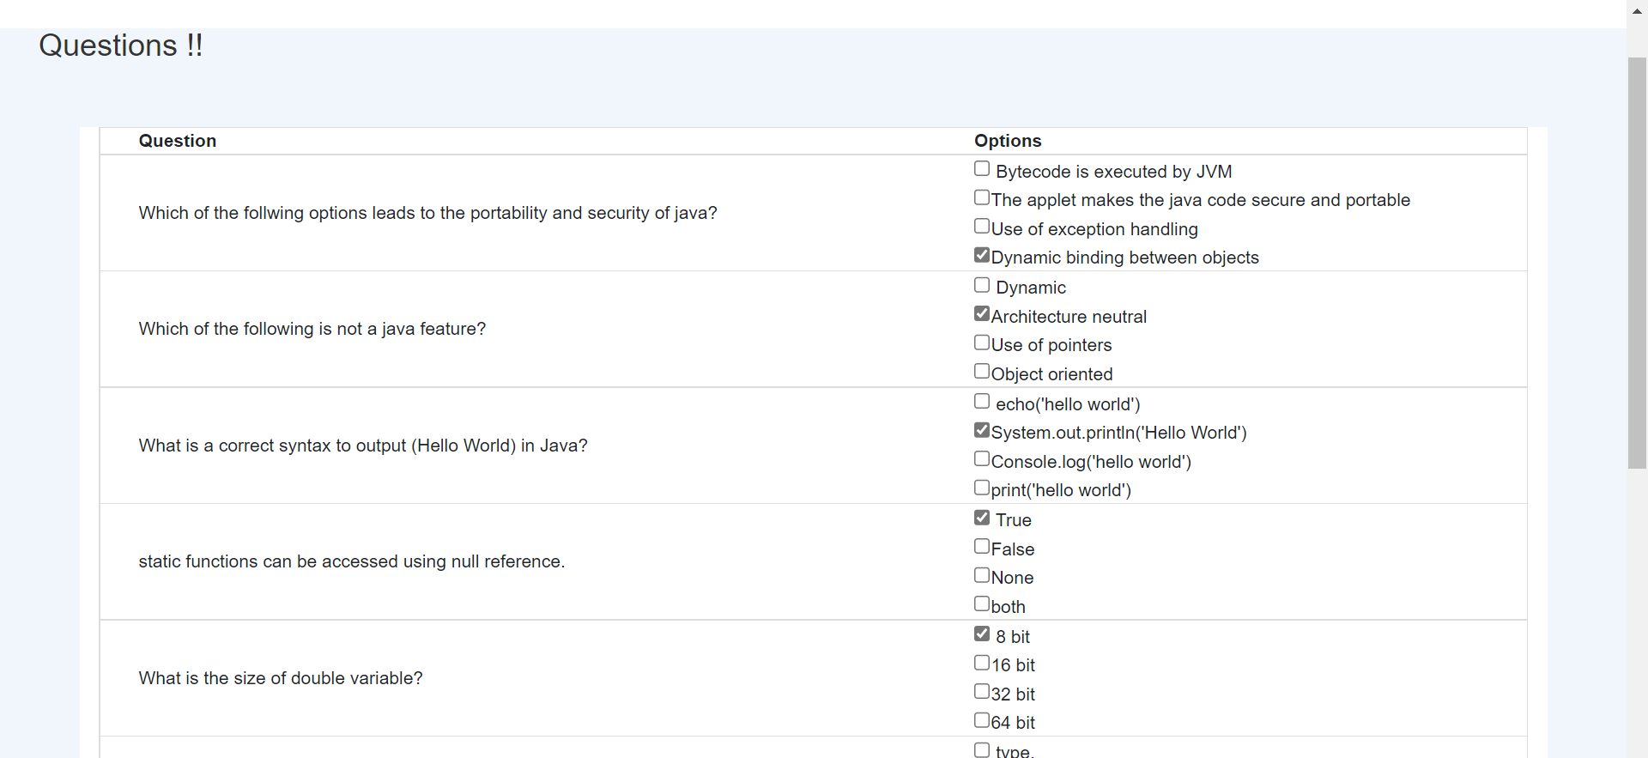

Slide 21
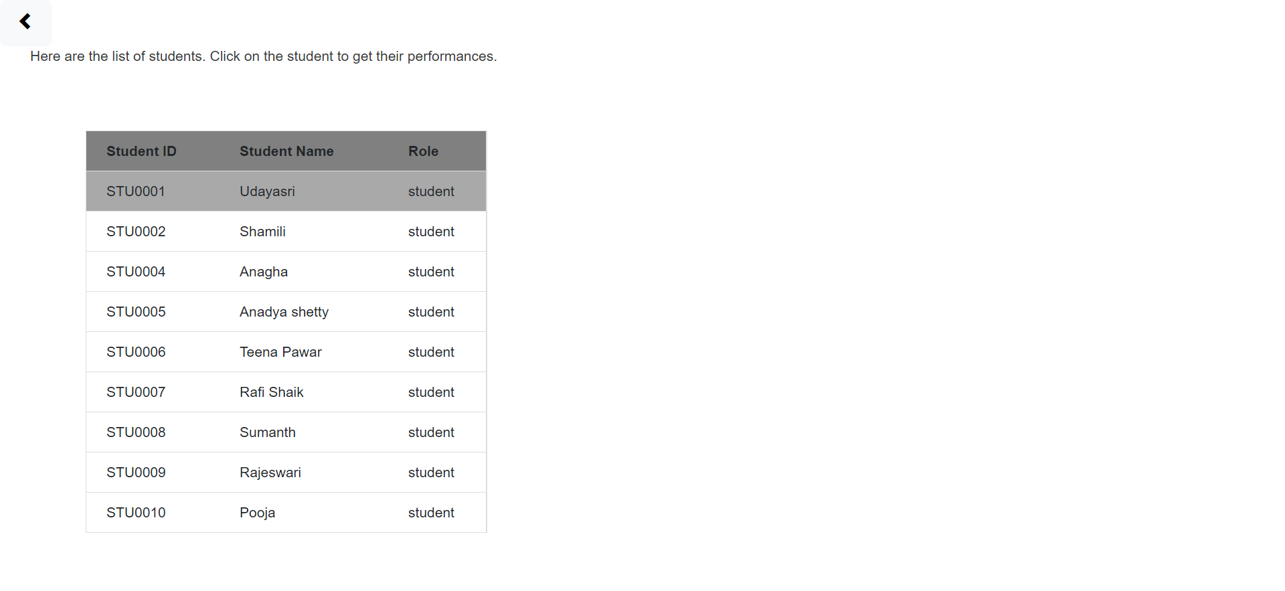

Slide 22
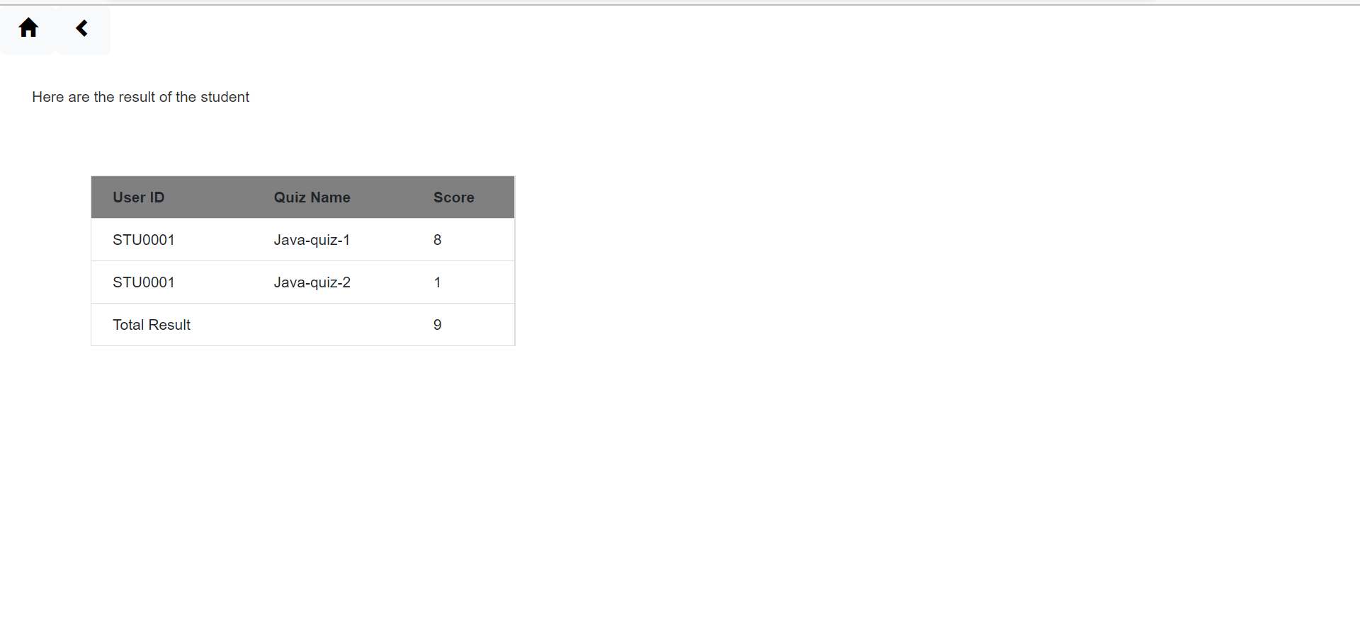

Slide 23



