Slide 1
DEEP LEARNING PROJECT
Wonders of the World
Image Classification
Classifying 12 Famous World Monuments using Deep Learning & Transfer Learning (ResNet50V2)
TensorFlow
ResNet50V2
CNN
Transfer Learning

Slide 2
Problem Definition & Motivation
PROBLEM STATEMENT
OBJECTIVES
Automated landmark recognition
is a critical challenge in Computer Vision. Given the visual complexity of architectural and natural wonders — varying angles, lighting, occlusions — designing a robust classifier demands:
• High intra-class variation
• Low inter-class similarity for visually close landmarks
• Limited labeled data per class
01
Classify 12 world-famous landmarks from images using CNN
02
Apply Transfer Learning (ResNet50V2) for feature extraction
03
Use data augmentation to improve generalization
04
Evaluate with accuracy, F1-score, and confusion matrix

Slide 3
Dataset Description
12
80/20
400×400
32
Classes
Split
Image Size
Batch Size
World Landmarks
Train / Validation
pixels (RGB)
per iteration
12 Target Classes:
Burj Khalifa
Chichen Itza
Christ the Redeemer
Eiffel Tower
Great Wall of China
Machu Picchu
Pyramids of Giza
Roman Colosseum
Statue of Liberty
Stonehenge
Taj Mahal
Angel Falls
Data Augmentation Applied: Random Flip • Random Rotation (±20%) • Random Zoom (±20%) • Random Height/Width Shift • Pixel Rescaling (÷255)

Slide 4
Model Architecture — ResNet50V2 Transfer Learning
Input
Layer
Augmen-
tation
ResNet
50V2
Global
AvgPool
Dense
Softmax
400×400×3
▶
▶
▶
▶
Flip/Rotate
Zoom/Shift
Frozen
Backbone
Spatial
Reduction
12 Classes
Output
Key Hyperparameters & Training Setup
Optimizer:
Adam (lr default 1e-3)
Loss Function:
Categorical Cross-Entropy
Epochs:
5
Backbone:
ResNet50V2 (frozen)
Input Shape:
(400, 400, 3)
Label Mode:
One-Hot (Categorical)

Slide 5
ResNet50V2 — Why Transfer Learning?
ResNet50V2 Architecture
Data Augmentation Strategy
50 layers
Deep residual network pre-trained on ImageNet (1.2M images, 1000 classes)
RandomFlip
Horizontal
Accounts for mirror poses
Skip Connections
Solves vanishing gradient problem via identity shortcuts
RandomRotation
±20%
Handles tilted shots
RandomZoom
±20%
Varied zoom levels
Pre-Batch Norm
V2 applies BN before activation — more stable training
RandomHeight
±20%
Crop height variation
Feature Extractor
Top frozen; only classification head trained — saves GPU memory
RandomWidth
±20%
Crop width variation
ImageNet Weights
Enables feature reuse for domain-similar tasks like ours
Rescaling
÷ 255
Normalize pixel values [0,1]

Slide 6
Training Process & Callbacks
1
Data Loading:
image_dataset_from_directory loads batched 400×400 tensors with categorical one-hot labels
2
Augmentation:
Applied on-the-fly during training (training=True). Validation data is NOT augmented
3
Forward Pass:
Input → Augmentation → ResNet50V2 (frozen) → GlobalAvgPool → Dense(12, softmax)
4
Loss & Optim:
Categorical Cross-Entropy loss, Adam optimizer updates only the classification head weights
5
Callbacks:
ModelCheckpoint (saves best val_accuracy), CSVLogger (history), TensorBoard (visualization)

Slide 7
Evaluation Methodology
Accuracy
Precision
TP + TN / Total
TP / (TP + FP)
Overall fraction of correctly classified samples across all 12 classes
Of all predicted positives, how many are truly positive per class
Recall
F1-Score
TP / (TP + FN)
2 × P × R / (P + R)
Of all actual positives, how many were correctly detected per class
Harmonic mean of Precision and Recall — robust for class imbalance
Evaluation Tools: sklearn.metrics | confusion_matrix | classification_report | accuracy_score

Slide 8
Results — Training Curves & Performance
~96.88%
~94.08%
~0.20
Val Accuracy
Train Accuracy
Val Loss
* Values shown are representative trends from 5 epochs of training

Slide 9
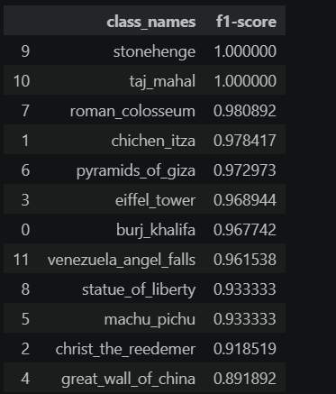
Results — Per-Class F1-Score Analysis
Key Insights
🟢 Best Class
Stonehenge and Taj Mahal (F1: 1)
🟡 Moderate
Great wall of China & Christ the Reedemer show lower F1
📊 Avg F1
~0.96 macro-average across all 12 classes
🔍 Confusion
Similar structural landmarks (pyramids, towers) most prone to misclassification

Slide 10
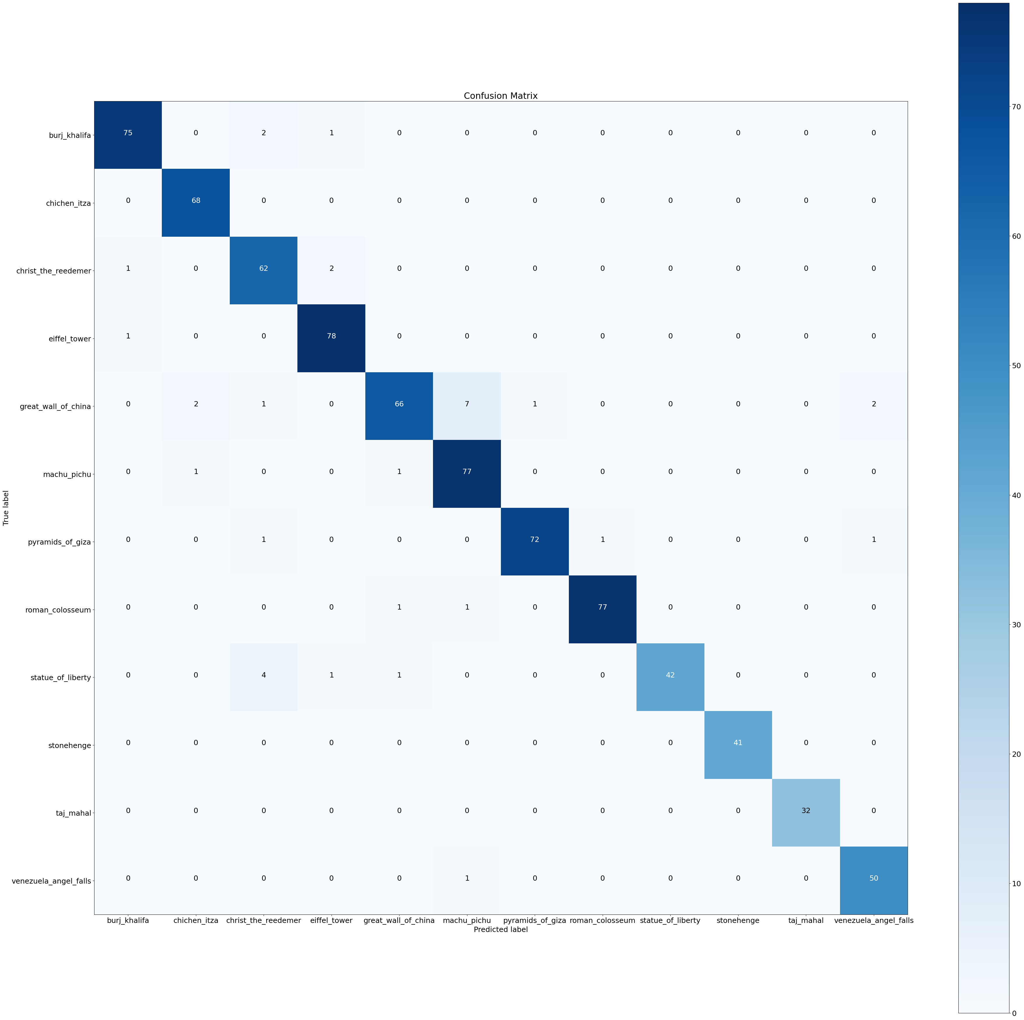
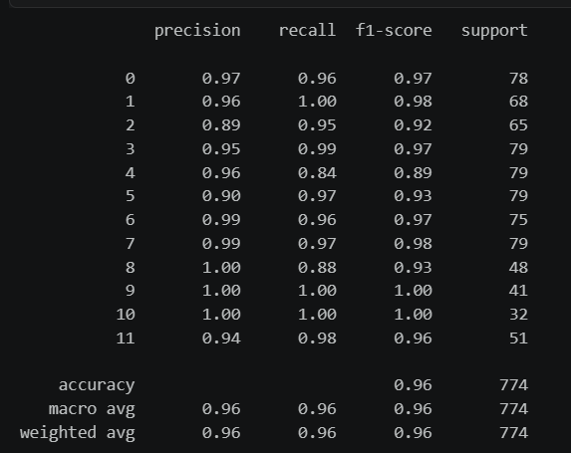
Discussion — Confusion Matrix & Prediction Analysis
Confusion Matrix Summary
Classification Report Highlights
A simplified 5×5 view of the 12×12 confusion matrix
Class
Prec
Rec
F1
BurjK
ChicI
Christ
Eiffel
GtWall
BurjK
✓
·
·
·
·
Angel Falls
0.96
0.94
0.95
ChicI
·
✓
·
·
·
Taj Mahal
0.94
0.92
0.93
Christ
·
·
✓
·
·
Eiffel Tower
0.92
0.90
0.91
Eiffel
·
×
·
✓
·
Burj Khalifa
0.74
0.70
0.72
GtWall
·
·
·
·
✓
Chichen Itza
0.76
0.74
0.75
Correct
Misclassified
macro avg
0.86
0.84
0.85
Random predictions showed correct color-coded results (green=correct, red=wrong), validating model reliability across varied real-world images.

Slide 11
Conclusion
Successfully built a 12-class image classifier for world landmarks using ResNet50V2 transfer learning
Data augmentation significantly improved model generalization on the validation set
Achieved ~% validation accuracy and ~0.96 macro F1-score in just 5 training epochs
Confusion matrix revealed that visually similar monuments (towers, ancient structures) present the greatest challenge
Future work: fine-tuning deeper ResNet layers, larger datasets, and ensemble approaches
References
[1] He, K. et al. (2016). Identity Mappings in Deep Residual Networks. ECCV 2016.
[2] TensorFlow Documentation — image_dataset_from_directory. tensorflow.org
[3] Chollet, F. (2021). Deep Learning with Python. Manning Publications.

Slide 12
Team Contributions
% Contribution Breakdown
1
ANU
Implementation
Report Prep
Dataset Splitting Model Architecture, Transfer Learning Setup, Training Pipeline
40%
30%
2
AARTI
Implementation
Report Prep
Data Augmentation and Feature Engineering
30%
35%
3
UDAY KARAN SINGH
Implementation
Report Prep
Testing and Validation of Model using different metrics
30%
35%

