Slide 1
Ground water level Prediction
Submitted By (Batch: 3)
B.SIVARAMA KRISHNA (21VV1A1212)
B.YAMUNA (21VV1A1213)
B.AJAY KUMAR (21VV1A1214)
CH.UDHAY KIRAN (21VV1A1215)

Slide 2
Abstract
Predicting groundwater availability is a crucial step that needs to be taken by governments and environmental agencies as it is becoming a significant concern for water resource management. Groundwater depletion can have severe consequences, such as agricultural losses, reduced water supply, and environmental degradation. Accurately forecasting groundwater levels using advanced machine learning models can help mitigate these challenges, allowing for better planning and sustainable water use.

Slide 3
What is GROUND WATER LEVEL PREDICTION
India uses Groundwater Level Index (GWLI) to predict the quality and availability of groundwater resources.
The groundwater index is composed of several factors related to recharge and extraction.
The factors are Total Groundwater Recharge (from Rainfall and other sources), Groundwater Extraction for Irrigation, Groundwater Extraction for Domestic and Industrial use, Natural Discharge, and Net Groundwater Availability for future use.

Slide 4
Water Quality index Categories
The Groundwater Level Index measures the availability and quality of groundwater. It shows the amount of groundwater available and the rate of extraction. There are 6 categories that have been created in this groundwater level index.
Those categories are:
1.High Availability 2.Adequate Availability
3.Moderate Availability 4.Low Availability
5.Critical 6.Over-exploited

Slide 5
Design
Data collection: Gathering ground level water data, meteorological data, and geographical information.
Data preprocessing: Cleaning and preparing the data for modeling.
Model selection: Choosing an appropriate machine learning algorithm for GROUND WATER LEVEL prediction.
Model training: Training the model on historical data.
Model evaluation: Assessing the model's performance on unseen data.
Model deployment: Integrating the model into a system for real-world use.

Slide 6
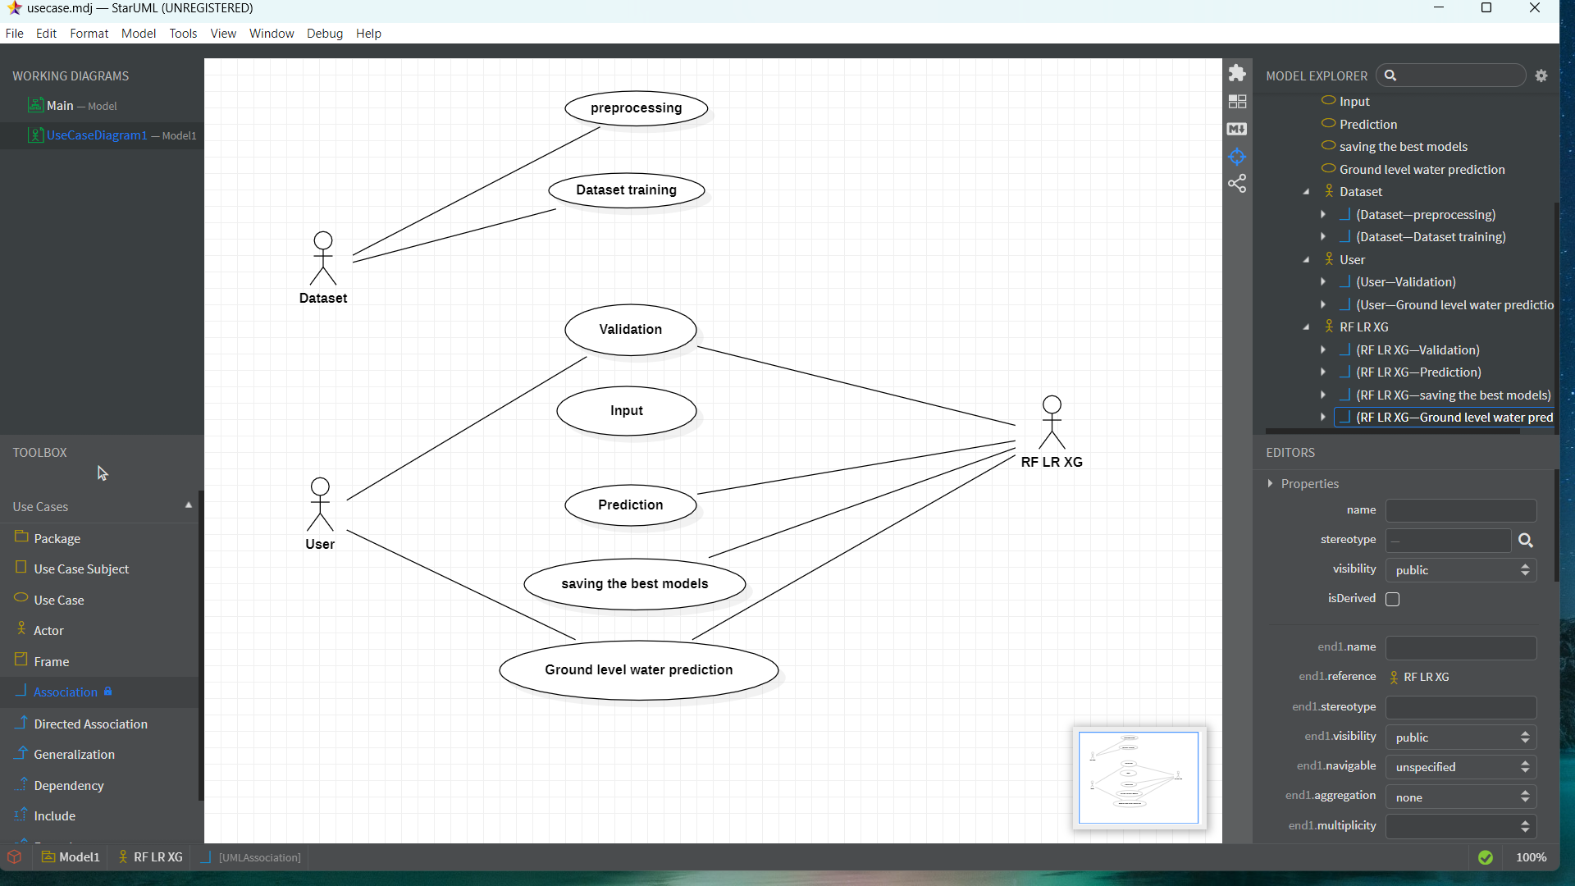
1 .Use Case Diagram

Slide 7
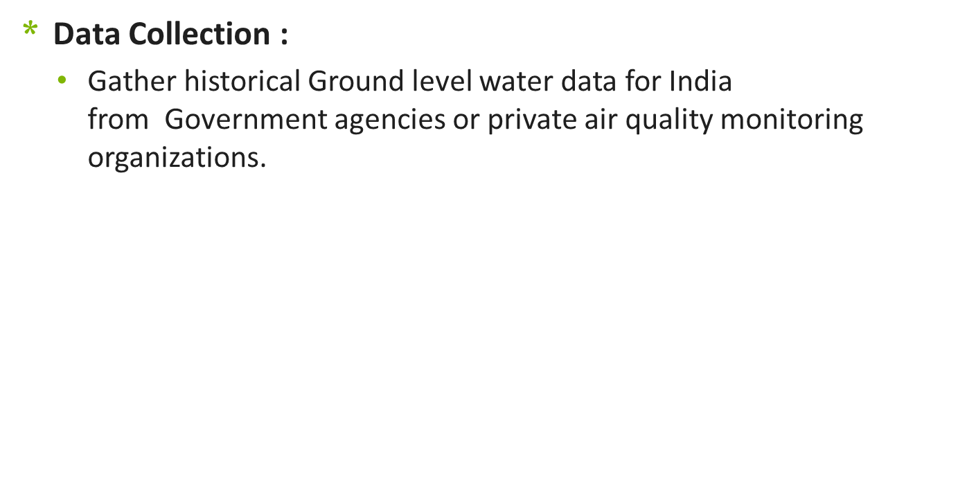
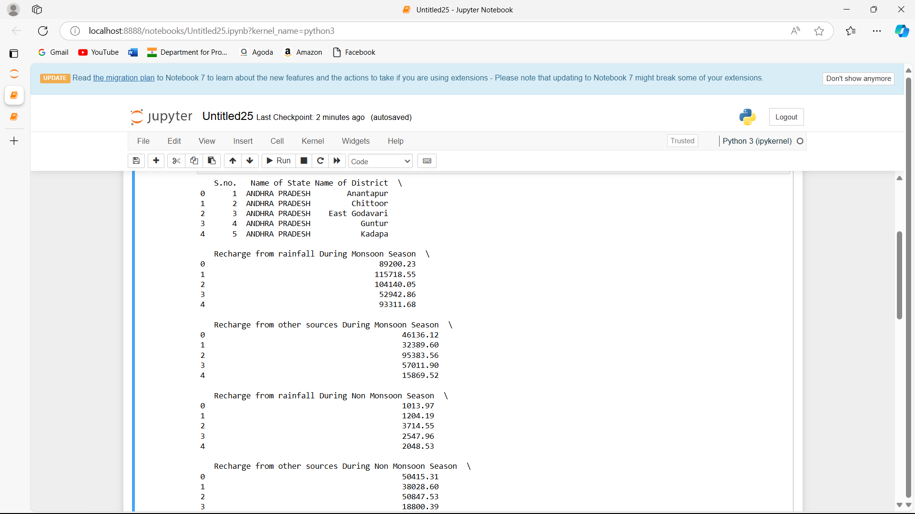
Implementation

Slide 8
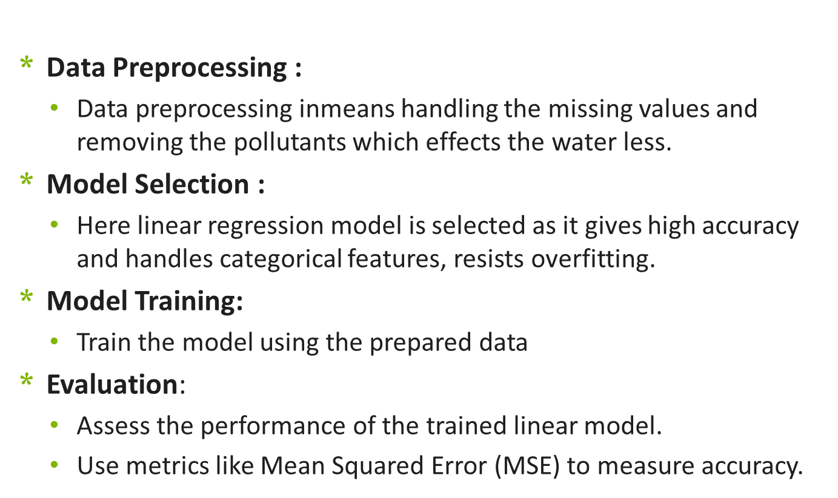
Implementation

Slide 9
Results
Model | RMSE | MAE | R²
XG Boost | 8631.21 | 4030.42 | 0.9223959538026505
Random Forest | 9239.582262986769 | 4203.721621739135 | 0.9096584888648153
Linear Regression | 7322.972274667175 | 5129.853499257325 | 0.9432510987290998

Slide 10
Results(Continued)
By observing the table , when compared to all algorithms the model has lower MAE, lower RMSE and higher r-squared error when built using Linear regression algorithm.
This indicates that Linear regression model is good for Predicting the Ground water level prediction .
Finally, by observing performance metrics for all the models, we can say that among all regression models Linear regression model performs well in Predicting (Ground water level) for given data.

Slide 11
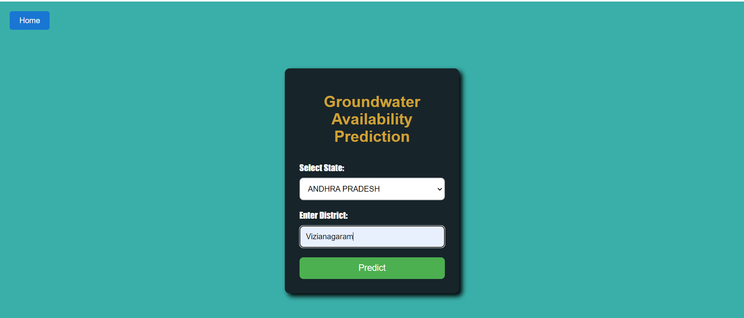
Results(Continued)

Slide 12
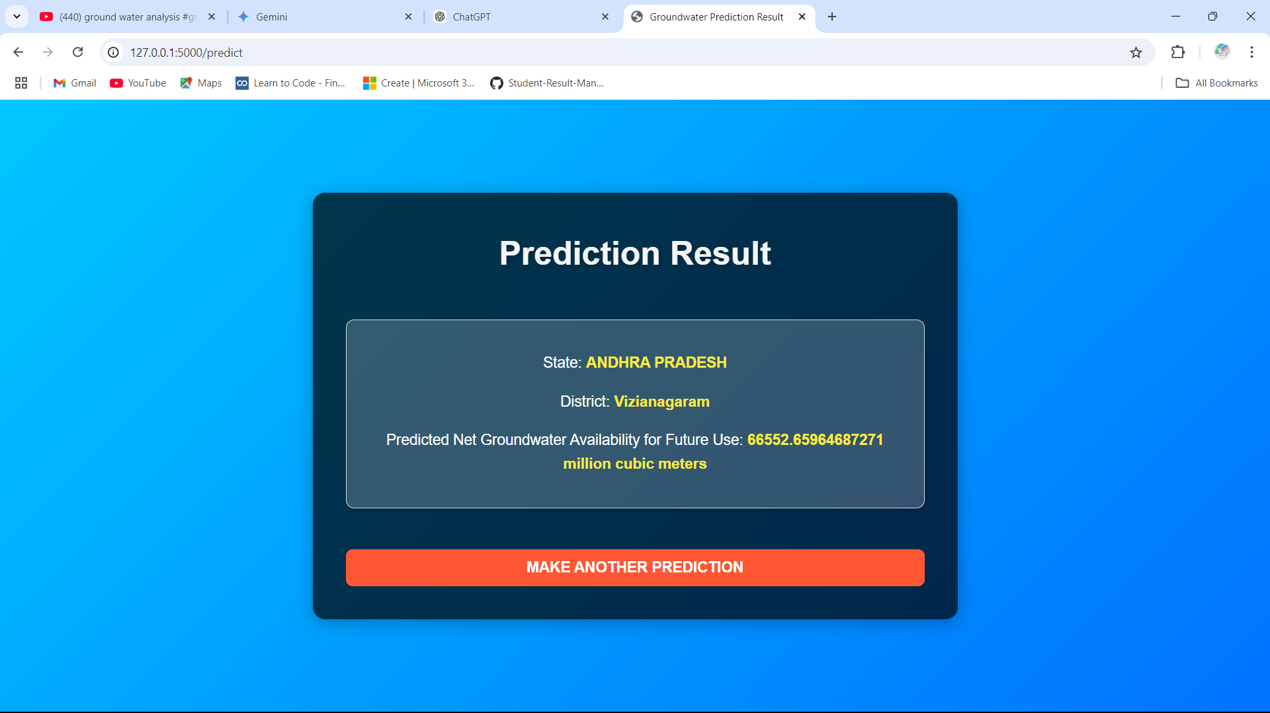
Results(Continued)

Slide 13
Conclusion
Based on our literature review, Linear regression was identified as a promising machine learning algorithm for predicting Ground water level.
We preprocessed the data and successfully trained the Linear regression algorithm.
Performance evaluation of the Linear regression model was conducted using key metrics including Mean Absolute Error (MAE), Root Mean Square Error (RMSE), and R-squared (R²).
We can conclude that Linear regression exhibited better performance in predicting Ground water level , outperforming traditional regression-based algorithms in terms of predictive accuracy and model fit.

Slide 14
Thank You All

