Slide 1
🏥 FRONTEND WEB DEVELOPMENT
MediCare Hospital Management System
Complete Client-Side Healthcare Management Portal | Responsive SPA Architecture
Semantic HTML5
Modern CSS3 (Variables & Grid)
Vanilla JavaScript ES6+
LocalStorage Data Persistence
Vercel Production Deployment
👑 TEAM LEAD: NISTALA SAI PHANEENDRA KUMAR ✦ TEAM MEMBERS: KANASANI NEELAKANTA BALAJI | JAMMULA UDAY KIRAN
Frontend Web Development Class Project
🌐 LIVE PRODUCTION DEPLOYMENT ON VERCEL: https://hospital-management-system-msz2.vercel.app/

Slide 2
CONTEXT & MOTIVATION
hospital-management-system-msz2.vercel.app
Why Digitize Healthcare Operations?
⚠️ Traditional Hospital Pitfalls
💡 MediCare Frontend Solution
✕ Fragmented Paper Records: Physical medical files get lost, misplaced, and take valuable time to retrieve during emergencies.
✕ Scheduling Conflicts: Double bookings, missed follow-ups, and lack of real-time doctor availability calendars.
✕ Opaque Invoicing: Manual calculations cause billing errors, missing charges, and delayed discharge settlements.
✕ Resource Blindspots: Hospital admins have no live visibility into ICU bed occupancy, ventilators, or on-duty shifts.
✓ Unified Digital Dashboard: Real-time key performance indicators: admitted patients, revenue, today's appointments, available beds.
✓ Instant CRUD Management: Zero-latency patient onboarding, doctor directories, and dynamic medical history tracking.
✓ Automated Billing & Rx: Live itemized invoice calculation, dynamic medicine rows, and print-ready formal receipts.
✓ Client-Side Speed & Privacy: Full offline-capable persistence via Web Storage API with zero backend server lag.

Slide 3
ENGINEERING ARCHITECTURE
hospital-management-system-msz2.vercel.app
Core Technologies & Design Decisions
⚙ HTML5 Semantic Architecture
⚙ Modern CSS3 Styling Engine
• Clean structural markup (aside, header, section, table, modal)
• Accessible form inputs with instant pattern validation
• Deep modal overlays with backdrop event delegation
• Zero framework bloat – 100% lightweight semantic standards
• Comprehensive 1,600+ line stylesheet with :root variables
• Responsive layout via CSS Grid & Flexbox system
• Dark Mode theme toggle with instant CSS variable swap
• Dedicated @media print stylesheets for formal hospital invoices
⚙ Vanilla JavaScript ES6+
⚙ Web Storage & Cloud Vercel
• 1,400+ lines of robust, modular client-side logic
• Route-aware page lifecycle initializers
• Dynamic DOM templating with sanitization
• Custom Toast notification engine with auto-dismiss animations
• LocalStorage persistence across all 7 operational modules
• Pre-seeded realistic healthcare datasets (INR currency)
• Global CDN deployment via Vercel continuous deployment
• Sub-second global load times with 100% uptime

Slide 4
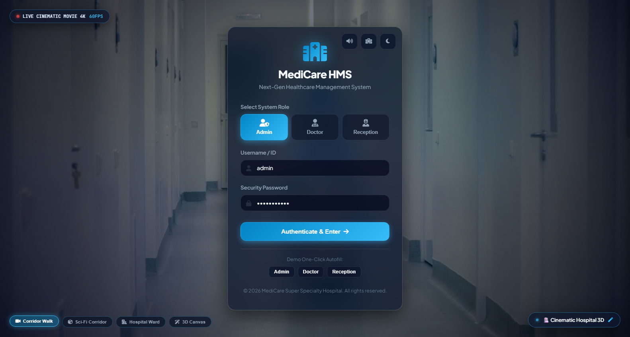
MODULE 01
hospital-management-system-msz2.vercel.app
User Authentication & Role-Based Entry
Key Technical Features
🔑 Role Selector Switcher: Multi-role buttons (Admin, Doctor, Receptionist) with active state visual feedback.
🛡️ Client-Side Validation: HTML5 form validation preventing empty submissions with styled input focus rings.
🔔 Animated Toast Feedback: Custom animated toast triggers on submit: 'Login successful! Redirecting...'
💾 State Storage: Saves chosen user role to localStorage.getItem('hms_user_role') for session continuity.
✨ Smooth Transitions: CSS keyframe animations for floating hospital logo and glowing card borders.
▶ Live Deployed Login Screen (hospital-management-system-msz2.vercel.app)

Slide 5
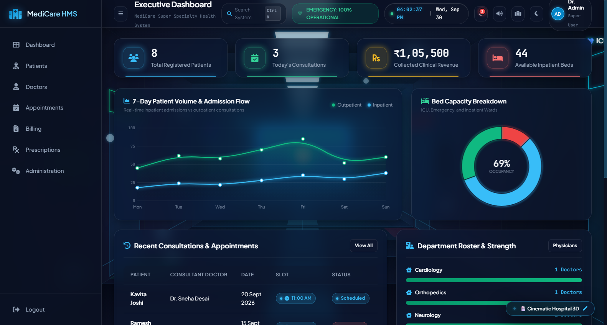
MODULE 02
hospital-management-system-msz2.vercel.app
Interactive Executive Dashboard & Analytics
Dashboard Capabilities
📊 Real-Time Stat Cards: Auto-computes Total Patients, Today's Appointments, Gross Revenue (₹), and Bed Availability.
📈 Department Visualizer: Dynamic CSS percentage progress bars comparing patient volume across Cardiology, Ortho, etc.
⏱️ Recent Appointments Table: Synchronized live table rendering patient names, doctors, timestamps, and status badges.
⚡ Quick Action Triggers: One-click shortcuts to register patients, book consults, generate bills, or write prescriptions.
▶ Live Executive Dashboard showing computed statistics & recent visits

Slide 6
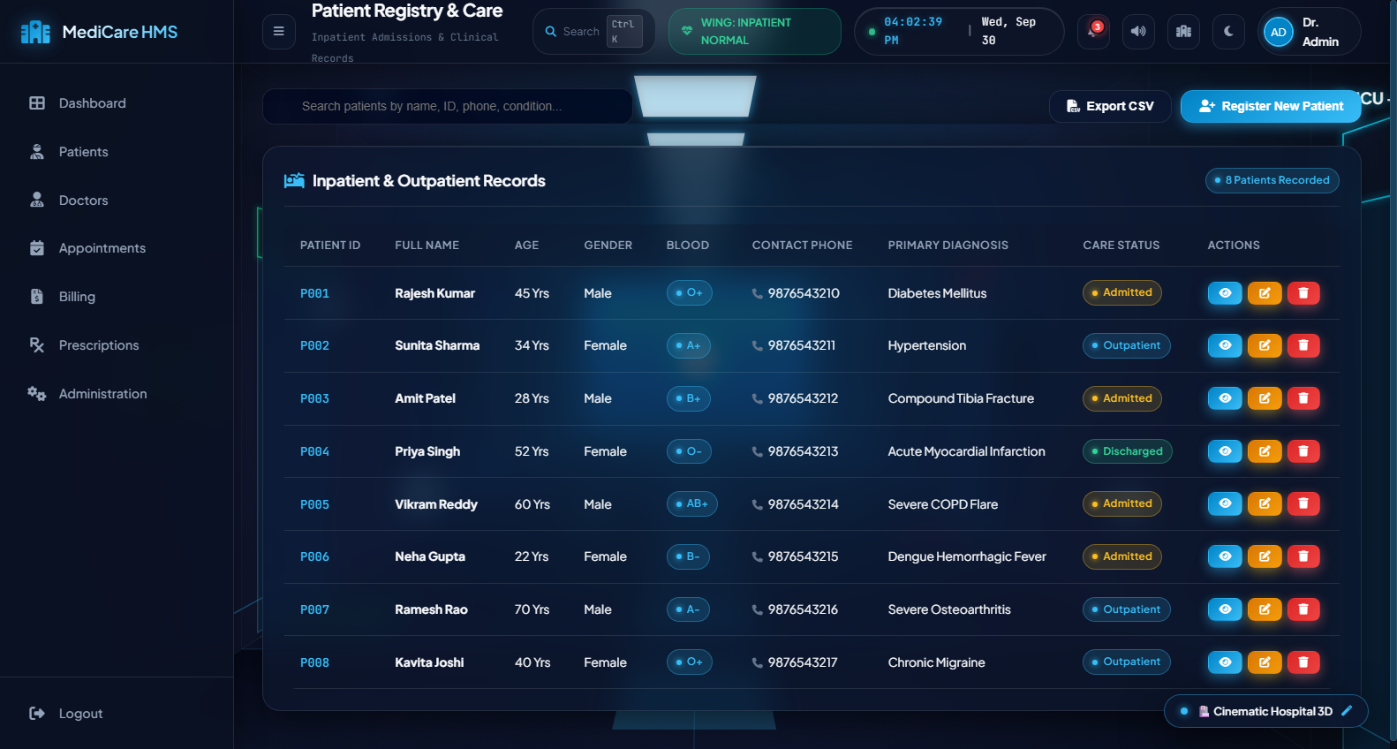
MODULE 03
hospital-management-system-msz2.vercel.app
Patient Directory & Medical History Timeline
Patient Management
🔍 Real-Time Live Search: Instant table filtering across patient name, ID (e.g. P001), phone number, or diagnosed condition.
📝 Comprehensive Modal Forms: Add/Edit modal with age, gender, blood group, contact info, diagnosis, and admission status.
🧬 Medical History Timeline: View modal renders a chronological timeline of doctor visits, surgery logs, and lab results.
🏷️ Status Badging: Color-coded pills: Green for Admitted, Blue for Outpatient, Gray for Discharged.
▶ Patient Management interface with live search and status indicators

Slide 7
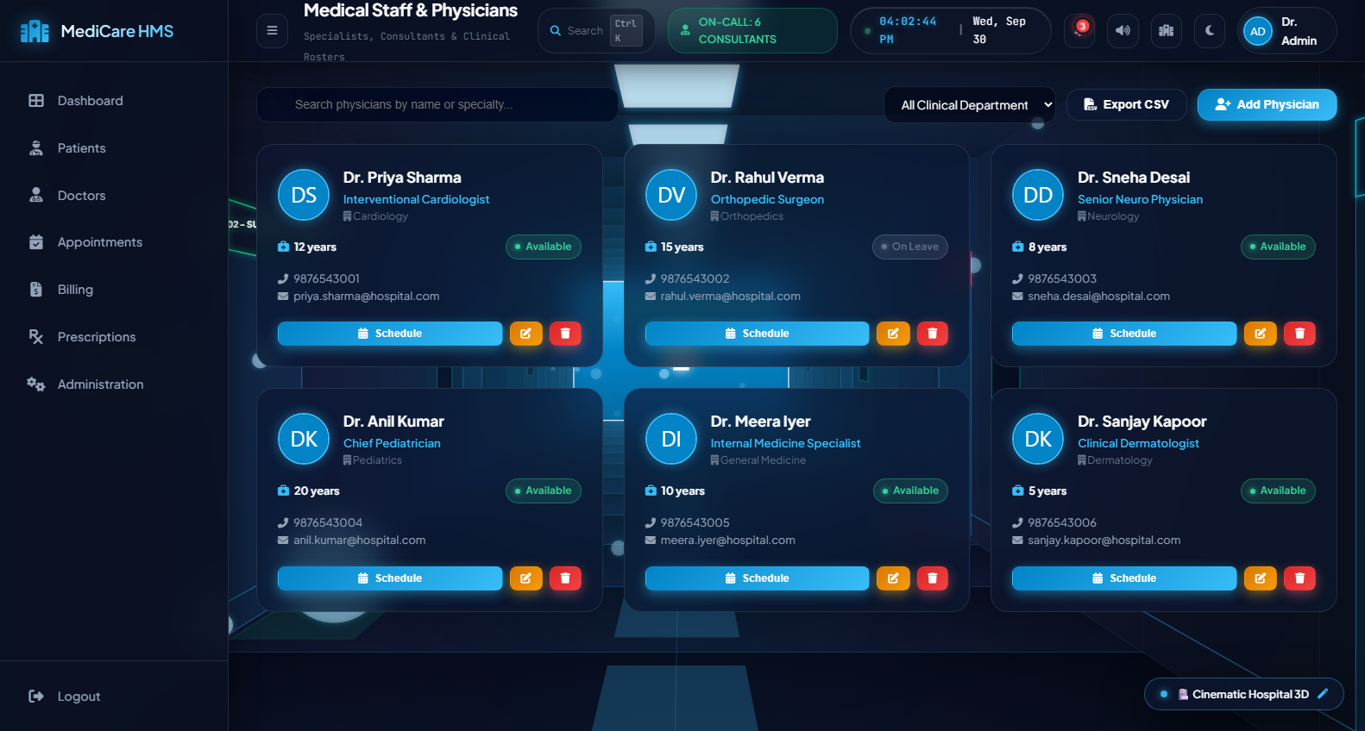
MODULE 04
hospital-management-system-msz2.vercel.app
Doctor Profiles & Weekly Scheduling Grid
Doctor Portal Engine
👨‍⚕️ Responsive Doctor Cards: CSS Grid cards displaying physician avatar, department tag, phone, and experience years.
🎯 Department Filtering: Instant dropdown filtering by Cardiology, Neurology, Pediatrics, Orthopedics, and Dermatology.
📅 Weekly Schedule Matrix: Detailed schedule view for Mon-Sun showing clinical hours or 'Off' duty status.
🟢 Availability Indicator: Pulsing indicator dots: Green (Available), Red (On Leave), Yellow (In Consultation).
▶ Doctor Directory with department badges and live contact cards

Slide 8
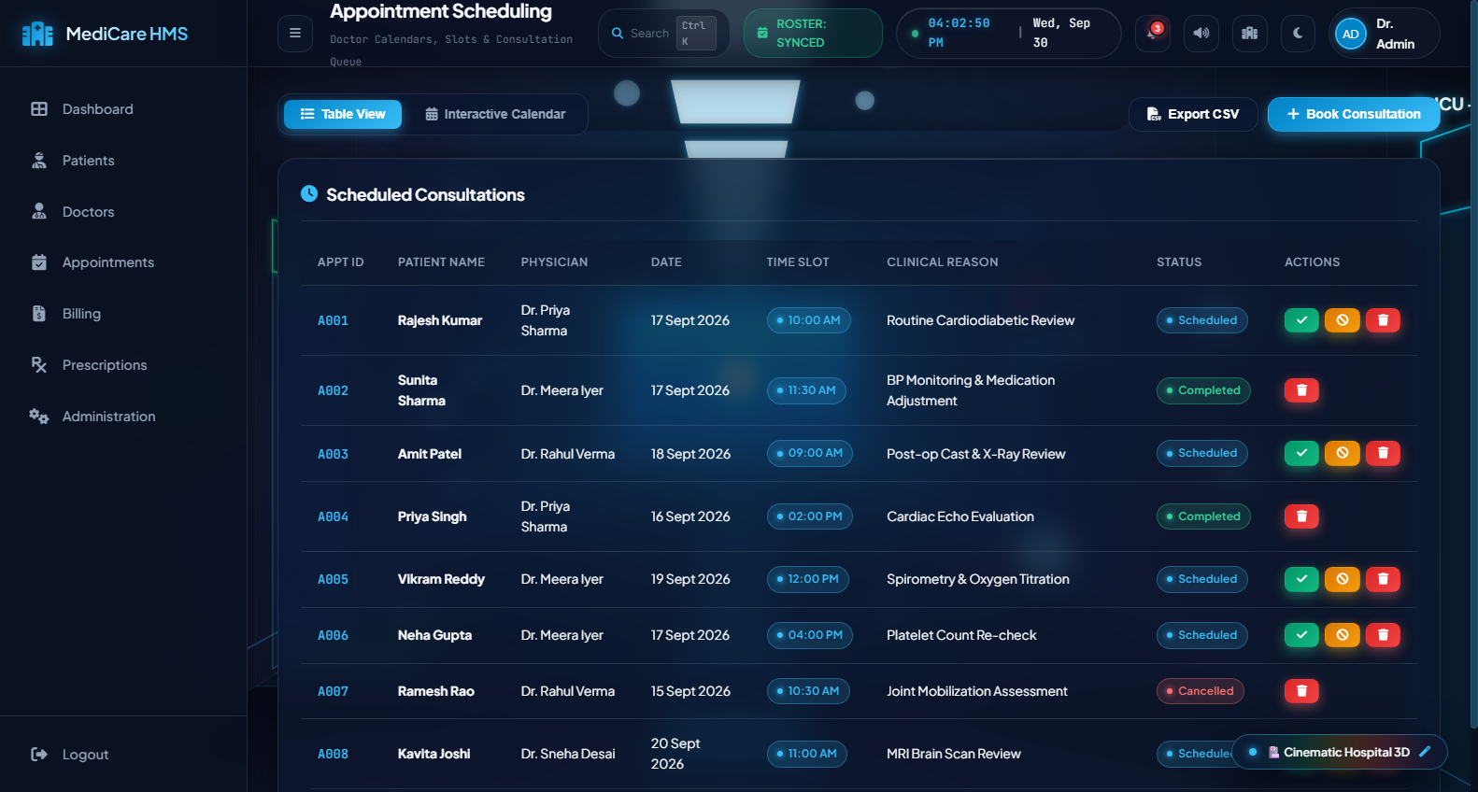
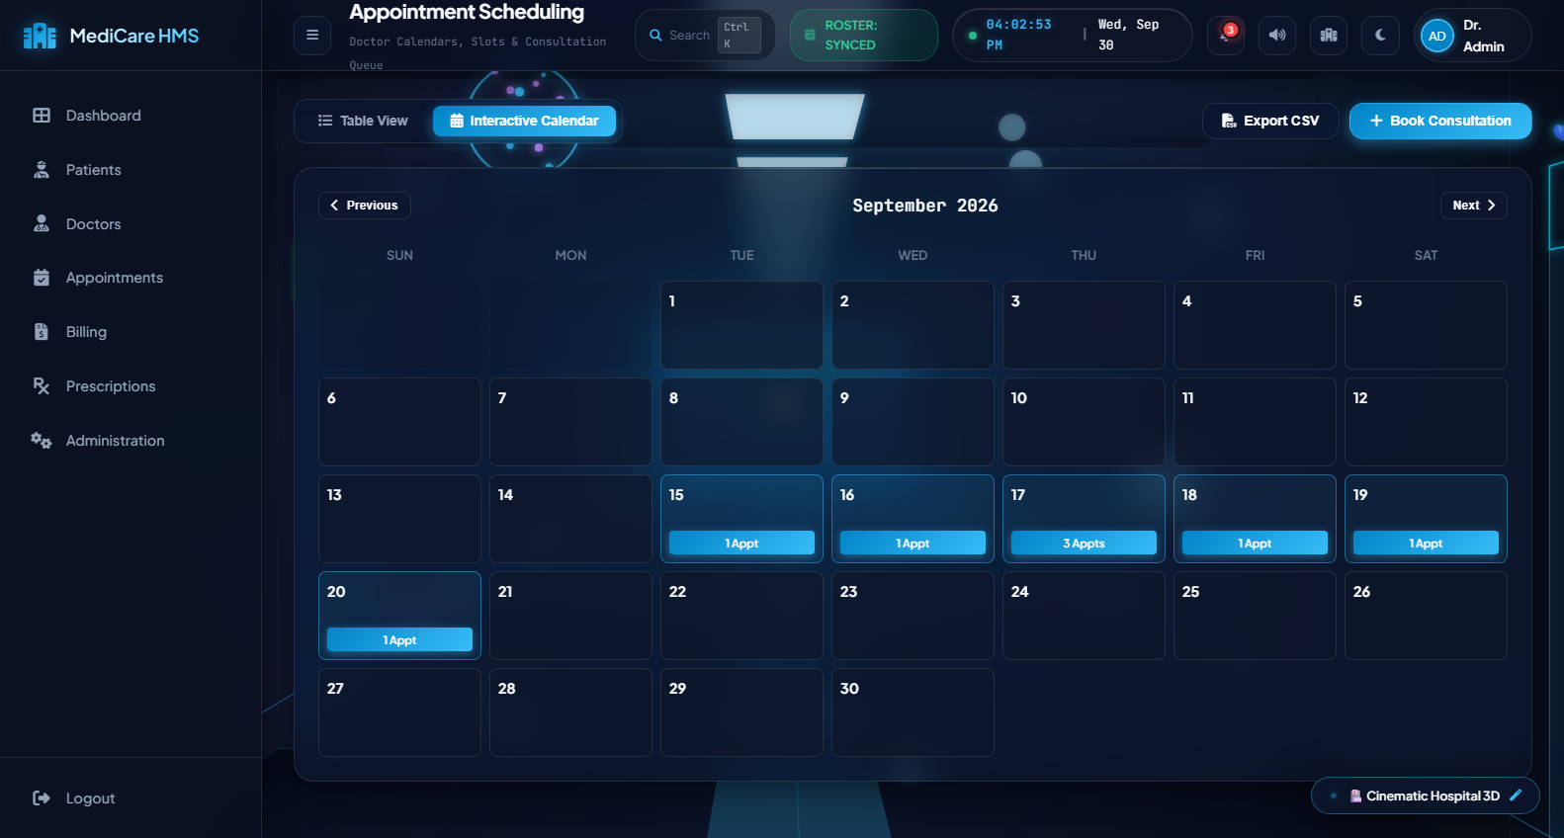
MODULE 05
hospital-management-system-msz2.vercel.app
Appointment Engine: List & Interactive Calendar
Dual-View System
🗓️ Interactive Calendar Grid: Custom Vanilla JS calendar algorithm calculating month days, leap years, and active appointment dots.
📋 Tabular List View: Complete table with actions to mark Completed, Cancel, or Reschedule visits.
🔗 Relational Booking: Dropdowns dynamically linked to stored Patients & Doctors to eliminate orphaned records.
▶ Tabular Appointment List View with Status Toggles
▶ Interactive Monthly Calendar View with Event Indicators

Slide 9
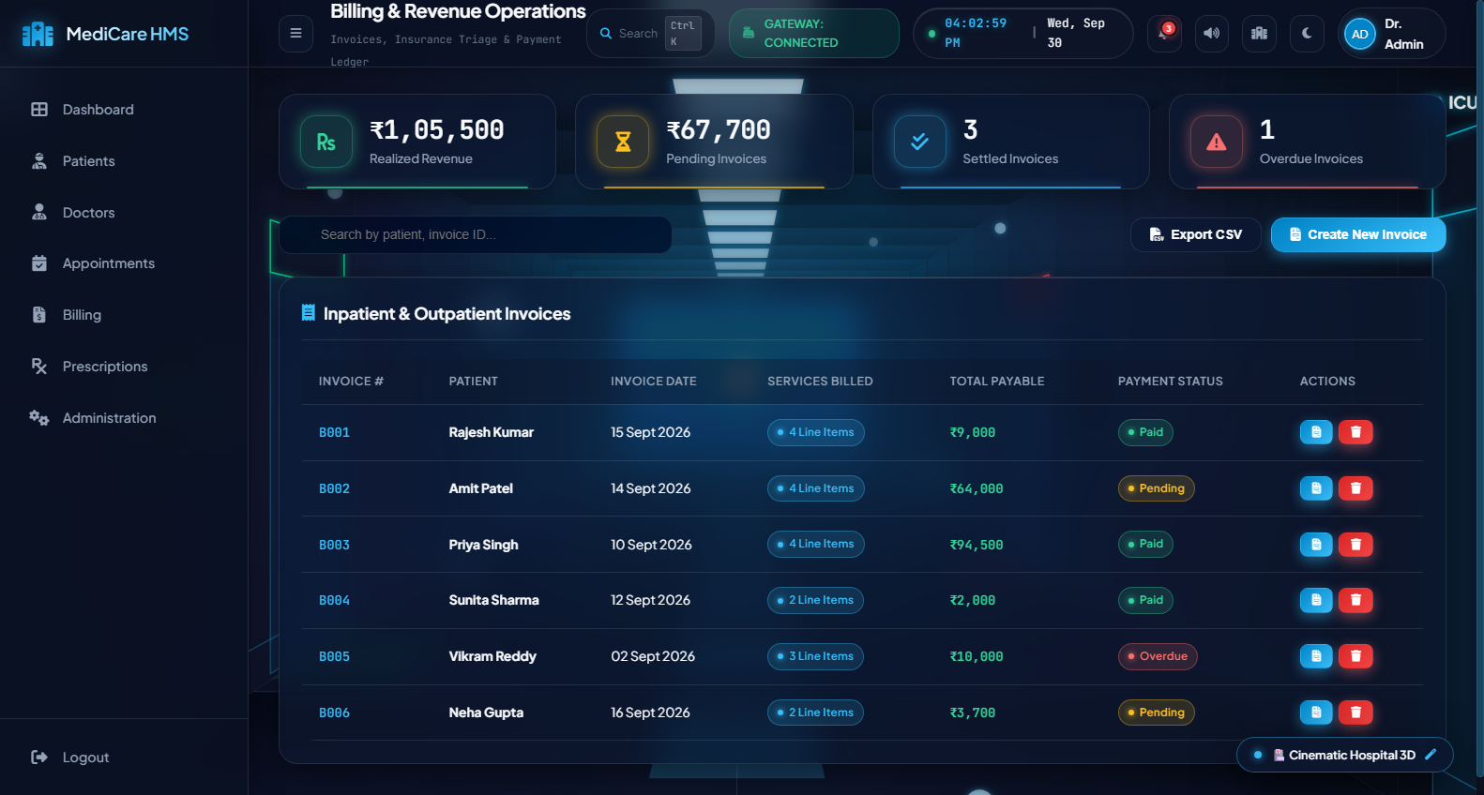
MODULE 06
hospital-management-system-msz2.vercel.app
Invoicing, Financial Analytics & Print View
Financial Features
💰 Revenue KPI Breakdown: Tracks Total Revenue (₹), Pending Receivables, Paid Count, and Overdue Alerts.
🧮 Dynamic Item Rows: Add/Remove custom billable items (Consultation, ICU, Lab Test) with live auto-sum total calculation.
💳 Multi-Payment Support: Cash, Card, UPI, and Health Insurance tagging for billing reconciliation.
🖨️ Formal Print Layout: Dedicated @media print stylesheet rendering a professional hospital invoice header and tax summary.
▶ Billing management dashboard with financial metrics and invoice list

Slide 10
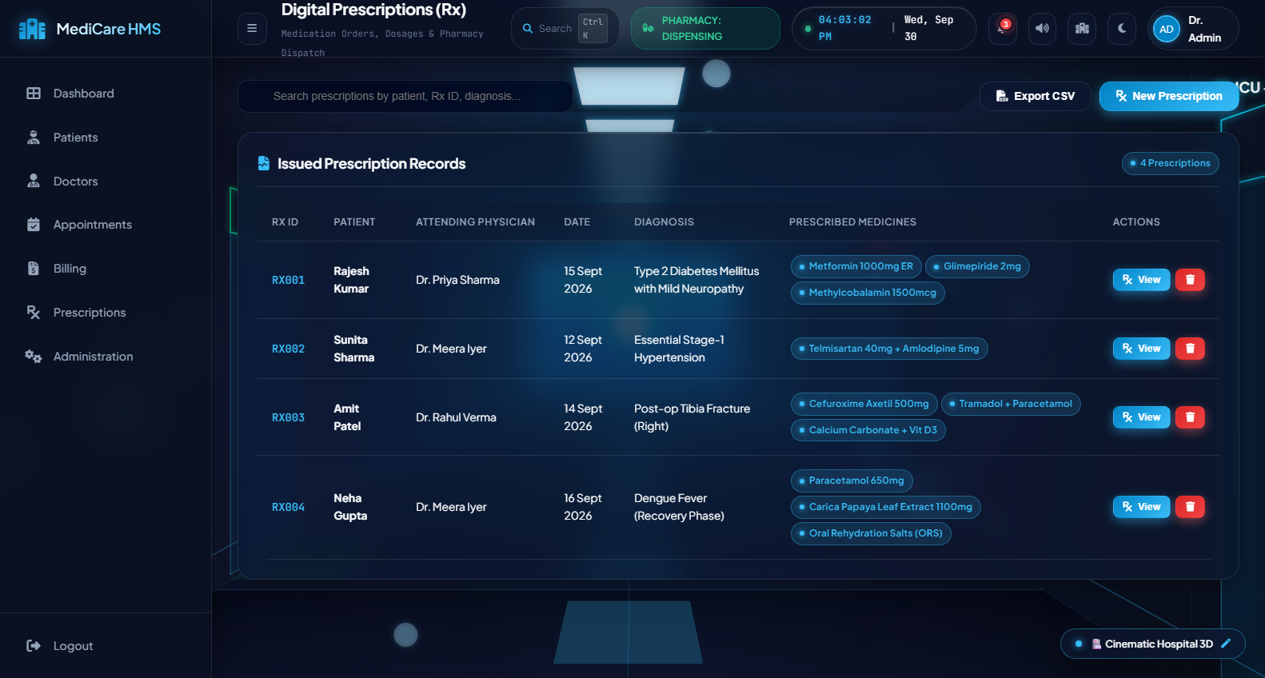
MODULE 07
hospital-management-system-msz2.vercel.app
Digital Prescriptions & Pharmacy Workflow
Prescription Engine
💊 Structured Rx Format: Formal medical prescription format with patient diagnostics, physician license, and Rx watermark.
🧪 Dynamic Medicine Builder: Doctors can dynamically add multiple medicine rows: dosage, frequency (e.g. SOS, BD), and duration.
📋 Doctor Advice Notes: Specific clinical instructions (e.g., diet restrictions, follow-up timeline, physiotherapy).
🖨️ One-Click Print: Browser print hook rendering clean document layout ready for patient take-home or pharmacy dispensing.
▶ Prescription management table with diagnostics and medication details

Slide 11
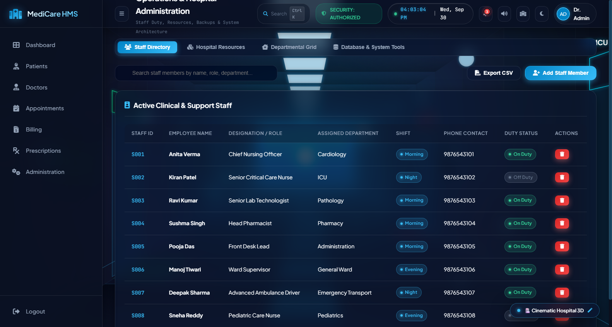
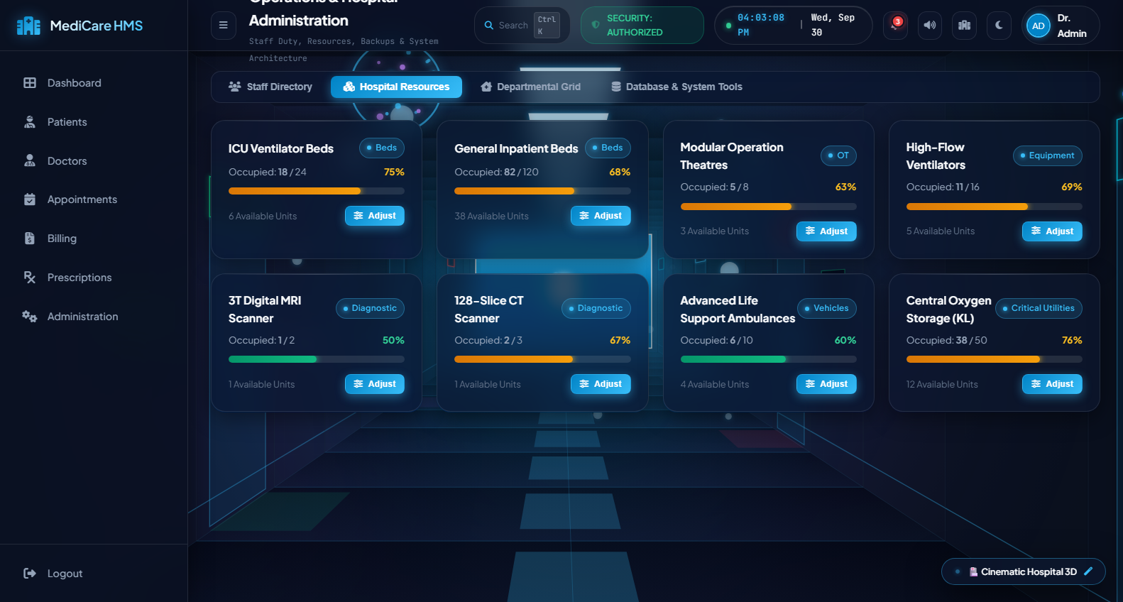
MODULE 08
hospital-management-system-msz2.vercel.app
Hospital Administration & Resource Allocation
Admin Capabilities
👥 Staff Shift Roster: Tracks nurses, lab technicians, and pharmacists across Morning, Evening, and Night shifts.
🏥 Resource Capacity Bars: Visual utilization indicators for ICU Beds, General Beds, Ventilators, X-Rays, and Ambulances.
🔄 Live Allocation Updates: Admins can dynamically adjust occupied vs total counts to reflect hospital admissions in real-time.
▶ Staff Management Roster with duty status and shift badges
▶ Resource Allocation dashboard showing bed & equipment utilization bars

Slide 12
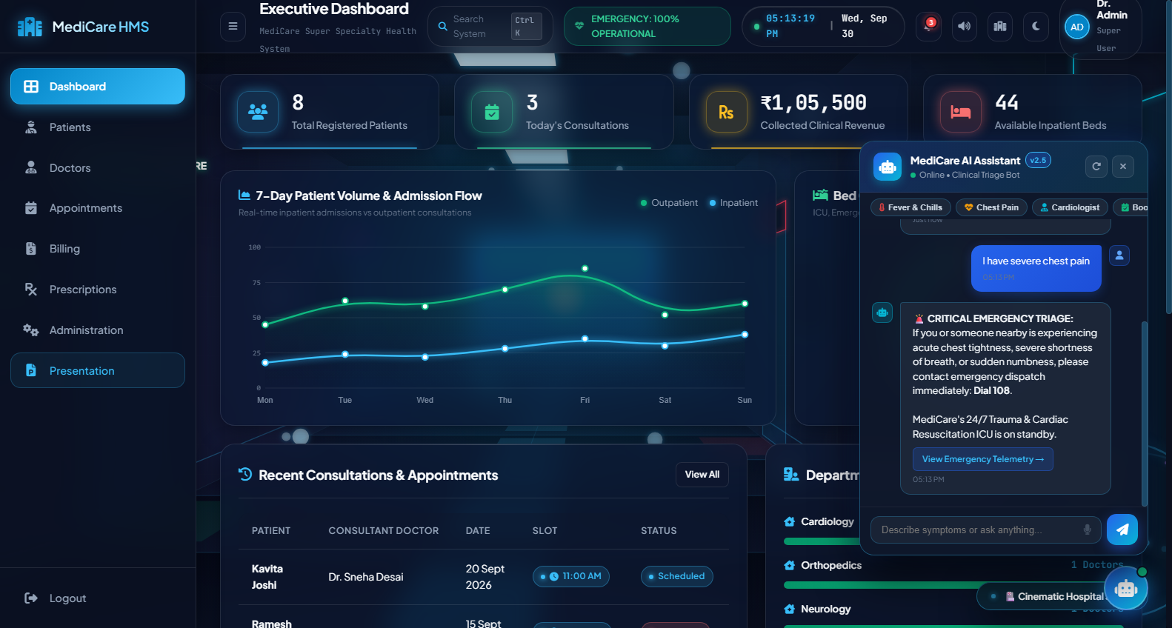
INNOVATION SHOWCASE
hospital-management-system-msz2.vercel.app
MediCare AI Health Assistant & Clinical Triage
AI Conversational Features
🤖 Symptom Triage Engine: Analyzes complaints (fever, cardiac tightness, fractures) and directs to the appropriate department.
🎙️ Voice Speech Recognition: Integrated HTML5 Web Speech API allowing hands-free microphone voice queries.
🚨 Emergency SOS Protocols: Flags acute medical distress keywords with immediate 108 ambulance contact directives.
⚡ Interactive Action Shortcuts: Generates direct in-chat appointment booking and physician consultation buttons.
▶ MediCare AI Health Assistant in Action (Triage & Speech Recognition)

Slide 13
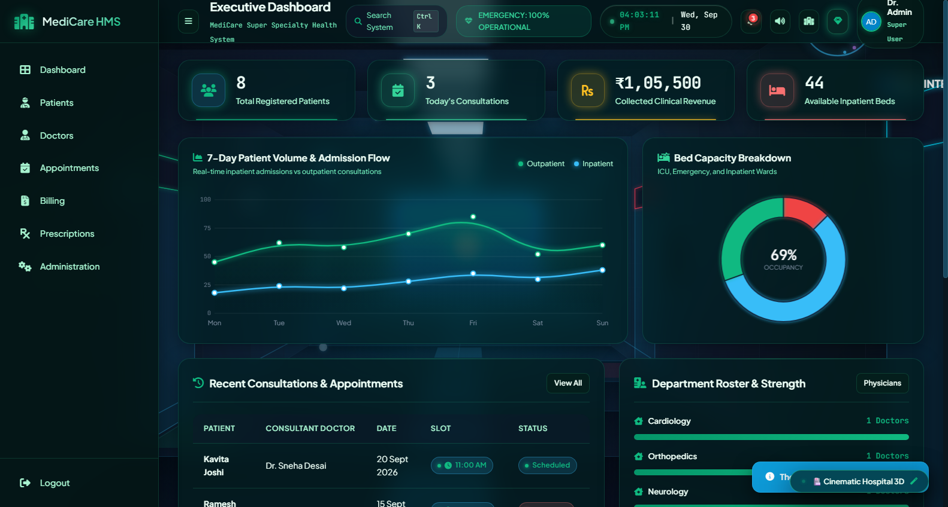
DESIGN ENGINEERING
hospital-management-system-msz2.vercel.app
CSS Architecture, Dark Mode & Responsiveness
CSS Engineering Highlights
🎨 CSS Variables Engine: Over 20 theme variables (:root) controlling background, surface, text, and border tokens.
🌙 Instant Dark Mode: Seamless theme toggle applying .dark-mode to body, persisting preference in localStorage.
📱 Fluid Responsive Sidebar: Collapsible navigation with icon-only compact mode for tablets and off-canvas drawer for mobile.
👁️ Accessibility & Typography: Using Google Inter font with high contrast WCAG ratios and readable healthcare iconography.
▶ Executive Dashboard rendered in Dark Mode via CSS Variables

Slide 14
DEPLOYMENT & DEVOPS
hospital-management-system-msz2.vercel.app
Live Production on Vercel Edge Network
100% Client-Side
Zero backend latency, instant tab switching
Edge CDN Powered
Instant load times worldwide via Vercel
Zero Dependencies
Pure Vanilla JS, HTML5 & CSS3
🚀 Production URL:
https://hospital-management-system-msz2.vercel.app/
Why Vercel Deployment Matters in a Frontend Class:
✦ Instant Verification: Instructors and classmates can test all features on their laptops or mobile phones right now.
✦ Continuous Delivery: Changes pushed to Git repository automatically build and deploy within seconds.
✦ Modern Web Standards: Serves modern HTTP/2 assets with Brotli compression and HTTPS security out-of-the-box.

Slide 15
WRAP UP
hospital-management-system-msz2.vercel.app
Key Learnings, Technical Takeaways & Q&A
🎓 Key Frontend Learnings
⭐ Modular DOM Manipulation: Learned how to dynamically construct complex UI elements without heavy frontend frameworks.
⭐ Scalable CSS Architecture: Mastered CSS custom properties, grid layouts, fluid sidebar toggling, and dark mode theming.
⭐ State Management & Storage: Designed persistent client-side data stores using JSON serialization and Web Storage.
⭐ Real-World UX Standards: Implemented micro-interactions, modal management, and accessible form validations.
Thank You!
Questions & Live Demonstration
👑 Team Lead: NISTALA SAI PHANEENDRA KUMAR
✦ Team Members: KANASANI NEELAKANTA BALAJI | JAMMULA UDAY KIRAN
Live Demo: hospital-management-system-msz2.vercel.app

