Slide 1
PLAYWRIGHT CHEAT SHEET TYPESCRIPT AND JAVA SCRIPT

Slide 2
Installation npm init playwright@latest
System requirements​
Node.js 18+
Windows 10+, Windows Server 2016+ or Windows Subsystem for Linux (WSL).
macOS 13 Ventura, or later.
Debian 12, Ubuntu 22.04, Ubuntu 24.04, on x86-64 and arm64 architecture.

Slide 3
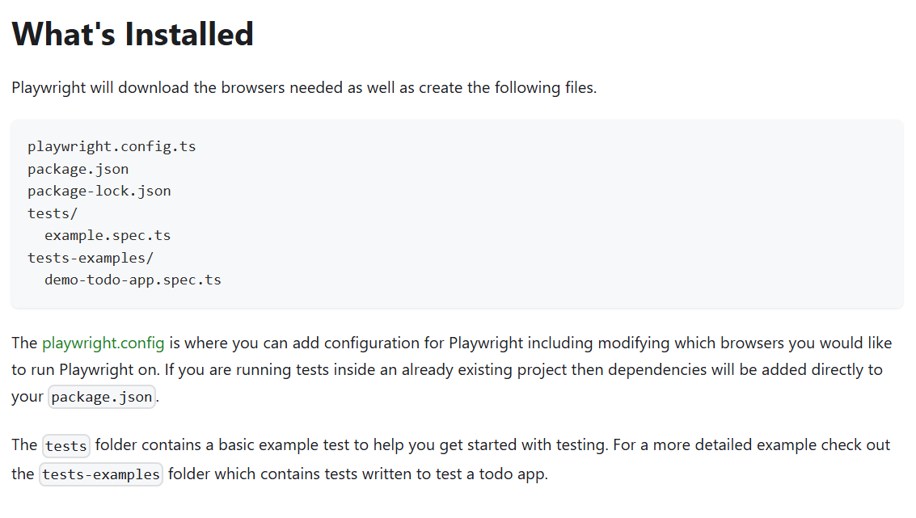

Slide 4
Running the Example Test ------------------------------ npx playwright test
HTML Test Reports --------------------------------- npx playwright show-report
Running the Example Test in UI Mode -------------------------------- npx playwright test --ui
Updating Playwright --------------------------------- npm install -D @playwright/test@latest
# Also download new browser binaries and their dependencies:
npx playwright install --with-deps
Running Codegen ---------------------------------- npx playwright codegen demo.playwright.dev/todomvc
Run tests in headed mode ---------------------------------- npx playwright test –headed
Run tests on different browsers ---------------------------------- npx playwright test --project webkit
npx playwright test --project webkit --project firefox
Run specific tests ----------------------------------- npx playwright test landing-page.spec.ts
npx playwright test tests/todo-page/ tests/landing-page/
npx playwright test landing login
Run last failed tests ------------------------------------ npx playwright test --last-failed
Debug tests in UI mode ------------------------------------ npx playwright test –ui
Debug tests with the Playwright Inspector ------------------------------------ npx playwright test –debug
npx playwright test example.spec.ts --debug

Slide 5
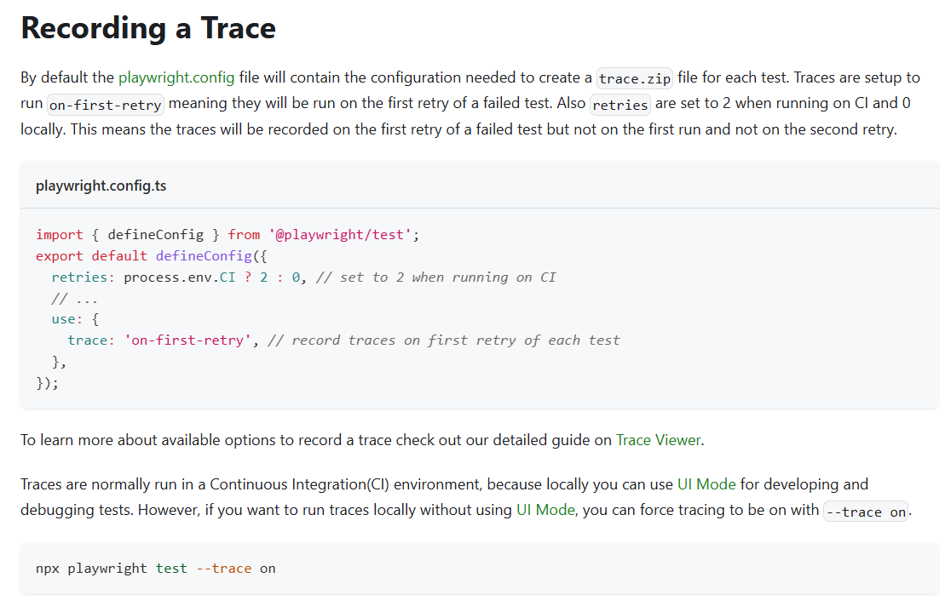
Trace viewer

Slide 6
Actions
Text input
Using locator.fill() is the easiest way to fill out the form fields. It focuses the element and triggers an input event with the entered text. It works for <input>, <textarea> and [contenteditable] elements.
// Text input
await page.getByRole('textbox').fill('Peter');
// Date input
await page.getByLabel('Birth date').fill('2020-02-02');
// Time input
await page.getByLabel('Appointment time').fill('13:15');
// Local datetime input
await page.getByLabel('Local time').fill('2020-03-02T05:15');

Slide 7
Checkboxes and radio buttons
Using locator.setChecked() is the easiest way to check and uncheck a checkbox or a radio button. This method can be used with input[type=checkbox], input[type=radio] and [role=checkbox] elements.
// Check the checkbox
await page.getByLabel('I agree to the terms above').check();
// Assert the checked state
expect(page.getByLabel('Subscribe to newsletter')).toBeChecked();
// Select the radio button
await page.getByLabel('XL').check();
Select options
Selects one or multiple options in the <select> element with locator.selectOption(). You can specify option value, or label to select. Multiple options can be selected.
// Single selection matching the value or label
await page.getByLabel('Choose a color').selectOption('blue');
// Single selection matching the label
await page.getByLabel('Choose a color').selectOption({ label: 'Blue' });
// Multiple selected items
await page.getByLabel('Choose multiple colors').selectOption(['red', 'green', 'blue']);

Slide 8
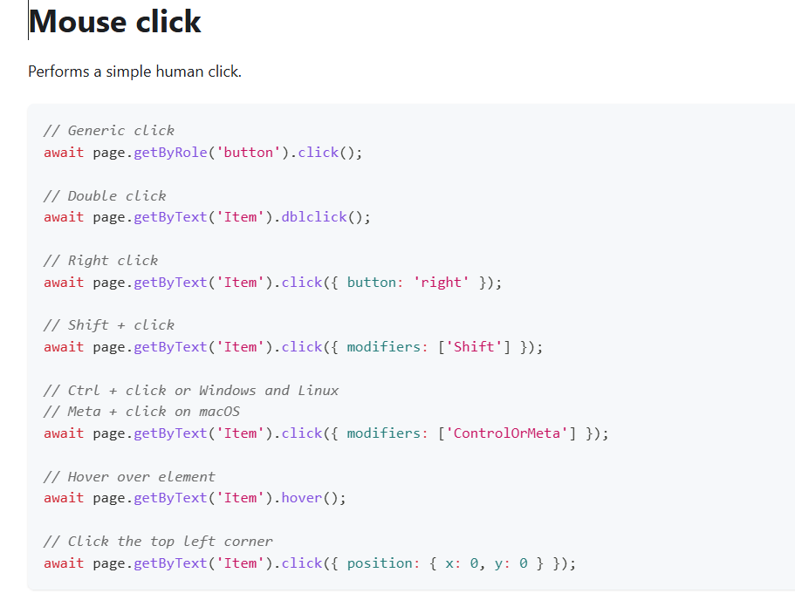
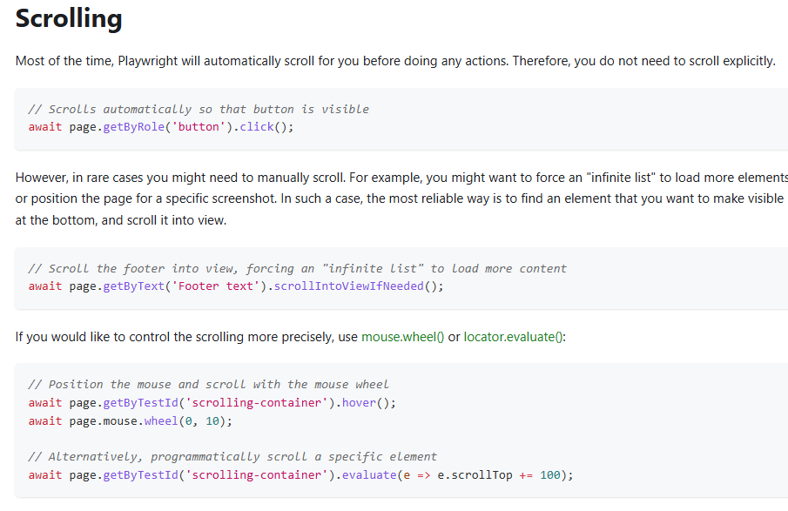

Slide 9
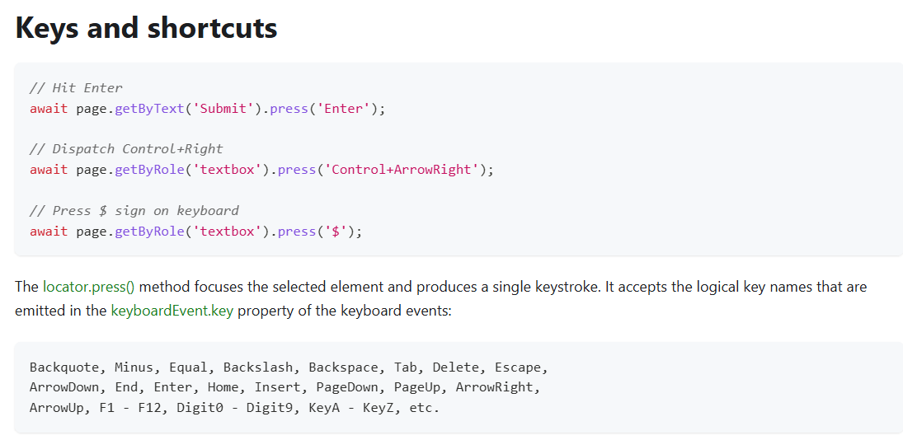

Slide 10
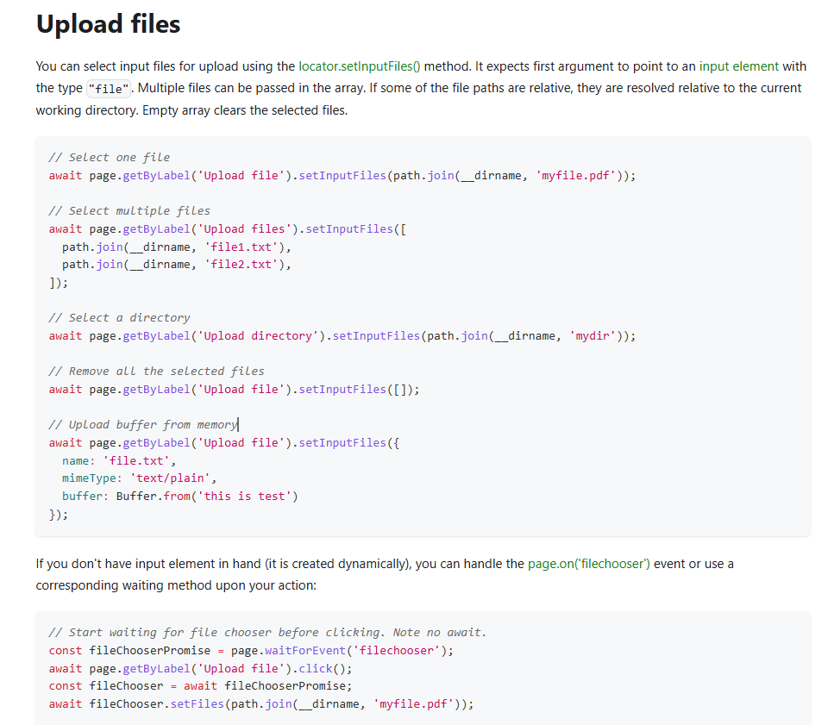
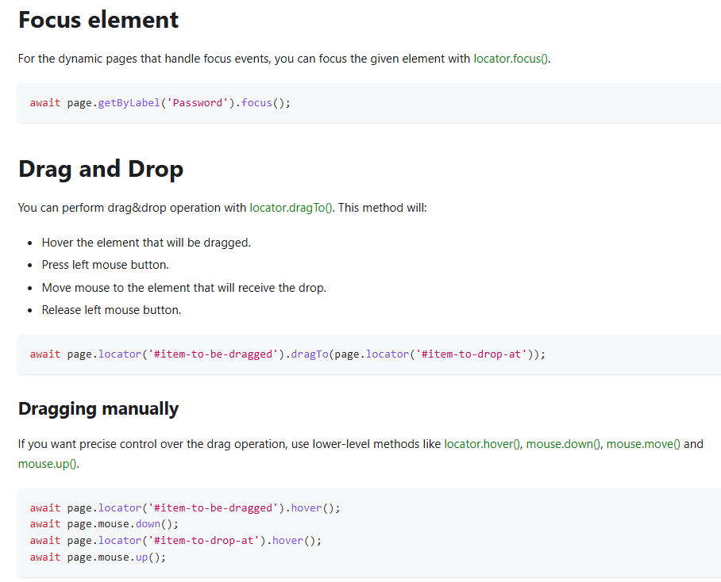

Slide 11
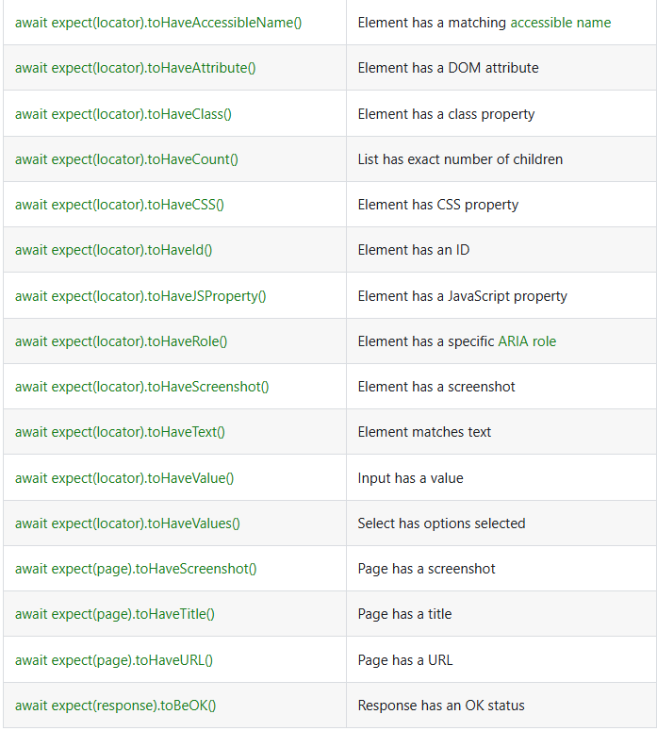
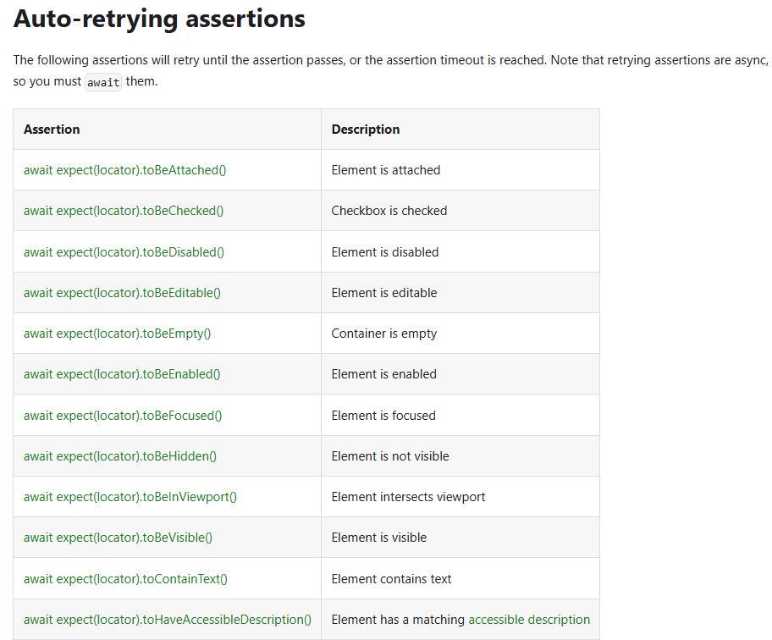
Assertions

Slide 12
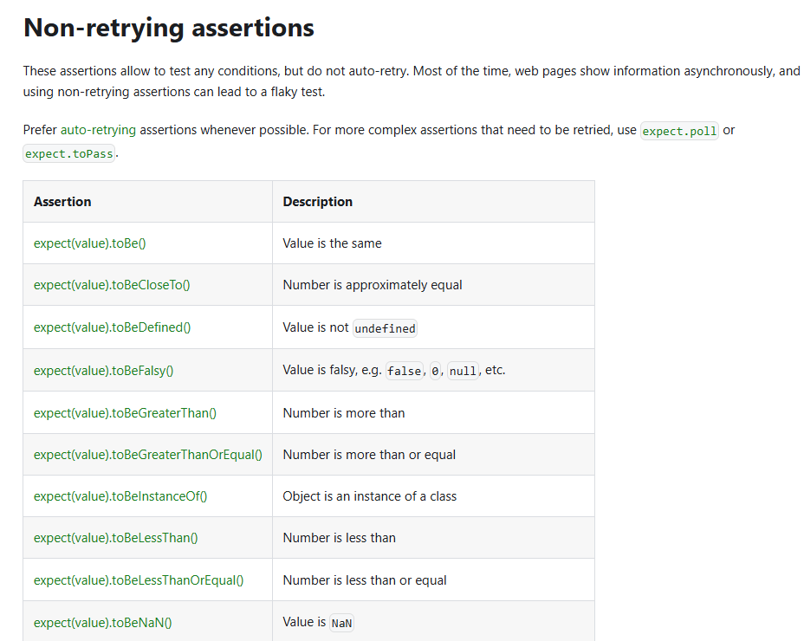
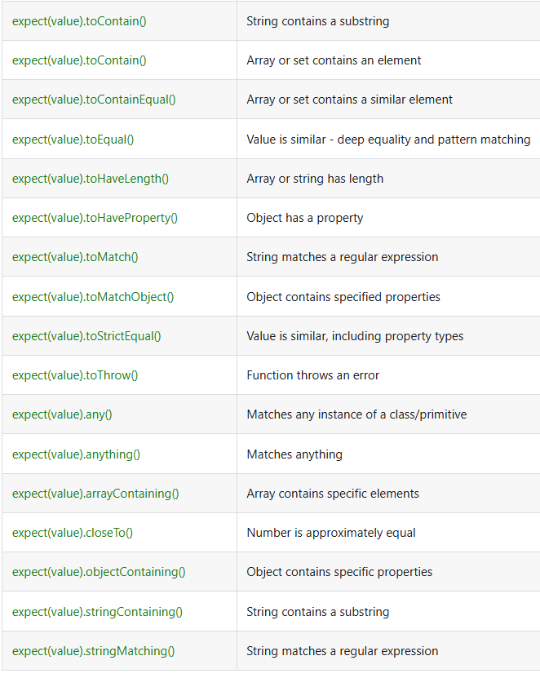

Slide 13
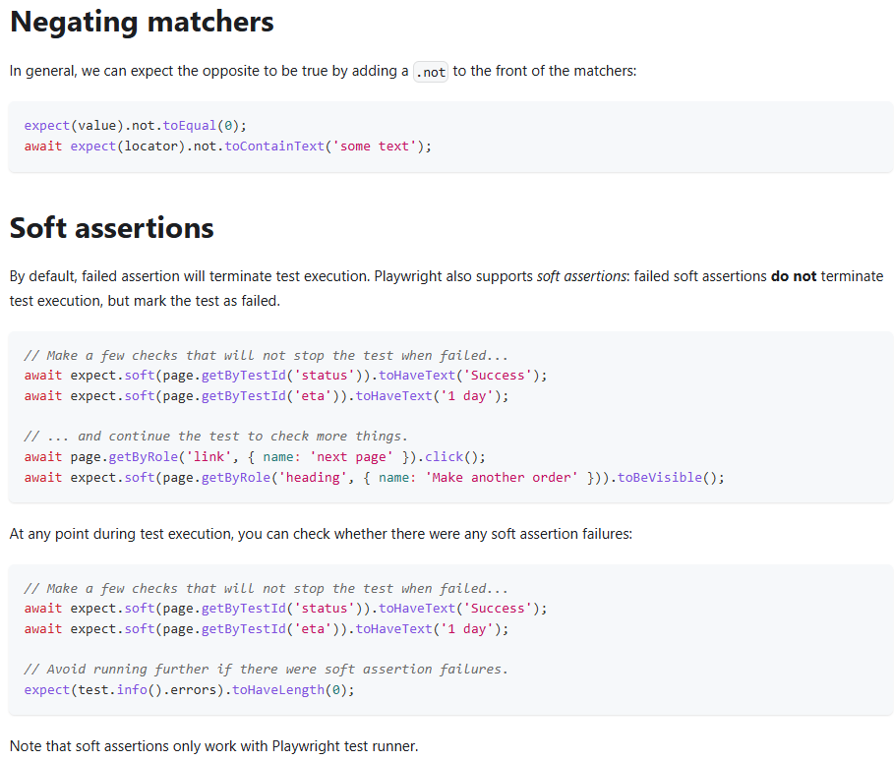
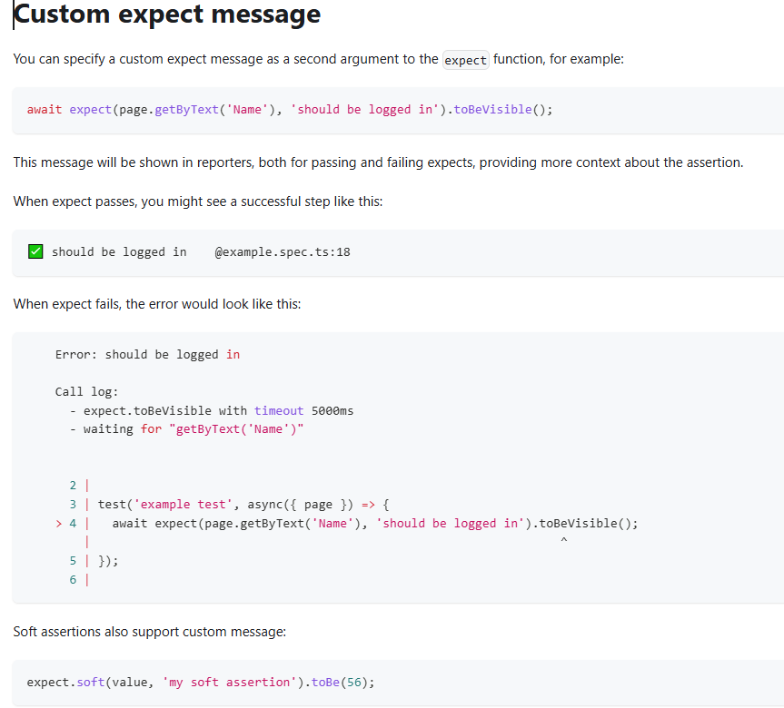

Slide 14
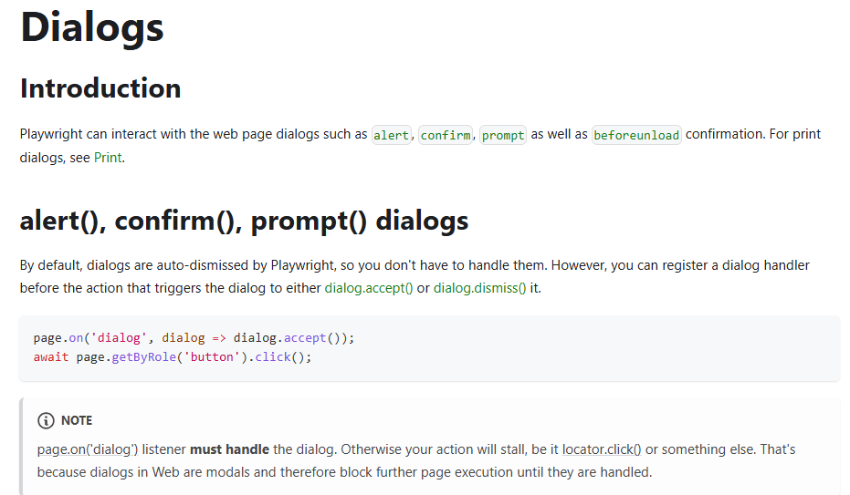
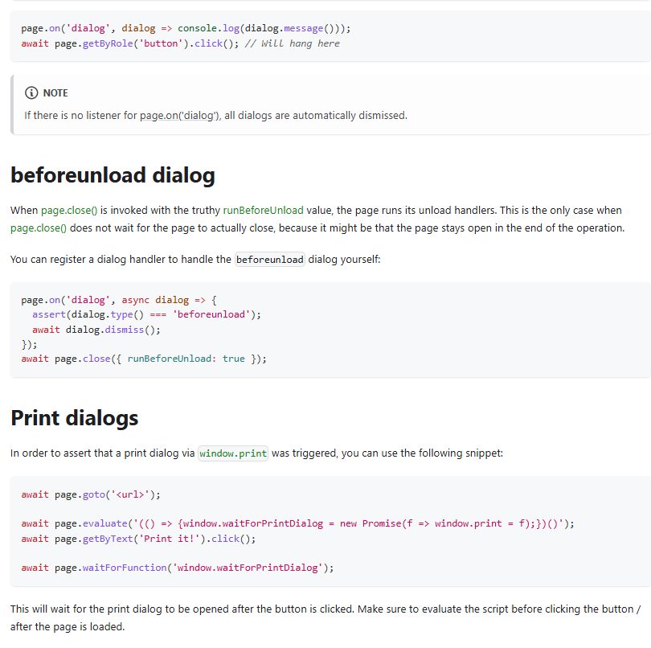

Slide 15
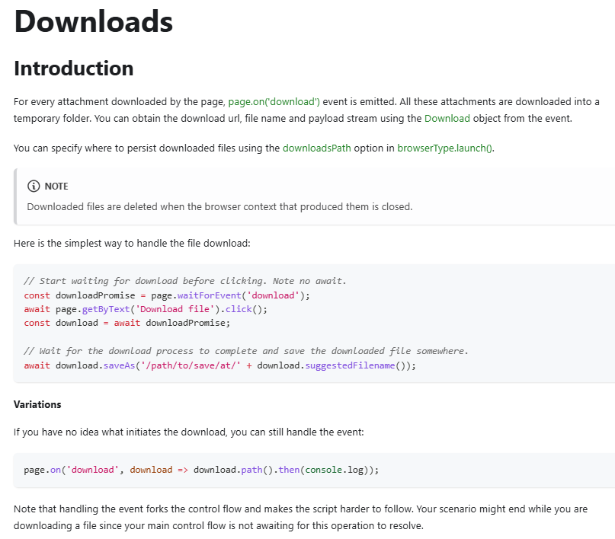
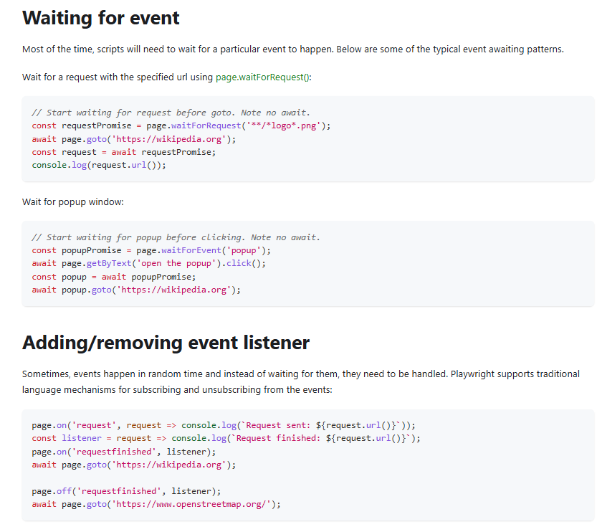

Slide 16
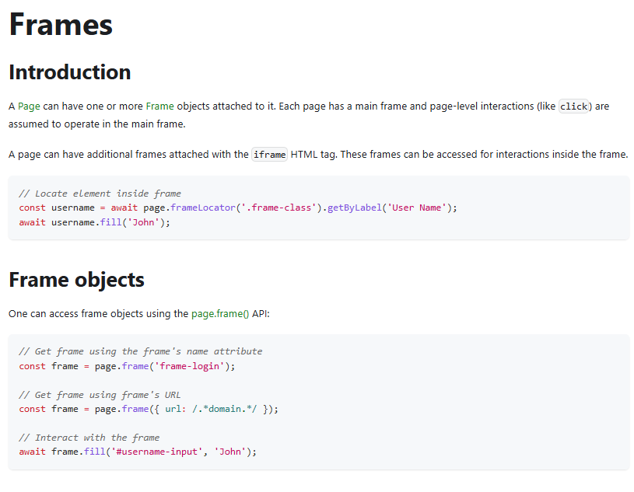
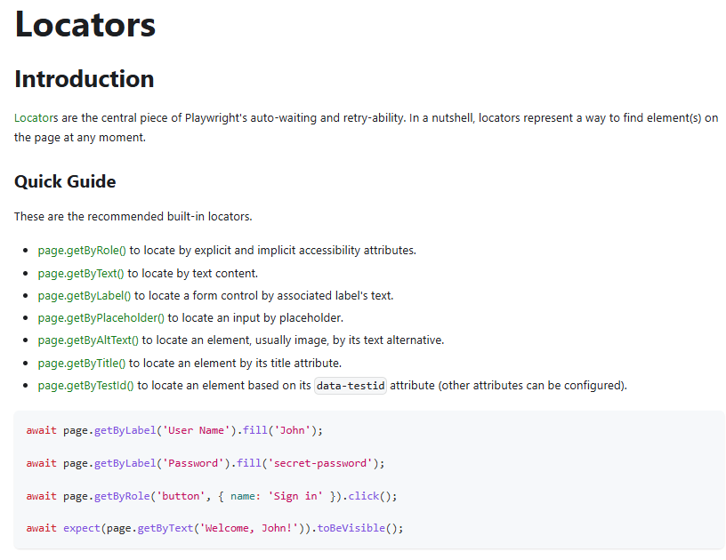

Slide 17
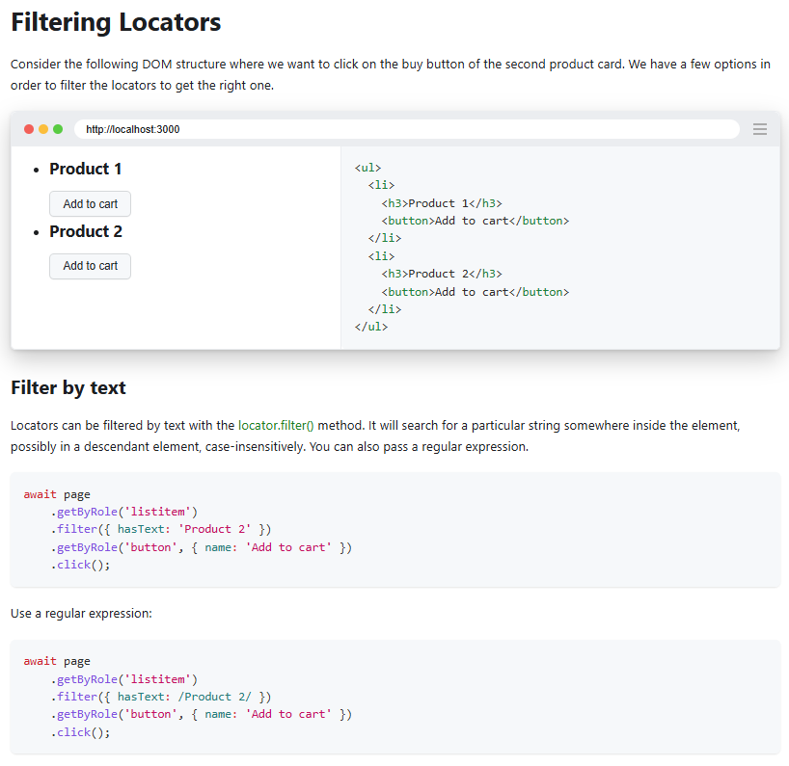
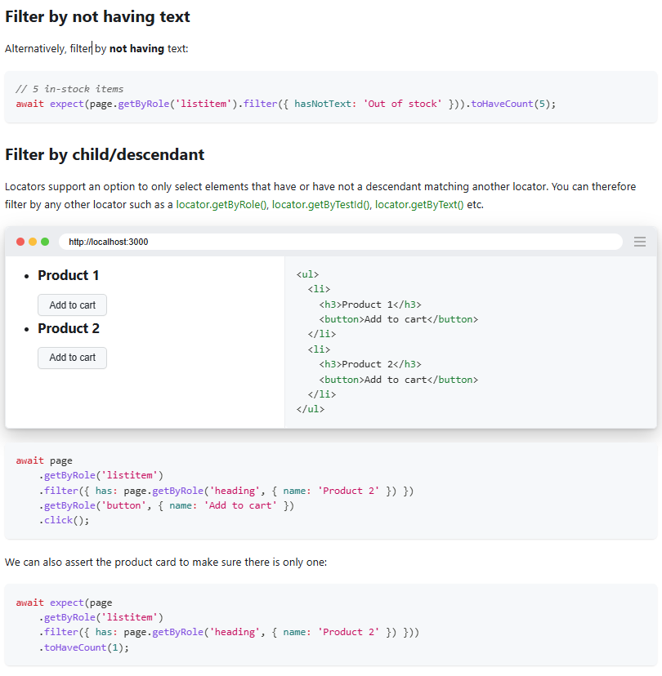

Slide 18
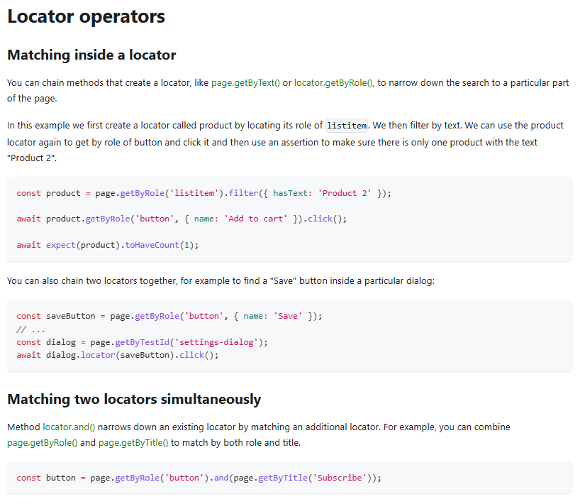
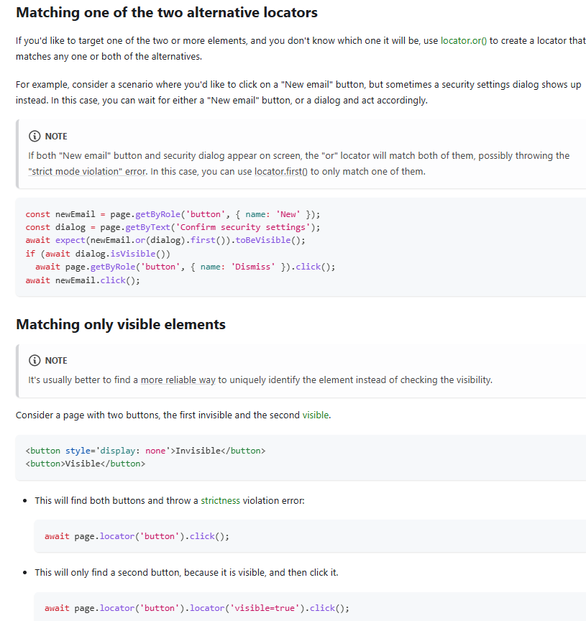

Slide 19
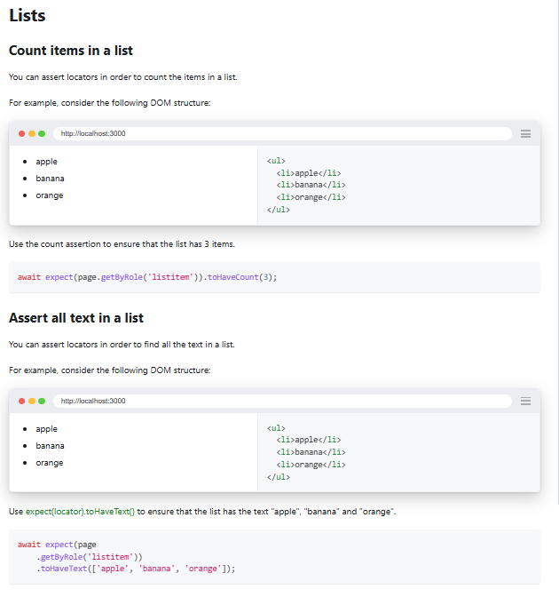
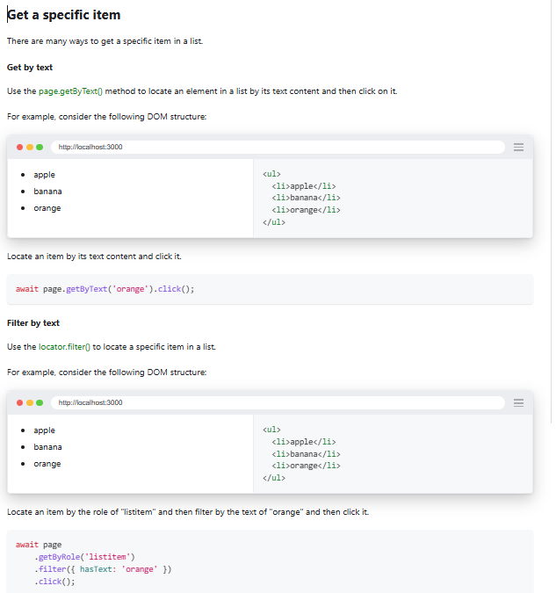

Slide 20
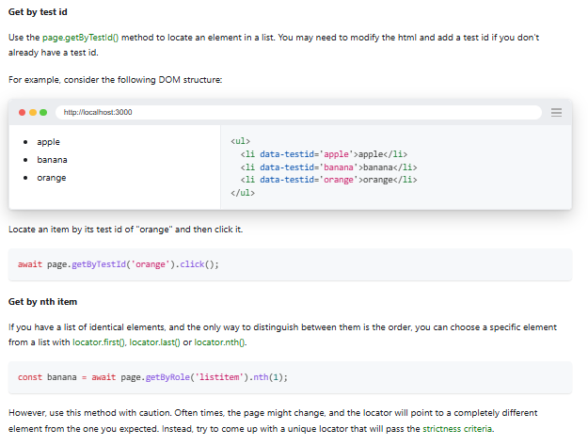
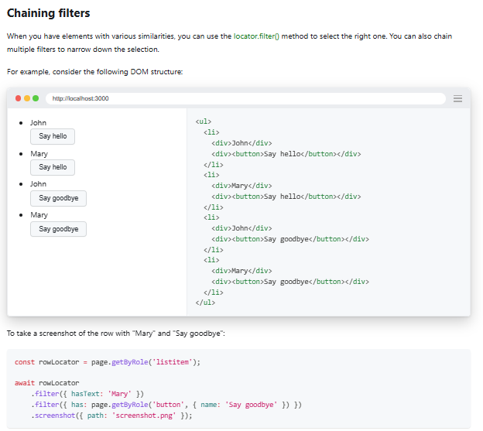

Slide 21
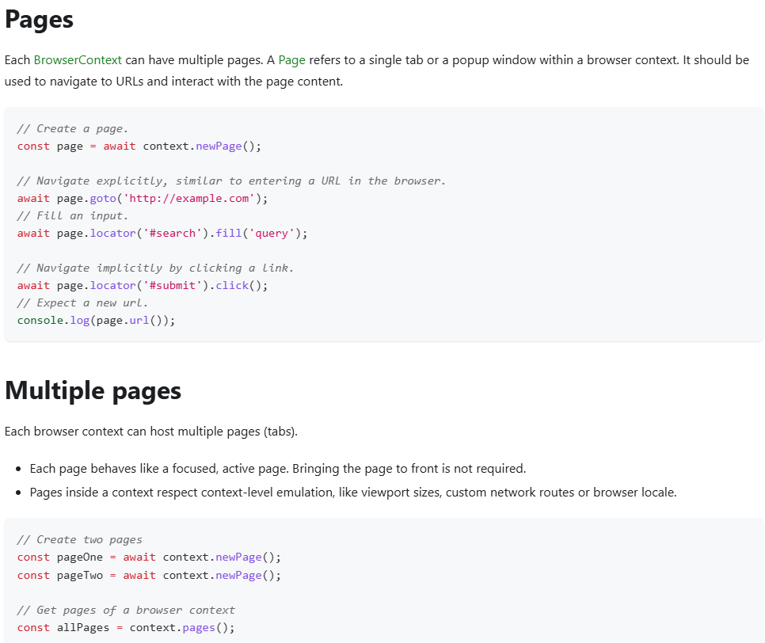
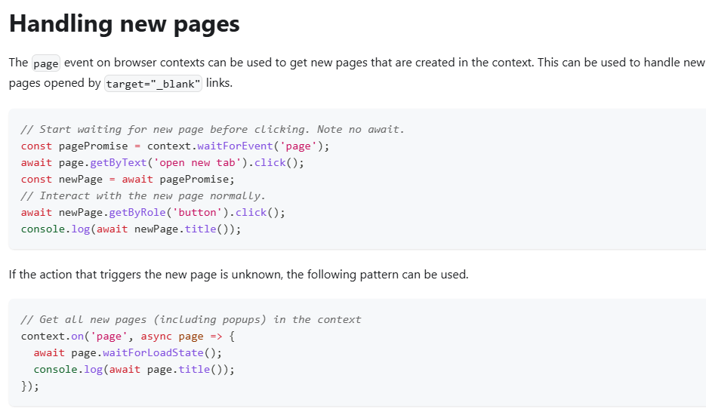

Slide 22
