Slide 1

Semester Project - III
“GlucoCare: A ML - Based Web App for Diabetes Detection and Lifestyle Suggestions”
By
1. Jinendra Gopal Gavit (231106001 & DS002)
2. Nilesh Kantilal Marathe (231106007 & DS008)
3. Uday Pravin Patil (231106012 & DS011)
4. Ganesh Kanhaiyasing Pawar (231106017 & DS016)
Under the Guidance of
Prof. S. V. Chaudhari
Department of Computer Science & Engineering (Data Science)
The Shirpur Education Society’s
R. C. Patel Institute of Technology, Shirpur - 425405.
[2025-26]

Slide 2
Outline
Problem Statement
Objectives
Literature Survey
Proposed Solution
Dataset
Technical Approach
Methodology / Process
Conclusion
References

Slide 3
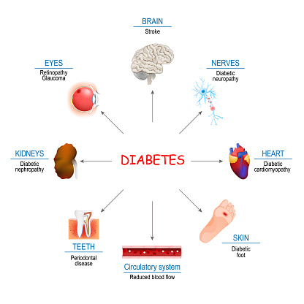
GlucoCare: A ML - Based Web App for Diabetes Detection and Lifestyle Suggestions
Problem Statement
Diabetes is a common and serious health problem that can lead to many complications if not detected early. Traditional methods to check for diabetes can be slow, expensive, and hard to access for everyone.
There is a need for a simple and reliable system that can quickly predict the risk of diabetes using basic medical information. Such a system will help people check their health easily and allow doctors to take early action to prevent complications.

Slide 4
GlucoCare: A ML - Based Web App for Diabetes Detection and Lifestyle Suggestions
Objectives
Analyze the dataset (EDA) – Understand patterns in medical data like glucose, BMI, blood pressure, etc.
Train multiple ML models – Using Logistic Regression, Random Forest, and XGBoost to predict diabetes.
Evaluate and select the best model – Compare performance using metrics like Accuracy and F1-score.
Save the best model – Store it as a Pickle file for deployment.
Deploy the model on Heroku – Make it accessible via a web application.
Design a user-friendly interface – Allow users to register, input medical data, and view their results.
Provide instant diabetes risk prediction – ML model processes input and returns results quickly.
Store user reports in database – Keep history for users to track their health over time.

Slide 5
Literature Survey
1. Existing Solutions / Studies:
Many studies use machine learning to predict diabetes using datasets like Pima Indians Diabetes Dataset.
Common algorithms include Logistic Regression, Decision Trees, Random Forest, SVM, and XGBoost.
2. Limitations of Existing Methods:
Limited user interaction. Predictions are often isolated – no user tracking or report storage.
3. How GlucoCare Improves / Differs:
Deploys the best ML model as a user-friendly web app accessible online.
Users can register, input data, get instant predictions, and track their health history.
Combines accurate predictions with practical usability, making it suitable for individuals and healthcare professionals.

Slide 6
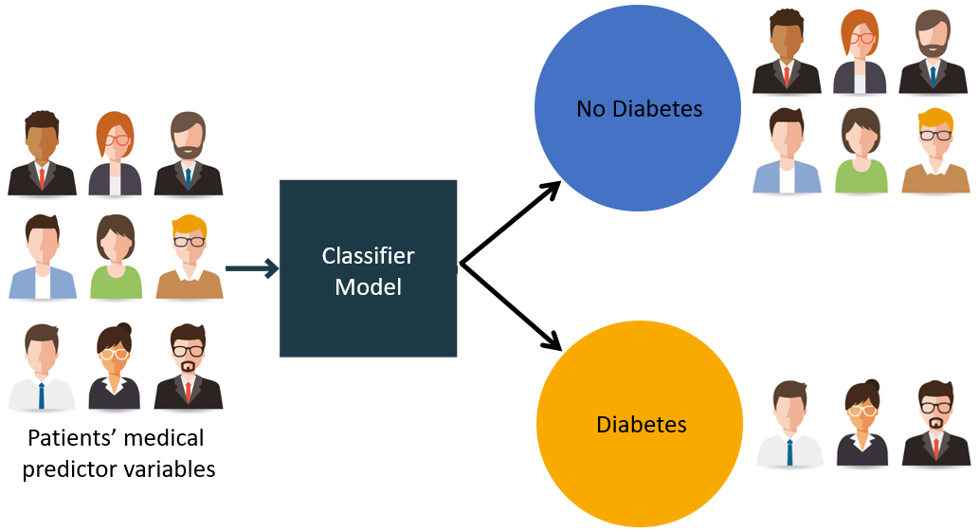
Proposed Solution
1. Detailed Explanation:
Web-based app predicts diabetes risk using ML models.
Users register and input medical data.
ML model processes input and gives instant prediction.
2. How it Solves the Problem:
Provides quick and accurate predictions.
Allows users to track health over time.
Eliminates need for slow manual testing or offline models.
3. Innovation / Uniqueness:
Best-performing ML model integrated into a user-friendly web app.Combines accuracy + usability + report tracking.
Accessible anytime, anywhere for preventive healthcare.

Slide 7
Dataset
Dataset – Pima Indians Diabetes
Source: Kaggle (from NIDDK)
Size: 768 records, 9 features
Features: Pregnancies, Glucose, BloodPressure, SkinThickness, Insulin, BMI, DiabetesPedigreeFunction, Age
Target: Outcome (0 = Non-Diabetic, 1 = Diabetic)
Preprocessing: Handled missing/zero values, normalized data, train-test split
Split data into train (80%) and test (20%) sets.
Exploratory Data Analysis (EDA):
Checked feature distributions (histograms & boxplots).
Correlation heatmap to study relationships.
Observed: High glucose, high BMI, and older age strongly increase diabetes risk.

Slide 8
Technical Approach
Technologies Used
Programming Language: Python
Frameworks & Libraries: Flask, Scikit-Learn, Pandas, NumPy, Matplotlib, Seaborn, XGBoost
Deployment: Heroku (Cloud Platform)
Database: PostgreSQL / MySQL (for user data & reports)
Frontend (UI): HTML, CSS, JavaScript
Tools: Jupyter Notebook, Kaggle

Slide 9
Methodology / Process
Dataset Collection → Kaggle (Pima Indians Diabetes Dataset)
EDA & Preprocessing → Handle missing values, normalize data, visualize patterns
Model Training → Train Logistic Regression, Random Forest, XGBoost
Model Evaluation → Compare Accuracy, F1-Score, ROC-AUC
Best Model Selection → Save as Pickle file
Deployment → Flask API + Heroku
User Interface → User registers, inputs data
Prediction & Storage → Model predicts diabetes risk → Save report in database
GlucoCare: A ML - Based Web App for Diabetes Detection and Lifestyle Suggestions

Slide 10
Conclusion
GlucoCare provides a fast and reliable system for early diabetes prediction.
Combines machine learning accuracy with a user-friendly web application.
Allows users to register, input medical data, get instant results, and track reports.
Helps individuals and healthcare professionals in early diagnosis and better management of diabetes.
A step forward in using data-driven technology for preventive healthcare.

Slide 11
References
WHO (World Health Organization) – Reports that diabetes affects over 422 million people worldwide and early diagnosis is critical.
WHO – Diabetes Fact Sheet
American Diabetes Association (ADA) – Research shows that data-driven approaches and early prediction can reduce diabetes complications.
ADA – Research & Statistics
Research Study (2019, Journal of Diabetes Research):
Machine Learning models like Random Forest and SVM were tested for diabetes prediction with ~78–80% accuracy.
Kaggle – Pima Indians Diabetes Dataset – Widely used benchmark dataset for ML-based diabetes prediction
Kaggle Dataset Link

Slide 12
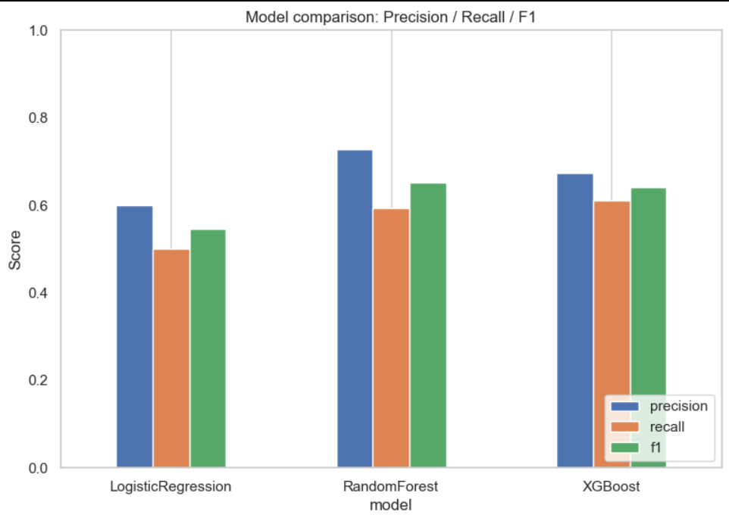
Model’s F1 Score, Precision & Recall
GlucoCare: A ML - Based Web App for Diabetes Detection and Lifestyle Suggestions

Slide 13
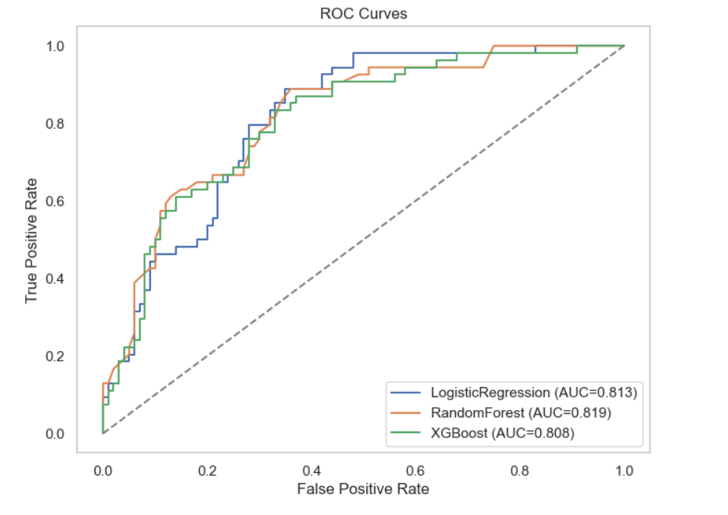
GlucoCare: A ML - Based Web App for Diabetes Detection and Lifestyle Suggestions

Slide 14
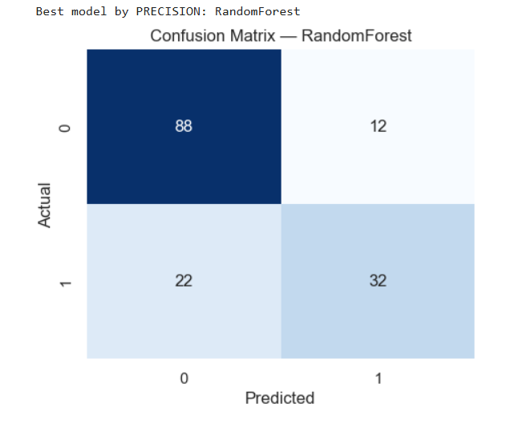
GlucoCare: A ML - Based Web App for Diabetes Detection and Lifestyle Suggestions

Slide 15
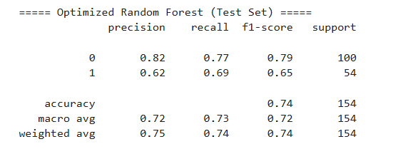
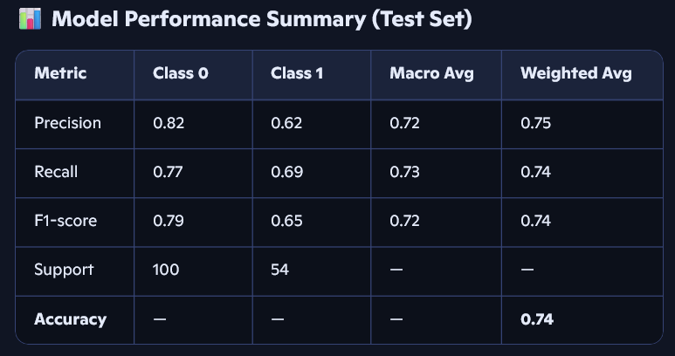
GlucoCare: A ML - Based Web App for Diabetes Detection and Lifestyle Suggestions

Slide 16
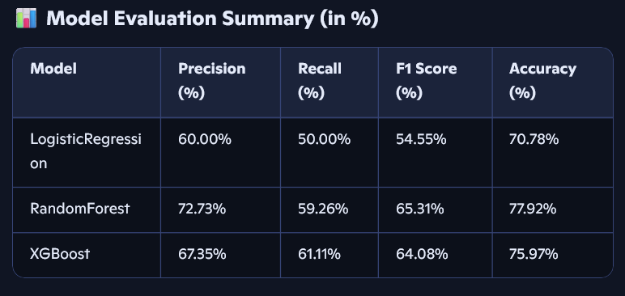
GlucoCare: A ML - Based Web App for Diabetes Detection and Lifestyle Suggestions

