Slide 1
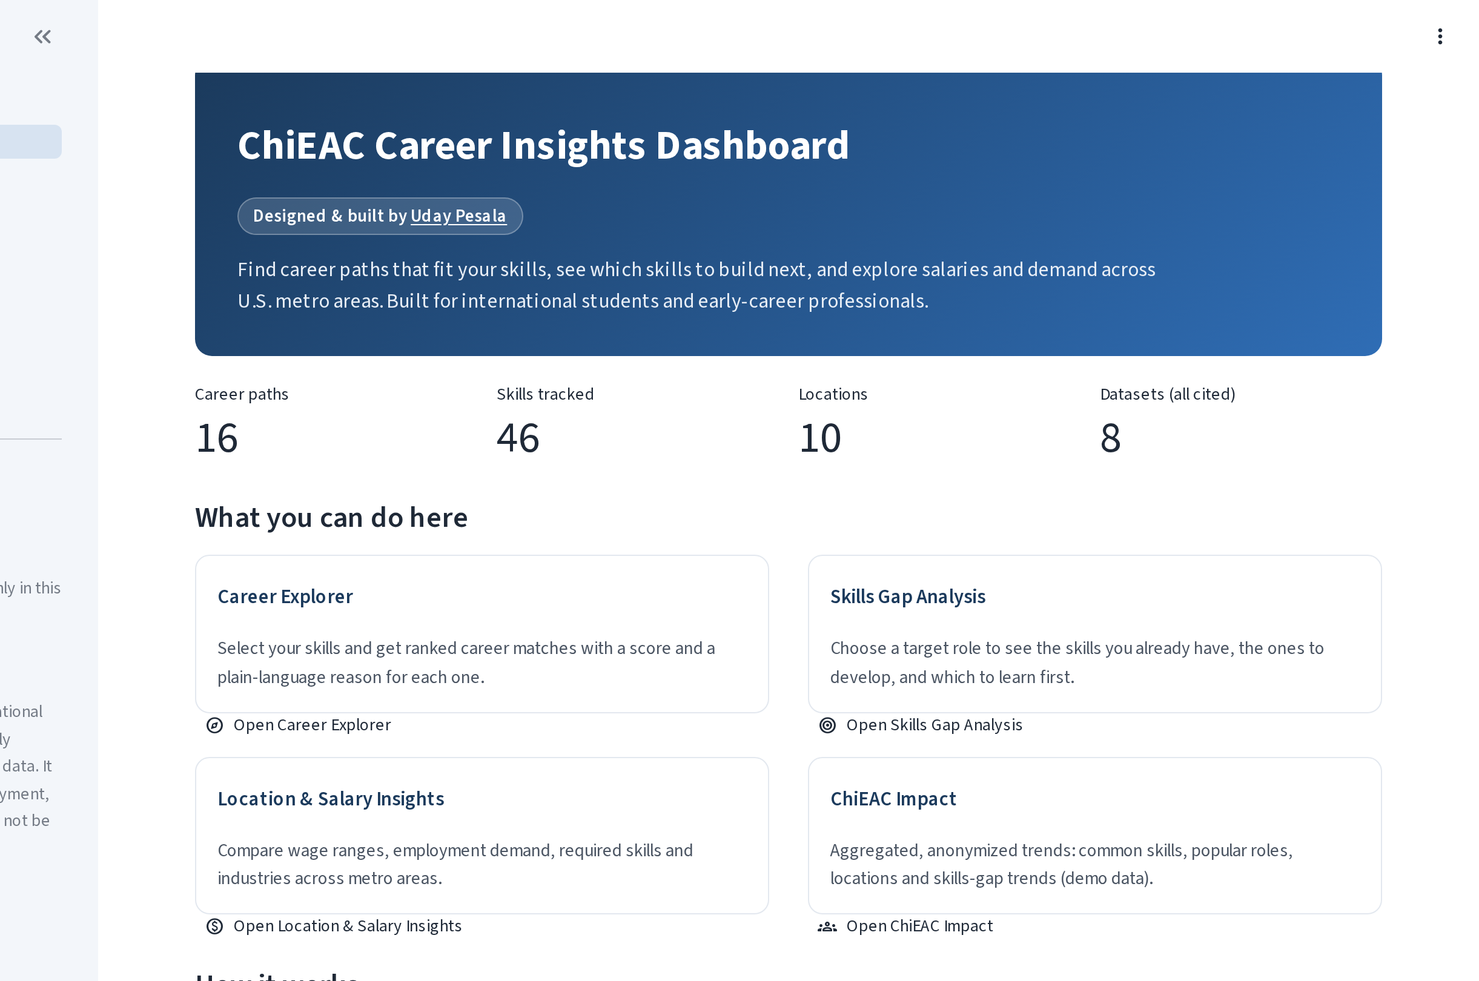
PROJECT SHOWCASE
ChiEAC Career
Insights Dashboard
Helping international students find careers that fit their skills, close skill gaps, and understand salaries and demand across U.S. cities.
Designed & built by Uday Pesala
Live app uday-pesala-chieac-project-career-insights-dashboard.streamlit.app
Built with Python · Streamlit · Pandas · Plotly · scikit-learn
Notes:
Introduce yourself and the project in one breath.
"Hi, I'm Uday Pesala. This is the ChiEAC Career Insights Dashboard, a live web app I designed and built end to end. It helps international students and early-career professionals answer three questions: Which careers fit my skills? What should I learn next? What do pay and demand look like in different U.S. cities?"

Slide 2
WHY IT MATTERS
The challenge, and what I built
THE CHALLENGE
THE SOLUTION
● Unclear job titles. Strong skills, but no clear map to U.S. roles like Data Analyst or Cloud Engineer.
● Scattered information. Salary, demand and skills data live across many government sites.
● Generic advice. Students don't know which skills to learn first for their target role.
● Personal career matches from your own skills, with a score and a plain-language reason.
● A prioritized learning plan showing what you have, what's missing, and what to learn first.
● Pay and demand by city, using cited public data (BLS, O*NET, Data USA), in one place.
16
46
10
8
career paths
skills tracked
U.S. metro areas
cited datasets
ChiEAC Career Insights Dashboard · Uday Pesala
2 / 5
Notes:
Key message: students have the skills but lack a clear map to U.S. careers.
- Many international students have strong technical skills but struggle to map them to U.S. job titles.
- The data they need (salaries, demand, required skills) is spread across government websites.
- So I built one place that turns their skills into personal career matches, a prioritized learning plan, and city-level pay and demand, all from cited public data.
- Scope today: 16 career paths, 46 skills, 10 metro areas including Chicago, and 8 documented datasets.

Slide 3
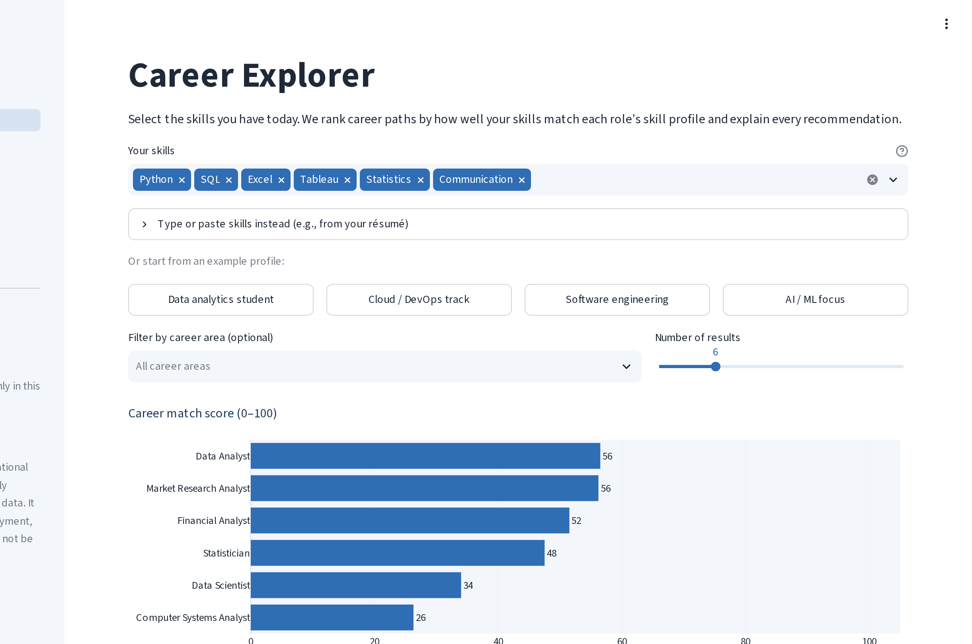
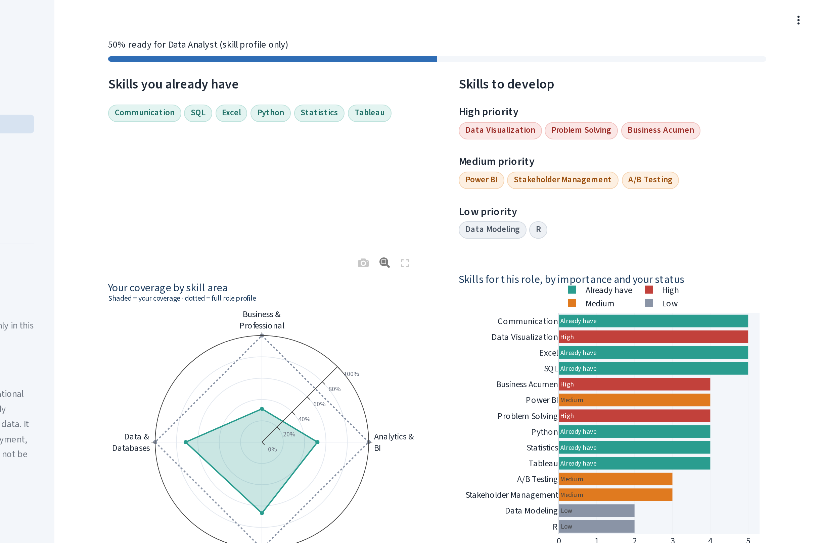
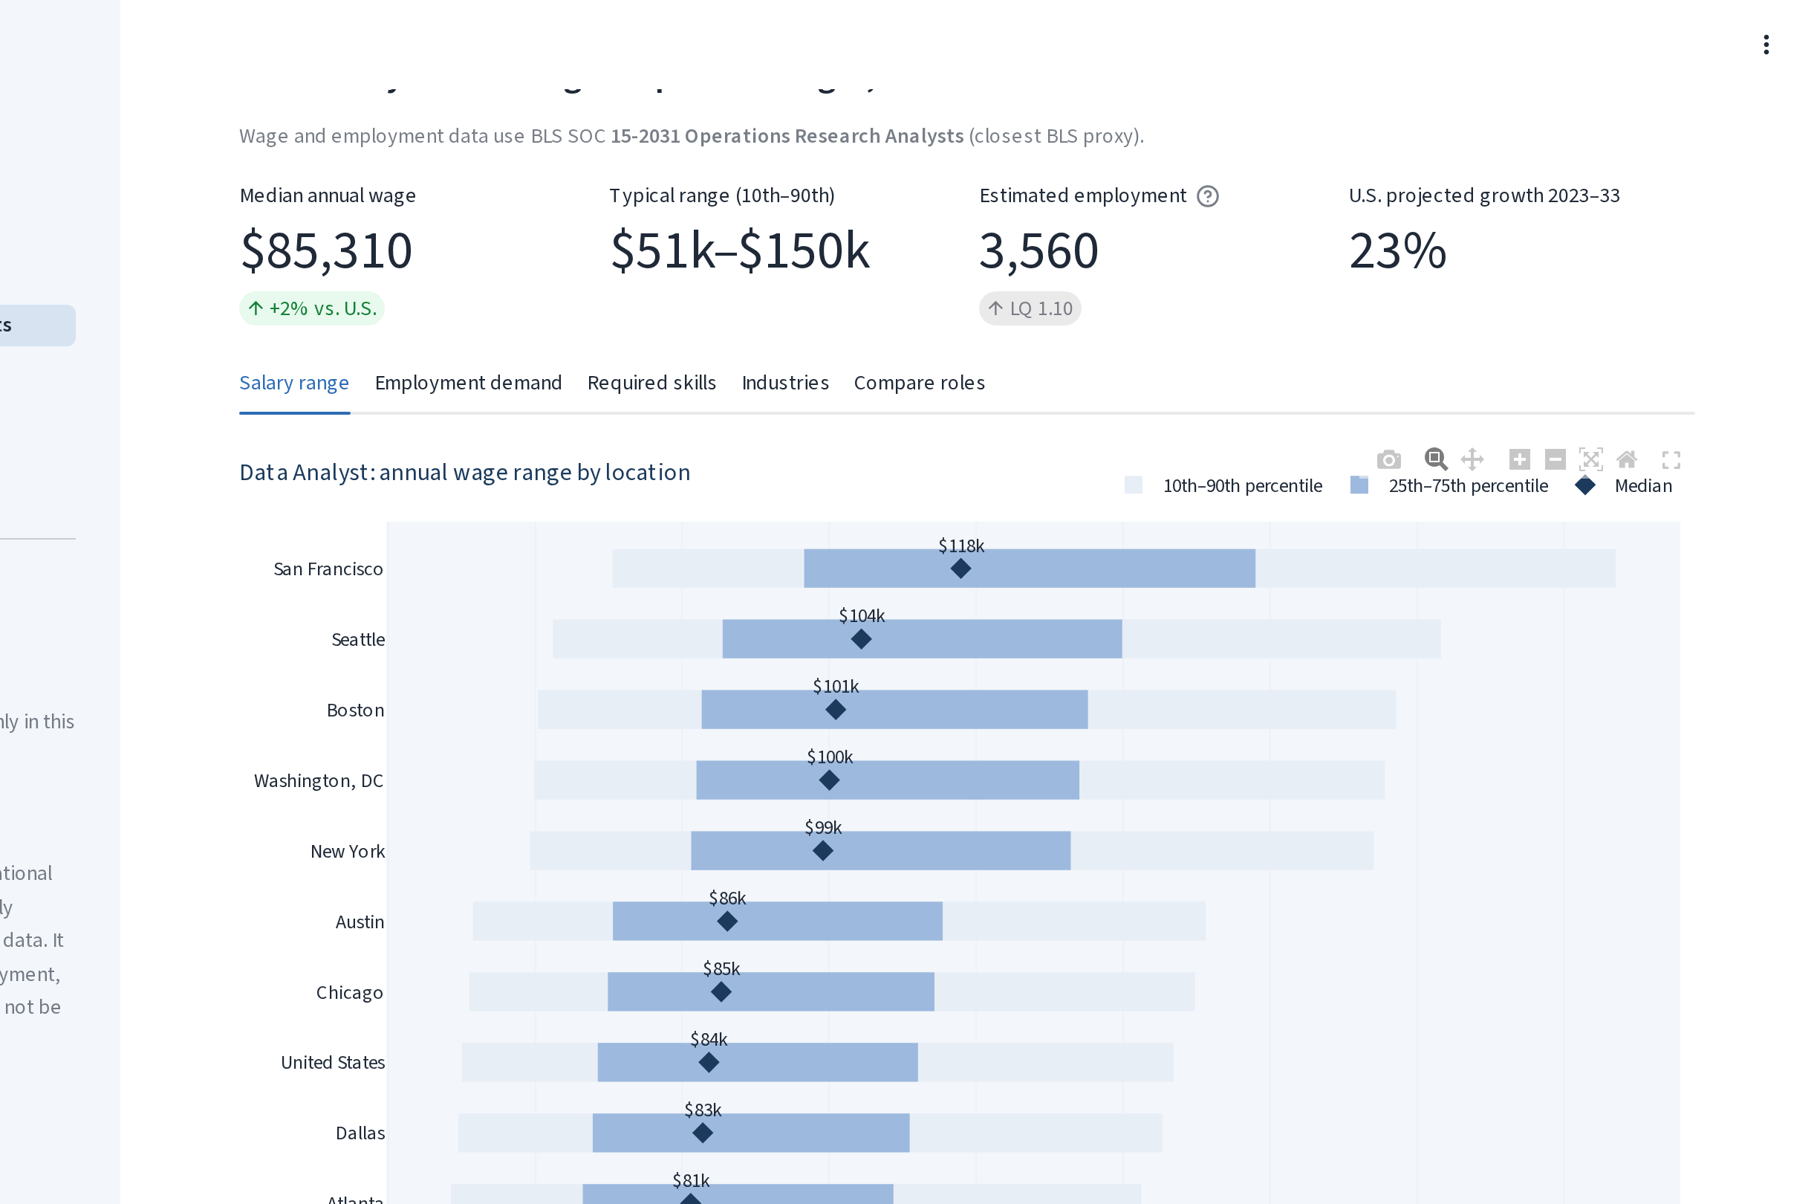
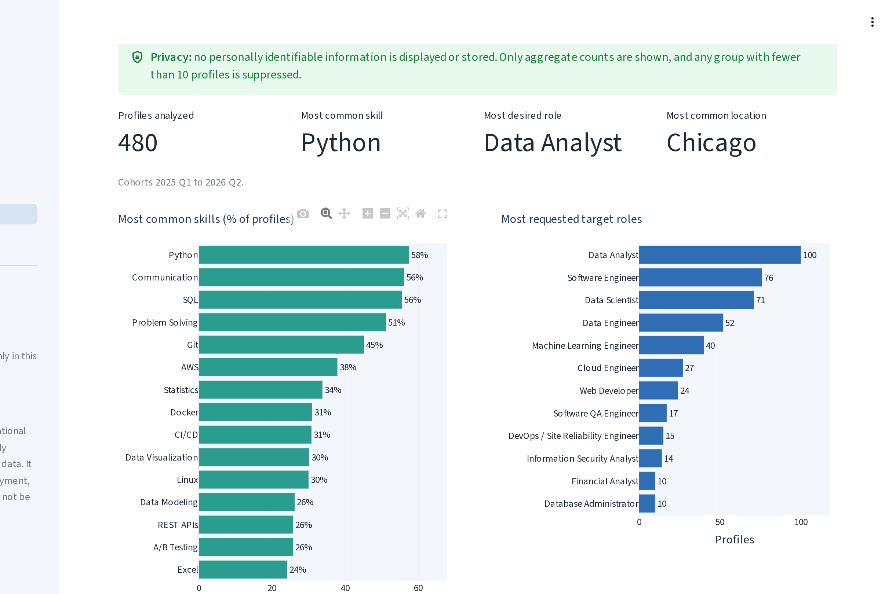
WHAT IT DOES
Four tools in one dashboard
Career Explorer
Skills Gap Analysis
Location & Salary Insights
ChiEAC Impact
Pick skills, get ranked careers with a 0–100 match score and the reason why.
Readiness score, skills to build by priority, and a downloadable PDF/CSV report.
Salary ranges, job demand and hiring industries across 10 metros.
Anonymized community trends: top skills, target roles and skill gaps.
01
02
03
04
ChiEAC Career Insights Dashboard · Uday Pesala
3 / 5
Notes:
Walk through the four tools; demo live if you can.
1. Career Explorer: choose skills (or paste them from a résumé; it understands shorthand like 'k8s' and catches typos). Each career gets a match score and a plain-language explanation.
2. Skills Gap Analysis: pick a target role, see a readiness score, what you already have, and what to learn first (High / Medium / Low priority). Download a personal PDF or CSV report for an advisor.
3. Location & Salary Insights: compare pay ranges, job demand, required skills and industries across 10 metros, including Chicago. Every chart shows its source and date.
4. ChiEAC Impact: anonymized trends across profiles. No personal information; small groups are hidden.

Slide 4
HOW IT WORKS
Built end to end: data, model, app and deployment
Public data
Data pipeline
Scoring model
Dashboard
Deployed
BLS wages, O*NET skills, Data USA
Python + Pandas with integrity checks
scikit-learn TF-IDF + weighted coverage
Streamlit + Plotly, desktop & mobile
Streamlit Cloud, auto-deploys from GitHub
TRANSPARENT SCORING
BUILT TO BE TRUSTED
Match = 60% skill coverage + 40% specificity
Coverage: how much of the role's weighted skill profile you have. Specificity: TF-IDF similarity, so distinctive skills count more than common ones.
● Cited data: source & date under every chart; demo data clearly labelled.
● Privacy first: no accounts, nothing stored; small groups (<10) hidden.
● Quality: input validation, error handling, 17 automated tests.
● Reproducible: documented data dictionary and build script.
Priority = 70% importance + 30% transferability
High / Medium / Low, explained on every page.
ChiEAC Career Insights Dashboard · Uday Pesala
4 / 5
Notes:
Show you can take a project from idea to production.
- Data: public sources (Bureau of Labor Statistics wages and projections, O*NET skills, Data USA).
- Pipeline: Python and Pandas, with automatic checks so bad data fails loudly.
- Model: the match score combines how much of a role's skill profile you cover with a scikit-learn TF-IDF similarity, so distinctive skills count more. It's transparent, not a black box.
- App: Streamlit and Plotly, accessible colors, works on phones.
- Deployed on Streamlit Community Cloud; every push to GitHub redeploys automatically.
- Trust: sources cited on every chart, demo data labelled, privacy by design, 17 automated tests.

Slide 5
IMPACT
Value for ChiEAC, and what's next
For students
For advisors
For ChiEAC
● Clear career options from their own skills
● A focused plan for what to learn next
● A report to bring to advisors
● A shared, evidence-based starting point
● Explainable scores for 1:1 sessions
● Useful in workshops and events
● Anonymized insight into skills & gaps
● Data to plan workshops & partnerships
● A ready foundation for impact reporting
NEXT STEPS
Try it live
● Pilot with a ChiEAC student cohort and gather feedback
● Connect real program data (with consent), replacing demo data
● Refresh with the latest BLS and O*NET releases
uday-pesala-chieac-project-career-insights-dashboard.streamlit.app
github.com/Udaypesala123/Chicago-education-advocacy-cooperative
Designed & built by Uday Pesala
ChiEAC Career Insights Dashboard · Uday Pesala
5 / 5
Notes:
Close on value and a clear ask.
- Students get clear options and a focused learning plan; advisors get an explainable, shared tool; ChiEAC gets anonymized insight to plan workshops and partnerships.
- Next steps: pilot with a cohort, connect real (consented) program data, refresh with the latest BLS / O*NET data.
- "The app is live now; please try it at the link on screen. I'm happy to take questions or walk through any part in more detail. Thank you."
Reminder: this is educational guidance, not immigration, legal, employment or salary advice.

