Slide 1


Slide 2

ICC World T20 2024 Player Analysis
=

Slide 3
Objective: Develop a dynamic Power BI dashboard to evaluate player performance in ICC World T20 2024. Scope: Analyze players' contributions across different roles to identify the best Final 11. >Analyzing Player Performances: Evaluate players across various roles to understand their strengths and weaknesses. >Identifying Top Performers: Use key metrics like Strike Rate, Batting Average, and Boundary Percentage to highlight the best players in each category. >Selecting the Final 11: Based on the analysis, determine the most balanced and effective combination of players that can maximize the team's chances of winning. >Enhancing Decision-Making: Provide a visual and analytical tool that aids in making strategic decisions for team management and selection.
INTRODUCTION
=

Slide 4
To ensure a fair and objective selection, we defined specific metrics for five player categories: Openers, Anchors, Finishers, All-Rounders, and Specialist fast Bowlers. These metrics focus on key performance aspects like scoring ability, consistency, all-round contributions and bowling effectiveness. By applying these role-specific criteria, we conducted a data-driven selection process, ultimately choosing the final 11 players to best align with the team's strategic goals.
Parameter Scoping
=

Slide 5
The culmination of the analysis is the selection of the Final 11 players for the ICC World T20 2024. This team is chosen based on a careful balance of: Batting Strength: A mix of Power Hitters, Anchors, and Finishers who can handle different match situations. Bowling Strength: A combination of Specialist Fast Bowlers and All-rounders who can deliver in crucial overs. Fielding and Versatility: Players who contribute not just with the bat or ball but also add value in the field. The selected Final 11 represents the optimal combination of players who can adapt to various match scenarios, providing the best chance for success in the tournament.
Final-11 Selection
=

Slide 6



OPENERS
Parameter Scoping
PARAMETERS | DESCRIPTION | CRITERIA
Batting Average | Average runs scored in an innings | > 30
Strike Rate | No of runs scored per 100 balls | > 140
Innings Batted | Total Innings batted | > 3
Boundary % | % of runs scored in boundaries | > 50
Batting Position | Order in which the batter played | < 4

Slide 7


ANCHORS / MIDDLE ORDER
Parameter Scoping
PARAMETERS
Batting Average
DESCRIPTION
Average runs scored in an innings
CRITERIA
> 18
Strike Rate
No of runs scored per 100 balls
> 110
Innings Batted
Total Innings batted
> 3
Average balls faced by the batter in an innings
Avg. Balls Faced
> 15
Batting Position
Order in which the batter played
> 2

Slide 8



FINISHER / LOWER ORDER ANCHOR
Parameter Scoping
PARAMETERS
Batting Average
DESCRIPTION
Average runs scored in an innings
CRITERIA
> 25
Strike Rate
No of runs scored per 100 balls
> 130
Innings Batted
Total Innings batted
> 3
Avg. Balls Faced
Average balls faced by the batter in an innings
> 12
Batting Position
Order in which the batter played
> 4
Innings Bowled
Total Innings Bowled by the bowler
> 1

Slide 9


ALL-ROUNDERS / LOWER ORDER
Parameter Scoping
PARAMETERS
Batting Average
DESCRIPTION
Average runs scored in an innings
CRITERIA
> 15
Strike Rate
No of runs scored per 100 balls
> 140
Innings Batted
Total Innings batted
> 2
Batting Position
Order in which the batter played
> 4
Innings Bowled
Total Innings bowled
> 2
Bowling Economy
Average runs allowed per over
< 9
Bowling Strike Rate
Average no. of balls required to take a wicket
< 20

Slide 10


SPECIALIST FAST BOWLERS
Parameter Scoping
PARAMETERS
Innings Bowled
DESCRIPTION
Total Innings bowled
CRITERIA
> 4
Bowling Economy
Average runs allowed per over
< 7
Bowling Strike Rate
Average no. of balls required to take a wicket
< 16
Wickets
Wickets taken by the player
>12
Bowling Average
No. of runs allowed per wicket
< 20
Dot Ball %
% of dot balls bowled
> 40

Slide 11
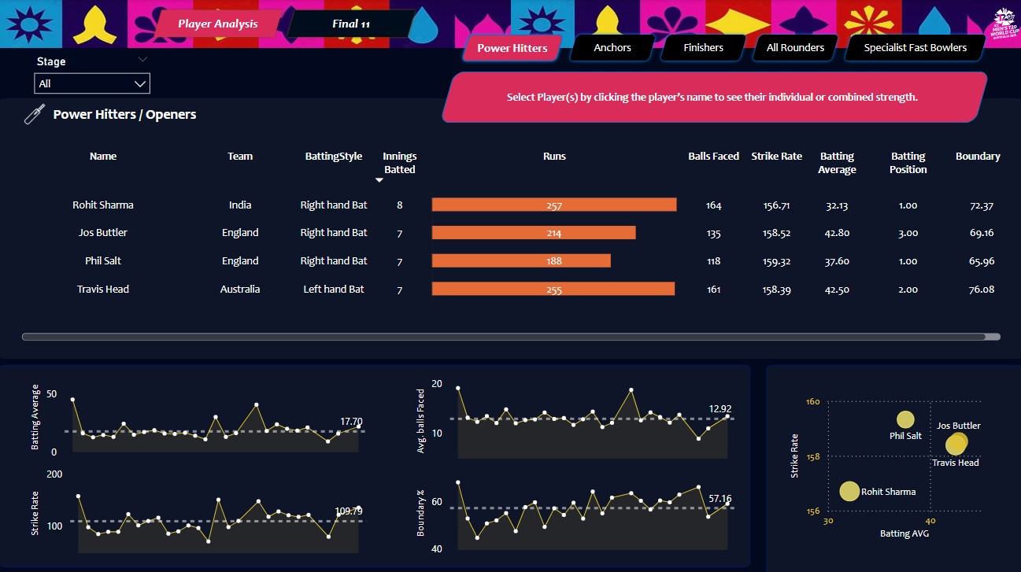
Dashboard Overview

Slide 12
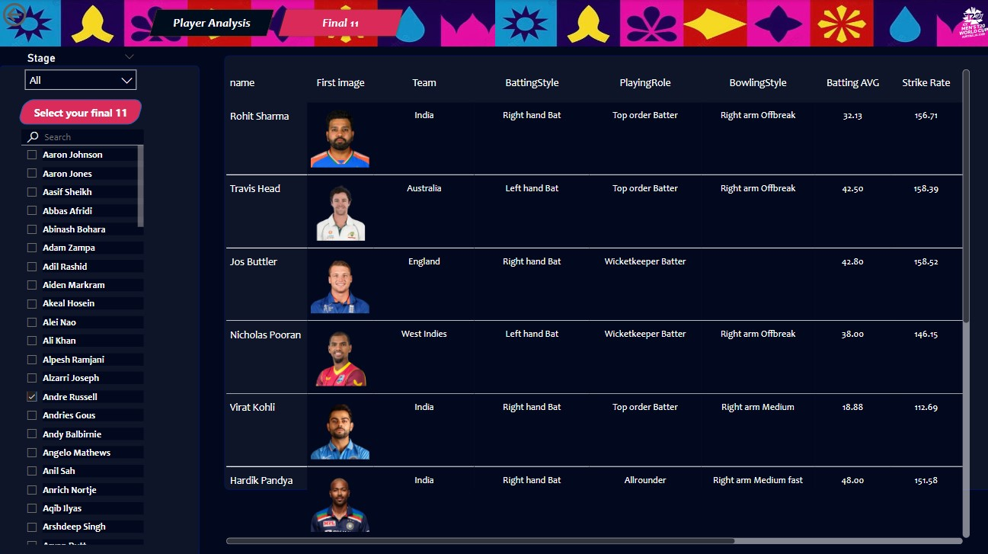
Final 11 - Overview

Slide 13
This project showcases the impact of data analytics on sports, focusing on cricket and the ICC Cricket World T20 2024. By analyzing player data, we developed a method to select the final 11 players for the tournament. The interactive Power BI dashboard simplifies complex data and supports decision-makers in choosing the optimal team based on objective criteria. This successful approach illustrates how data-driven strategies can enhance team performance and improve chances of winning. This methodology can be adapted for other sports and events, demonstrating the broad potential of data analysis in sports management.
Conclusion
=

Slide 14
Thank You
=

