Slide 1
COMPILER DESIGN LABORATORY • REVIEW 2
EduScript: Implementation Progress Review
Progress Report: Modular Architecture, Lexical & Syntax Pipeline, Scoped Symbol Management, and Working Components
STUDENT NAME
Udbhav Tiwari
REGISTER NUMBER
24BCT0328
COURSE & REVIEW
CD Lab • Review 2
PROJECT TYPE
Individual Project

Slide 2
EDUSCRIPT COMPILER DESIGN • REVIEW 2: IMPLEMENTATION PROGRESS
REVIEW 2 PROGRESS
Project Overview & Planned System Architecture
Problem Statement & Objectives
• Purpose of EduScript: To build a transparent, highly educational compiler/interpreter for an imperative language with customizable syntax.
• Educational Gap Addressed: Standard production compilers act as black boxes; EduScript enables students to inspect every transformation stage in real time.
• Key Project Goals: 1. Data-driven lexical scanning with custom multilingual keywords.
2. Recursive descent syntax analysis with structured AST nodes.
3. Scoped symbol tables with static semantic validation.
4. Intermediate code generation & execution engine.
Modular Pipeline Architecture
• Modular Staged Design: Each compiler phase is implemented as an independent, decoupled module communicating through explicit data structures.
• Lexical Analyzer (lexer.py): Converts raw characters into normalized Token stream using external JSON keyword mapping.
• Parser & AST (parser.py, ast_nodes.py): Validates grammatical structure and generates a strongly-typed Abstract Syntax Tree.
• Symbol Table & Semantic Checks: Tracks hierarchical lexical scopes, identifier declarations, and type compatibility.
• Backend Pipeline: Translates validated AST into Three-Address Code for virtual machine execution.

Slide 3
EDUSCRIPT COMPILER DESIGN • REVIEW 2: IMPLEMENTATION PROGRESS
REVIEW 2 PROGRESS
Implementation Progress & Current Development Status
Compiler Module / Component | Planned Functionality | Implementation Status | Verification Status
Lexical Analyzer (lexer.py) | Data-driven tokenization, keyword mapping, line/col tracking | Implemented & Operational | Verified with test suite
Configuration System (JSON) | External keyword mappings and token definitions | Implemented & Configurable | Tested with Hindi keywords
Parser (parser.py) | Recursive descent parsing with precedence climbing | Implemented & Operational | Verified with AST tests
AST Hierarchy (ast_nodes.py) | Typed AST node classes, Visitor pattern, ASCII printer | Implemented & Modular | Verified across statements
Symbol Table (symbol_table.py) | Hierarchical scope tree, variable shadowing & state | Implemented & Scoped | Tested across block scopes
Semantic Analyzer | Static type checking, undeclared & duplicate checks | Implemented & Validated | Diagnostic errors verified
Intermediate Code & Execution | Three-Address Code generation & Virtual Machine | Implemented & Integrated | End-to-end execution active

Slide 4
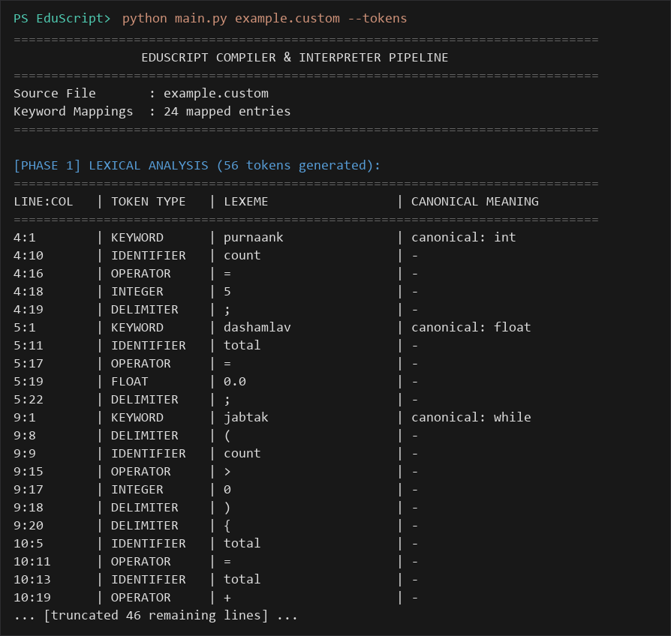
EDUSCRIPT COMPILER DESIGN • REVIEW 2: IMPLEMENTATION PROGRESS
REVIEW 2 PROGRESS
Working Module Demonstration: Lexical Analyzer
Lexer Execution & Keyword Normalization
• Working Command: python main.py example.custom --tokens
• Token Recognition: Scans raw source text into structured atomic Token objects with type, lexeme, and 1-based line:column coordinates.
• Custom Keyword Normalization: Custom Hindi keywords (purnaank, jabtak, agar, warna, dikhao, wapas) are transparently mapped to canonical equivalents (int, while, if, else, print, return).
• Token Stream Breakdown: Outputs clean tabular breakdown categorizing identifiers, integers, floats, operators, and delimiters.

Slide 5
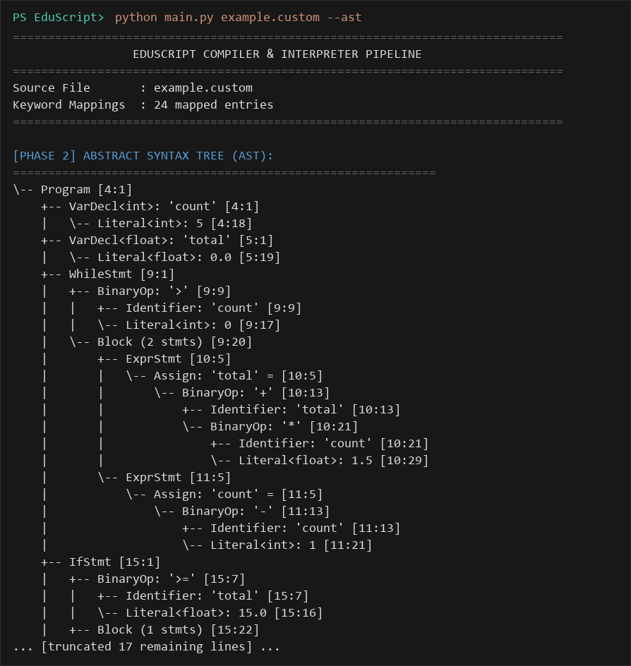
EDUSCRIPT COMPILER DESIGN • REVIEW 2: IMPLEMENTATION PROGRESS
REVIEW 2 PROGRESS
Compiler Concepts & Technical Implementation
Application of Core Compiler Theory
• Longest-Match Tokenization: Operators sorted by length to guarantee multi-character operators (==, !=, <=, >=) match before single-character tokens (=, <).
• Recursive Descent Parsing: Deterministic top-down grammar parsing with precedence climbing ensuring correct arithmetic & relational operator binding.
• Structured AST Construction: Abstract Syntax Tree constructed with dedicated node classes, preserving hierarchy for subsequent analysis passes.
• Panic-Mode Error Recovery: Synchronizes at statement delimiters (semicolons, braces) to continue validation after syntax errors.

Slide 6
EDUSCRIPT COMPILER DESIGN • REVIEW 2: IMPLEMENTATION PROGRESS
REVIEW 2 PROGRESS
Code Quality, Modularity & Architecture
1. Clean Separation of Concerns
Every phase is isolated in a dedicated source module:
• lexer.py (Tokenization & Lexing)
• parser.py & ast_nodes.py (Grammar & AST)
• symbol_table.py (Lexical Scopes)
• semantic_analyzer.py (Type & Scope Validation)
• tac_generator.py & interpreter.py (Backend)
2. Data-Driven Configuration
Language syntax is decoupled from source code logic:
• default_tokens.json (Operators, delimiters, comments)
• keyword_mapping.json (Custom keyword dictionary)
• config.json (Runtime behavior and path routing)
Allows changing keywords without altering scanner logic.
3. Strong Typing & Readability
Written in Python 3.11 with dataclasses and type annotations:
• Token dataclass with helper matchers
• ASTVisitor abstract base class
• Structured error classes with line/col attributes
• Zero external package dependencies.
4. Transparent CLI Diagnostic Engine
Provides interactive command-line inspection flags:
• --tokens (Token stream table)
• --ast (Visual ASCII AST tree)
• --symbols (Scoped symbol table)
• --tac (Three-Address Code IR)
• --all (Complete pipeline trace)

Slide 7
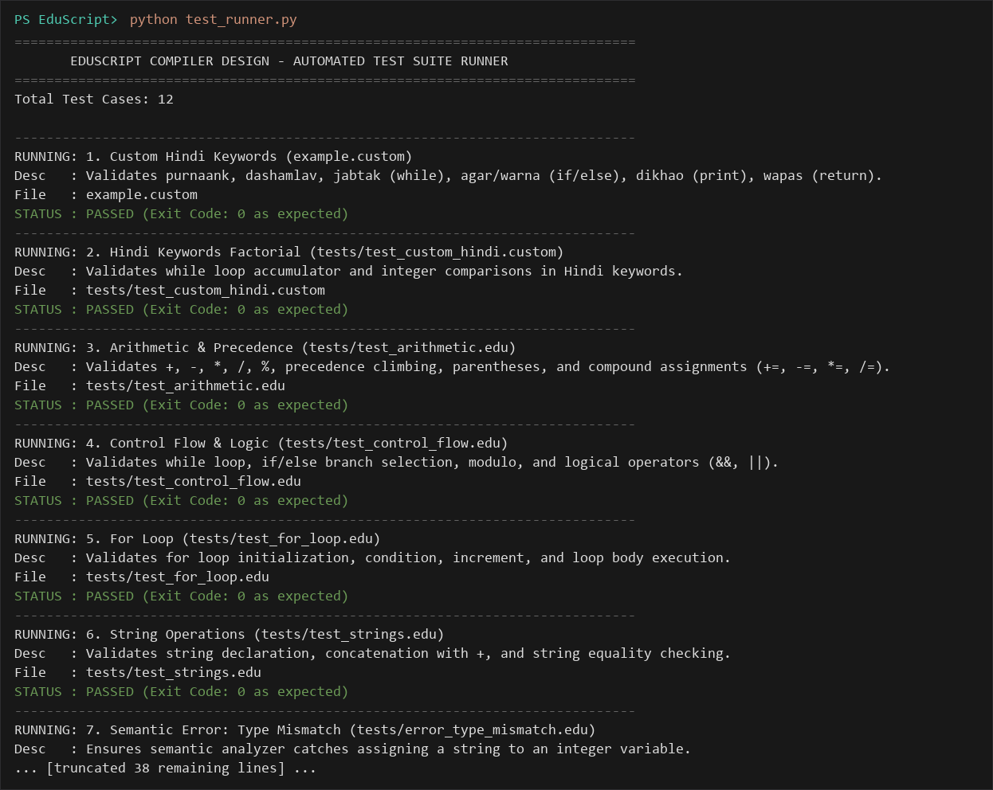
EDUSCRIPT COMPILER DESIGN • REVIEW 2: IMPLEMENTATION PROGRESS
REVIEW 2 PROGRESS
Testing Strategy & Functional Validation
Representative Test Cases
• Valid Custom Script (example.custom): Tests Hindi keyword normalization, while-loops (jabtak), float arithmetic, and if/else branching (agar/warna).
• Factorial Algorithm (test_custom_hindi.custom): Validates loop accumulator logic, integer multiplication, and conditional verification in custom keywords.
• Arithmetic Precedence (test_arithmetic.edu): Verifies operator precedence climbing, parenthesized sub-expressions, and compound assignments (+=, -=, *=, /=).
• Diagnostic Error Tests (error_*.edu): Negative test cases validating detection of lexical errors, syntax errors, and semantic type mismatches.

Slide 8
EDUSCRIPT COMPILER DESIGN • REVIEW 2: IMPLEMENTATION PROGRESS
REVIEW 2 PROGRESS
Problem Solving & Technical Innovations
1. Multi-Character Operator Collisions
Challenge: Operators like '=' and '==' share prefixes, leading to greedy single-character matching errors.
Solution: Implemented length-descending operator sorting in lexer.py ensuring longest matches are prioritized deterministically.
2. Multilingual Keyword Decoupling
Challenge: Supporting Hindi keywords (agar, jabtak) without complicating parser grammar rules.
Solution: Lexer attaches canonical attributes (e.g. 'if' for 'agar') based on JSON mapping, allowing parser to remain grammar-pure.
3. Precise Error Coordinate Tracking
Challenge: Providing actionable feedback when syntax or semantic errors occur in nested code.
Solution: Tracked exact 1-based line and column coordinates at token level, propagated through AST nodes to diagnostic error reporters.
4. Transparent Intermediate Inspection
Challenge: Lack of visibility into internal transformations during compiler lab testing.
Solution: Built dedicated CLI inspection options (--tokens, --ast, --symbols, --tac) allowing step-by-step verification of intermediate state.

Slide 9
EDUSCRIPT COMPILER DESIGN • REVIEW 2: IMPLEMENTATION PROGRESS
REVIEW 2 PROGRESS
Review 2 Viva Preparation — Key Technical Answers
Q1: What is the primary role of the Lexical Analysis stage in EduScript?
A1: The Lexer converts raw character streams into categorized Token objects, strips comments and whitespace, tracks exact line/column coordinates, and normalizes custom keyword aliases into canonical tags.
Q2: How does the parser handle custom Hindi keywords without modifying its grammar?
A2: The Lexer attaches canonical tags (e.g. canonical='while' for 'jabtak') based on keyword_mapping.json. The Parser checks token.canonical instead of raw lexemes, decoupling grammar rules from keyword naming.
Q3: How does the Lexer resolve ambiguities between '=' and '=='?
A3: EduScript applies the maximal munch (longest match) rule by sorting the operator table descending by length. Multi-character operators like '==' are checked before single-character operators like '='.
Q4: Why is modular architecture important for compiler construction in this project?
A4: Modular separation ensures each phase (Lexing, Parsing, Semantic Checking) has a single responsibility and well-defined input/output data contracts, simplifying debugging and intermediate inspection.

Slide 10
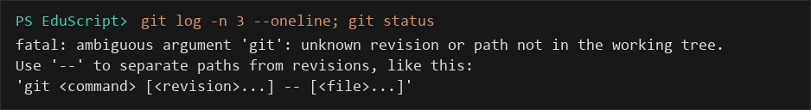
EDUSCRIPT COMPILER DESIGN • REVIEW 2: IMPLEMENTATION PROGRESS
REVIEW 2 PROGRESS
Review 2 Summary & Next Development Focus
Review 2 Progress Summary
• Working Front-End Pipeline: Lexical analysis, keyword normalization, recursive descent parsing, and AST construction are fully functional and verified.
• Semantic & Scoping Base: Scoped symbol tables and static semantic analysis rules actively validate identifier declarations and data types.
• Repository & Version Control: https://github.com/Udbhav-Tiwari16/EduScript (Branch: main).
• Next Development Steps: Further refining semantic diagnostic edge cases, exploring intermediate representation optimizations, and finalizing documentation.

