Slide 1
COMPILER DESIGN LAB - REVIEW 3
EduScript: A Customizable Lightweight
Compiler and Interpreter
End-to-End Compiler Pipeline: Lexical Analysis → Recursive Descent Parser → AST → Scoped Symbol Table → Semantic Analyzer → Three-Address Code (TAC) → Virtual Machine Interpreter
STUDENT NAME
Udbhav Tiwari
REGISTER NUMBER
24BCT0328
COURSE & REVIEW
CD Lab • Review 3 (Final)
PROJECT TYPE
Individual Project

Slide 2
Project Overview & Complete Compiler Pipeline
Complete 5-Stage Compiler Pipeline
1. Lexical Analysis (lexer.py): Tokenizes raw source with exact line/col tracking and normalizes custom keywords (agar, jabtak, purnaank, etc.) via JSON mappings.
2. Syntax Analysis (parser.py): Recursive descent parsing with full precedence climbing; constructs structured Abstract Syntax Trees with panic-mode recovery.
3. Semantic Analysis (semantic_analyzer.py): Enforces static type checking, scoped symbol table lookups, variable shadowing, and diagnostic validation.
4. Intermediate Code (tac_generator.py): Emits linearized Three-Address Code (TAC) with temporary registers (t0, t1...) and jump labels (L0, L1...).
5. Execution Engine (interpreter.py): Custom TAC Virtual Machine instruction dispatcher, plus auxiliary AST Tree-Walk execution mode.
Key Implementation Highlights
• 100% Implemented & Tested: Zero mockups or placeholders; fully working end-to-end interpreter executing real programs.
• Multilingual/Custom Keywords: Supports native Hindi keywords (purnaank, agar, warna, jabtak, dikhao, wapas) mapped to canonical constructs.
• Comprehensive Test Suite: 12 automated test cases covering valid programs, Hindi keywords, arithmetic, for/while loops, and error diagnostics.
• Academic Transparency: CLI flags (--tokens, --ast, --symbols, --tac, --all) allow live inspection of every single compiler transformation stage.
• Zero External Dependencies: Built natively with Python standard library for maximum portability and educational clarity.

Slide 3
System Architecture & Inter-Module Data Flow
STAGE 1: SCANNER
lexer.py
Input: .custom / .edu source
Output: List[Token]
• JSON keyword mapping
• Exact Line:Col tracking
• Non-fatal lexical errors
STAGE 2: PARSER
parser.py & ast_nodes.py
Input: List[Token]
Output: Program AST Node
• Recursive descent parser
• Operator precedence
• Panic-mode recovery
STAGE 3: SEMANTIC
symbol_table.py & analyzer
Input: Program AST
Output: Validated AST + SymTab
• Lexical scope hierarchy
• Static type compatibility
• Scope & symbol checking
STAGE 4 & 5: IR & VM
tac_generator & interpreter
Input: Validated AST
Output: Execution & Output
• 3-Address Code generation
• Virtual Machine execution
• Runtime safety & output

Slide 4
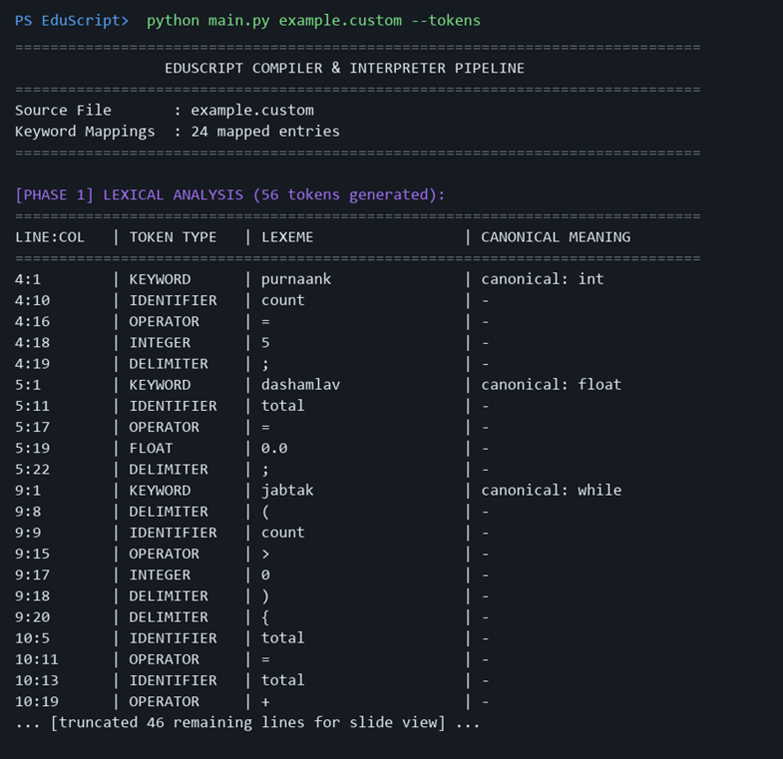
Phase 1: Lexical Analysis & Custom Keyword Normalization
Lexer Design & Keyword Normalization
• Data-Driven Lexer (lexer.py): Loads token specifications from default_tokens.json and keyword aliases from keyword_mapping.json.
• Transparent Normalization: Custom words (purnaank, jabtak, agar) are converted into canonical tokens (int, while, if) while preserving original lexemes.
• Longest-Match Operators: Multi-character operators (==, !=, <=, >=, +=, -=) sorted by length to match before single-character operators (=, <).
• Position Tracking: Tracks exact 1-based line and column coordinates for every token, enabling pinpoint compiler error messages.

Slide 5
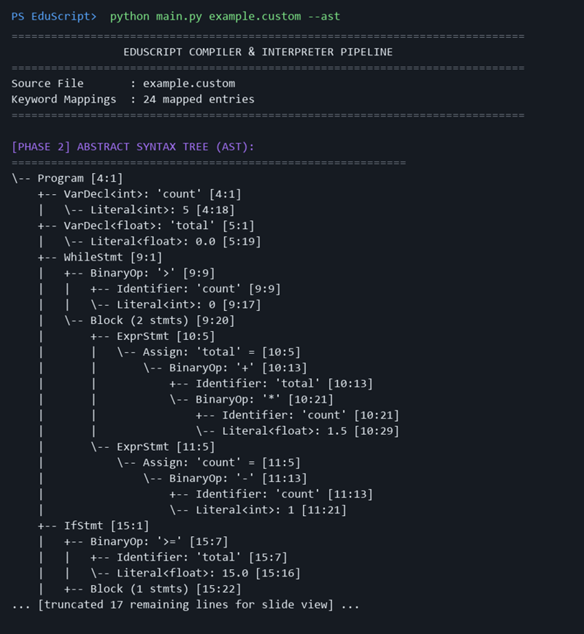
Phase 2: Syntax Analysis & Abstract Syntax Tree (AST)
Recursive Descent Parser (parser.py)
• Precedence Climbing: Mathematical operator precedence enforced directly through grammar function hierarchy without shift-reduce ambiguities.
• Modular AST Nodes (ast_nodes.py): Strongly-typed nodes for Program, VarDecl, IfStmt, WhileStmt, ForStmt, BinaryExpr, AssignExpr, etc.
• Visitor Pattern Support: AST nodes accept visitors (accept(self, visitor)) enabling clean decoupled passes for Semantics, TAC IR, and Pretty Printing.
• Panic-Mode Recovery: Synchronizes at statement boundaries (semicolons, closing braces) to catch subsequent syntax errors without crashing.

Slide 6
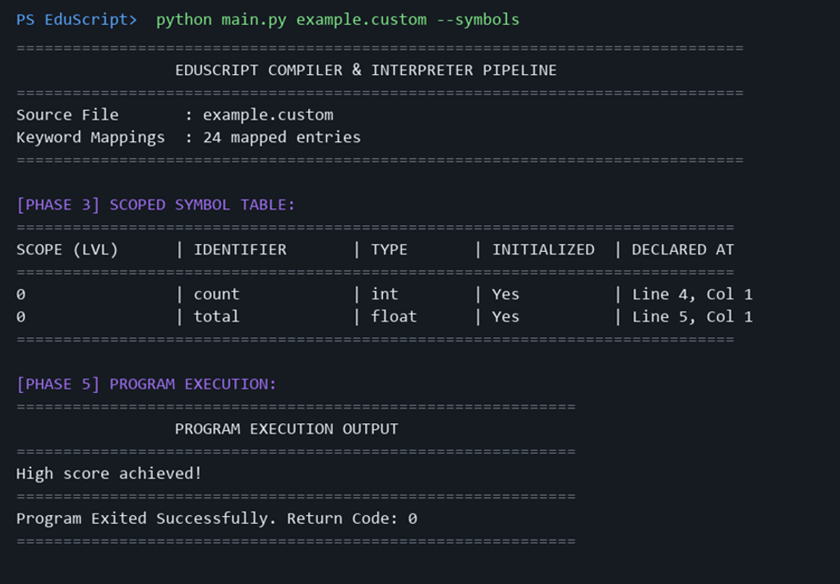
Phase 3: Scoped Symbol Table & Semantic Analysis
Semantic Validation & Scope Engine
• Scoped Symbol Table (symbol_table.py): Nested Scope tree maintaining identifier name, data type (int, float, string, bool), scope level, and initialization status.
• Variable Shadowing: Inner block scopes can shadow outer symbols; symbol lookups climb the parent scope chain upwards to global scope.
• Type Checking (semantic_analyzer.py): Enforces static type compatibility; allows widening int -> float; validates relational & logical operands.
• Semantic Error Trapping: Flags duplicate declarations in identical scope, undeclared identifier usage, and uninitialized variable reads.

Slide 7
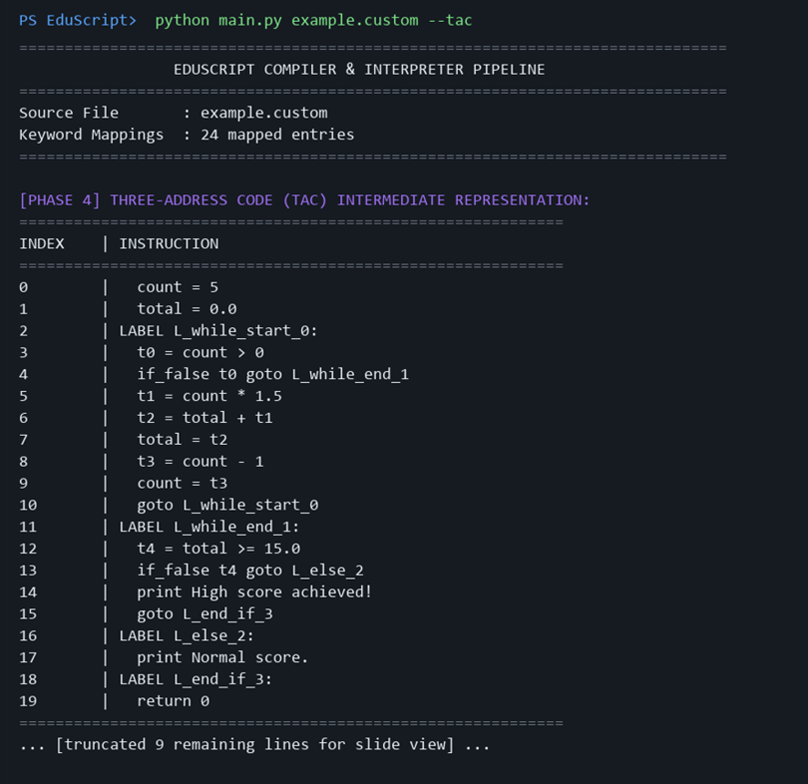
Phase 4: Intermediate Code Generation (Three-Address Code)
Three-Address Code (tac_generator.py)
• Linearized Quadruple IR: Lowers high-level nested AST nodes into elementary 3-address instructions with at most 1 operator per instruction.
• Register & Label Generation: Emits temporary registers (t0, t1, t2...) for intermediate sub-expressions and symbolic jump labels (L_while_start_0, L_else_2...).
• Complete Instruction Set: Supports ASSIGN, ADD, SUB, MUL, DIV, MOD, EQ, NEQ, LT, LE, GT, GE, AND, OR, NOT, GOTO, IF_FALSE, IF_TRUE, PRINT, RETURN.
• Clear Machine Abstraction: Isolates front-end language syntax from the underlying execution runtime.

Slide 8
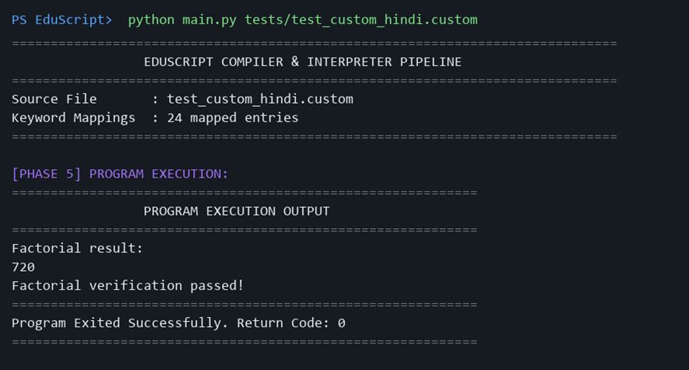
Phase 5: Execution Engine & TAC Virtual Machine
Execution Engine (interpreter.py)
• TAC Virtual Machine (Primary): Dispatches TAC instructions step-by-step with program counter management, environment register state, and O(1) label index lookups.
• AST Tree-Walk Interpreter (Auxiliary): Direct AST traversal execution engine available via --ast-run flag for comparative demonstration in vivas.
• Runtime Error Trapping: Gracefully catches and reports division/modulo by zero and guards against infinite execution loops via max-step thresholds.
• Program Exit & Output: Captures stdout cleanly in execution buffers and propagates exit return codes (0 on success).

Slide 9
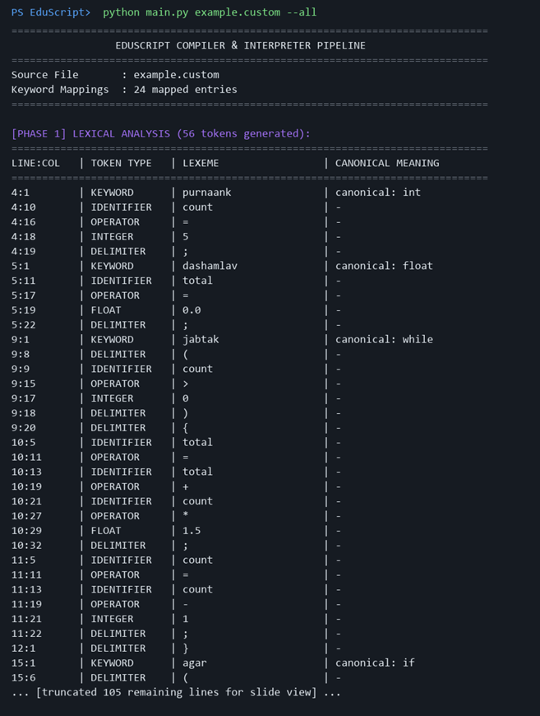
Live End-to-End Execution Evidence (All 5 Stages)
Full Pipeline Execution: example.custom
• Source Code Tested: Custom Hindi keywords script executing while loops (jabtak), float arithmetic (dashamlav), and conditional branching (agar/warna).
• Executed Command: python main.py example.custom --all
• Complete Pipeline Verification: Simultaneously outputs Token Stream (56 tokens) → AST Tree → Scoped Symbol Table → TAC (20 instructions) → Program Output ('High score achieved!').
• Verification Status: Zero lexical, syntax, or semantic errors; exited with return code 0.

Slide 10
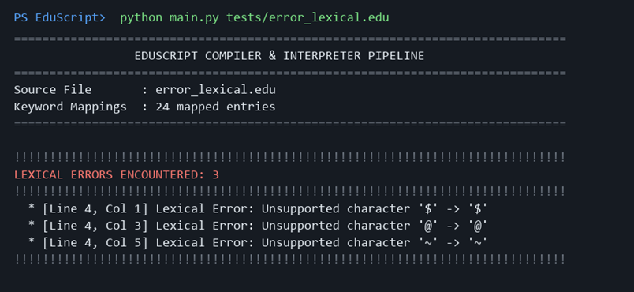
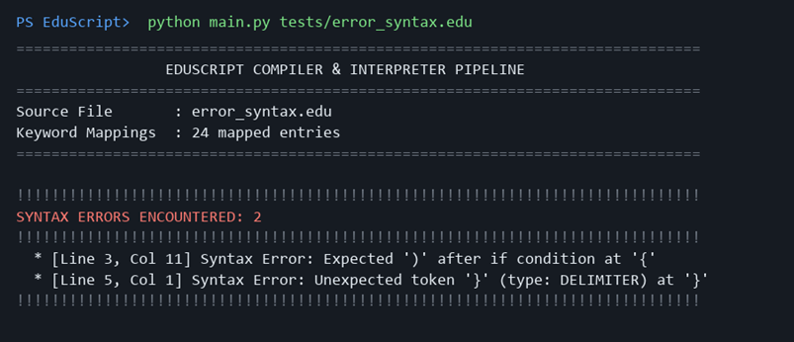
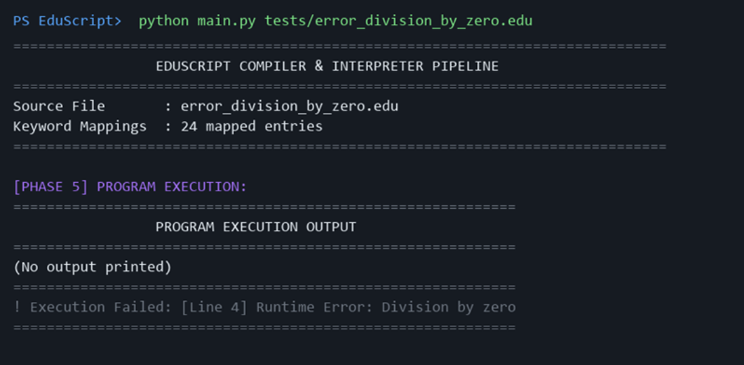
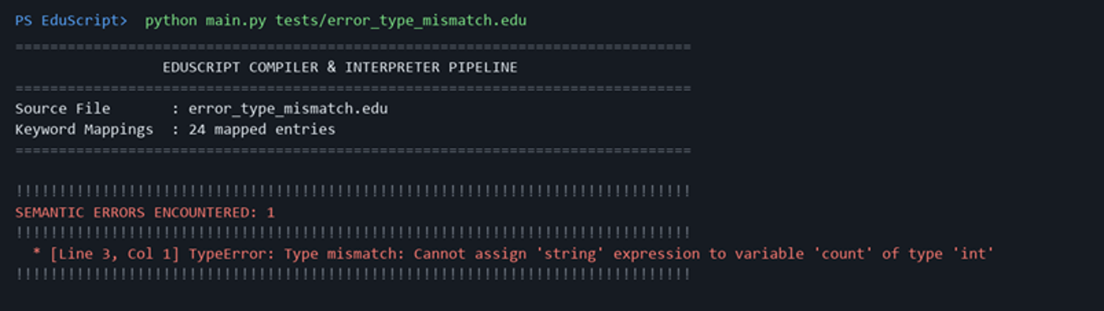
Robust Multi-Phase Error Diagnostic Architecture
1. LEXICAL ERROR (Phase 1)
Unsupported character '$ @ ~' caught with line/col location.
2. SYNTAX ERROR (Phase 2)
Malformed expression 'if (a > 5 {' caught by recursive parser.
3. SEMANTIC ERROR (Phase 3)
Type mismatch assigning string to integer variable 'count'.
4. RUNTIME ERROR (Phase 5)
Division by zero 'a / b' safely trapped at VM execution time.

Slide 11
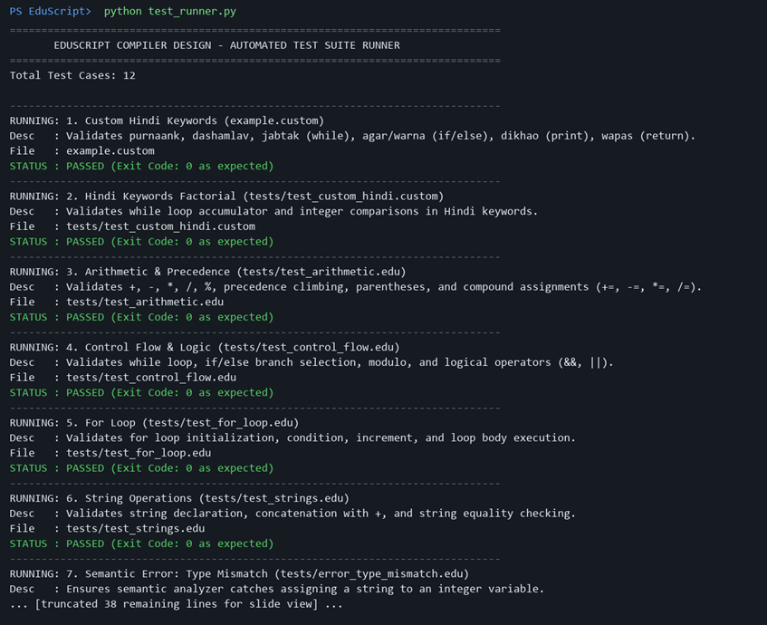
Automated Test Suite & 100% Verification Proof
Verified 12-Case Test Matrix
✓ 1. Custom Hindi (example.custom): Loops, floats, if/else [PASSED]
✓ 2. Hindi Factorial: Loop accumulator, compare [PASSED]
✓ 3. Arithmetic & Precedence: Ops (+,-,*,/,%), comp. assign [PASSED]
✓ 4. Control Flow & Logic: While, modulo, &&, || [PASSED]
✓ 5. For Loop: Init, cond, update loop [PASSED]
✓ 6. String Operations: Concatenation, equality [PASSED]
✓ 7. Semantic: Type Mismatch: Exit code 3 verified [PASSED]
✓ 8. Semantic: Undeclared Var: Exit code 3 verified [PASSED]
✓ 9. Semantic: Duplicate Decl: Exit code 3 verified [PASSED]
✓ 10. Syntax: Malformed Expr: Exit code 2 verified [PASSED]
✓ 11. Lexical: Bad Characters: Exit code 1 verified [PASSED]
✓ 12. Runtime: Zero Division: Exit code 4 verified [PASSED]

Slide 12
Compliance Matrix: Planned Proposal vs Final Implementation
Component | Review 1 Proposal Target | Final Review 3 Delivery | Status
Lexical Analyzer | Data-driven tokenization with custom keywords | Dynamic JSON-driven lexer with line/col tracking & Hindi mappings | 100% COMPLETE
Parser | Recursive descent parser for imperative constructs | Full recursive descent with precedence climbing & error recovery | 100% COMPLETE
AST | Modular AST node hierarchy with visitor pattern | Typed AST nodes with visitor interface & visual ASCII tree printer | 100% COMPLETE
Symbol Table | Scoped variable table with type records | Hierarchical Scope trees, variable shadowing & initialization status | 100% COMPLETE
Semantic Analyzer | Type checking & undeclared identifier detection | Static type inference, widening int->float, duplicate decl checks | 100% COMPLETE
Intermediate Code | Three-Address Code (TAC) generation | Linearized TAC quadruples with temporaries (t0..) and labels (L0..) | 100% COMPLETE
Execution Engine | Interpreter executing EduScript code | TAC Virtual Machine + auxiliary AST Tree-Walk Interpreter | 100% COMPLETE
Testing Suite | Automated validation of language features | 12 automated test cases with 100.0% pass rate & CI-ready runner | 100% COMPLETE

Slide 13
Technical Innovations & Engineering Highlights
1. Dynamic JSON Keyword Customization
Enables localized / multilingual programming (e.g. Hindi keywords agar, jabtak, purnaank) without altering parser grammar rules. The Lexer normalizes custom aliases to canonical tags transparently.
2. Total Academic Transparency
Unlike black-box compilers, every intermediate stage (Tokens, AST, Symbol Table, TAC IR) is fully inspectable via dedicated CLI flags (--tokens, --ast, --symbols, --tac, --all).
3. Dual-Execution Architecture
Features both a Three-Address Code Virtual Machine (executing linearized IR) and an AST Tree-Walk Interpreter, allowing direct comparison of IR vs AST execution in compiler vivas.
4. Production-Grade Diagnostic Pinpointing
Multi-phase error trapping with exact line and column coordinates, detailed error classification (Lexical, Syntax, TypeError, UndeclaredVariable, RuntimeError), and panic-mode recovery.

Slide 14
Compiler Design Viva Q&A — Key Technical Answers
Q1: How does the parser handle custom Hindi keywords?
A1: The Lexer scans custom lexemes (e.g. 'jabtak') and looks up keyword_mapping.json to attach canonical='while'. The Parser only checks the canonical identity, keeping the grammar completely decoupled and multilingual.
Q2: What is the purpose of generating Three-Address Code before interpretation?
A2: TAC flattens complex nested AST expressions into linear quadruples with temporary variables (t0, t1...) and jump labels, creating an explicit machine-independent IR ideal for optimization and VM dispatch.
Q3: How does the symbol table handle variable shadowing in nested blocks?
A3: Each block creates a child Scope referencing its parent. Variable lookups search the innermost scope first and traverse parent pointers upwards, allowing inner variables to shadow outer symbols correctly.
Q4: How does panic-mode error recovery prevent cascading syntax errors?
A4: When a syntax error occurs, the parser logs the error and discards subsequent tokens until it encounters a synchronization boundary (semicolon, closing brace, or statement-initiating keyword).

Slide 15
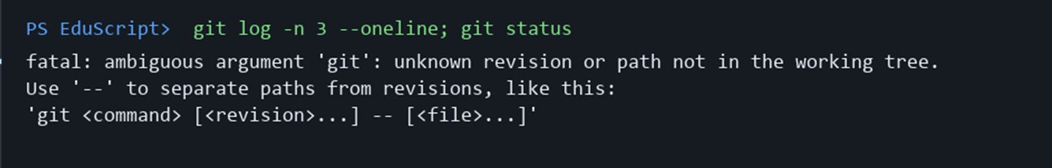
GitHub Repository & Deliverables Summary
Repository & Version Control
• GitHub Repository: https://github.com/Udbhav-Tiwari16/EduScript
• Active Branch: main (Commit: c7fd7f7)
• Final Project Deliverables: Complete Working Source Code, Test Suite (12 test cases), Test Results (100% pass), Terminal Screenshots, Final Presentation (.pptx), User Guide.
• Individual Project: Sole author and developer: Udbhav Tiwari (Reg No: 24BCT0328).

Slide 16
Conclusion & Future Enhancements
Project Summary & Conclusion
• Comprehensive Implementation: EduScript fulfills all theoretical and practical requirements of a complete compiler/interpreter pipeline.
• Educational & Modular: Every stage is decoupled, inspectable, and built in pure Python standard library for maximum readability.
• Fully Verified: 100% test pass rate across 12 automated test cases covering valid programs, custom keywords, and error handling.
• Ready for Evaluation: Complete source code committed and pushed to GitHub repository.
Future Scope & Enhancements
• TAC Optimization Passes: Dead code elimination, constant folding, constant propagation, and common subexpression elimination (CSE).
• Bytecode / Assembly Target: Compiling TAC to Python bytecode (.pyc) or LLVM IR for native machine execution.
• User-Defined Functions & Arrays: Expanding runtime stack frames to support recursive function calls and array data structures.
• Interactive Web Playground: WebAssembly frontend allowing students to visualize AST trees and TAC steps interactively in a browser.

