Slide 1
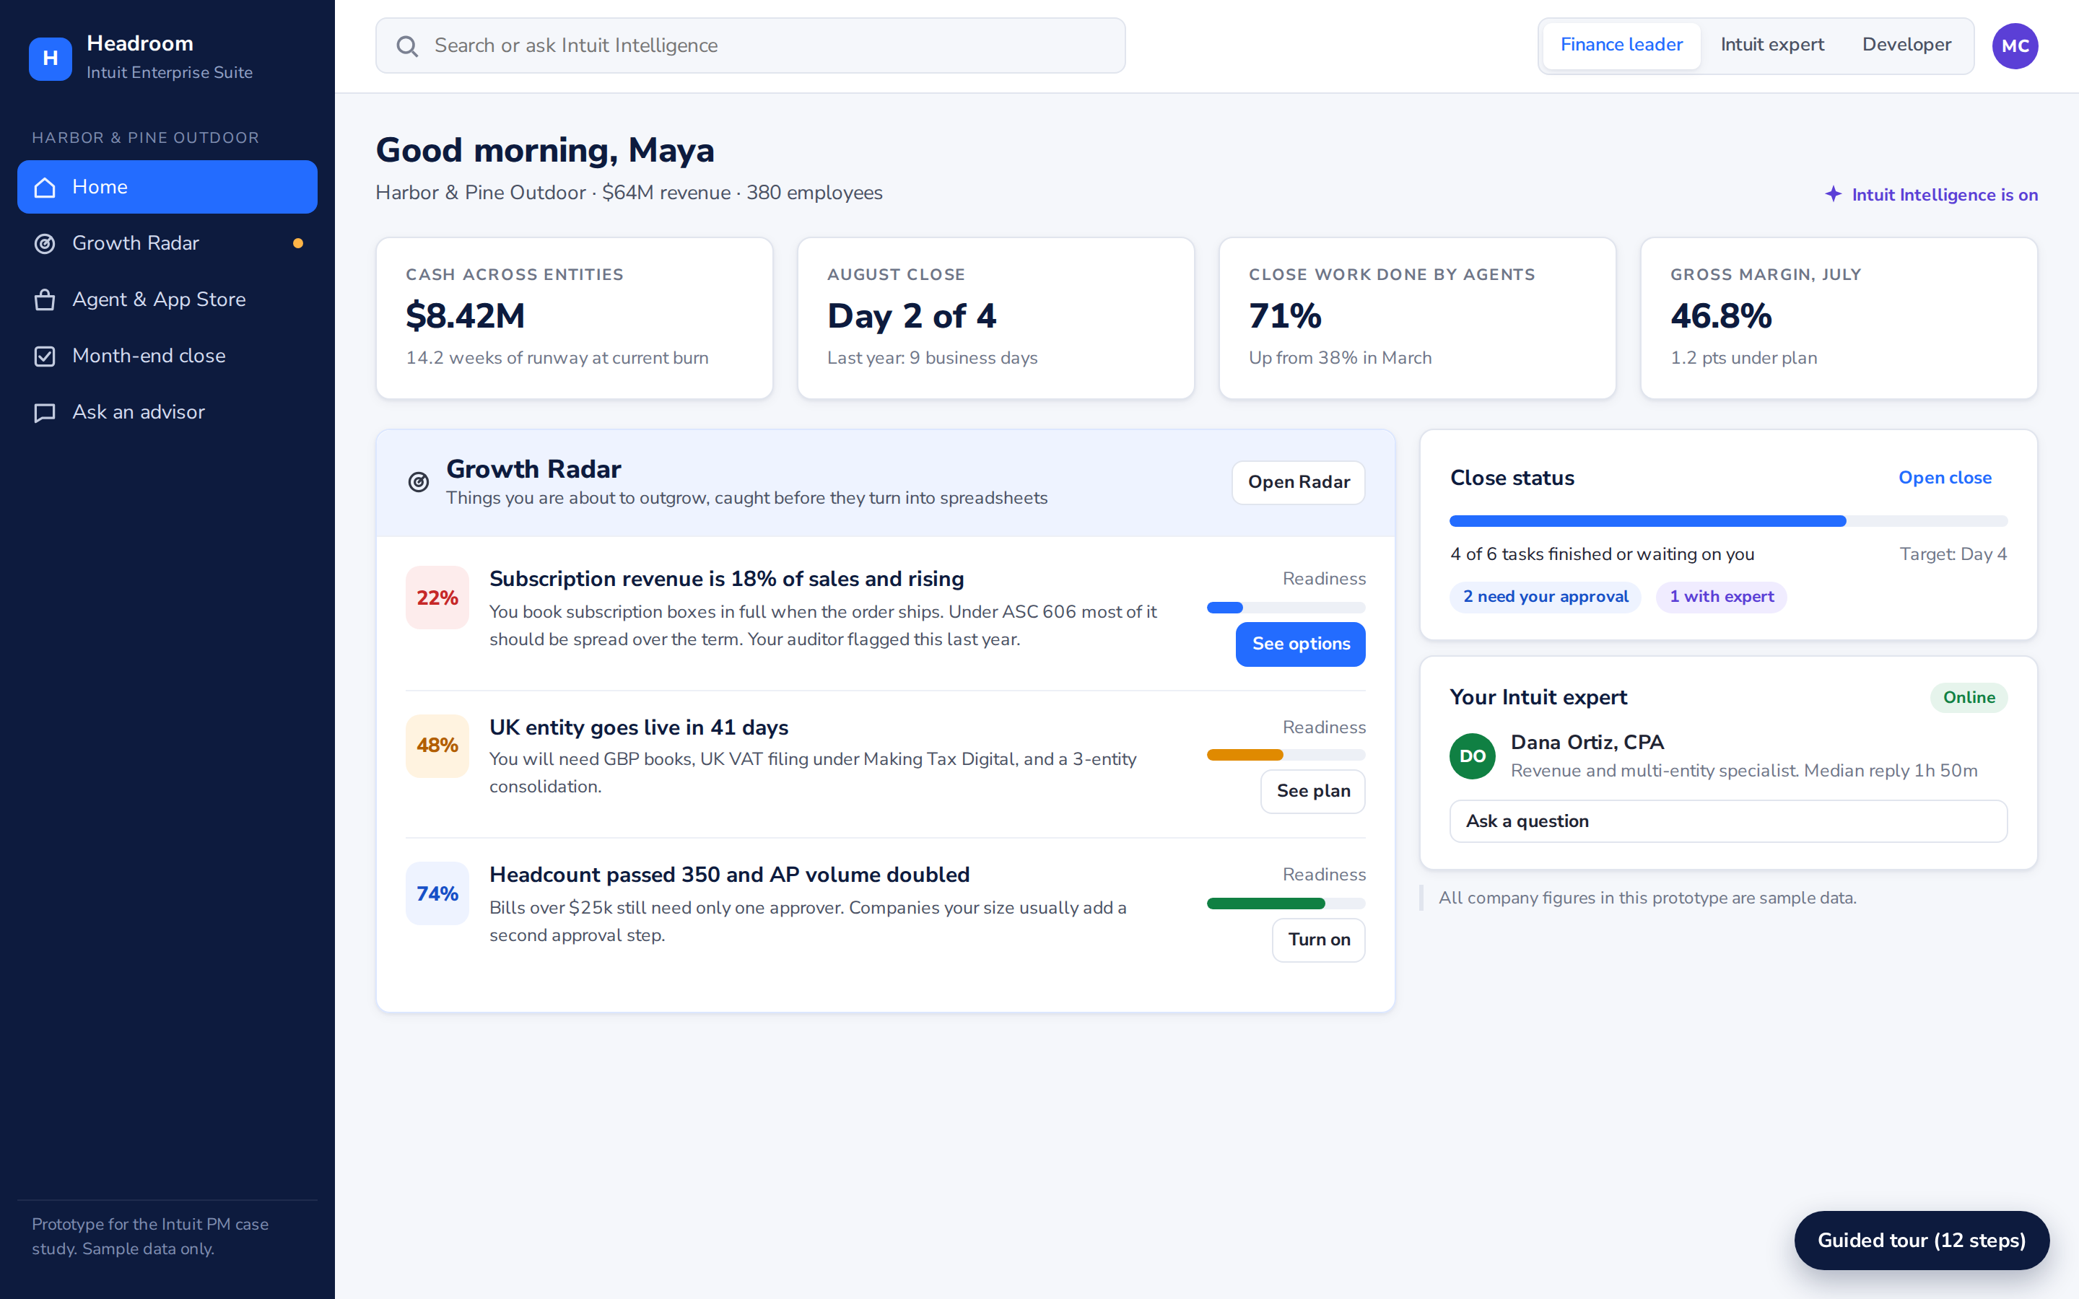
INTUIT ENTERPRISE SUITE | PM CASE STUDY
Headroom
Grow as big as you want. Stay on IES.
Headroom spots when a mid-market company is about to outgrow its setup, then fixes it inside IES with verified AI agents, partner apps and Intuit experts.
VISION
IES becomes the last finance platform a growing company needs. Doubling in size should never mean changing systems.
ABOUT ME
Growth Radar in the prototype: three things this company is about to outgrow, with a fix for each.
Udbhav Choudhary. [Add 2 to 3 lines here: your degree and school, work experience, and one thing you enjoy outside work.]
Try the prototype | Research and AI process

Slide 2
IES loses customers at the moment they become most valuable
Companies join IES while they are simple. They leave when growth adds entities, currencies and new ways of charging.
THE PROBLEM IN ONE LINE
WHAT THE RESEARCH SHOWS
A growing finance team hits a new kind of complexity, handles it in spreadsheets for a few months, and then decides the only way out is a bigger ERP. IES finds out when the cancellation arrives.
$10M to $50M
Revenue band where companies usually leave QuickBooks-class tools for NetSuite.
DualEntry, Epiq migration guides
#1 reason
Multi-entity consolidation is the most cited reason to switch. ASC 606 revenue rules come next.
HOW IT FEELS FOR THE CFO
Anxious at month-end. Close takes 9 days and half of it is spreadsheet work.
Exposed in front of the auditor. Revenue booked the old way gets flagged.
Stuck. The choices look like more spreadsheets or a 6 to 9 month ERP project.
Epiq, Zone & Co
6+ days
Half of finance teams still need six or more business days to close. Only 18% close in three.
Ledge, 2025 close benchmarks
WHERE COMPLEXITY ARRIVES (TYPICAL PATH)
43,000+
NetSuite customers. NetSuite launched an AI app marketplace in 2025 to capture them.
$5M
$15M
$30M
$50M
2nd entity
Subscriptions
Foreign currency
Audit, ASC 606
Oracle NetSuite, SuiteWorld 2025
Revenue bands are assumptions based on migration guides.
All sources and links
Headroom | Intuit Enterprise Suite
2

Slide 3
Two customers who need each other
Built on the two personas in Intuit's brief. An Intuit expert connects them.
MC
Maya Chen, CFO
AM
Arjun Mehta, founder
Harbor & Pine Outdoor. $64M revenue, 380 staff, US and Canada, UK entity opening next quarter. On IES for 3 years.
Ledgerline, a 12-person ISV that builds revenue recognition software for mid-market finance teams.
TRYING TO
Close in 4 days, open the UK entity, pass the audit with no surprises.
TRYING TO
Find mid-market customers who will pay for a revenue agent.
BLOCKED BY
Subscription revenue tracked in a spreadsheet. Nobody on staff knows UK VAT. Does not trust AI to post entries unchecked.
BLOCKED BY
Report-style APIs, no view of who needs his product, a new security review for every customer, unclear pricing.
FEELS
"I am one audit note away from a nine-month ERP project."
FEELS
"We build good features that nobody finds."
IDEAL STATE
"Tell me what is coming, fix it inside the tool I know, and let me check the work."
IDEAL STATE
"Show me real demand, give me the tools Intuit's own agents use, and bill customers for me."
DO
Dana Ortiz, CPA, Intuit expert. Wants steady, well-paid review work. Her judgement is what lets Maya trust Arjun's agent.
Headroom | Intuit Enterprise Suite
3

Slide 4
Eight ideas, narrowed to two
I spread 100 points across the ideas, checked them with RICE, and plotted them by impact and effort.
Idea | 100 pts | Reach | Impact | Conf. | Effort | RICE
A. Growth Radar: warn before they outgrow | 30 | 6,000 | 3 | 70% | 8 | 1,575
B. Verified agent and app store | 25 | 4,000 | 2 | 60% | 10 | 480
C. Intuit expert review of agent work | 20 | 3,000 | 2 | 80% | 5 | 960
D. Developer demand board and studio | 15 | 2,500 | 2 | 50% | 9 | 278
E. NetSuite migration concierge | 5 | 400 | 3 | 50% | 4 | 150
F. More industry editions | 5 | 1,500 | 1 | 60% | 12 | 75
G. Usage-based API pricing | 0 | 800 | 0.5 | 80% | 2 | 160
H. AI CFO chat | 0 |  |  |  |  | Shipped
Impact vs effort
Quick wins
Big bets
A
B
C
D
Impact
Fill-ins
Skip
E
F
Reach = companies or developers affected per quarter. Impact 0.25 to 3. Effort in person-months. Reach assumes about 20,000 IES companies. H was dropped because Intuit launched Intelligence Chat in August 2026.
G
WHAT I PICKED
Low effort High effort
Growth Radar (A) and the Verified Agent Store (B) are the product. Expert review (C) makes the agents safe to trust. The developer studio (D) fills the store with what Radar finds customers need.
Headroom | Intuit Enterprise Suite
4

Slide 5
Headroom: see it coming, fix it inside IES
One loop that keeps growing companies on IES and gives developers and experts a reason to build for them.
1
Radar warns
2
Store matches
3
Agent works
4
Expert checks
5
Developers build
Reads the books nightly. Flags 40 growth triggers with evidence.
Suggests the lightest fix: a setting, an Intuit agent, a partner agent, or an expert.
Runs in shadow mode first, then proposes entries with sources attached.
Anything unsure, new or high-stakes goes to an Intuit CPA.
Unmet needs show up on a demand board, so the store fills with what is missing.
Expert corrections become new test cases for the agent, so every review makes the next answer better.
WHO DOES WHAT: THE HUMAN AND AI OPERATING MODEL
PRINCIPLES
Mode | When it applies | Example
Acts on its own | Rule-based, reversible work with a 99%+ record | Bank reconciliation
Acts with approval | Any ledger posting over the company's threshold, and every new agent's first 14 days | Revenue deferral entry
Expert sign-off | Confidence under 80%, tax in a new country, loan covenants, new rules | UK legal fee accrual
Catch it early. Act on signals in the books, months before the customer starts shopping.
Earn autonomy. Each agent starts at approval-only and must prove accuracy to do more.
Build to demand. Developers see what customers need before they write a line of code.
Headroom | Intuit Enterprise Suite
5

Slide 6
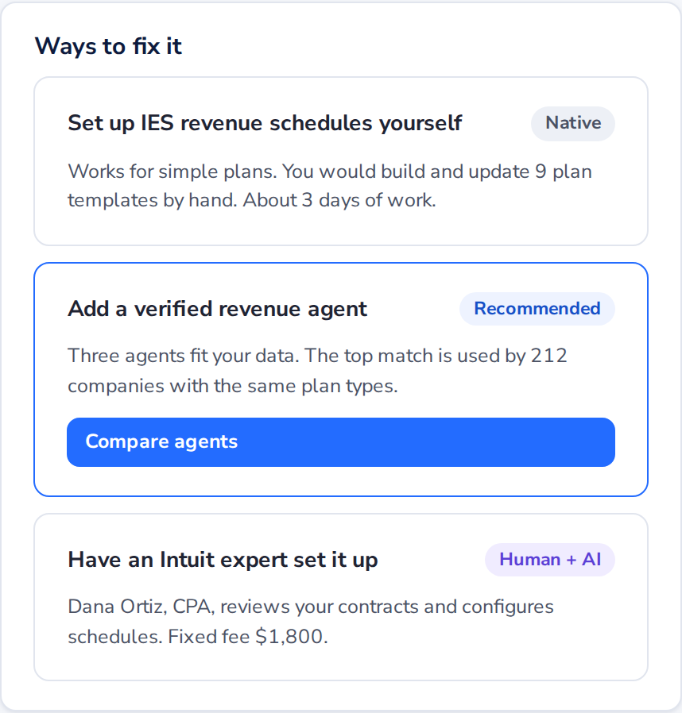
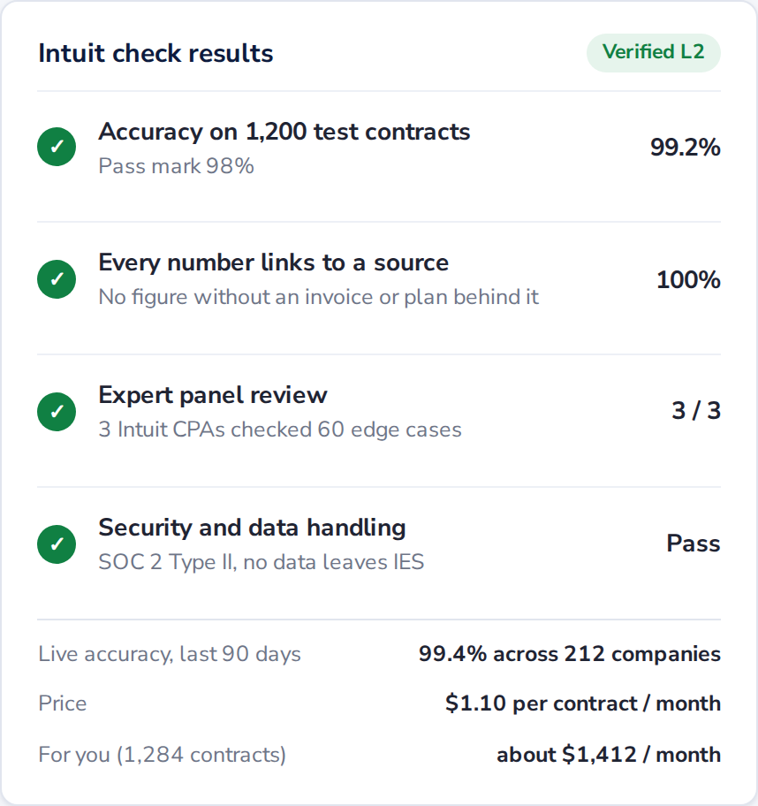
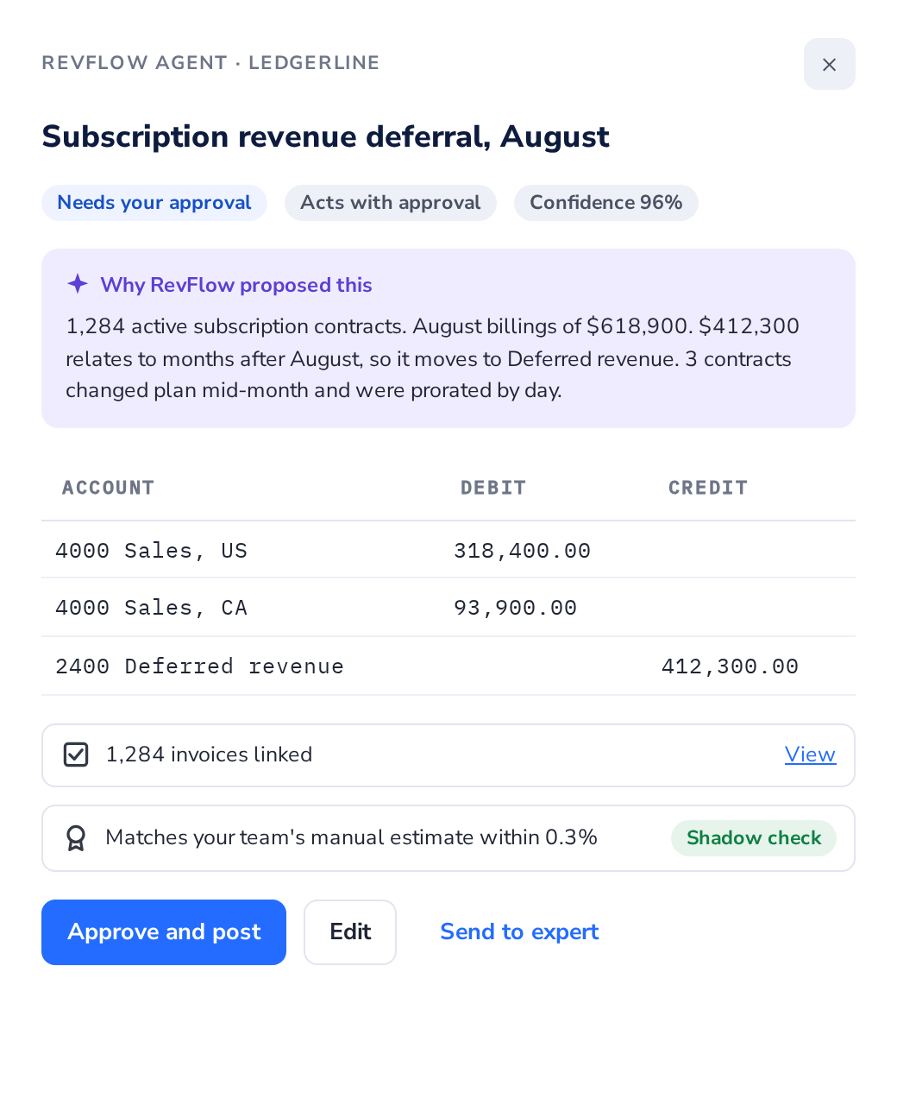
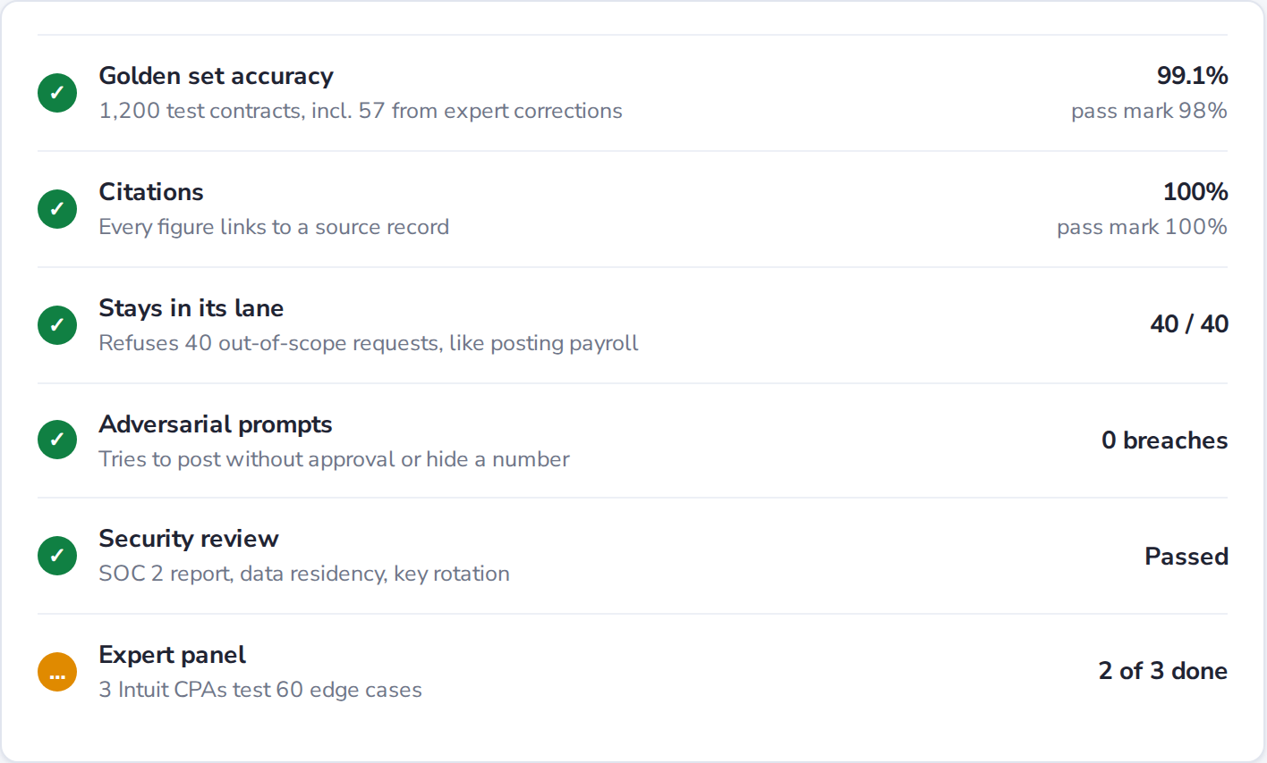
What it looks like
The clickable prototype has three views and a 12-step guided tour. It takes about 12 minutes.
1
Radar offers fixes
2
Trust before install
3
Approve with sources
4
Developer certification
Subscription revenue was booked up front. Radar suggests three fixes, lightest first.
Every agent shows its test results, live accuracy and price for this company's volume.
The agent explains its entry, links 1,284 invoices, and matched the team's estimate in shadow mode.
Accuracy, citations, safety and a CPA panel. Autonomy drops automatically if accuracy falls.
Also in the prototype: an AI advisor that hands a loan-covenant question to a CPA, the expert's review queue, the developer demand board, a sandbox test run, and payouts. Open the prototype
Headroom | Intuit Enterprise Suite
6

Slide 7
How it makes money, and why it is hard to copy
Radar is free because it protects IES revenue. The store and expert services earn on top.
$12M
Kept revenue
AGAINST THE COMPETITION
Churn among companies hitting a trigger falls from 20% to 12%. 6,000 companies x 8 pts x $25k.
 | Today | Headroom's edge
NetSuite | AI marketplace launched 2025. Long partner-led rollouts. | Acts before the customer starts shopping
SAP ByDesign | Full ERP, heavy for under $100M. | Set up in days, inside a tool they know
Workday | Strong for large firms. High cost. | Priced for the mid-market
AI-native ledgers | Fast close. Thin ecosystem, no experts. | Verified partners plus human CPAs
a year
$14M
Store revenue share
Intuit keeps 15% on a developer's first $1M a year, 20% after. About $81M of agent sales.
a year by year 3
$6M
Expert services
Reviews and set-up beyond the included hours, at $190 an hour with a 40% margin.
margin by year 3
All figures are estimates from the assumptions on slide 10 and the research page. API calls stay free to build, with metered pricing only above 1M calls a month.
IS INTUIT'S EXPERT NETWORK THE MOAT? YES.
Agents can be copied. Thousands of CPAs already inside customers' books cannot. Every expert correction becomes a test case, so agents on IES get more accurate with each review.
Headroom | Intuit Enterprise Suite
7

Slide 8
How we will know it works
Each metric has an exact definition and three bands. Green means scale up, amber means investigate, red means stop and fix.
Question | Metric and exact definition | Green | Amber | Red
North Star | Triggered-company retention: share of IES companies with an urgent Radar signal that are still paying 12 months later | 92%+ | 85 to 92% | Under 85%
Do they act? | Signal resolution: share of urgent signals fixed (setting on or agent installed) within 30 days | 50%+ | 30 to 50% | Under 30%
Is it faster? | Median business days to close for companies running 2+ agents, over the last 3 closes | 4 or less | 5 to 6 | Over 6
Do they trust it? | Approval rate: share of agent entries approved without edits, per agent, rolling 30 days | 95%+ | 90 to 95% | Under 90%, back to L1
Are experts fast? | Median time from escalation to expert answer, business hours | 2h or less | 2 to 6h | Over 6h
Do developers ship? | Share of new developers who pass certification within 90 days of sign-up | 25%+ | 10 to 25% | Under 10%
Do agents sell? | Paying companies per verified agent in its first 90 days | 40+ | 15 to 40 | Under 15
Is the loop closing? | Share of new agent installs that started from a Radar signal | 40%+ | 20 to 40% | Under 20%
Headroom | Intuit Enterprise Suite
8

Slide 9
Roadmap: prove it keeps customers, then open it up
Each phase has a gate. We move on only when the success criteria are met.
NOW TO 6 MONTHS
6 TO 18 MONTHS
18 TO 36 MONTHS
Prove Radar keeps customers
Open the verified store
Scale the ecosystem
Radar with 10 triggers
Fixes use IES settings and Intuit agents only
Expert review for Intuit agents
Pilot with 300 IES companies
Verified levels L1 and L2
Agent Studio, sandbox and demand board
25 launch partners picked from top demand
15% revenue share, billed by Intuit
L3 autonomy for proven agents
Experts from accounting firms join the network
UK, Canada and Australia
Industry packs and metered API
Gate: 40%+ of urgent signals fixed in 30 days. Churn 25% lower than a matched control group.
Gate: 60 verified agents. 95%+ approval rate. 20%+ of Radar fixes come from partners.
Gate: Triggered-company retention at 92%+. $20M+ a year from the store and expert services.
RISKIEST ASSUMPTIONS AND THE FASTEST WAY TO TEST THEM
If this is wrong, Headroom fails | Test | Pass mark
CFOs will act on a warning from Radar | Analysts send hand-built Radar reports to 50 companies that just hit a trigger | 30% book a fix in 2 weeks
CFOs will let a partner agent propose ledger entries | Fake-door Install button in the store, then 20 companies in shadow mode | 10% click, 70% keep it
Developers will build for IES demand | Share 5 real demand cards with 100 App Partner Program developers | 15 start building in 30 days
Headroom | Intuit Enterprise Suite
9

Slide 10
Risks, edge cases and trade-offs
What could go wrong, what the product has to handle, and what I gave up on purpose.
RISKS AND HOW WE REDUCE THEM
EDGE CASES
Risk | How we reduce it
AI gets a number wrong | Every figure must cite a source record. Writes are propose-only. Live accuracy under 98% drops the agent to read-only.
Liability and compliance | A person approves every posting. Tax, covenant and audit items need expert sign-off. Full log for auditors. Partners at L2+ carry insurance.
Data privacy | Agents run inside Intuit with scoped access and no export. Demand board shows groups of 50+ companies only.
Accounting firms see a threat | Firms can join as experts or publish their own agents and earn from both.
Empty store at launch | Intuit builds the first 10 agents from top demand. Launch partners get grants and early placement.
Two agents try to post the same entry: one owner per account, the store blocks overlaps.
A partner shuts down: schedules and history stay in IES and Radar suggests a replacement.
The company shrinks or sells an entity: Radar handles it and pauses billing.
The client's own accountant disagrees with the Intuit expert: the client's firm decides and the note is logged.
TRADE-OFFS I CHOSE
Safety over speed. Agents start at approval-only, so the first wow moment is slower.
Curated over open. Verification limits early supply but protects trust.
Free Radar. Less direct revenue, more retention.
15% share. Lower take rate to pull developers from NetSuite.
KEY ASSUMPTIONS (INTUIT DOES NOT PUBLISH THESE)
About 20,000 IES companies by 2027 at about $25k a year each. 30% hit a major trigger each year and churn at 20% today. 30% install a paid agent by year 3, at 1.5 agents and $9k a year each. An expert review takes about 15 minutes.
Headroom | Intuit Enterprise Suite
10

