Slide 1


Slide 2

VERDANT OS

Slide 3
Verdant OS: Your Desktop, Anywhere
Imagine an operating system that requires no installation and lives entirely in your browser. Verdant OS provides users with a seamless, interface equipped with essential tools: a dynamic calendar, a functional calculator, and a notepad. With a focus on user customization and a "Glassmorphic" UI, Verdant OS states that the future of productivity is web-based, beautiful, and eco-inspired.

Slide 4
LOGIN

Slide 5
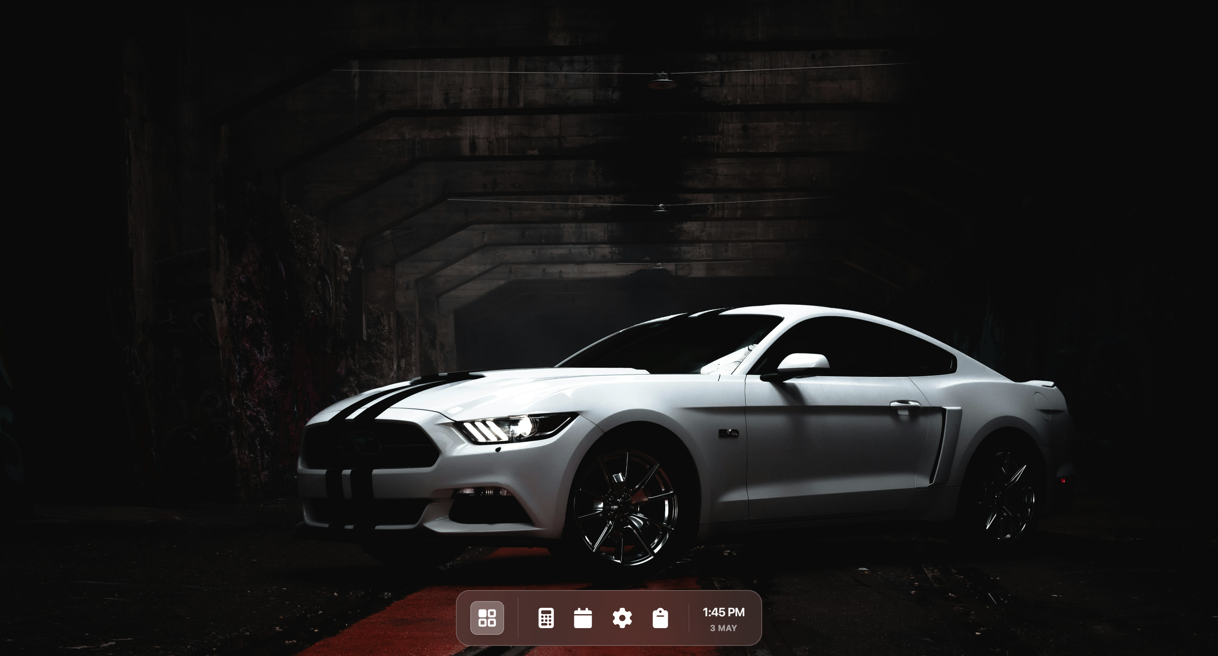
Welcome Aboard!
Let’s Step Into The Ecosystem

Slide 6
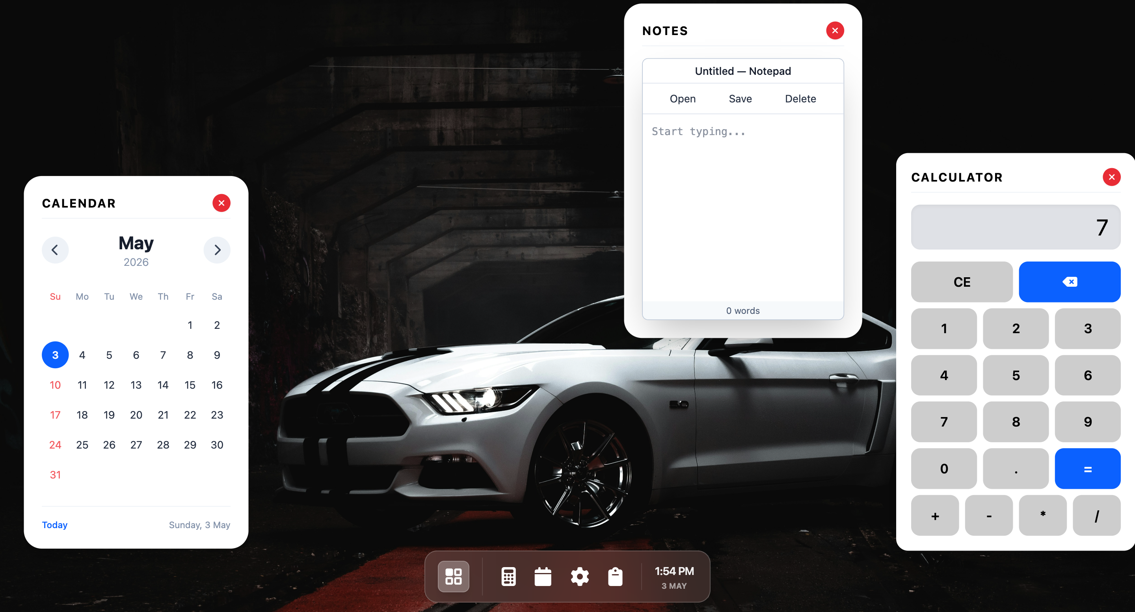
A calendar that highlights the current date and provides navigation. It offers a clear monthly overview to help track time within the ecosystem
Welcome Aboard!
A text editor powered by “LocalStorage”. It allows you to draft, save and delete notes instantly, ensuring your ideas remain secure.
A sleek, glassmorphism-style calculator. It features a responsive grid layout and a display, designed for quick calculations within the workspace.

Slide 7
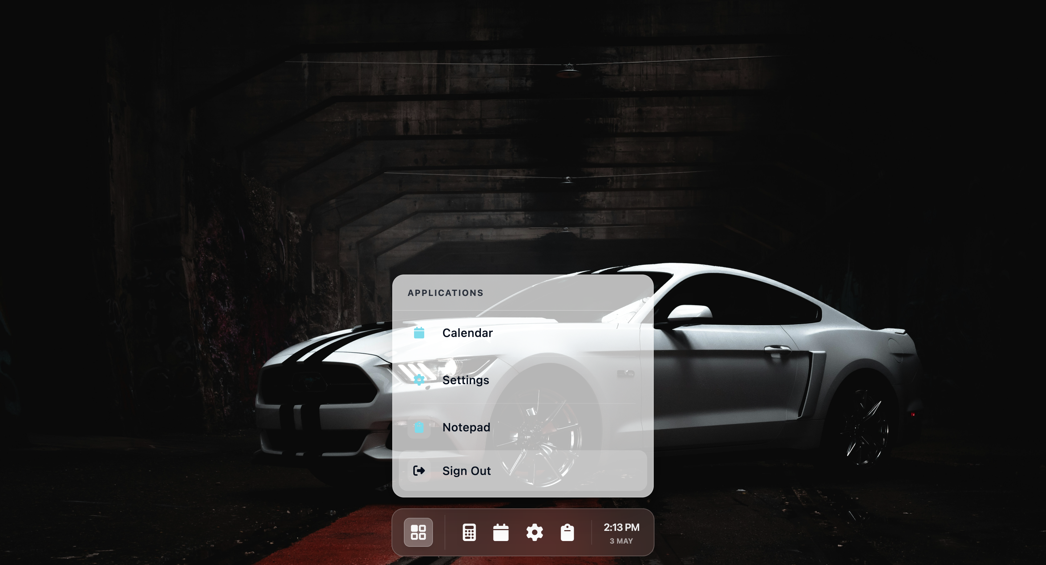
Welcome Aboard!
Signing Out…
Thank you for your time.
Let’s Step Into The Ecosystem
Team – CM SHRI Gandhi Nagar
Made by – Udbhav Dalmia, Om Tiwari and Shashwat Tiwari

