Slide 1

New Delhi Temperature Forecast
Time Series Term Project
Udbhav Kush

Slide 2
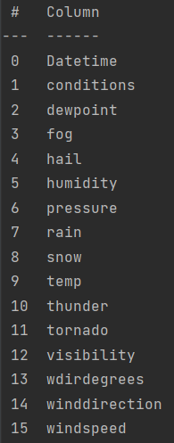
Introduction:
In this project, I am going to predict the average daily temperature of New Delhi (capital of India).
Original dataset is sampled hourly.
There were some missing values, so resampled on a daily basis.
Columns in the dataset:

Slide 3
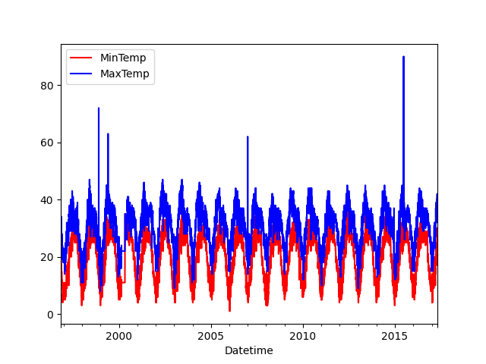
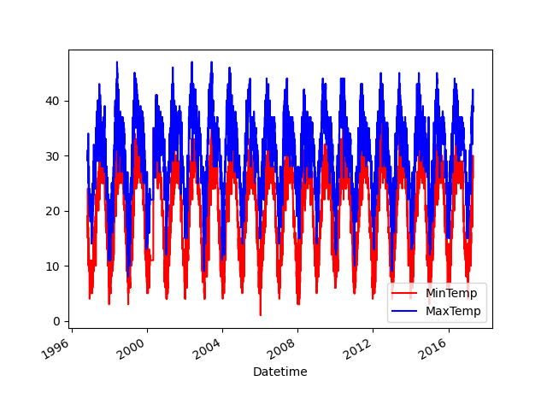
Cleaning of the Data:

Slide 4
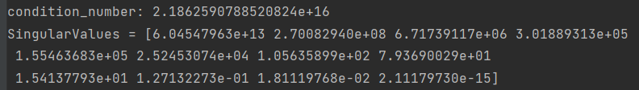
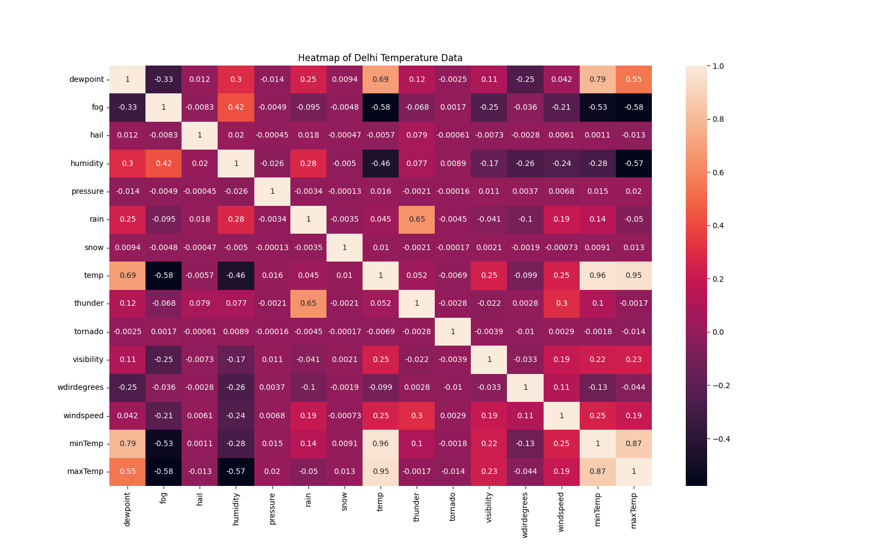
Continued..

Slide 5
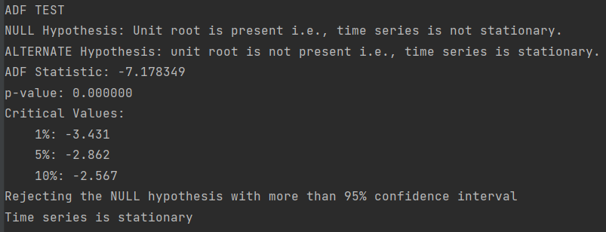
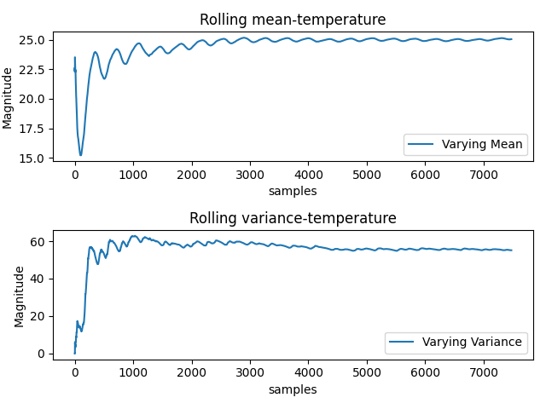
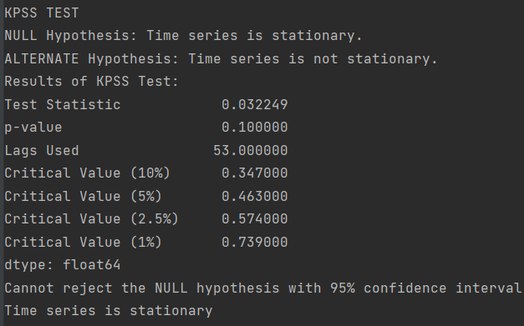
STATIONARITY CHECK

Slide 6
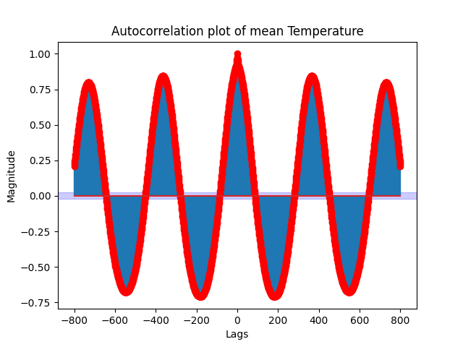
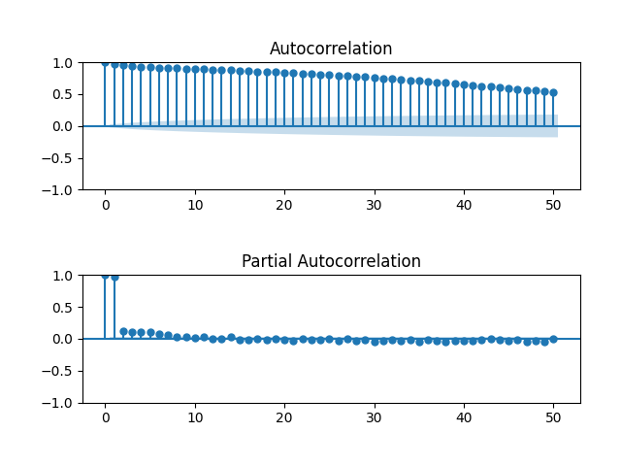
ACF AND PACF

Slide 7
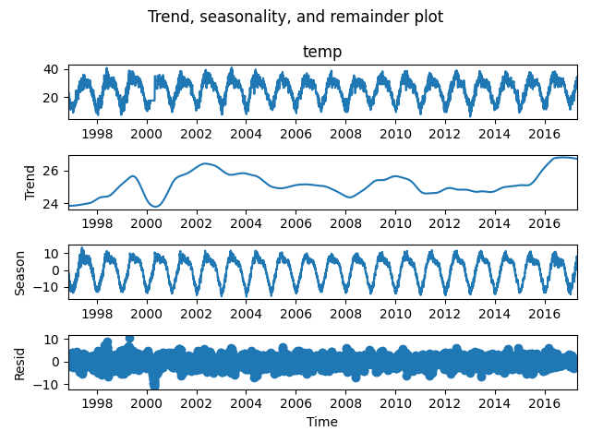
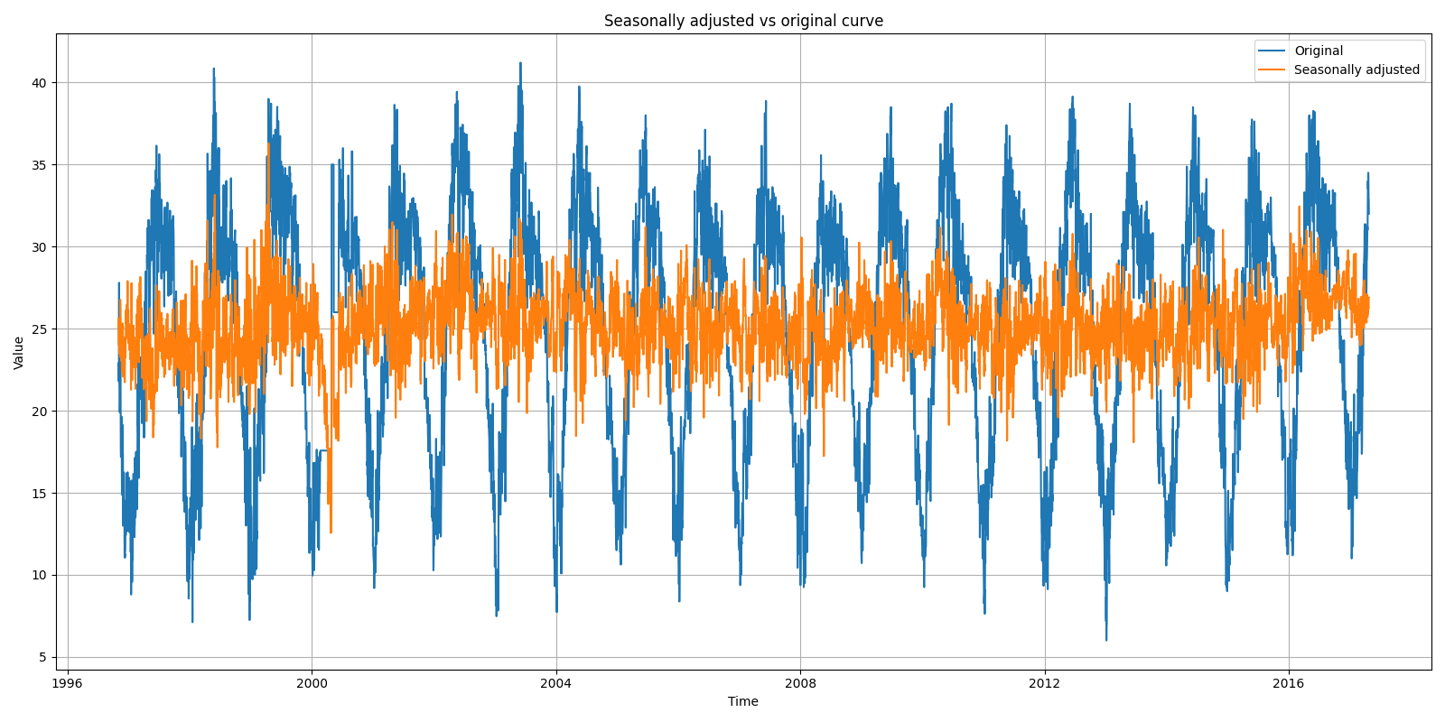
STL ANALYSIS

Slide 8
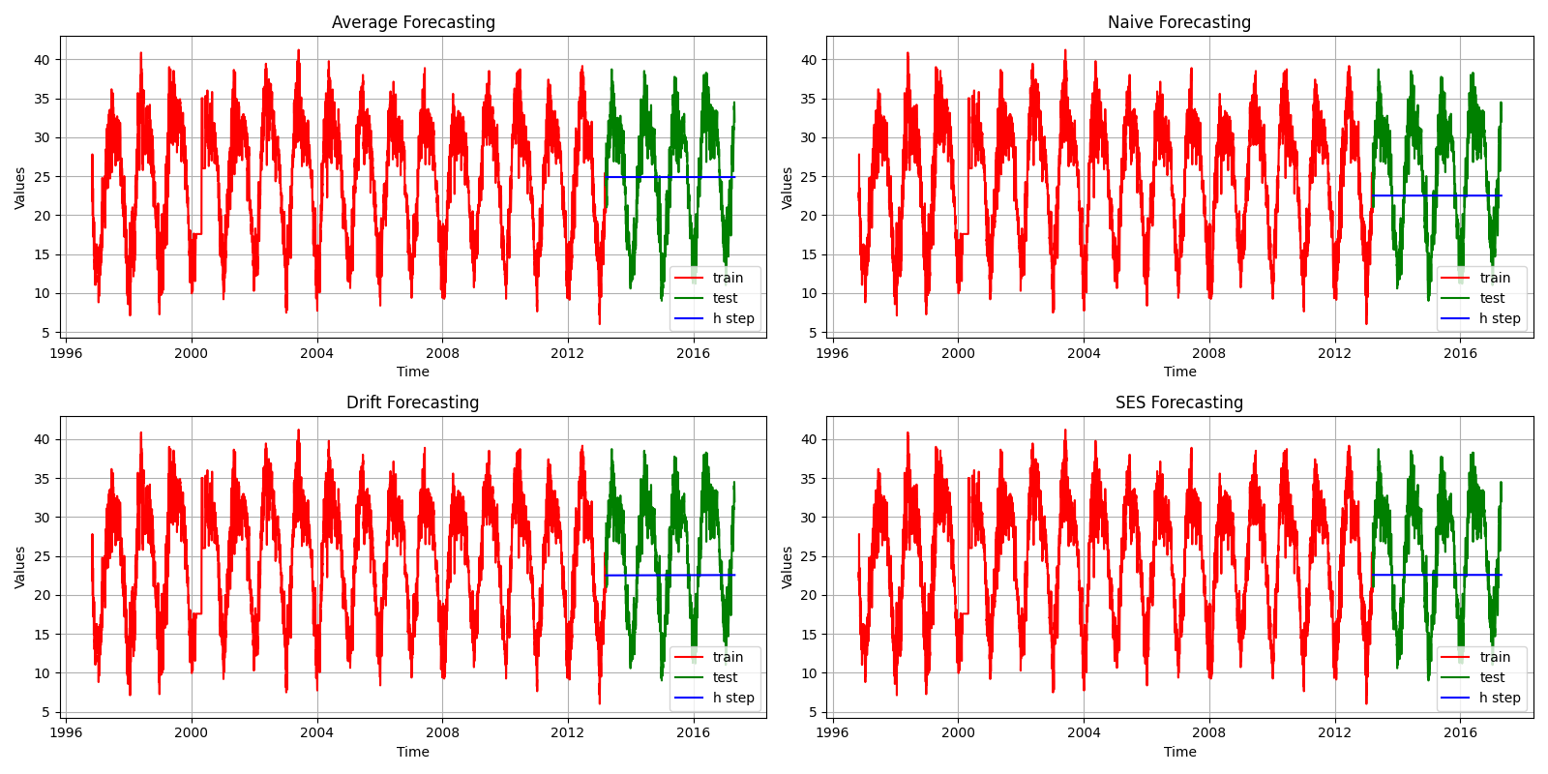
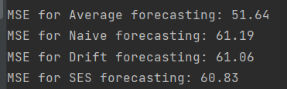
Analysis on Base Models

Slide 9
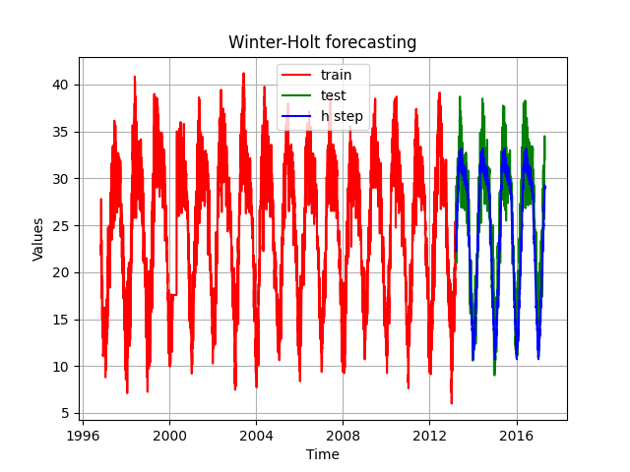

Winter-Holt Method

Slide 10
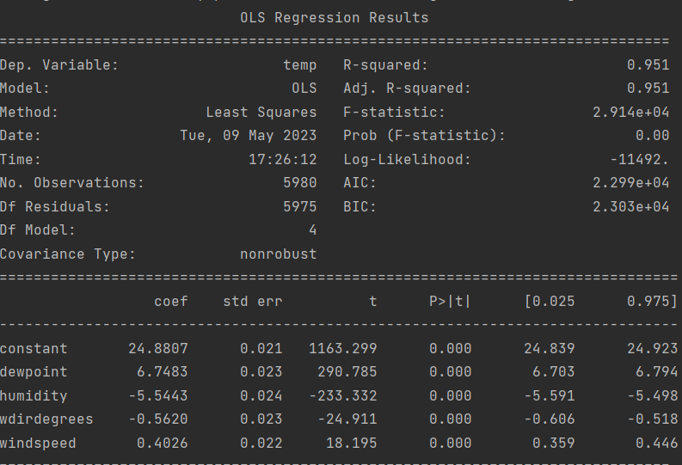
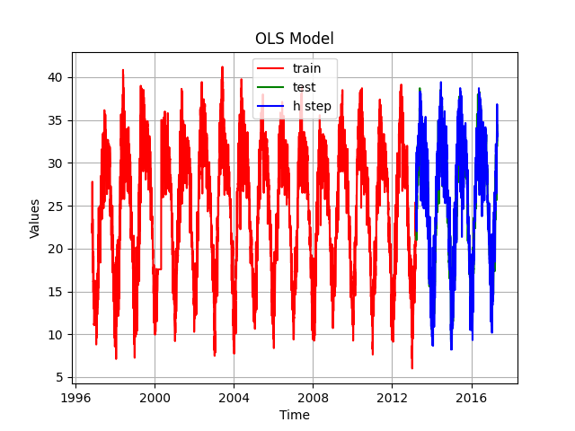
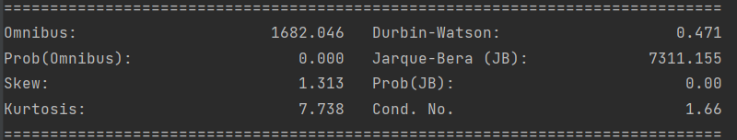

OLS Method
Initial condition number was very high.
After back propagating and removing unnecessary column, condition number dropped significantly.

Slide 11
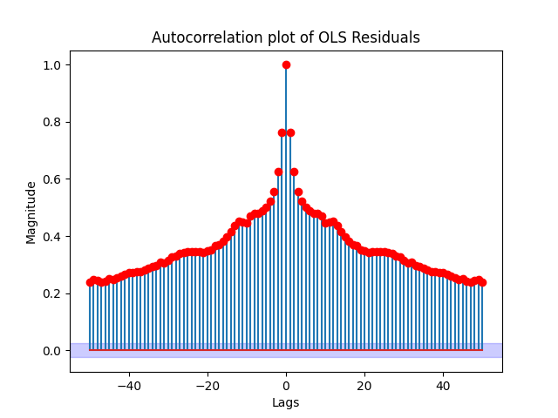

Continued..

Slide 12
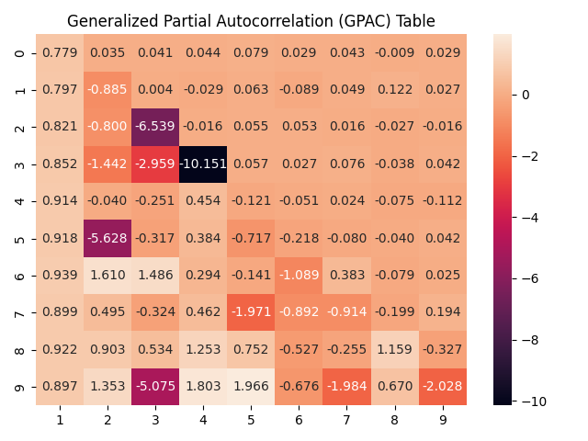
ARIMA Model
Seasonal Differencing of 365.
Probable orders: (1, 0), (1, 4), (7, 0)

Slide 13
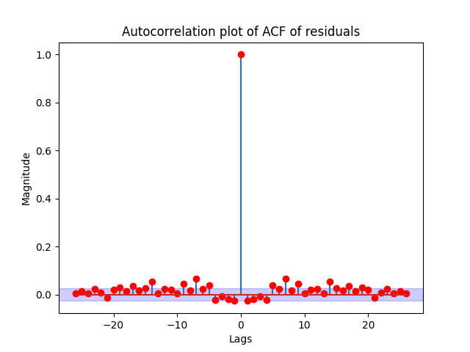
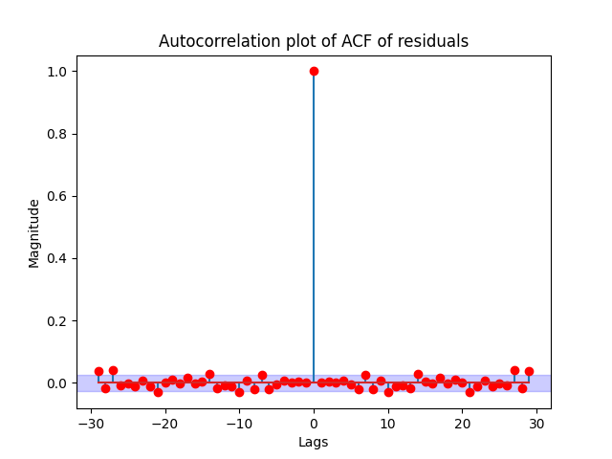
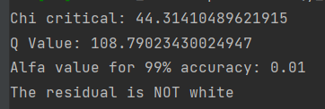
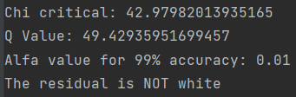
Residual Analysis Using ARIMA Package

Slide 14
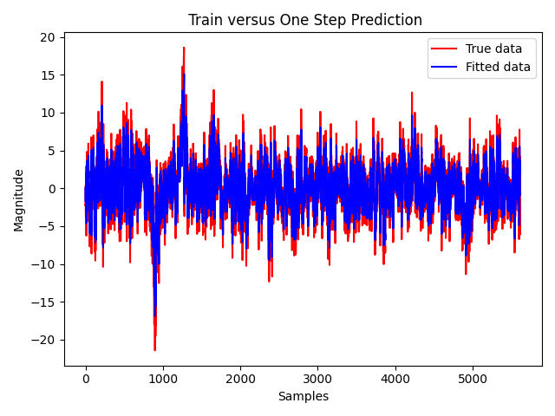
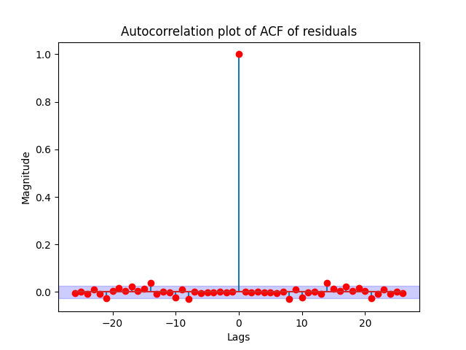
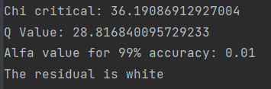
Continued..

Slide 15
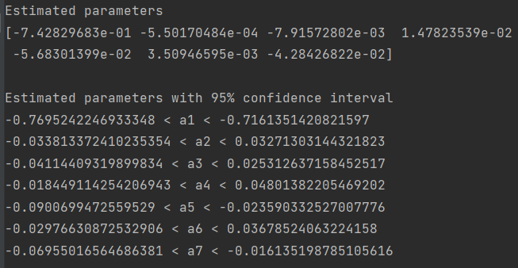
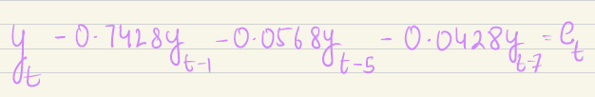
Parameter Estimation Using LM

Slide 16
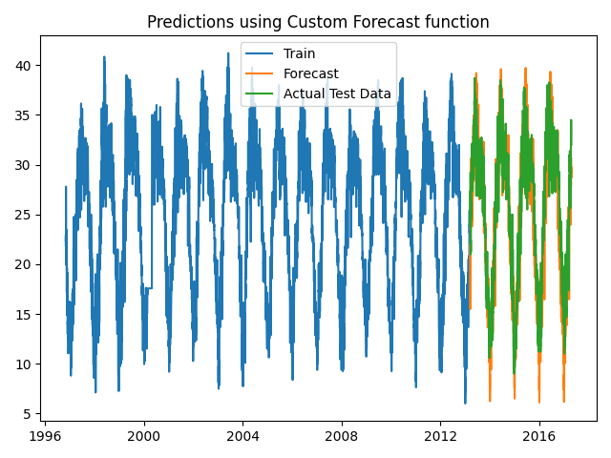








Prediction on Test Set:

Slide 17
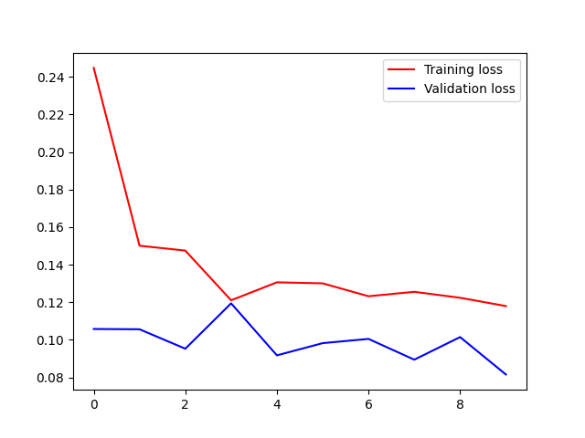
LSTM Model
10 epochs
First layer: activation = ‘relu’ and 64 neurons
Second layer: 50 neurons.

Slide 18
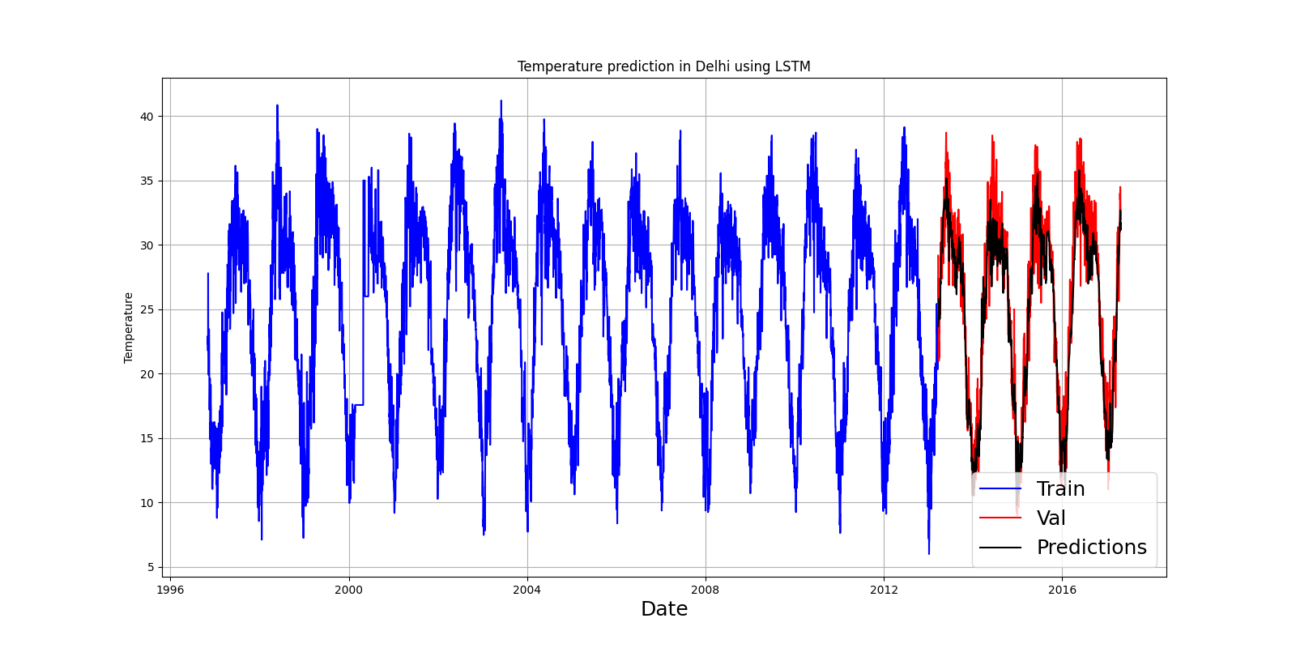

Performance:

Slide 19
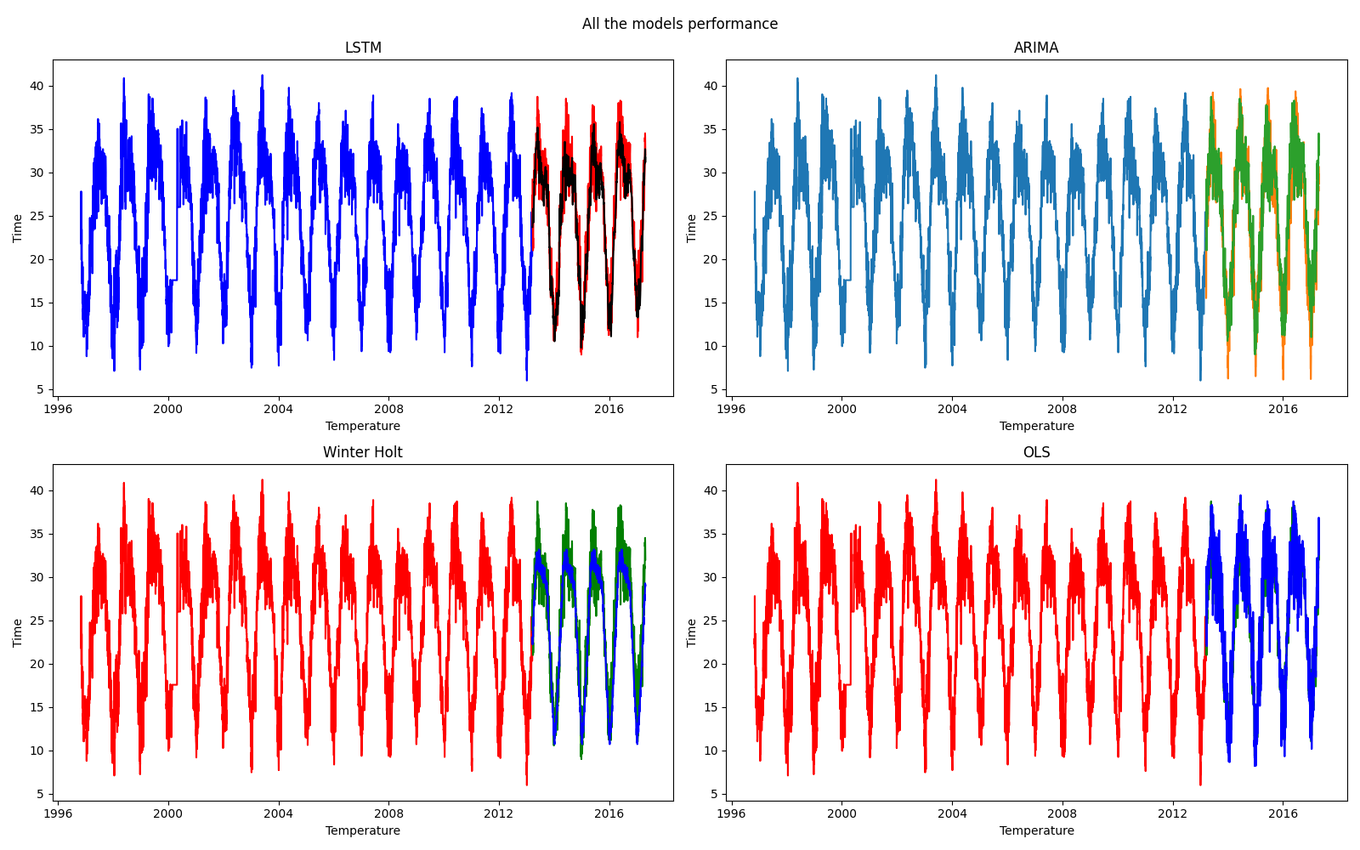
Verdict:

Slide 20

Thank you!

