Slide 1

Artificial intelligence
Project 1 : - AI CHATBOT IN PROLOG
Name : - Udbhavsinh Solanki
Id : - 0873798

Slide 2
What are chatbots?
A chatbot is a product application used to lead an on-line talk discussion through content or text-to-discourse, in lieu of furnishing direct contact with a live human operator.
Intended to convincingly mimic the manner in which a human would act as a conversational accomplice, chatbot frameworks commonly require nonstop tuning and testing, and numerous underway stay unfit to enough speak or finish the business standard Turing assessment.
Chatbots are utilized in discourse frameworks for different purposes including client care, demand directing, or for data gathering.

Slide 3
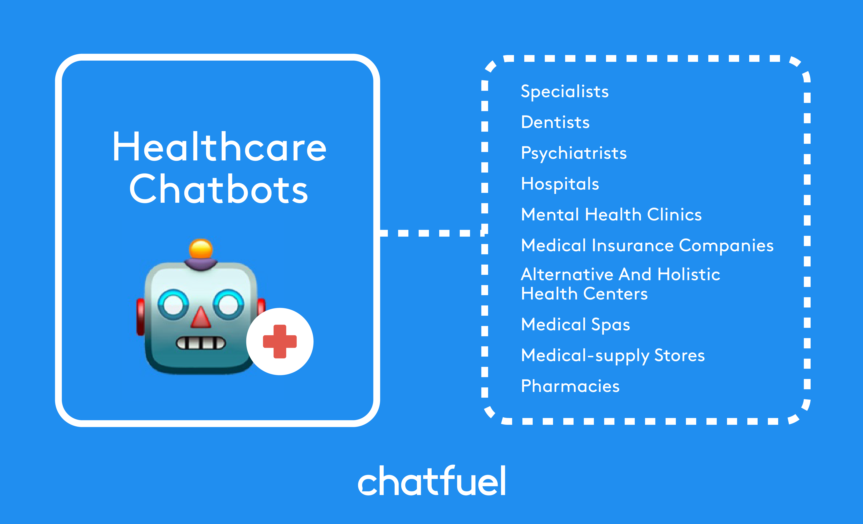
General Idea of my chatbot:-
I have created the chatbot where a person is consulting to a psychiatrist. Where a chatbot is used on the psychiatrist part for general consultation.

Slide 4
About the coding part: - (Stored in .pl extension)
I have made the backend part using notepad where all our conversation between the user and psychiatrist is stored using appropriate coding In the notepad and we have stored that file using .pl extension.
So I have made several queries in the notebook such as greeting, starting conversation, general abilities, set some sentences to give reply for yes or no , past and future terms, general possibilities, asking about the third person, categorize the important persons in the patients life and the set key values of integers, numerical , ASCII etc. in notebook which will be used in the conversation between the person and a psychiatrist.

Slide 5
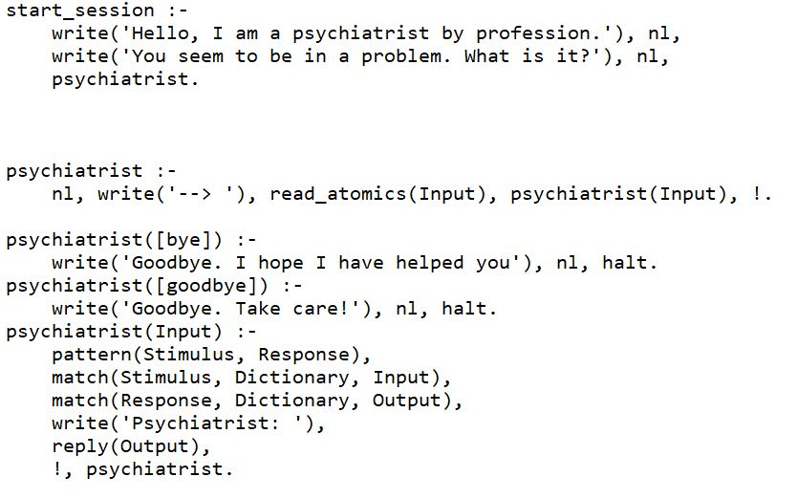
Coding part: -
In the below snapshot, I have made the first query (start_session) which will initiate the conversation between the psychiatrist and the patient. Also I have set the end line for the conversation or a goodbye statement to the patient from the psychiatrist side.

Slide 6
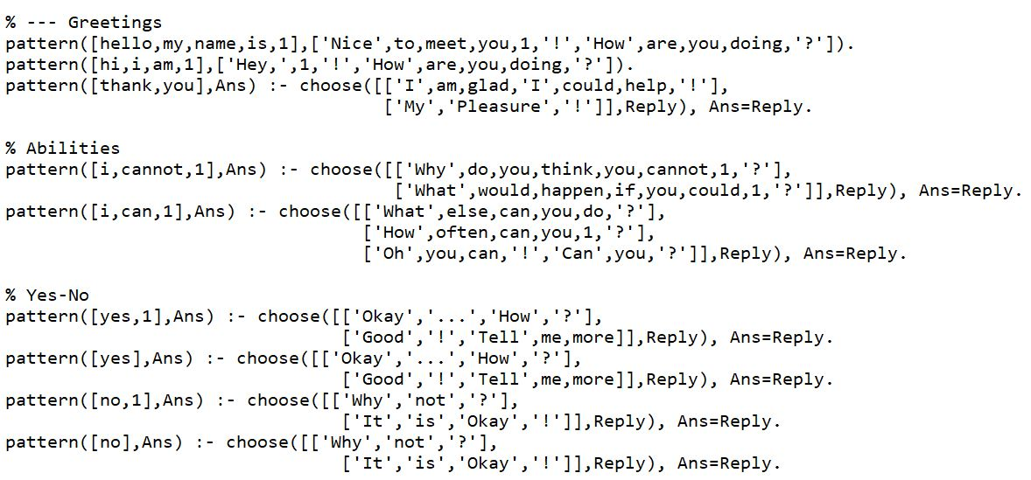
Coding part: -
Below is a snapshot of the general coding part of the greeting terms like hello, nice to meet you etc. Other part is the reply to the questions related to the abilities(like how,why,can you etc). Third query is regarding the replies given by the psychiatrist to the yes or no terms from the patient.

Slide 7
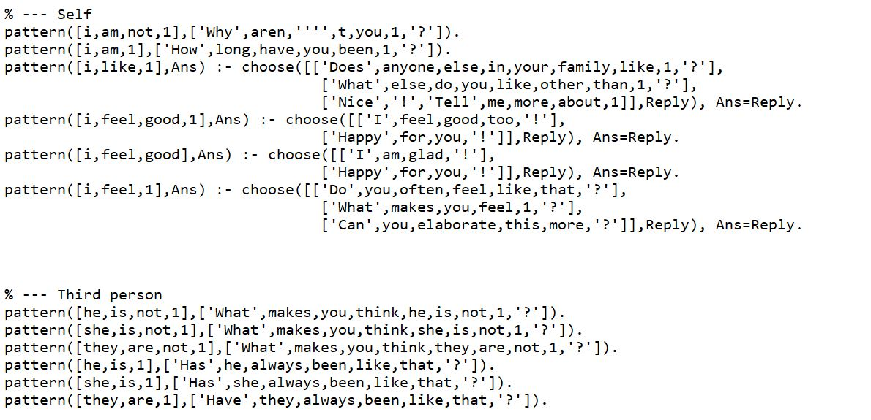
Coding part: -
Below are the codes for the questions which are either directly related to the patient or related to the third person or the relative of the patient asked by the psychiatrist chatbot according to the reply of the patient.

Slide 8
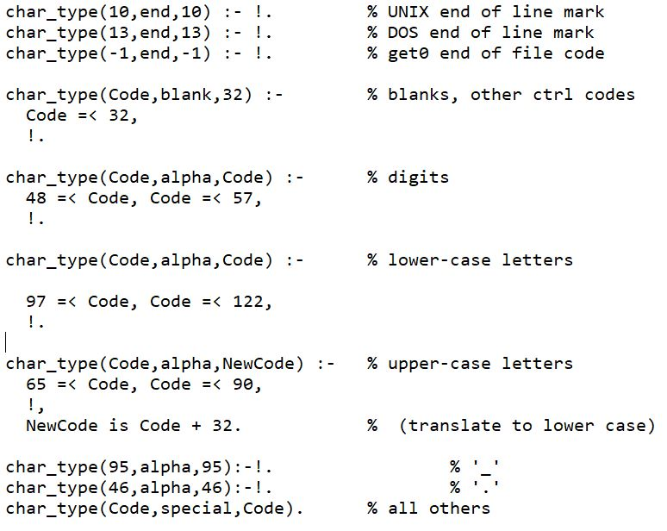
Coding part: -
Lastly, in the coding part I have set the general parameters for the digits, lower case letters, upper case letters, special characters , etc which is shown in below snapshot.

Slide 9
End of coding part
This way I have done all the necessary coding into the notepad and stored it by .pl extension.
After creating .pl file, Using SWI Prolog I have consult my .pl file.
After consulting the .pl file I have written the initial query which I have set to start the conversation between the patient and the chatbot.
Hence, a chatbot between psychiatrist and a patient is created.

Slide 10
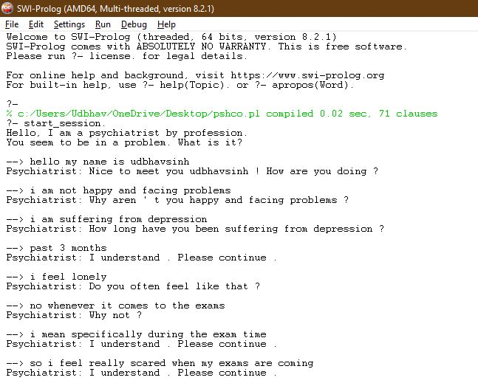
Glimpse on the output: -

Slide 11
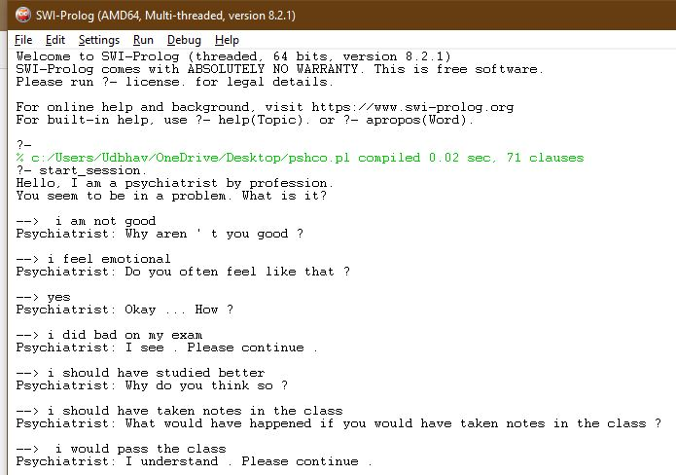
Glimpse on the output: -

Slide 12

Thank You
Stay home and study !!!

