Slide 1

Integrating Relational Databases
Uddhav Mishra – 2014A7PS048H
Kampara Sriteja – 2014A7PS149H

Slide 2
Why is Database Integration Necessary?
Data integration appears with increasing frequency as the volume and the need to share existing data explodes.
Data integration involves combining data residing in different sources and providing users with a unified view of these data.
It has become the focus of extensive theoretical work, and numerous open problems remain unsolved.

Slide 3
Example
Consider when two companies that are merging have their data integrated because when their databases come together.

Slide 4
Abstract
Data Integration is necessary these days as the volume of data is rapidly increasing. So data residing in various databases has to be combined.
A smart approach to be above problem is not to manually combine the databases into a single database, but providing the user an illusion that the data is combined by allowing him to query on a mediated schema and displaying the results accordingly.
The mediated schema has the semantic mappings which when queried upon automatically directs the queries to the respective databases and displays the result accordingly.

Slide 5
Technologies used
Since we are dealing with relational databases MySQL seemed the most obvious choice for the following reasons -
It is open source open source and a responsive online community (and other various resources) exists to guide developers through difficulties.
Ability to support stored procedures, triggers, views.
Microsoft SQL server was used.

Slide 6
Relationships
Various types of relationships might exist between data existing in the databases we wish to integrate. They are:
Corresponding or analogous data in one database might be represented with different attribute names in another database.
Corresponding or analogous data in one database might be represented in a different number of columns in another database.
Corresponding or analogous data in one database might be represented in a different number of rows in another database.

Slide 7
Relationships
Corresponding or analogous data in one database might be represented using different values in another database (e.g., one database uses "m" and "f" for "male" and "female", while the other might use "0" and "1", respectively), or the same values in the various databases might mean different things (e.g., one database uses "1" and "0" for "male" and "female", while the other might use "0" and "1", respectively), or the values in the various databases might be incompatible in ways that make the mapping very difficult (e.g., one database uses "0" and "1" for "male" and "female", respectively, which the other database uses values from "0" through "9" to represent medically-significant variations of human sexes, such as types of hermaphrodites).

Slide 8
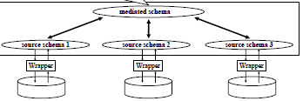
Schema Structure

Slide 9
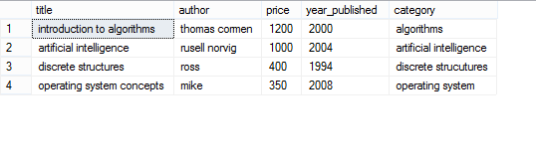
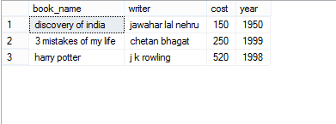
Source Schemas

Slide 10

Mediated Schema

Slide 11
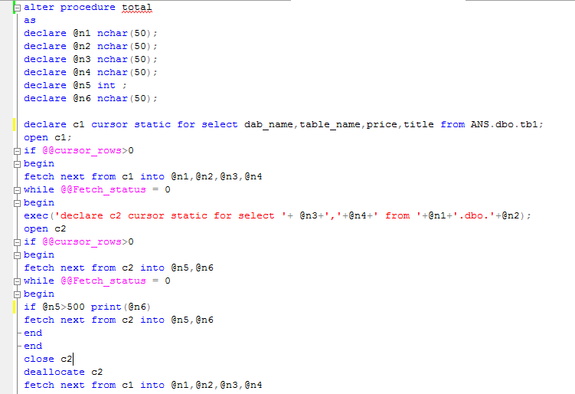
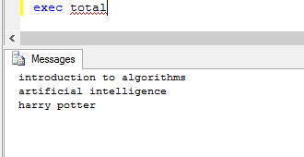
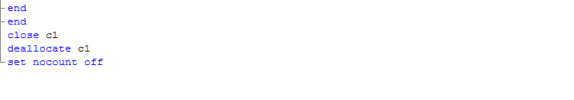
Sql Query on Mediated Schema

Slide 12
Improvements and further work
Automation of semantic mappings using machine learning or mass collaboration techniques.
Creating triggers to insert tuples into the mediated schema.
Getting details about the missing values in the source schemas about certain attributes present in the mediated schema but not in the source schema by user feedback techniques.

Slide 13
References
http://pages.cs.wisc.edu/~whshen/papers/mobs-icde05-poster.pdf
http://marenas.sitios.ing.uc.cl/publications/hyperion.pdf
https://en.wikipedia.org/wiki/Data_integration

Slide 14
THANK YOU

