Slide 1

Integrating Heterogeneous Databases
Uddhav Mishra – 2014A7PS048H

Slide 2
Abstract
Data Integration is necessary these days as the volume of data is rapidly increasing. So data residing in various databases has to be combined.
A smart approach to be above problem is not to manually combine the databases into a single database, but providing the user an illusion that the data is combined by allowing him to query on a mediated schema and displaying the results accordingly.
The mediated schema has the semantic mappings which when queried upon automatically directs the queries to the respective databases and displays the result accordingly.

Slide 3
XML and Relational Database Integration
Data might be residing in many types of databases like relational database, object database, XML document…etc.
Consider a situation in which there is a need to combine the data in a bookstore having two different branches.
One branch might be using a relational database to store the data and the other branch might be using XML document.
This a typical example of heterogeneous database integration.

Slide 4
Approach
Our approach to querying XML documents is the following:
First, we process a DTD to generate a relational schema.
Second, we parse XML documents conforming to DTDs and load them into tuples of relational tables in a standard commercial DBMS.
Now this becomes a homogenous database integration model.
The other approach is to have a XML schema as a mediated schema on which the user queries.

Slide 5
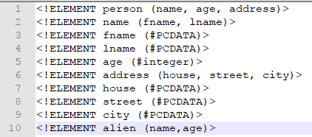
Schema of an XML document - DTD
DTD(Document Type Descriptors) describe the structure of XML documents.
A DTD specifies the structure of an XML element by specifying the names of its sub-elements and attributes.

Slide 6
Mapping DTD to Relational Schema
Inlining technique.
Inlining as many descendants of an element as possible into a single relation.
Do a depth first traversal of the DTD graph, starting at the element node for which we are constructing relations.

Slide 7
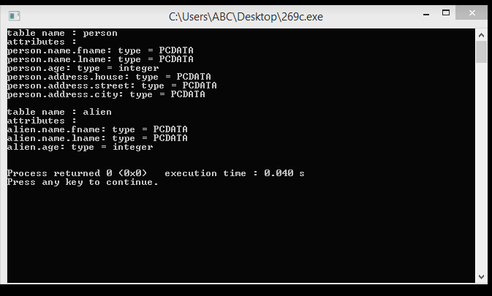
Relational Schema from DTD

Slide 8
XML as the Mediated Schema
In the heterogeneous integration problem there must be a mediated schema on which the user queries , to get his results.
The mediated schema is like a combined database which has wrappers to the respective database. The most commonly used mediated schema must be in XML format as XML supports nesting of data.

Slide 9
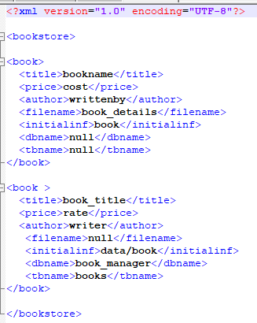

XML/DTD as the Mediated Schema

Slide 10
Xpath query
Xpath which stands for XML path language is a query language for XML documents. It is a query language which selects nodes form the XML document.
The user queries on this schema and gets an illusion that the data is coming from this database.

Slide 11
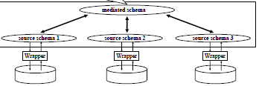
Schema Structure

Slide 12
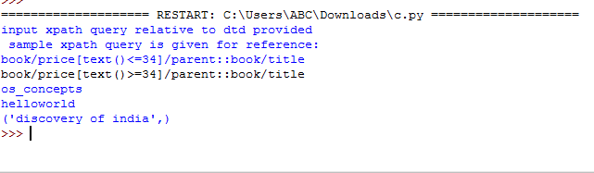
XPath query and result.

Slide 13
References
Integrating XML and Relational Database Systems by Gerti Kappel.
Relational Databases for Querying XML Documents: Limitations and Opportunities Jayavel Shanmugasundaram Kristin Tufte Gang He Chun Zhang David DeWitt Jeffrey Naughton.

Slide 14
THANK YOU

