Slide 1
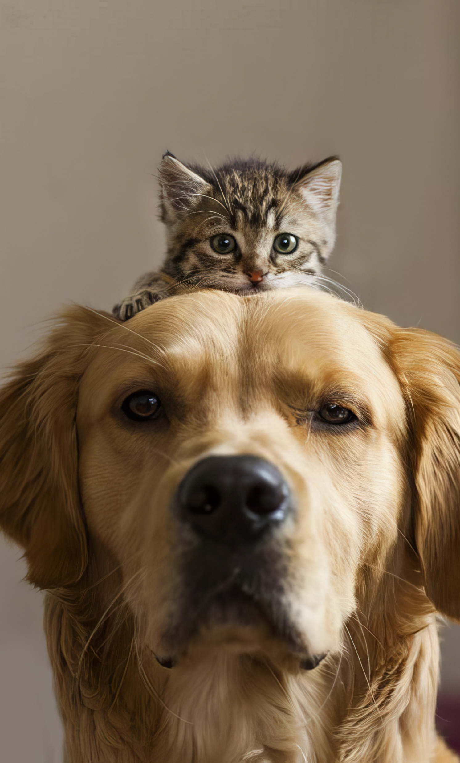

Pettofy
TAILORED PET CARE DELIVERED YOUR WAY
Highlights your delivery service with a friendly, approachable feel.
Supervised by Safayet Nur Lecturer Dept. of CSE Port City International University
Presented by Uddipto Barua (CSE 02807575) Forhaduzzaman Remon (CSE 02807594) Sacin Arman (CSE 02807584)

Slide 2










CONTENTS
Pettofy
01
INTRODUCTION
INTRODUCTION
MOTIVATION
limitation
Of PRESENT SYSTEM
The primary goal of this project is to create an accessible website where users can easily find pets available for adoption and purchase, order essential pet products, and access expert guidance on pet care. Our mission is to make pet ownership simple, meaningful, and informed—ensuring that pets find loving homes and owners feel fully supported every step of the way.
Objective
FEATURES
METHODOLOGY
Benefits of
Our system
Pettofy
CONCLUSIONS
REFERENCES

Slide 3
CONTENTS
INTRODUCTION
MOTIVATION
limitation
Of PRESENT SYSTEM
Objective
FEATURES
METHODOLOGY
Benefits of
Our system
CONCLUSIONS
REFERENCES
01
02
INTRODUCTION
MOTIVATION
The primary goal of this project is to create an accessible website where users can easily find pets available for adoption and purchase, order essential pet products, and access expert guidance on pet care. Our mission is to make pet ownership simple, meaningful, and informed—ensuring that pets find loving homes and owners feel fully supported every step of the way.
As passionate pet lovers, we understand how challenging it can be to find trustworthy information, quality pets, and essential products at one place in Bangladesh. This project inspires us to create a service that not only simplifies pet adoption and purchase but also supports pet owners in providing care for their beloved companions.
Pettofy
Pettofy

Slide 4

LIMITATION
OF PRESENT SYSTEM
01
02
INTRODUCTION
MOTIVATION
The primary goal of this project is to create an accessible website where users can easily find pets available for adoption and purchase, order essential pet products, and access expert guidance on pet care. Our mission is to make pet ownership simple, meaningful, and informed—ensuring that pets find loving homes and owners feel fully supported every step of the way.
As passionate pet lovers, we understand how challenging it can be to find trustworthy information, quality pets, and essential products at one place in Bangladesh. This project inspires us to create a service that not only simplifies pet adoption and purchase but also supports pet owners in providing care for their beloved companions.
Pettofy
Pettofy
Saturated Platforms
Finding everything in one location is challenging for pet owners.
Limited Delivery Options
Delivery pets in Bangladesh is not enough popular due to lack of professionalism.
Lack of Online Support
Most existing pet services do not provide comprehensive online guidance
Absence of Transparency
Often, buyers lack access to complete health, vaccination, and microchipping records for pets.

Slide 5
02
MOTIVATION
As passionate pet lovers, we understand how challenging it can be to find trustworthy information, quality pets, and essential products at one place in Bangladesh. This project inspires us to create a service that not only simplifies pet adoption and purchase but also supports pet owners in providing care for their beloved companions.
Pettofy
LIMITATION
OF PRESENT SYSTEM
Pettofy
Saturated Platforms
Finding everything in one location is challenging for pet owners.
Limited Delivery Options
Delivery pets in Bangladesh is not enough popular due to lack of professionalism.
Lack of Online Support
Most existing pet services do not provide comprehensive online guidance
Absence of Transparency
Often, buyers lack access to complete health, vaccination, and microchipping records for pets.

Slide 6

Pettofy
Centralized Pet Services
To create a single platform that offers pet adoption, veterinary care, pet supplies, and delivery services.
FEATURES
PROJECT
OBJECTIVES
Pet Delivery Solutions
To establish a reliable, safe, and pet-friendly delivery service across various cities in Bangladesh.
The objective of this project is to create an all-in-one platform for pet adoption, products, and services, making pet care convenient.
Enhance Pet Ownership Experience
To make pet care easier, more informed, and accessible by providing resources, expert advice, and quality products.
Promote Ethical Practices
To emphasize responsible sourcing, proper documentation, and animal welfare for all pets available on the platform.

Slide 7




Pettofy
Pet Adoption and Listings
A section dedicated to available pets for adoption, with detailed profiles, including health records and vaccinations.
FEATURES
PROJECT
OBJECTIVES
Home Delivery
Safe, specialized delivery options for both pets and pet supplies
The platform offers pet adoption, a store for essentials, and professional services like veterinary care and pet boarding, with safe delivery and educational resources.
The objective of this project is to create an all-in-one platform for pet adoption, products, and services, making pet care convenient.
Professional Services
Bookable services for veterinary care, pet sitting/walking, and boarding.
Pet Essentials Store
A shop offering pet food, toys, medicines, and accessories.

Slide 8
Pettofy
METHODOLOGY
SYSTEM ARCHITECTURE
USER MODULE
LOG IN/ REGISTER
OUR SERVICES
PET HUB
PET SUPPORT
VET ON CALL
ABOUT US
Name
Pet Import
Pet Foods
Pet Adoption Service
Appoint a Vet for Service
Gallery
Pet Health and Care
Our Partners
E-mail
Pet Delivery
Pet Veterinarian
Mobile No
Contacts
Pet Items
Password
Pet Documentation
Pet Hostel
Phone No
Pet Passport
Pet Sitter/Walker
Pet Relocation

