Slide 1

HTML(Hyper text Markup Language)
Fatma Aktaş / Frontend Developer
Udemig Job Guaranteed Software Academy

Slide 2
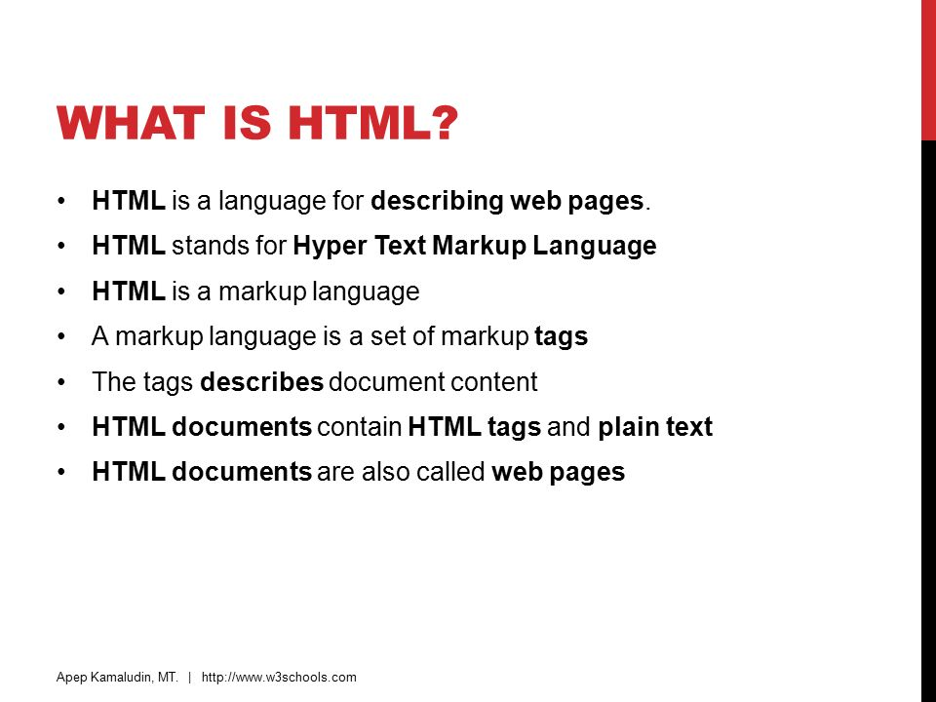

Slide 3
