Slide 1

Algorithms & Flowcharts
Fatma Aktaş / Frontend Developer
Udemig Job Guaranteed Software Academy

Slide 2
What’s an Algorithm?
Set of steps to accomplish a task
Describes the step by step action to solve a problem.
Has a well defined sequence of steps.
Gives you an output and it will eventually terminate.
A self-contained step-by-step set of operations to be performed to solve a specific problem or a class of problems.
(https://www.slideshare.net/AngelaDeHart/what-is-an-algorithm-130758029)

Slide 3
What is an Algorithm?
An algorithm is a step-by-step procedure to solve a problem.
A good algorithm should be optimized in terms of time and space.
Different types of problems require different types of algorithmic techniques to be solved in the most optimized manner.
There are many types of algorithms but the most important and fundamental algorithms that you must are discussed in this article.

Slide 4
Example-1:
An algorithm for driving to a friend's house could be:
1. Find your keys
2. Walk out of the house
3. Close the door
4. Open the car door
5. Get into the car
6. Put the key into the ignition, etc..

Slide 5
Example-2:
Making a Cup of Tea
Algorithm:
Start.
Boil water.
If water is boiled, add a tea bag to a cup.
Pour the boiled water into the cup.
Let the tea steep for 3-5 minutes.
Remove the tea bag.
Add sugar or milk if desired.
Stir the tea.
Serve the tea.
End.

Slide 6
Example-3:
Preparing a Grocery List
Algorithm:
Start.
Check the pantry and fridge for items that are running low.
Write down each item that needs to be restocked.
Think about meals you plan to cook in the coming week.
Add ingredients for those meals to the list.
Review the list to ensure all essentials are included (bread, milk, etc.).
Organize the list by section (produce, dairy, etc.) if needed.
End.

Slide 7
Example-4:
Crossing the Street Safely
Algorithm:
Start.
Approach the pedestrian crossing.
Look left, look right, and look left again.
If there are no cars, cross the street.
If cars are present, wait until they stop or the road is clear.
Continue looking while crossing.
Reach the other side safely.
End.

Slide 8
Example-5:
ATM Cash Withdrawal
Algorithm:
Start.
Insert your ATM card into the machine.
Enter your PIN.
Select "Withdraw Money."
Enter the amount you want to withdraw.
If the balance is sufficient, dispense cash.
If the balance is insufficient, display an error message.
Take your card and cash.
End.

Slide 9
Example-6:
Finding a Book in a Library
Algorithm:
Start.
Enter the library.
Search for the book by title or author using the library catalog.
If the book is available, note the section and shelf number.
Go to the specified section.
Search the shelves for the book.
If the book is found, take it; otherwise, ask a librarian for help.
End.

Slide 10
Example-7:
Cooking Pasta
Algorithm:
Start.
Boil a pot of water.
Add a pinch of salt.
When the water is boiling, add pasta.
Stir occasionally to prevent sticking.
Cook for the time specified on the package (e.g., 10 minutes).
Taste the pasta to check if it's cooked (al dente).
Drain the water.
Serve with sauce.
End.

Slide 11
Example-8:
Setting an Alarm
Algorithm:
Start.
Determine the time you want to wake up.
Check the current time.
Calculate the difference between the current time and wake-up time.
Set the alarm for the calculated time.
Double-check that the alarm is set.
Go to sleep.
End.

Slide 12
Example-9:
Sorting Laundry
Algorithm:
Start.
Gather all dirty clothes.
Separate clothes into piles: whites, colors, and delicates.
For each pile, check the care labels.
If special care is needed, set those clothes aside.
Wash each pile separately according to the instructions.
Dry the clothes accordingly (air dry, tumble dry, etc.).
Fold and put away the clean clothes.
End.

Slide 13
Example-10:
Watering a Plant
Algorithm:
Start.
Check the soil moisture by touching the soil or using a moisture meter.
If the soil is dry, proceed to water the plant.
Pour water into the soil until it is moist but not waterlogged.
If the plant is in a pot with drainage, let excess water drain out.
Check the plant's leaves for any signs of distress.
If the leaves are yellow or wilting, adjust the watering schedule.
End.

Slide 14
An algorithm self-contained step-by-step set of operations to be performed to solve a specific problem or a class of problems.
A computer program is a sequence of instructions that comply the rules of a specific programming language, written to perform a specified task with a computer.

Slide 15
FAQs on Algorithms for Beginners
1. What types of algorithms are there and how to learn them?
There are algorithms everywhere around us. The process of doing laundry, the way we solve a long division problem, the ingredients for making a cake, and the operation of a search engine are all instances of algorithms.
Following are the on how to learn Algorithms
Know the fundamentals inside and out.
Know exactly what happens in an algorithm.
Using examples, work out an algorithm's steps.
Clearly know complexity analysis.
Make an effort to apply the algorithms on your own.
Make a note of crucial information so you can review it later.

Slide 16
2. Name three algorithms and what practical applications does it have.
In an algorithm, there are three fundamental building blocks:
Linear Sequence: A continuation of actions or utterances made one after the other is known as a linear sequence.
Conditional: A choice is made between two possible courses of action.
Loop: Statements in the WHILE and FOR sequences are repeated numerous times.
The core of computing is an algorithm. If we look at ourselves, we may see various algorithms at work, addressing the issues we face every day: Algorithms power a variety of applications, including Netflix recommendation systems, social media networks, GPS apps, Google search, and e-commerce platforms.

Slide 17
What’s your algorithm for getting up on Sundays?
Your turn ☺

Slide 18
What’s your algorithm for brushing your teeth?
Your turn ☺

Slide 19
What’s your algorithm for eating breakfast?
Your turn ☺

Slide 20
What’s your algorithm for making a cup of coffee?
Your turn ☺

Slide 21
Examples and flowcharts 1. Find the Maximum of Two Numbers
This algorithm compares two numbers and returns the larger one.
Algorithm:
Start.
Input two numbers, A and B.
If A > B, return A.
Otherwise, return B.
End.

Slide 22
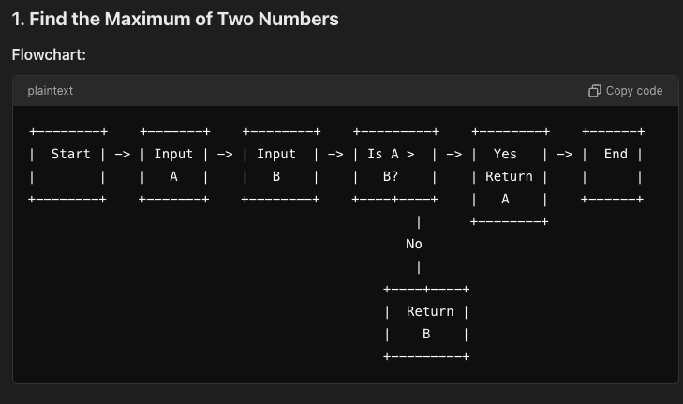

Slide 23
2. Calculate the Sum of Two Numbers
This algorithm adds two numbers and returns the sum.
Algorithm:
Start.
Input two numbers, A and B.
Calculate the sum: Sum = A + B.
Return the Sum.
End.

Slide 24
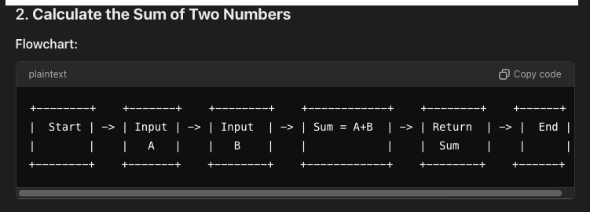

Slide 25
3. Check if a Number is Positive, Negative, or Zero
This algorithm checks if a number is positive, negative, or zero.
Algorithm:
Start.
Input a number, N.
If N > 0, return "Positive".
If N < 0, return "Negative".
Otherwise, return "Zero".
End.

Slide 26
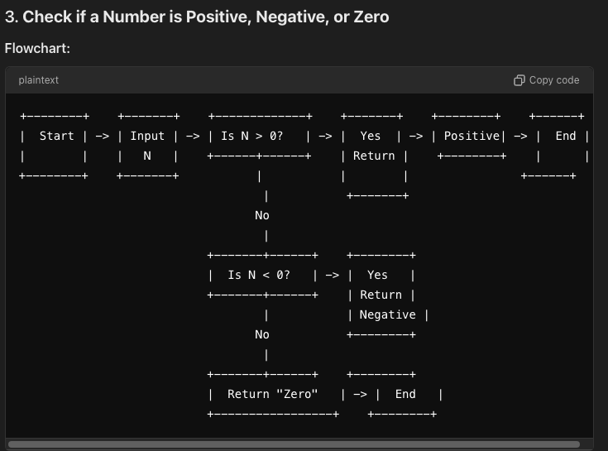

Slide 27
4. Find the Smallest of Three Numbers
This algorithm finds the smallest number among three numbers.
Algorithm:
Start.
Input three numbers, A, B, and C.
If A < B and A < C, return A.
If B < A and B < C, return B.
Otherwise, return C.
End.

Slide 28
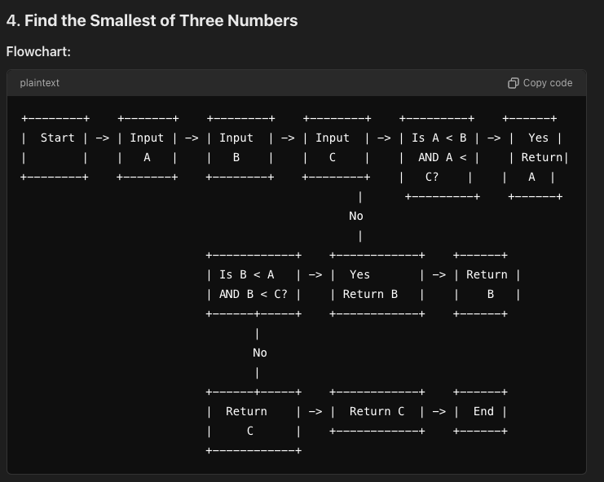

Slide 29
5. Condition Check
# Basic algorithm in English for determining if someone is eligible for a driver's license based on their age:
Algorithm:
Start
Get Age: Ask the user to input their age.
Condition Check:
If age ≥ 18, print "You can get a driver's license."
Otherwise, print "You cannot get a driver's license."
End

Slide 30
Mathematical and Logical Operations:
Addition: +
Subtraction: -
Division: /
Multiplication: *
Modulus: % (Finds the remainder of division, e.g., 5 % 2 = 1).

Slide 31
Logical Operations:
Equal to: ==
Less than: <
Less than or equal to: <=
Greater than: >
Greater than or equal to: >=
Strict equality: === (Checks both type and value)
Not equal to: !=

Slide 32
What Is A Flowchart?
Flow charts are diagrams showing the exact sequence of logical steps. They use geometrical shapes and arrows to show processes, relationships, and data/process flow. In other words, flowcharts depict decisions and results of them.

Slide 33
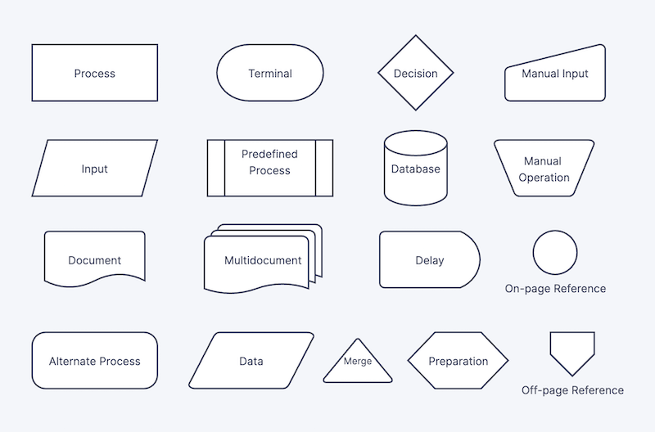

Slide 34
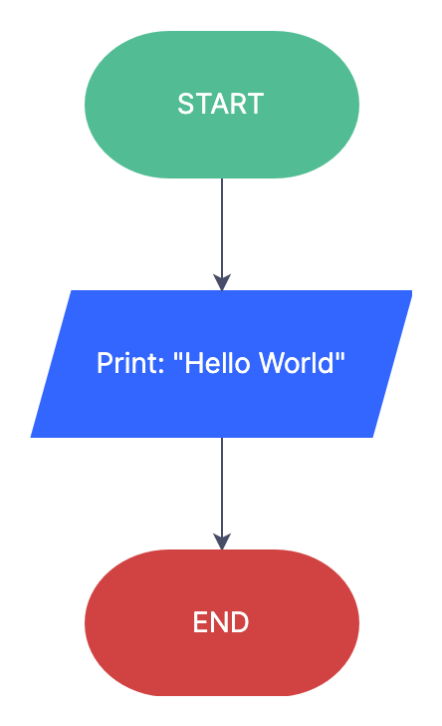
Example 1:
Print “Hello World.” On-screen

Slide 35
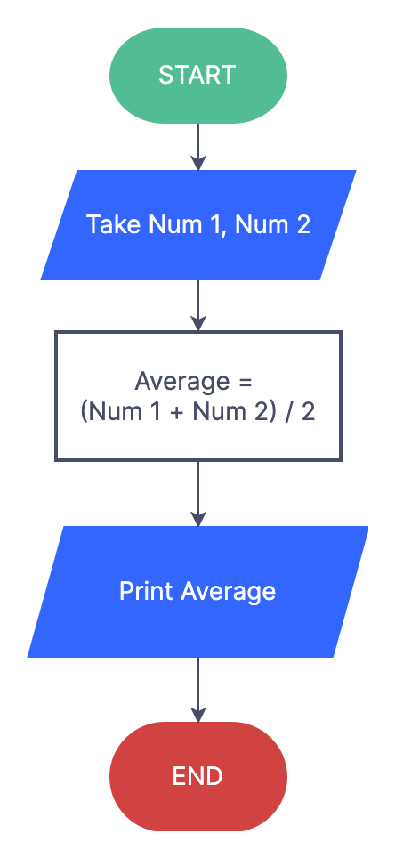
Example 2:
Calculate The Average Of Two Numbers.

Slide 36
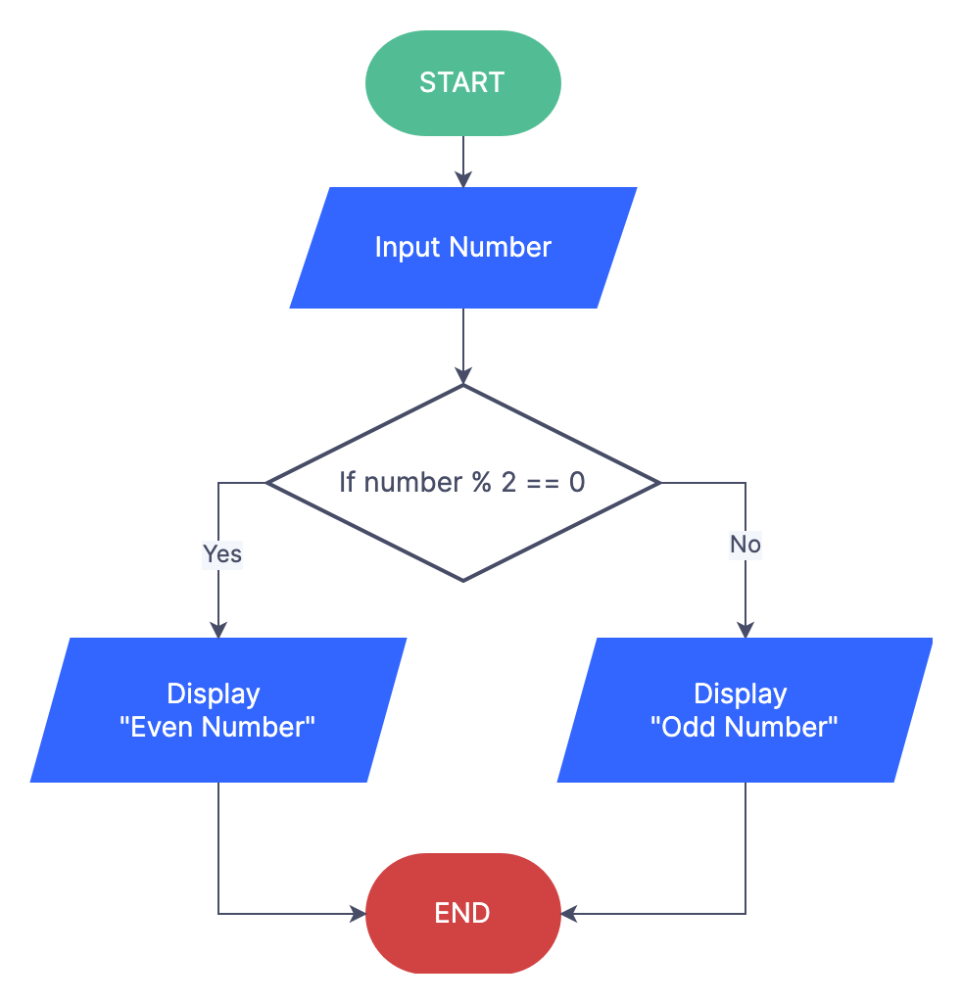
Example 3:
Input Number And
Check If They Are
Odd Or Even

Slide 37
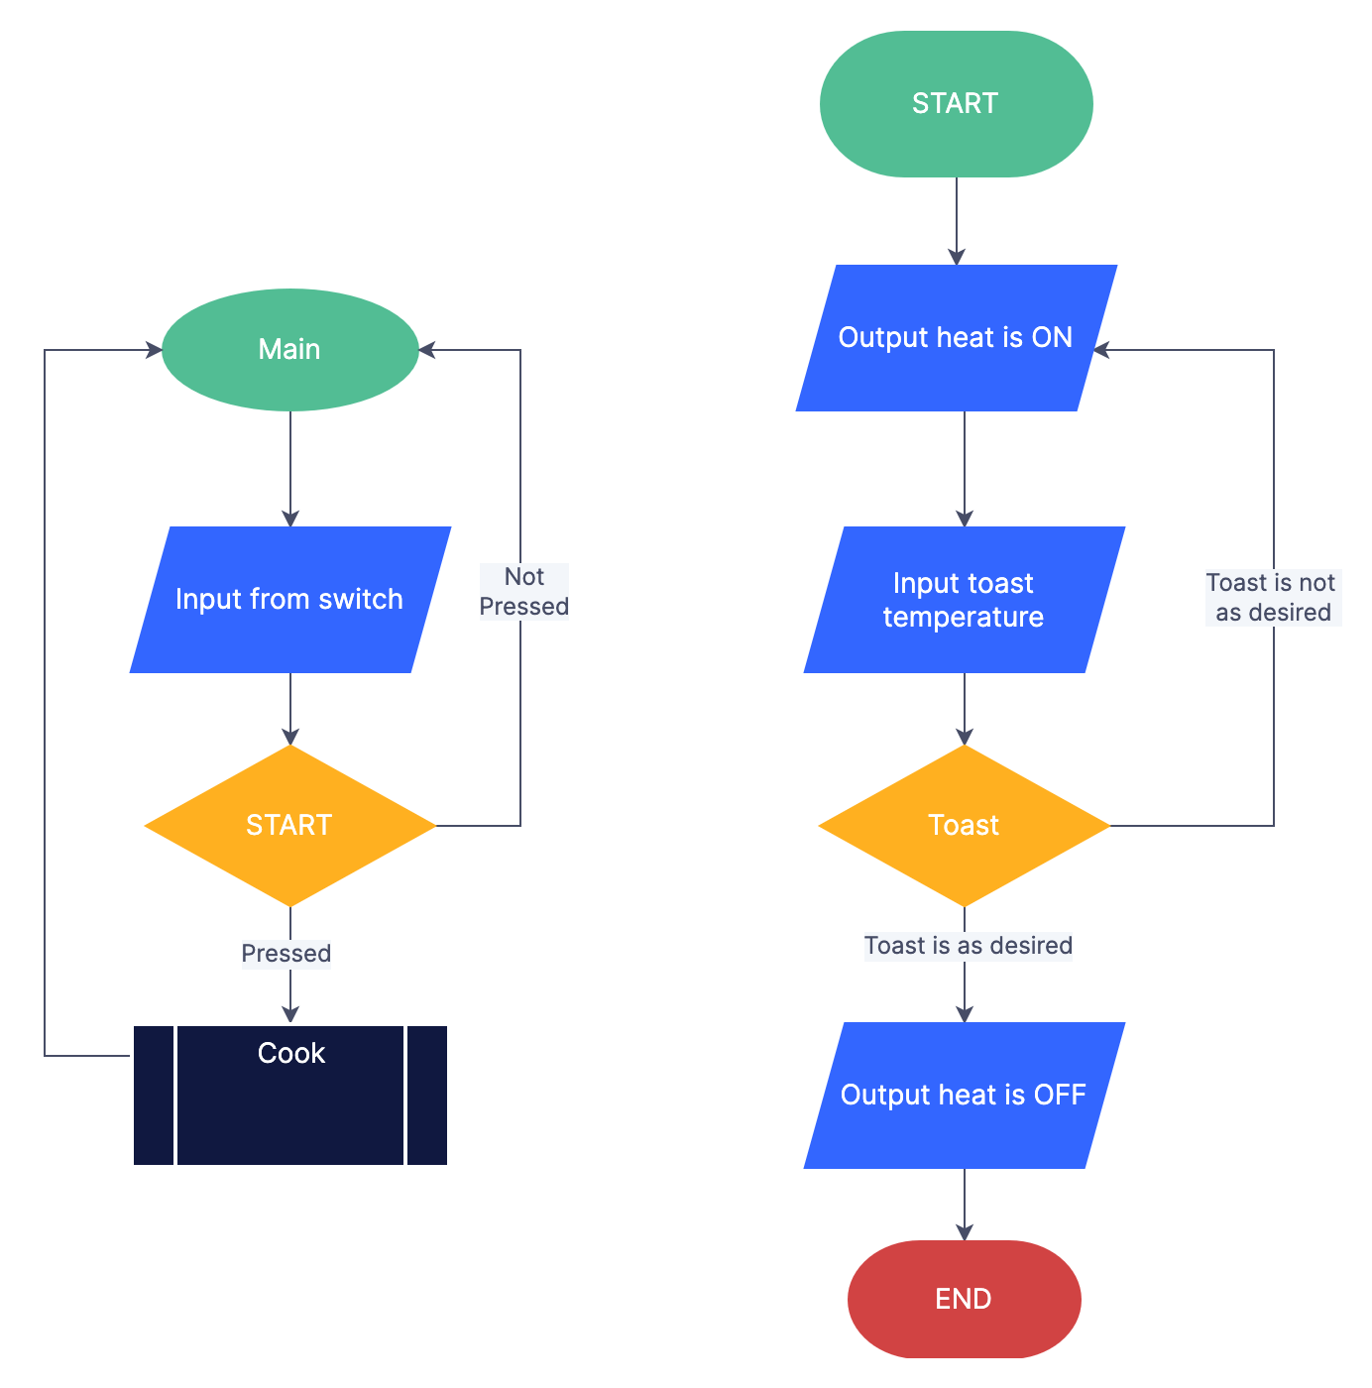
Example 4:
Controlling Algorithm
For Toaster

Slide 38
Flowchart Guidelines
To create a flowchart, you must follow the following current standard guideline:
Step 1: Start the program.
Step 2: Begin Process 1 of the program.
Step 3: Check some conditions and take a Decision (“yes” or “no”).
Step 4: If the decision is “yes”, proceed to Process 3. If the decision is “no”, proceed to Process 2 and return to Step 2.
Step 5: End of the program.

Slide 39
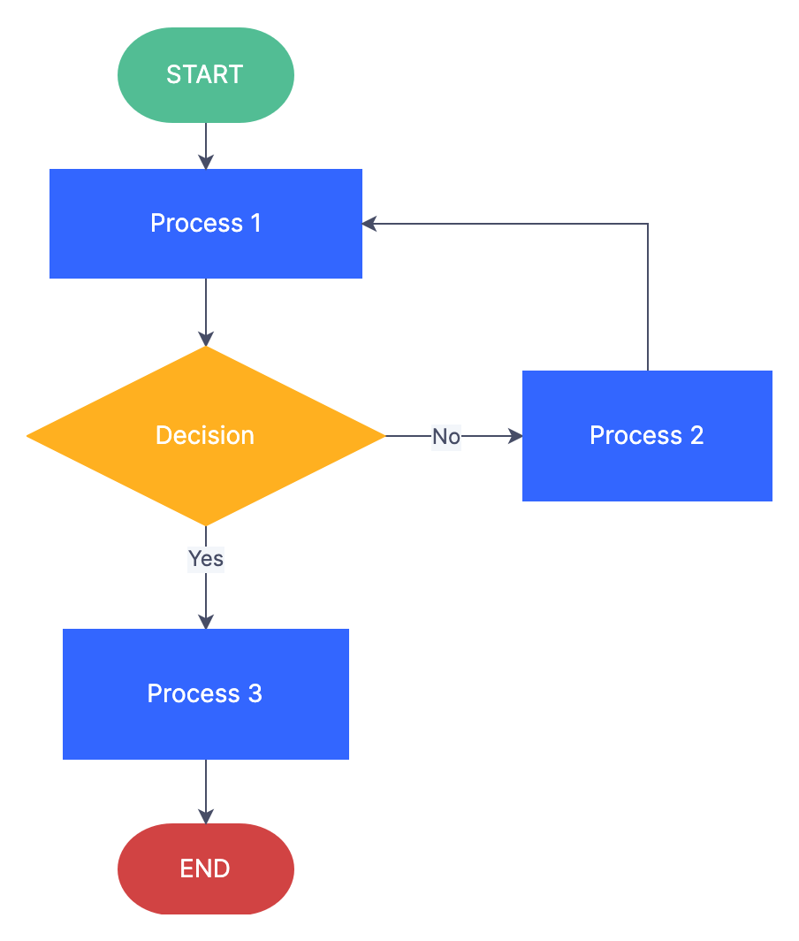

Slide 40
Additionally, the following can be helpful tips in creating flowcharts as well:
You can only have one start and one end in your chart, no more, no less.
On-page connectors are referred to by numbers, while off-page connectors are referred to by alphabetical letters.
The flow of processes is generally from top to bottom or left to right, not the other way around.
It would be best not to make the arrows cross each other.

Slide 41
Conclusion
It is important to plan ahead with coding. Coding is a process that can take a while and it it is best to plan ahead. One way of planning is by using a flowchart as a guide. This flowchart should indicate which blocks of code will be used where, what the codes will do, and how they will interact with each other. These are just some of the many methods programmers use to plan their coding before they even start.

Slide 42
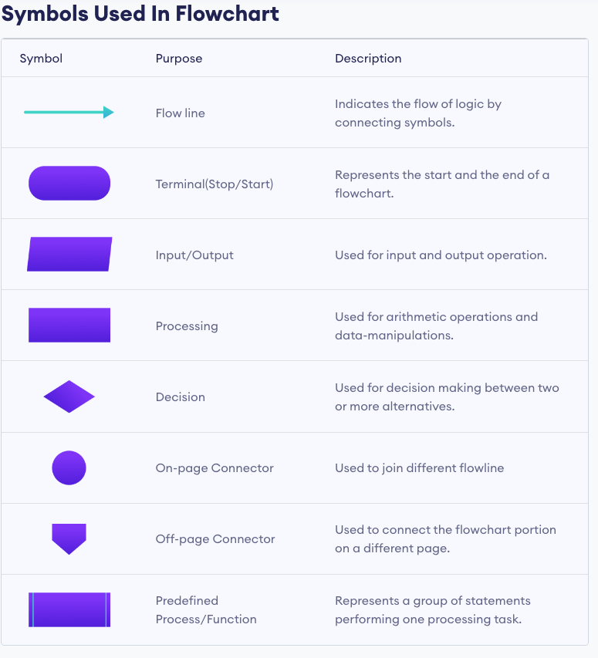

Slide 43
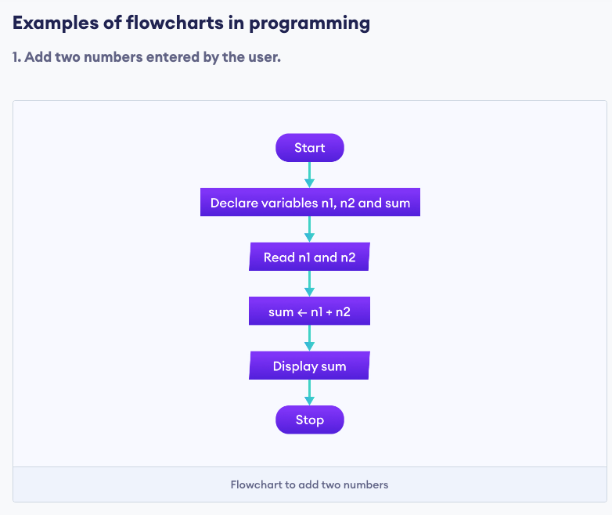
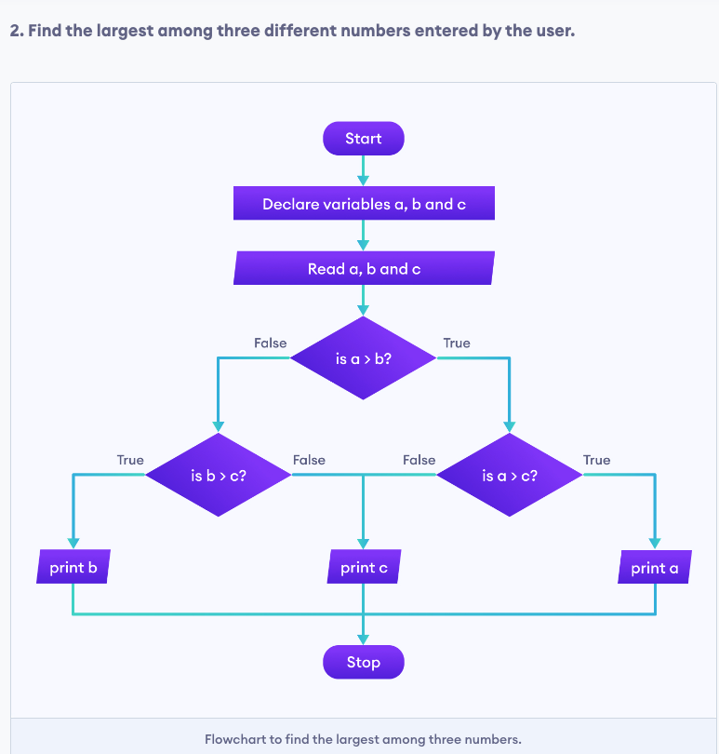

Slide 45
Thanks for your attention!

