Slide 1
Online Bus Reservation System
Project Team & Supervision
Supervised By:
Submitted By:
Udesh Regmi (6-2-577-22-2023)
Sangam Sedai (6-2-577-19-2023)
Mr. Yuba Raj Devkota
Tribhuvan University
Faculty of Humanities and Social Sciences
Nepalaya College, Kalanki

Slide 2
Introduction
Online Bus Reservation System
Online Bus Reservation System (OBRS) is a web-based platform that allows passengers to search routes, check seat availability, and book bus tickets online in real time, reducing the need for physical reservations and long queues. It also enables administrators to manage buses, users, reservations, and seat allocations efficiently. By digitizing the booking process, the system improves convenience for passengers and operational efficiency for transport companies in Nepal.

Slide 3
Problem Statement
The traditional bus reservation system in Nepal depends on manual records and ticket counters, which often causes long queues, booking mistakes, and confusion during busy travel seasons like Dashain and Tihar.
Many passengers, especially those living far from bus parks, cannot easily check schedules or seat availability, while OBRS allows them to view routes and book tickets online from anywhere.

Slide 4
Project Objectives
To develop a web application - Online Bus Reservation System utilizing PHP for server-side logic, MySQL for relational database management, HTML/CSS/JavaScript for responsive frontend design, ensuring secure and efficient handling of user interactions and data persistence.
To enable passengers to register, search and book bus seats, and download e-tickets; while administrators can manage bus routes, monitor bookings, manage users, thereby facilitating end-to-end reservation management.

Slide 5
Technology Stack & Tools
Frontend
HTML5, CSS3, JavaScript
Backend
PHP 8.4.16
Database
MySQL 5.7+
Server
Apache (via XAMPP)
Development
VS Code, Figma, phpMyAdmin, Git
Methodology
Traditional Waterfall Model

Slide 6
Three-Tier Architecture
Presentation Layer
Business Logic Layer
Data Layer
HTML, CSS, JavaScript
Responsive UI Design
PHP Scripts
Data Validation
CRUD Operations
MySQL Database
Data Persistence
Data Integrity
System workflows with data flow from client through business logic to persistent database storage.

Slide 7
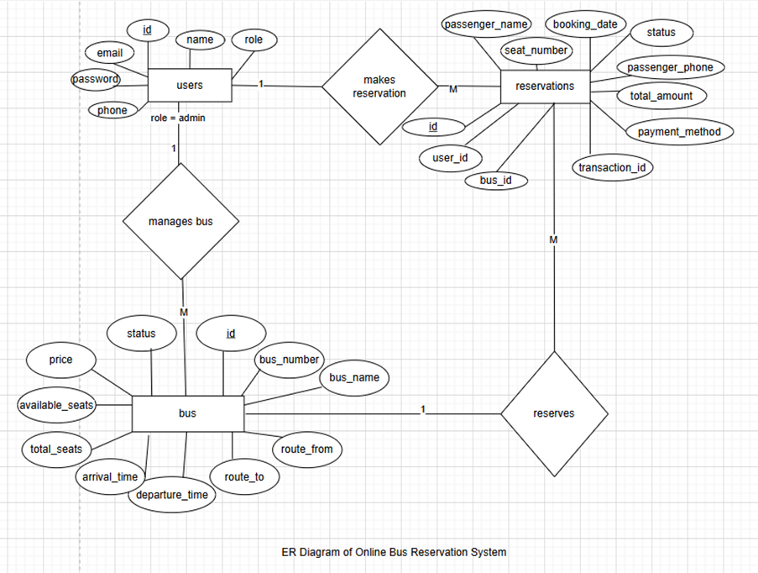
ER Diagram of Online Bus Reservation System

Slide 8
Database Structure (ER Model)
Core Entities:
Users Table: Stores passenger and admin credentials, roles, contact information
Buses Table: Contains bus details, routes, schedules, capacity, and fare information
Reservations Table: Tracks bookings, seat assignments, passenger details, and payment status
Relationships:
Users ← → Reservations (One-to-Many: A user can make multiple reservations)
Buses ← → Reservations (One-to-Many: A bus has multiple seat reservations)
Data integrity maintained through primary and foreign key constraints

Slide 9
User Reservation Process
Step-by-Step Booking Workflow:
Step 1: User logs in or registers with credentials
Step 2: Search for buses by specifying source, destination.
Step 3: Select preferred bus from filtered results
Step 4: View interactive seat map and select desired seats
Step 5: Enter passenger details and confirm reservation
Step 6: Proceed to simulated payment gateway
Step 7: Receive instant booking confirmation with unique reference number
Step 8: Download or print e-ticket with all booking details

Slide 10
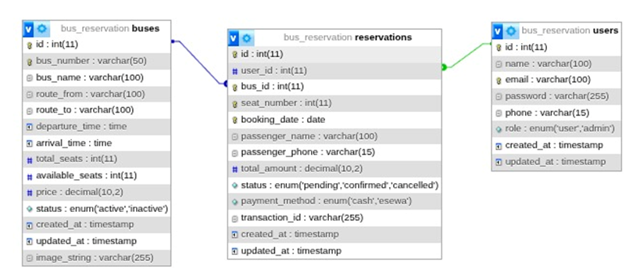
Database Schema of OBRS

Slide 11
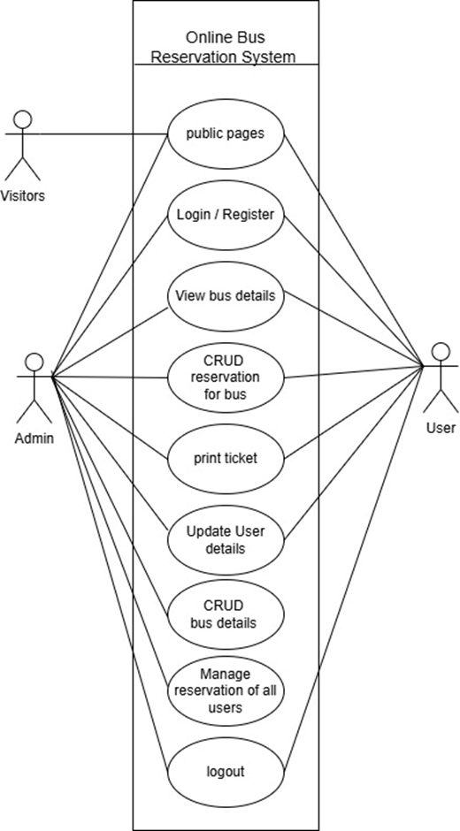
Use Case Diagram of OBRS

Slide 12
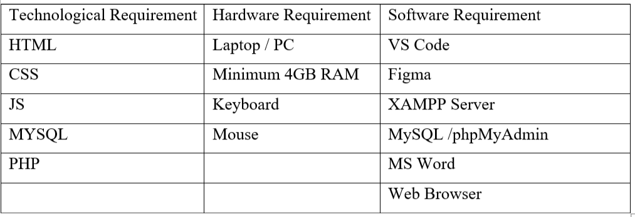
Technical Feasibility of OBRS

Slide 13
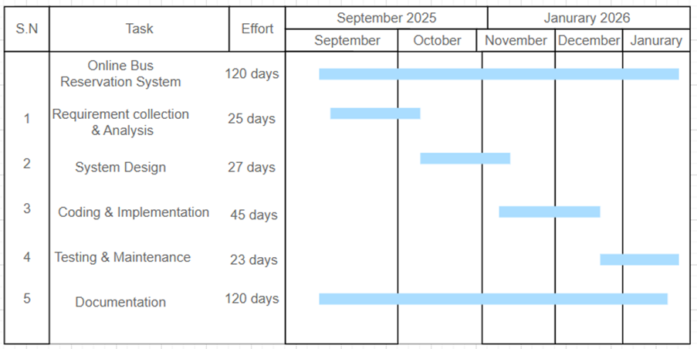
Schedule Feasibility of OBRS

Slide 14
Admin Management Functions
Bus & Route Management:
Create, update, and delete bus routes and schedules
Set fares, capacity, and departure/arrival times
Monitor real-time seat availability and occupancy
User & Reservation Management:
View and manage all registered users.
Monitor all reservations and booking statuses
Cancel or modify reservations when needed
Generate reports and analytics for business insights

Slide 15
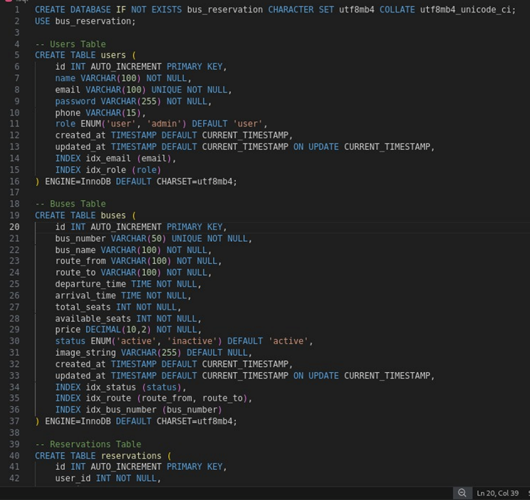
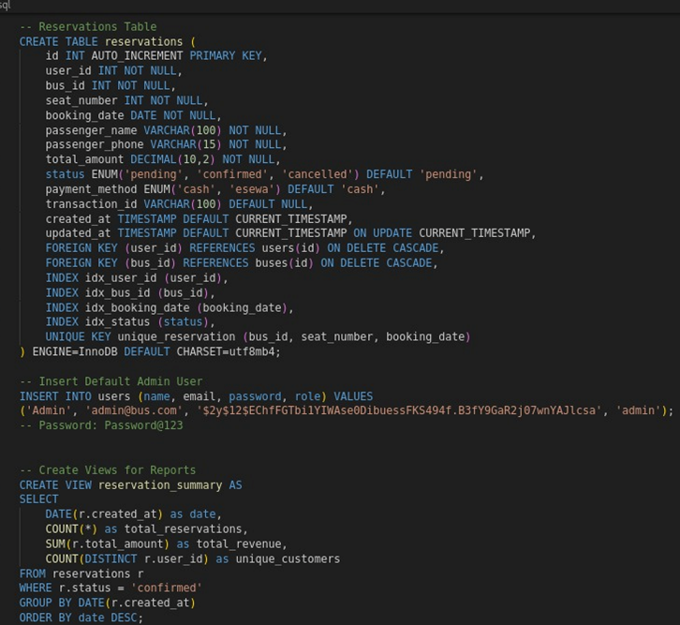
SQL Code for OBRS

Slide 16
Future Enhancements
Live Payment Integration: Implement real payment gateways such as eSewa, Khalti, or mobile banking for real transactions.
Mobile Application Development: Build Android and iOS apps using frameworks like Flutter or React Native to support mobile users.
Advanced Features: Add GPS bus tracking, delay notifications, multilingual support, and basic analytics for demand forecasting.
Security & Performance: Implement HTTPS, CAPTCHA protection, and load balancing to handle high traffic during peak seasons.
Deployment & Partnerships: Deploy on reliable servers and collaborate with bus operators for pilot testing and real-world adoption.

Slide 17
Conclusion
OBRS addresses major problems in Nepal’s traditional bus ticketing system such as long queues, overbooking, and lack of real-time information.
Built using PHP, MySQL, and responsive web design, the system provides a simple and cost-effective digital reservation platform.
Features like route search, seat selection, simulated payment, e-ticket generation, and admin management tools ensure complete booking management.
System design, feasibility analysis, and testing confirmed strong functionality, usability, and reliability.
The project supports the digital transformation of Nepal’s transportation sector and demonstrates practical software engineering skills in a real-world context.
Website is live at bussewa.infinityfreeapp.com/BCA-4TH-PROJECT-BUS-RESERVATION/pages/public/home.php

Slide 18
References
https://www.bussewanepal.com
https://www.sourcecodester.com/php/5012/online-bus-ticket-reservation-using-phpmysql.html
https://www.ijraset.com/research-paper/online-quick-bus-ticket-reservation-system
https://www.studocu.com/row/document/pokhara-university/simulation-and-modelling/final-project-report-online-bus-reservation-system-eng-190/134856650
https://hamrobus.wordpress.com/2015/06/08/nepal-online-bus-booking-hamrobus-com
https://iiste.org/Journals/index.php/CEIS/article/view/18128
https://www.ioinformatic.org/index.php/JAIEA/article/view/934
https://arkajainuniversity.ac.in/naac/dvv-clarification/Criteria%201/1.3.4/1_3_4_DOCUMENTS/MCA/AJU210650.pdf
Website is live at bussewa.infinityfreeapp.com/BCA-4TH-PROJECT-BUS-RESERVATION/pages/public/home.php

Slide 19
Thank You
bussewa.infinityfreeapp.com/BCA-4TH-PROJECT-BUS-RESERVATION/pages/public/home.php
Udesh Regmi & Sangam Sedai
Nepalaya College, Kalanki, Kathmandu
March, 2026

