Slide 1
Understanding and Introspecting AI

Slide 2
Contents
Interpretable AI
Explainable AI
Trustworthy AI
Fairness AI
Responsible AI

Slide 3
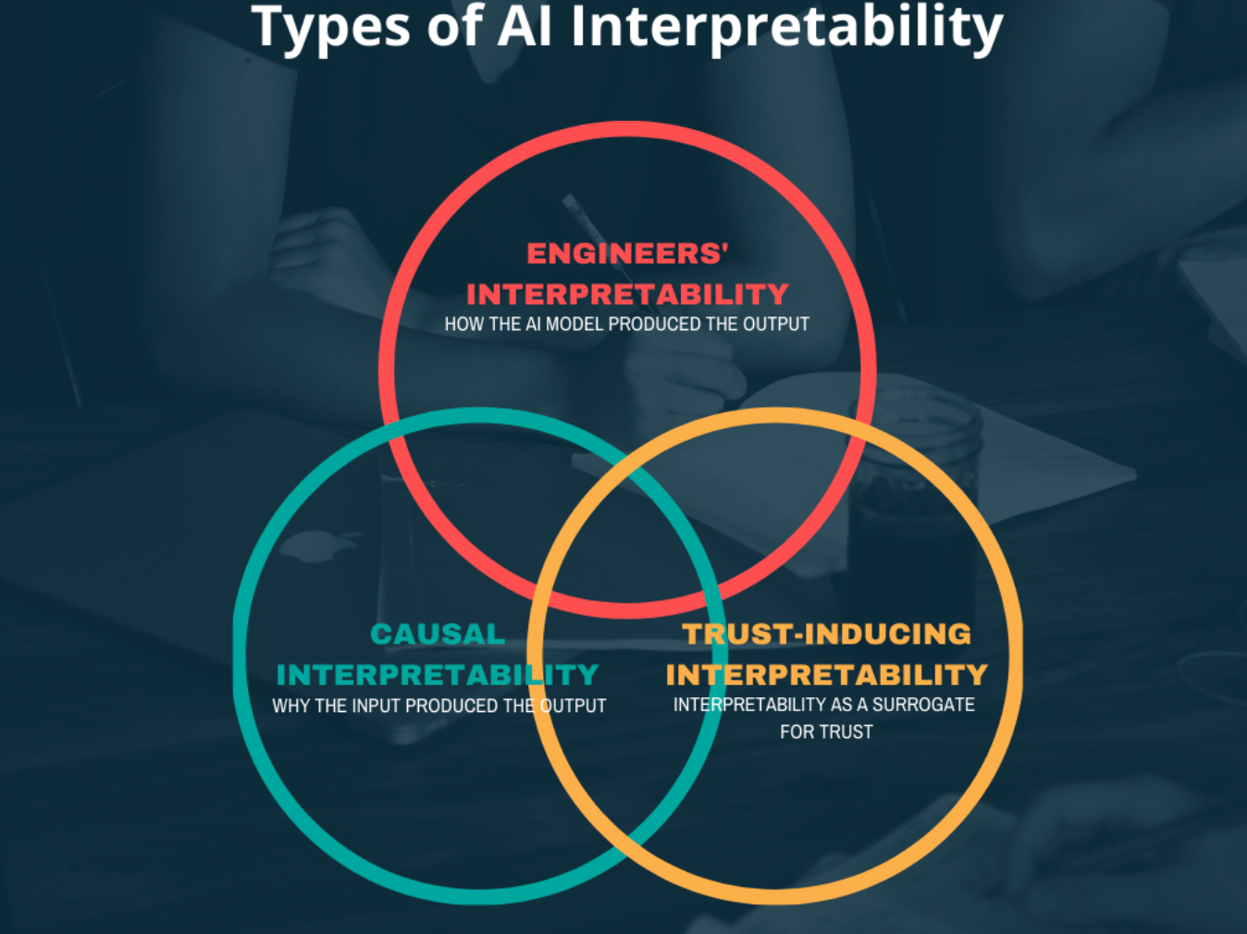
Interpretable AI
It refers to model transparency and understand exactly why and how the model is generating predictions.
We need to observe the inner mechanics of the AI/ML method used.
This leads to interpreting the model’s weights and features to determine the given output.

Slide 4
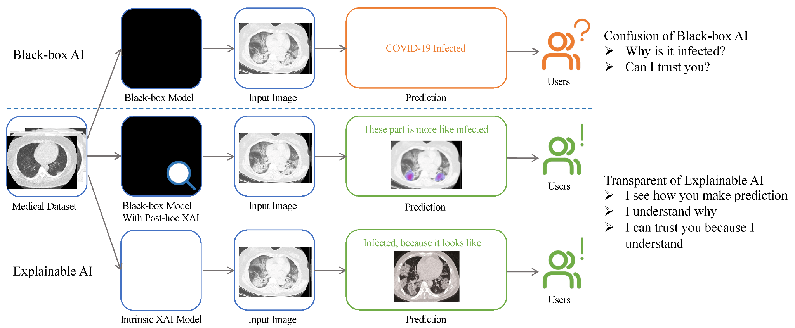
Explainable AI
Refers to the capability of AI systems to provide understandable explanations for their outputs or recommendations.
It addresses the inherent opacity of machine learning models, enabling stakeholders to comprehend why a specific decision was made or action was recommended.
Once a model is Interpretable then it can be Explainable by techniques such as feature importance analysis, decision trees, and model-agnostic approaches like LIME (Local Interpretable Model-Agnostic Explanations) and SHAP (SHapley Additive explanations).

Slide 5
 | Interpretable AI | Explainable AI
Focus | Concentrates on making the AI system's internal processes understandable. | Concentrates on providing explicit justifications and reasons for the model’s outputs.
Accessibility | More concerned with the overall understandability of the AI model. | Specifically targets the clarity of explanations provided for individual decisions made by the model.
User Perspective | User-centric, aiming to ensure that users can comprehend the system's functioning. | User-focused, with a primary goal of delivering meaningful explanations to users about the AI's decisions.
Implementation | Involves in simpler model architectures or visualizations that make it easier to follow the decision process. | Often incorporates techniques and methods designed explicitly for generating human-understandable justifications for AI decisions. (LIME)

Slide 6
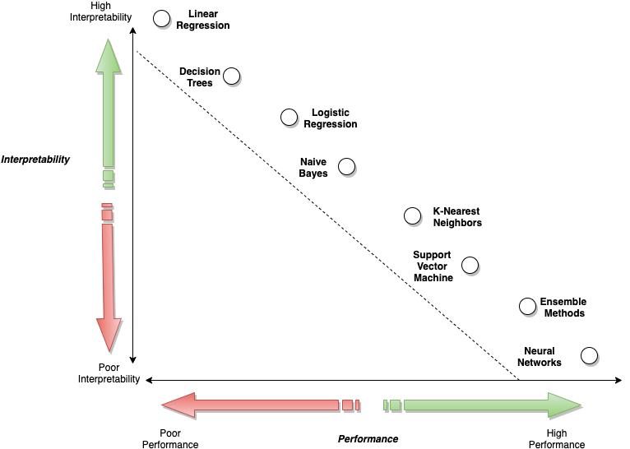
Interpretability & Performance of ML Algorithms

Slide 7
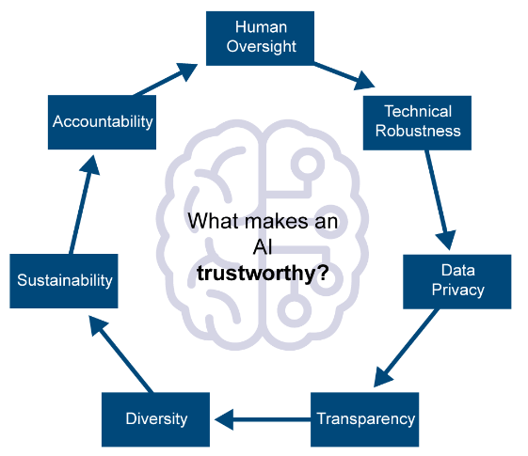
Trustworthy AI
AI is considered trustworthy when its outputs can be easily interpreted and explained, fostering a clear understanding of the model's decisions.
Trustworthy AI instills confidence by providing transparent, reliable, and comprehensible results, instilling faith in the system's reliability and accountability.

Slide 8
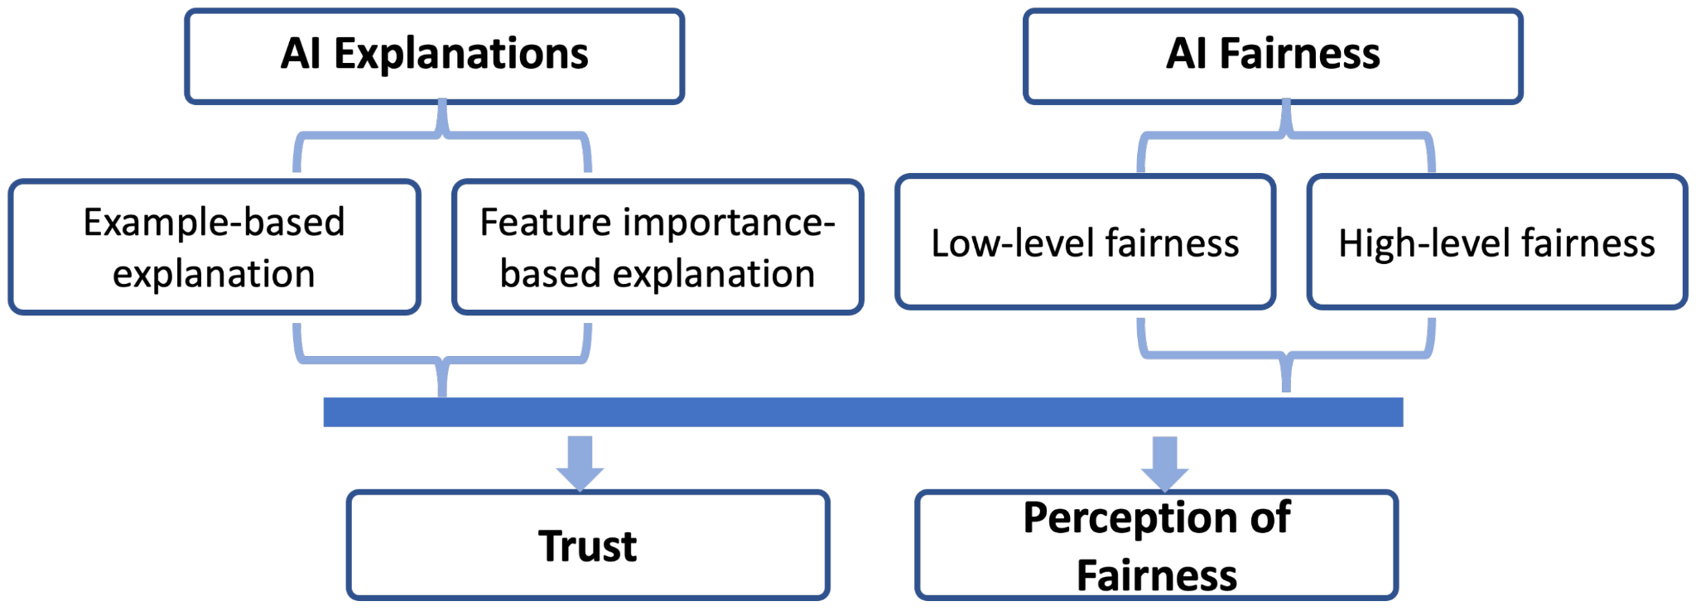
Fairness AI
The goal of fairness in AI is to ensure that AI systems make decisions that are unbiased, equitable, and do not propagate or reinforce societal disparities.
Fairness metrics are tools used to measure and mitigate bias in AI systems.

Slide 9
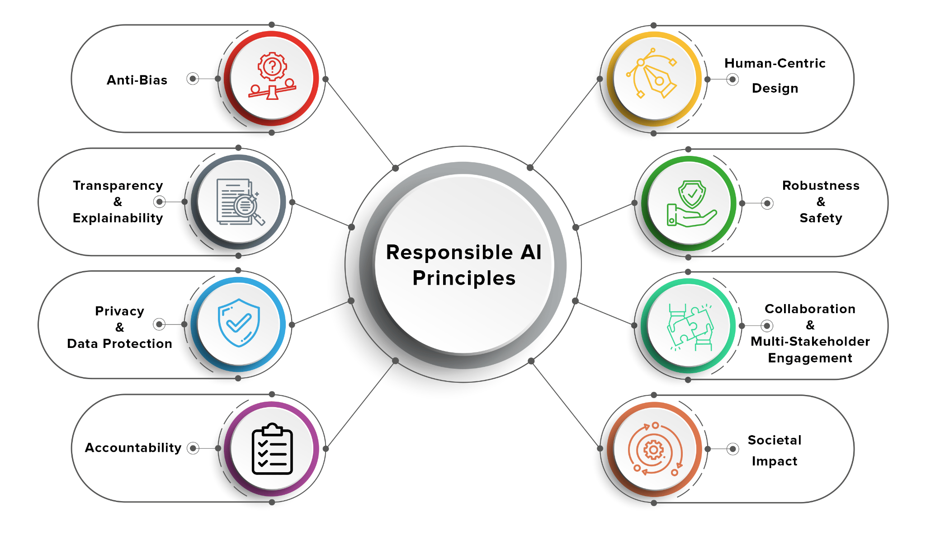
Responsible AI
It is the practice of designing, developing, and deploying AI with good intention to empower employees and businesses, and fairly impact customers and society—allowing companies to trust and scale AI with confidence. Artificial Intelligence.

Slide 10
Conclusion
If a model is interpretable like its inner working, architecture, weights. We can have explainability of that model that is which features is being used and why the model is taking such decision.
Once we come to know about the reasons (Features and their importance) behind the decisions made by model then we can trust that model, and hence it is "Trustworthy".
Once we have trust in the model predictions, then we can develop Responsible AI, which is fair, transparent, accountable.

