Slide 1



Kabadi Wala
Admin
sets prices, adds recyclers
Collector
sells scrap
From scrap to payment: how the platform works
Admin · Collector · Recycler | November 2026
Recycler
buys and pays
Notes:
Kabadi Wala connects informal scrap collectors with verified recyclers. This deck walks through the full flow, from the admin setting today's prices to the recycler paying and both sides getting an invoice.

Slide 2



One platform, three roles
Admin
Collector
Recycler
Sets today's price for every material
Adds recyclers with their exact location
Approves recyclers, settles disputes
Lists scrap: materials, kg, photos
Picks the best buyer nearby
Gets paid by QR, keeps the invoice
Sees lots within 5 km
Quotes a price per material
Pays and gets the invoice
Notes:
Three roles share one platform. The admin sets the rules (prices, which recyclers are verified), the collector lists scrap, and nearby recyclers compete to buy it.

Slide 3
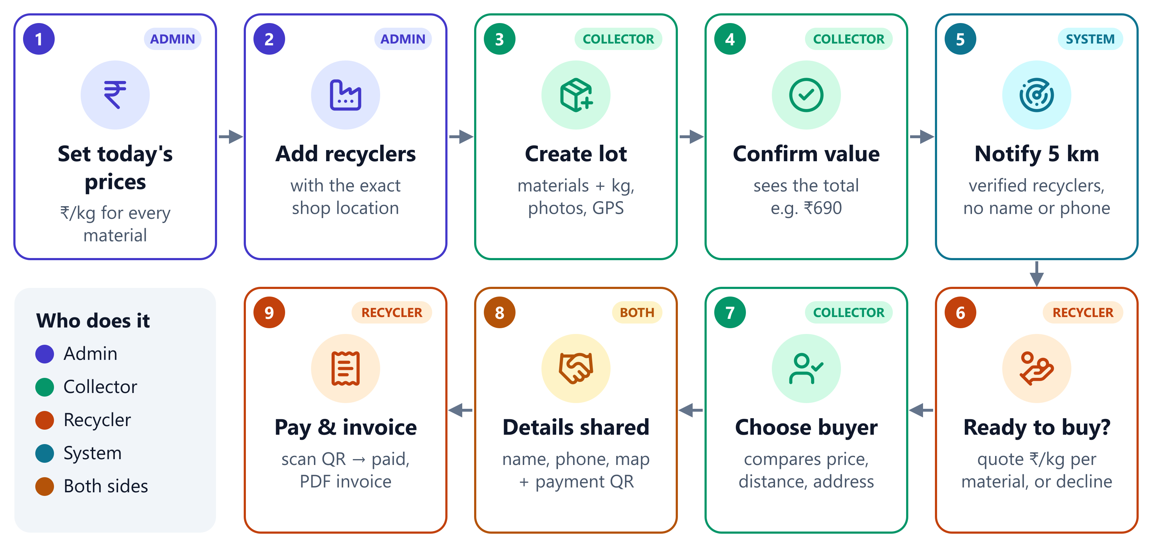
The full flow in 9 steps
Notes:
Read left to right on the top row, then right to left on the bottom row. Colours show who acts: indigo is the admin, green the collector, orange the recycler, teal the system. The example lot is PCB 5 kg plus Wires 2 kg, worth Rs 690 at today's price.

Slide 4
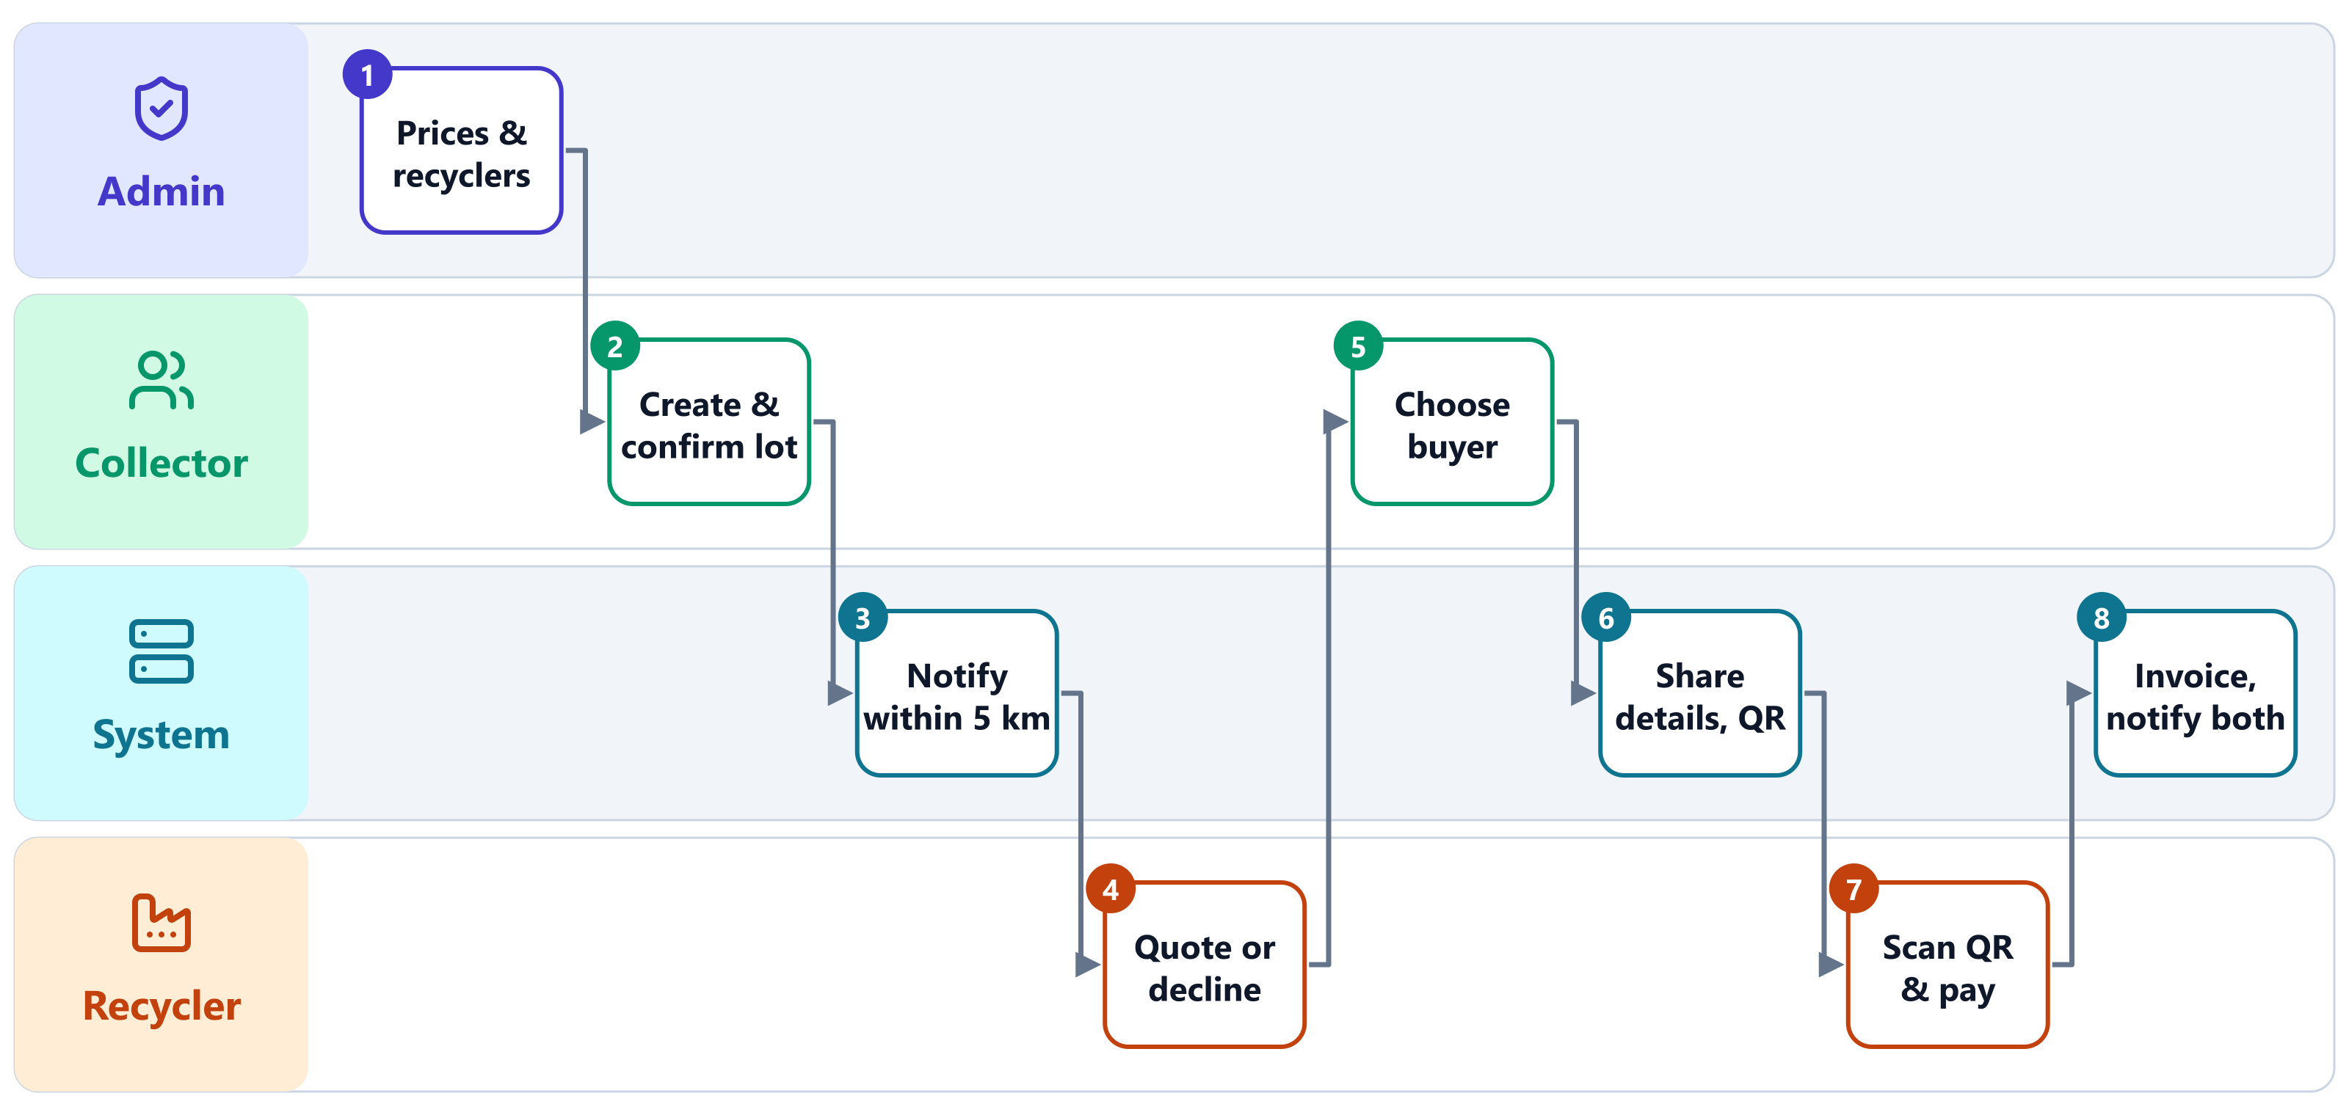
Who does what, and when
Notes:
The same flow as swimlanes. The system does the work between people: it finds recyclers within 5 km, shares contact details only after the collector chooses, and sends notifications and the invoice to both sides.

Slide 5
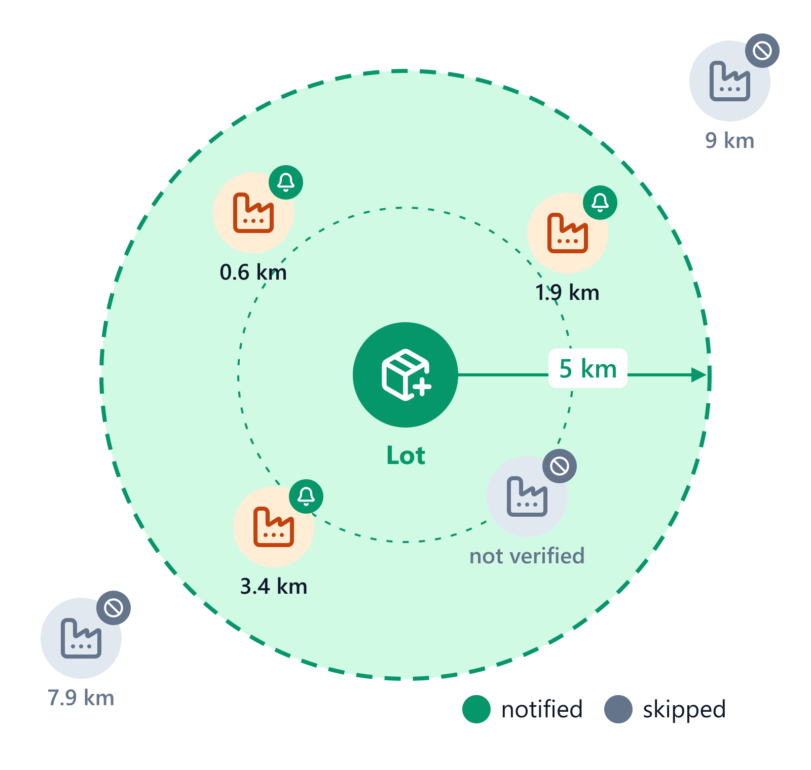



Lots reach recyclers within 5 km
5 km from the lot
Uses the phone's GPS, or the collector's registered area
Verified recyclers only
Pending, suspended or expired recyclers are skipped
Collector stays private
Name and phone are shared only after the collector chooses
Notes:
When the collector confirms a lot, every verified recycler within 5 km gets a notification with the materials, weights, price, distance and area. Recyclers outside the circle, or not yet approved by the admin, are skipped. 'Search again' reaches recyclers added later.

Slide 6


One lot can hold many materials
Material | Weight | Today's rate | Amount
PCB | 5 kg | ₹120/kg | ₹600
Wires & cables | 2 kg | ₹45/kg | ₹90
Total | 7 kg |  | ₹690
A recycler offers
₹715
₹125/kg for PCB, keeps ₹45/kg for wires. The collector compares every offer before choosing.
Up to 10 materials in one lot
Up to 5 photos, shrunk on the phone
Notes:
A collector can sell several materials in one lot. Each is valued at the admin's price for today, so the collector sees the total before confirming. Recyclers can change the rate per material; here one recycler offers Rs 125 instead of Rs 120 for PCB, so the collector sees Rs 715.

Slide 7
The collector picks the best offer
Sion Green Recyclers
Mahim Metal Works
Kurla E-Waste Hub
0.6 km · Sion
1.9 km · Mahim
3.4 km · Kurla
₹690
₹715
—
Ready to buy
Best offer
Not interested
Each recycler's answer moves through these states
NOTIFIED
INTERESTED
SELECTED
lot sent to recycler
or DECLINED
others: NOT_SELECTED
Notes:
The collector's lot page refreshes on its own and lists every recycler who is ready to buy, with total price, distance and address. Choosing one marks that offer SELECTED, tells the others the lot is gone, and creates the deal.

Slide 8
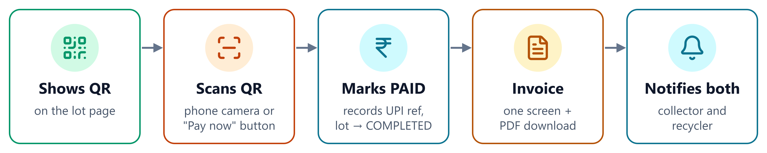

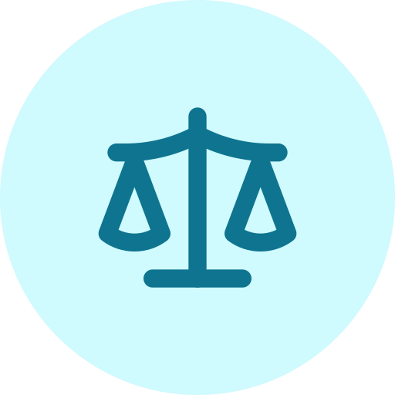
Getting paid
Demo QR (web app today)
Handover check (API)
One scan marks the deal paid
Invoice page + PDF download
No real money moves yet
Recycler enters code + real weight
Within 5%: confirmed and paid
Over 5%: accept or dispute, admin decides
Notes:
Today the web app uses a demo QR payment: scanning it marks the deal paid, completes the lot, opens the one-screen invoice with a PDF download and notifies both sides. The REST API also supports a stricter handover check, where the recycler enters the collector's code and the real weight; a difference over 5% needs the collector to accept or dispute it.

Slide 9
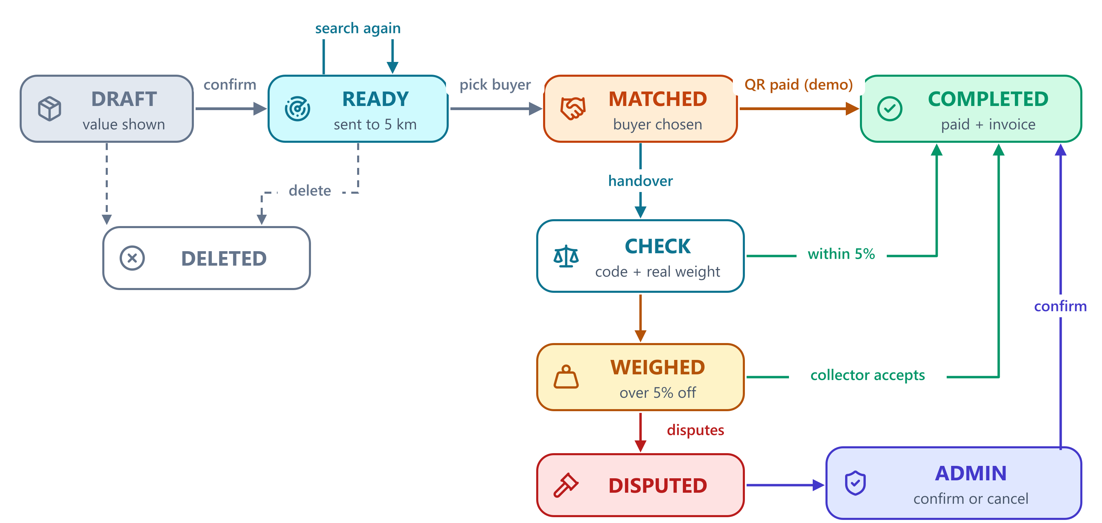
Every lot follows one lifecycle
Notes:
The top row is the main path: DRAFT, READY, MATCHED, COMPLETED. A collector can delete a lot while it is DRAFT or READY, and can search again while it is READY. The lower branch is the API handover check: within 5% it completes, over 5% the collector accepts or disputes, and a dispute goes to the admin.

Slide 10
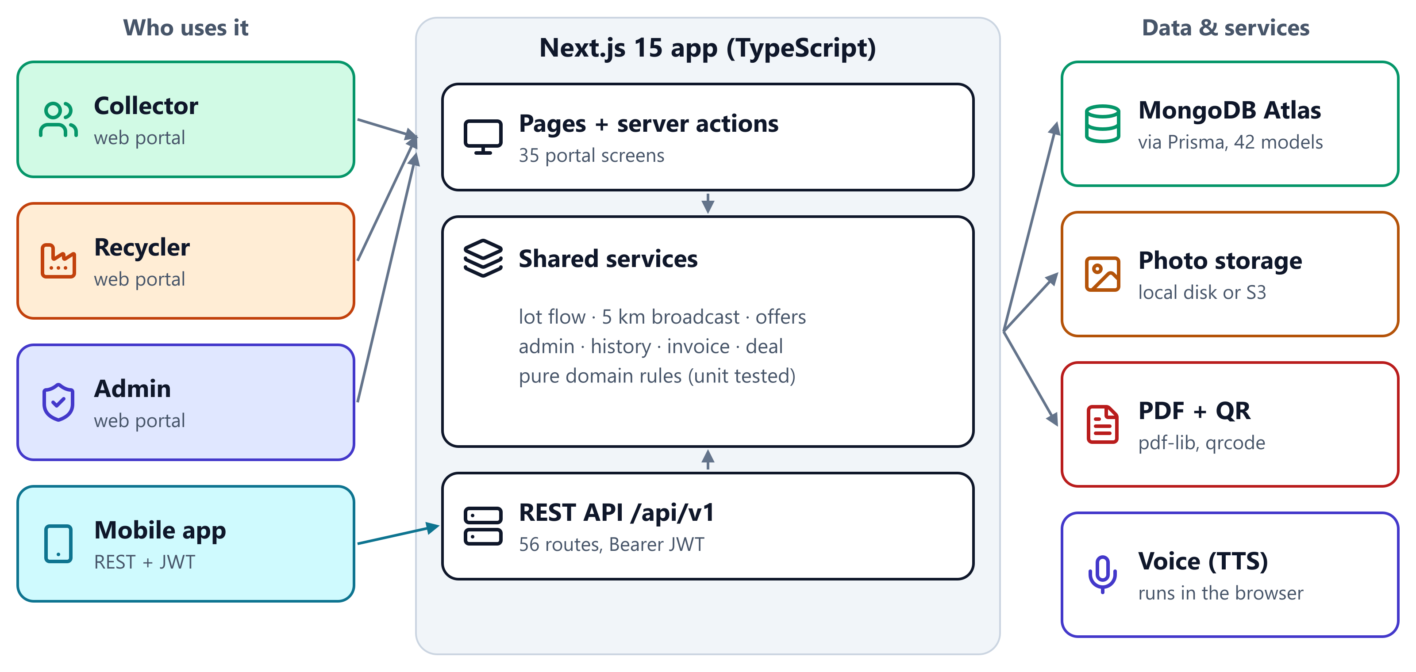
How it is built
Notes:
One Next.js app serves the three web portals and the REST API for the mobile app. Both go through the same services, so web and app follow the same rules. Data is in MongoDB Atlas through Prisma; photos are on local disk or S3; PDFs and QR codes are made on the server; voice runs in the browser.

Slide 11
56 API routes for the mobile app
13
9
4
4
56
Lots
Auth
Admin
Sync
REST routes under /api/v1, Bearer token from login
4
3
3
3
Field agent
Recycler
Prices
Notifications
Plus uploads, payments, invoices, receipts, health and reference data · full list: docs/APP_API_GUIDE.md
Notes:
The mobile app talks to the same backend through 56 REST routes, with a Bearer token from login. The full list with request and response examples is in docs/APP_API_GUIDE.md.

Slide 12

Flow check: what we found
Found in the check
138 / 139
Bug
/lots/{id}/arrived has no ownership check: any collector can mark another collector's lot as arrived and see who bought it.
automated tests pass (1 skipped)
Bug
The same endpoint saves an arrival time even when the collector is still far away.
0
Setup
After pulling, run npx prisma generate and restart the dev server.
type errors after prisma generate
Pending
Live end-to-end run against a test database.
Notes:
The code builds and the automated tests pass. The type errors seen after pulling were only an out-of-date Prisma client. Two problems were found in the new 'arrived' endpoint. A live end-to-end run against a database was not done for this deck.

Slide 13

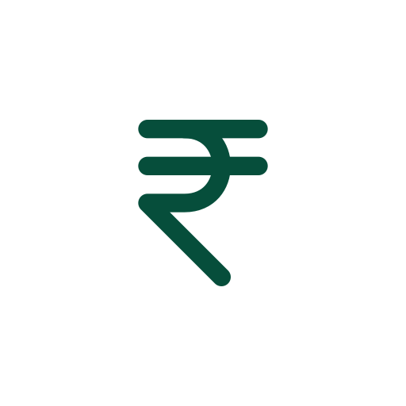



Next steps
Fix the arrived endpoint
check owner and distance
Real UPI payments
replace the demo QR
Server voice for Marathi
same clear audio on every phone
What would make the flow ready for real users
End-to-end test
on a staging database
Refresh OpenAPI docs
match the latest API
Notes:
Fixing the arrived endpoint is small and should come first. Real payments, server-side voice and an end-to-end test on a staging database are the steps before real users.

