Slide 1
Recommendation System

Slide 2
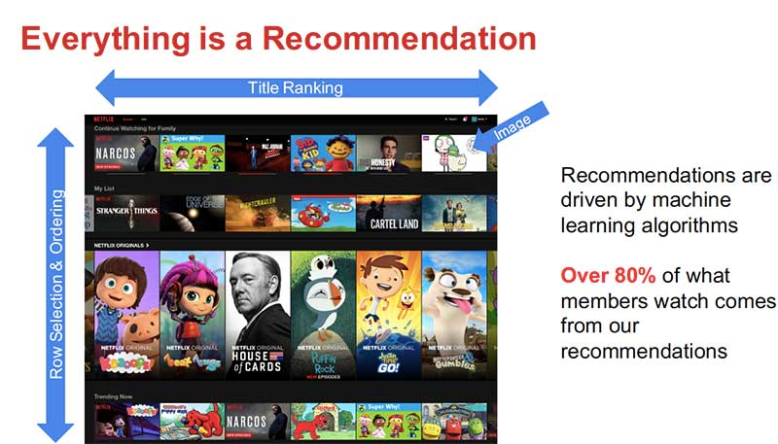
Recommendation Engine

Slide 3
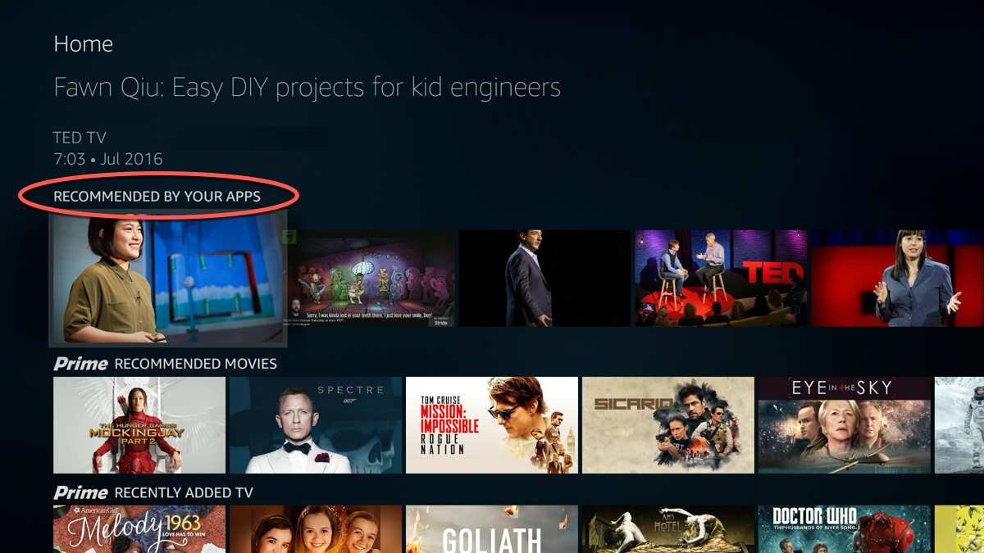
Recommendation Engine

Slide 4
Types of recommendation Engine
Collaborative Recommendation System
User based/Memory Based System
Item Based
Content Based Recommendation System
Popularity Based Recommendation System

Slide 5
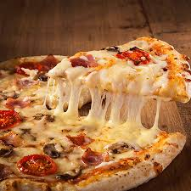
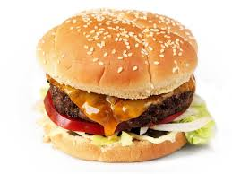



Collaborative Recommendation System
Overview about RS
User based/Memory Based System
Similar User
Recommend

Slide 6
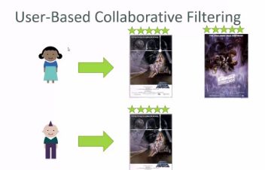
Collaborative Recommendation System
Overview about RS
User based/Memory Based System

Slide 7
Collaborative Recommendation System
User based/Memory Based System
Little Deeper How this overview works

Slide 8
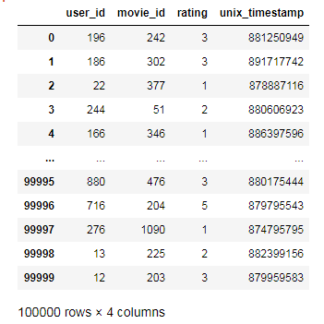
Collaborative Recommendation System
Little Deeper How this overview works
User based/Memory Based System
Dataset

Slide 9
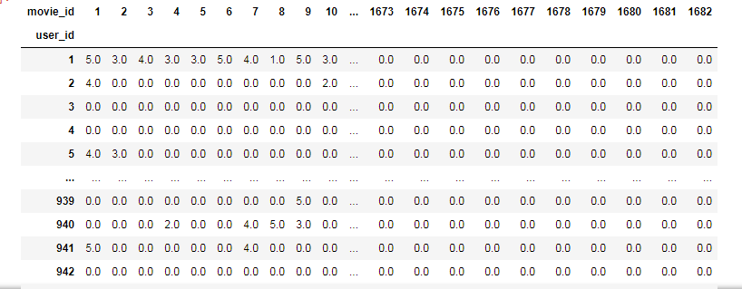
Collaborative Recommendation System
Little Deeper How this overview works
User based/Memory Based System
Pivot Table

Slide 10
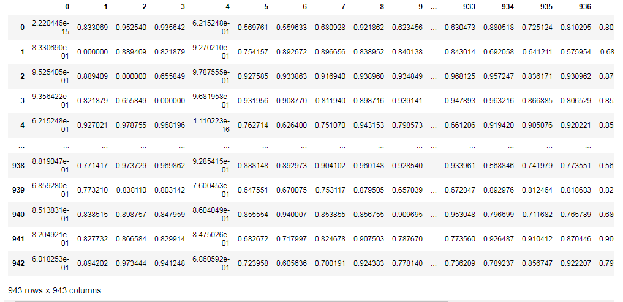
Collaborative Recommendation System
Little Deeper How this overview works
User based/Memory Based System
Similarity Table(Cosine)

Slide 11
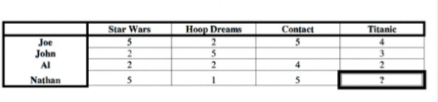
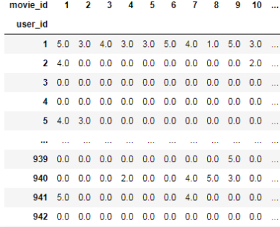
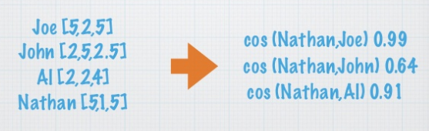
Collaborative Recommendation System
Little Deeper How this overview works
User based/Memory Based System
Prediction Table

Slide 12

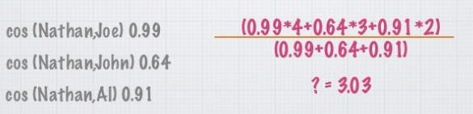
Collaborative Recommendation System
Little Deeper How this overview works
User based/Memory Based System
Prediction Table

Slide 13
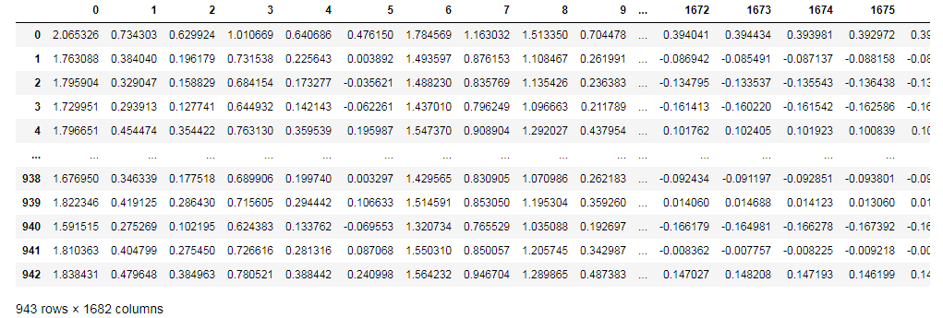
Collaborative Recommendation System
Little Deeper How this overview works
User based/Memory Based System
Prediction Table

Slide 14
Collaborative Recommendation System
Little Deeper How this overview works
User based/Memory Based System
Prediction Table

Slide 15
Collaborative Recommendation System
Little Deeper How this overview works
User based/Memory Based System
Select the User_Input
UserID=34

Slide 16




Collaborative Recommendation System
Little Deeper How this overview works
User based/Memory Based System
Similar users Based on Similarity Table
SimScore(0.14)
SimScore(0.24)
SimScore(0.28)
SimScore(0.34)

Slide 17
Collaborative Recommendation System
Little Deeper How this overview works
User based/Memory Based System
Similar users movie Id
34
45
89
673
876
893
34
56
67
78
89
93
67
83
56
83
86
90
67
83
53
87
86
90

Slide 18
Collaborative Recommendation System
Little Deeper How this overview works
User based/Memory Based System
User_Input movie Id
Movie_Id
Movie_Id
Movie_Id
Movie_Id
Movie_Id
34
45
67
93
57
83
98
89
100
34
45
89
673
876
893
34
56
67
78
89
93
67
83
56
83
86
90
67
83
53
87
86
90

Slide 19
Collaborative Recommendation System
Little Deeper How this overview works
Filtered Movieid from similar user based on User_input
User based/Memory Based System
50
78
87
90
673
876
893

Slide 20
Collaborative Recommendation System
Little Deeper How this overview works
Filtered Movie List based on the User Prediction Table(highest)
User based/Memory Based System
Movie_Id
Prediction Value
50
78
87
90
673
876
893
0.99
0.89
0.75
0.74
0.45
0.37
0.25

Slide 21
Collaborative Recommendation System
Little Deeper How this overview works
User based/Memory Based System
Highest Rated Movie_id
Threshold=0.7
Movie_Id
Prediction Value
Sorted Movie_List
50
78
87
90
673
876
893
0.99
0.89
0.75
0.74
0.45
0.37
0.25
50
78
87
90

Slide 22
Collaborative Recommendation System
Little Deeper How this overview works
User based/Memory Based System
Retrieve the Movie Title using Highest rated movieid
Threshold=0.7
Movie Title
Sorted Movie_List
50
78
87
90
InterSteller
Inception
Gravity
Imitation Game

Slide 23
Collaborative Recommendation System
User based/Memory Based System
STEPS FOR USER BASED RECOMMENDATION SYSTEM
Step1: Create Pivot Table , values as rating
Step2: Create similarity table between Users using Pivot → Cosine Decision
Step3: Predict the non filled rating for the users using formula*(This helps to find the not watched film )
Step4: Select the user_input
Step5: For the user_input select the similar user using similarity Table(Minimum Distance is the similar)

Slide 24
Collaborative Recommendation System
User based/Memory Based System
STEPS FOR USER BASED RECOMMENDATION SYSTEM
Step6: Create a list of movie id for similar user
Step7: Create a list of movie id for user_input
Step8: Filter the movieid of user_input which is not present in similar user
Step9: Filtered movieid have to check with Prediction table(step3 Answer) because of filtered movieid list are the recommended list

Slide 25
Collaborative Recommendation System
User based/Memory Based System
STEPS FOR USER BASED RECOMMENDATION SYSTEM
Step10: But we have to select only the highest rated movie of the filtered list.
Step11: With help of threshold value we can select the highest rated movie(Completely using predicted table )
Step12: Now we have only the highest rated movieid list of important user.
Step13: Now load the movie tile table
Step14: Using movie title table we can retrive the highesr rated movie list of the user_input(Final Recommendation Title.)

Slide 26
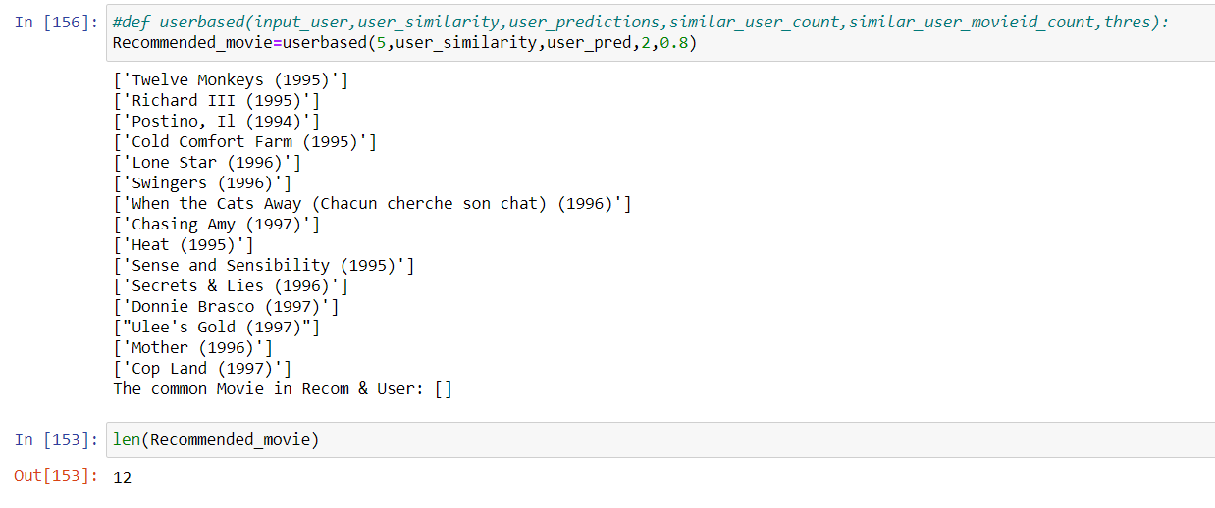

Slide 27
Collaborative Recommendation System
Item Based Recommendation

Slide 28
Collaborative Recommendation System
Item Based Recommendation
Recommended
Similar item
Recommended

Slide 29
Collaborative Recommendation System
Item Based Recommendation
Dataset

Slide 30
Collaborative Recommendation System
Item Based Recommendation
Pivot Table

Slide 31
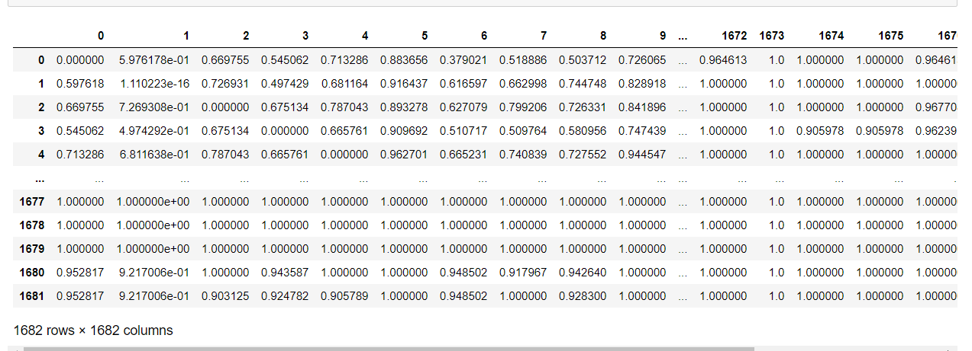
Collaborative Recommendation System
Item Based Recommendation
Similarity Table(Cosine)

Slide 32
Collaborative Recommendation System
Item Based Recommendation
Prediction Table

Slide 33
Collaborative Recommendation System
Item Based Recommendation
Prediction Table

Slide 34
Collaborative Recommendation System
Item Based Recommendation
Prediction Table

Slide 35
Collaborative Recommendation System
Item Based Recommendation
Prediction Table

Slide 36
Collaborative Recommendation System
Item Based Recommendation
Input Item
Item ID=34

Slide 37
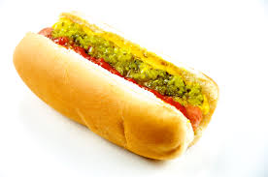

Collaborative Recommendation System
Item Based Recommendation
Similar Items

Slide 38
Collaborative Recommendation System
Item Based Recommendation
User-Id
User-Id
User-Id
34
45
89
673
876
893
34
56
67
78
89
93
67
83
56
83
86
90

Slide 39
Collaborative Recommendation System
Item Based Recommendation
User ID vs input Item
Filter the unique user id
Unique User ID
50
78
87
90
673
876
893

Slide 40
Collaborative Recommendation System
Item Based Recommendation
User ID vs input Item
Filter the unique user id
Unique User ID
Predicted value
50
78
87
90
673
876
893
0.99
0.89
0.75
0.74
0.45
0.37
0.25

Slide 41
Collaborative Recommendation System
Item Based Recommendation
User ID vs input Item
Filter the unique user id
Unique User ID
Predicted value
Threshold=0.7
50
78
87
90
673
876
893
0.99
0.89
0.75
0.74
0.45
0.37
0.25
Sorted
50
78
87
90

Slide 42
Collaborative Recommendation System
Item Based Recommendation
User Id
Recommended
50
78
87
90

Slide 43
Collaborative Recommendation System
Item Based Recommendation
STEPS FOR ITEM BASED RECOMMENDATION SYSTEM
Step1: Create Pivot Table , values as rating
Step2: Create similarity table between items using Pivot → Cosine Decision
Step3: Predict the non filled rating for the users using formula*(This helps to find the not watched film )
Step4: Select the item_input
Step5: For the item_input select the similar item using similarity Table(Minimum Distance is the similar)

Slide 44
Collaborative Recommendation System
Item Based Recommendation
STEPS FOR USER BASED RECOMMENDATION SYSTEM
Step6: Create a list of user id for similar items
Step8: Filter the user id of item_input which is not present in similar user
Step9: Filtered userid have to check with Prediction table(step3 Answer) because of filtered userid list are the recommended list
Step7: Create a list of user id for item_input

Slide 45
Collaborative Recommendation System
Item Based Recommendation
STEPS FOR USER BASED RECOMMENDATION SYSTEM
Step10: But we have to select only the highest rated movie of the filtered list user id
Step11: With help of threshold value we can select the highest rated movie(Completely using predicted table )
Step12: Now we have only the highest rated movieid list of important user.

Slide 46
Collaborative Recommendation System
Item Based Recommendation
ramisha@astrone.ltd
8883916171
https://www.linkedin.com/in/ramisha-rani-k-02b430154/
https://forms.gle/6kR2qA9zE6mUCb1h8

Slide 47
Content Based Recommendation

Slide 48
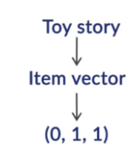
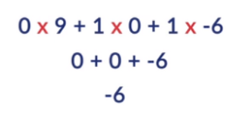
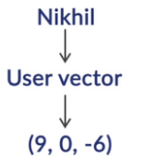
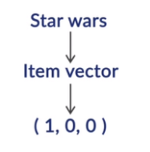
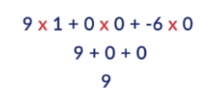
Content Based Recommendation
Overview
Recommended

Slide 49
Content Based Recommendation
Content Based Recommendation
Three important parameters
User Vector-for each user
Movie Vector- for each movie
Content Vector- user vector* movie Vector

Slide 50
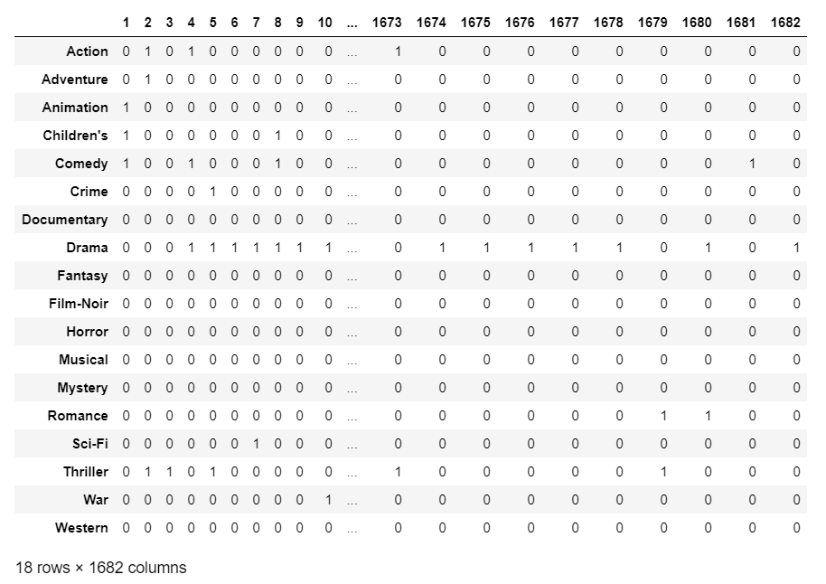
Content Based Recommendation
Movie Vector

Slide 51
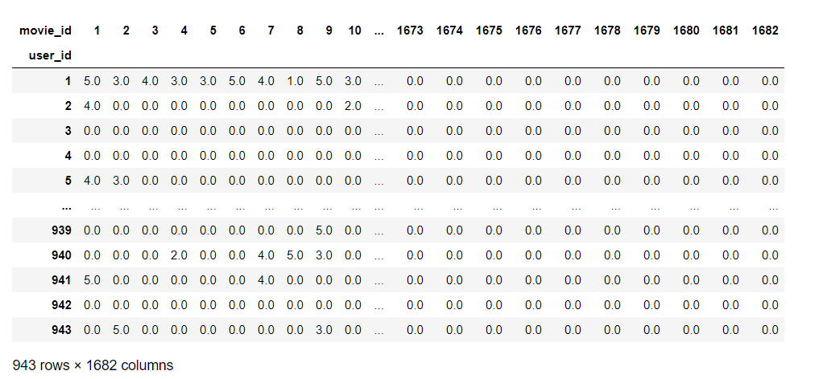
Content Based Recommendation
How to create User Vector
Step1: Pivot Table

Slide 52
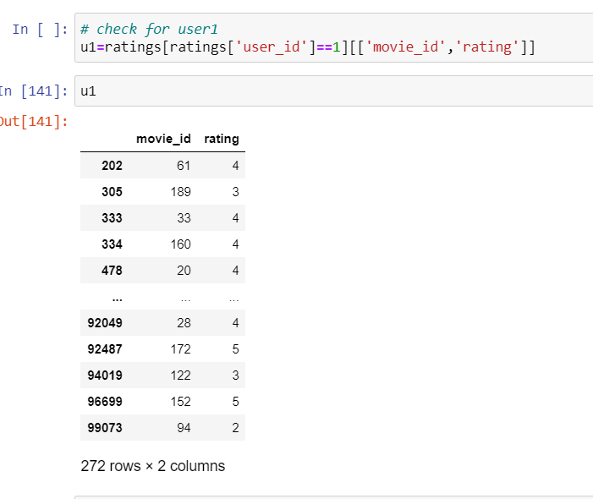
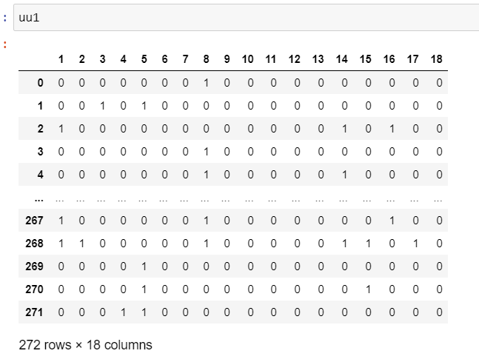
Content Based Recommendation
Step2: Create the single user

Slide 53
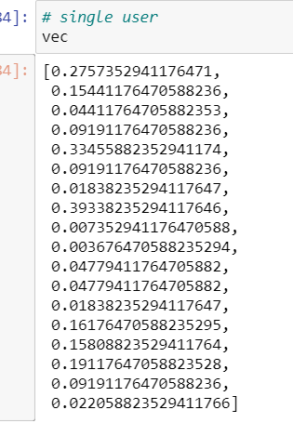
Content Based Recommendation
Step2: Create the single user

Slide 54
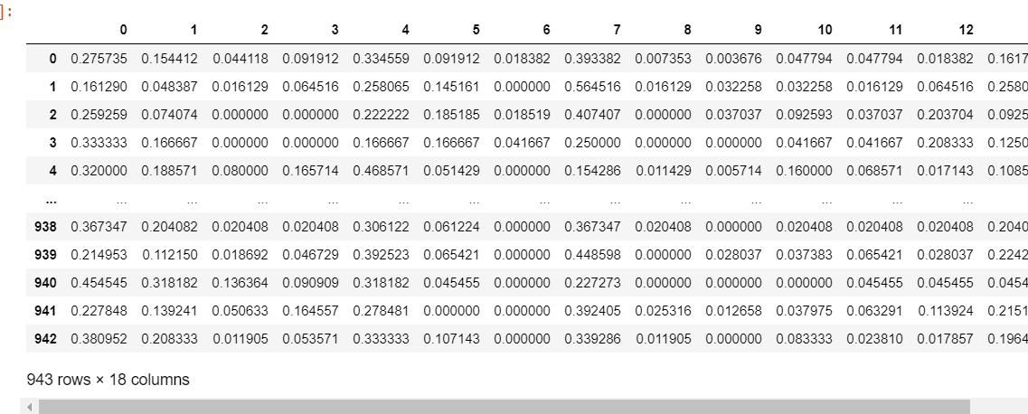
Content Based Recommendation
How to create User Vector
Step3: Based movie genre created user vector

Slide 55
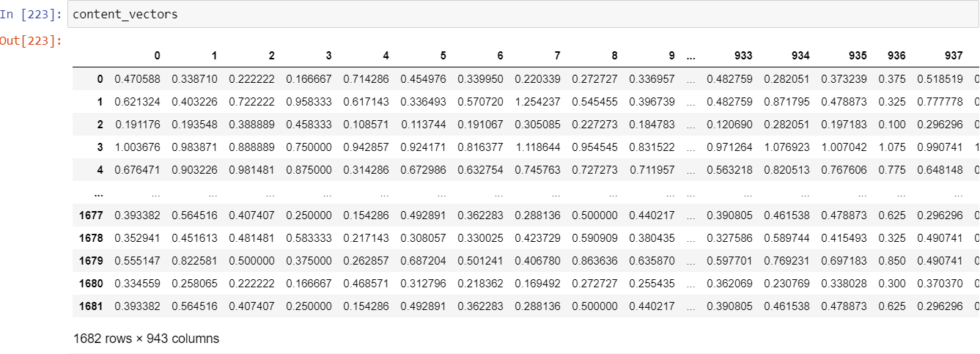
Content Based Recommendation
Content Vector
Dot Product(user vector, Movie Vector)

Slide 56

Content Based Recommendation
Based on threshold value we can recommended the movie for the user

Slide 57
Create user vector from the past user watch history
Create movie Vector based on the genre
Create content Vector by dot product of the user vector and movie vector
Select one user, retrieve the watched films
Remove the common on selected user list and content vector of the user.
With threshold value of content vector of the selected user list, movies list will be generated

