Slide 1



MCTM: Automotive Mixed-Criticality Task Manager
State Level Hackathon
Team Fallouts
Protect high-criticality execution under CPU pressure using QNX scheduling, IPC and adaptive workload degradation.

Slide 2
Problem & Design Target
Design and Execution
Problem in one line
Design target
A shared automotive compute platform may carry safety, control and infotainment workloads at the same time. Under CPU pressure, low-criticality work must yield before critical timing constraints are compromised.
Continuously measure execution behaviour, classify resource pressure and transition the system through NORMAL → DEGRADED → EMERGENCY while keeping Safety and Control protected.
Criticality hierarchy
Key evidence from the stress run
SAFETY
Priority 30 | HIGHEST
100 ms deadline | 20 ms budget
• Control workload injected at 25 ms
• Control budget = 10 ms
• Observed log: MCTM=DEGRADED
• Observed Control exec ≈ 28.8 ms
• BUDGET=OVERRUN, DEADLINE=OK
CONTROL
Priority 25 | HIGH
SCHED_SPORADIC | 50 ms period | 10 ms budget
INFOTAINMENT
Priority 10 | LOW
Workload adapts: 20 ms → 5 ms → 0 ms
Differentiator: policy-driven degradation, not a blanket shutdown of the platform.
QNX SDP 8.0 documentation
02

Slide 3
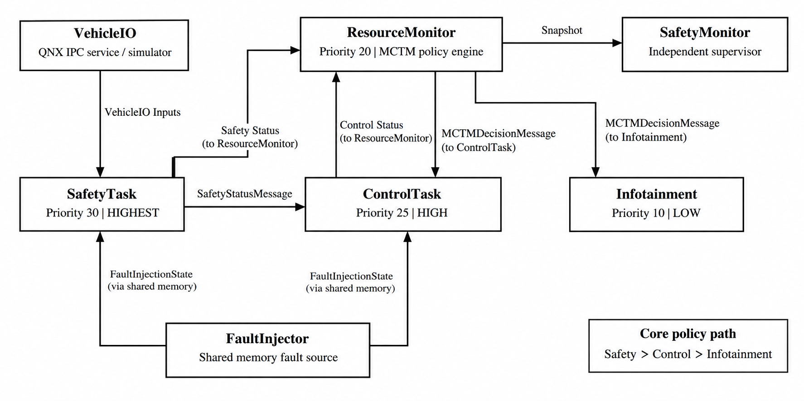
QNX Architectural Approach
Design and Execution
Microkernel + IPC
QNX keeps core kernel services small and exposes message passing as a fundamental OS mechanism. The project uses named channels and synchronous MsgSend/Receive/Reply.
Scheduling model
Safety/monitor processes use fixed priorities; ControlTask uses SCHED_SPORADIC to cap execution within its replenishment period.
Policy authority
ResourceMonitor is the MCTM decision engine; SafetyMonitor remains an independent supervisor.
Isolation boundary
Current prototype relies on priority separation + sporadic budget. Explicit CPU affinity/partitioning is a production follow-up.
QNX SDP 8.0: Microkernel • Message Passing • Scheduling • SCHED_SPORADIC
03

Slide 4
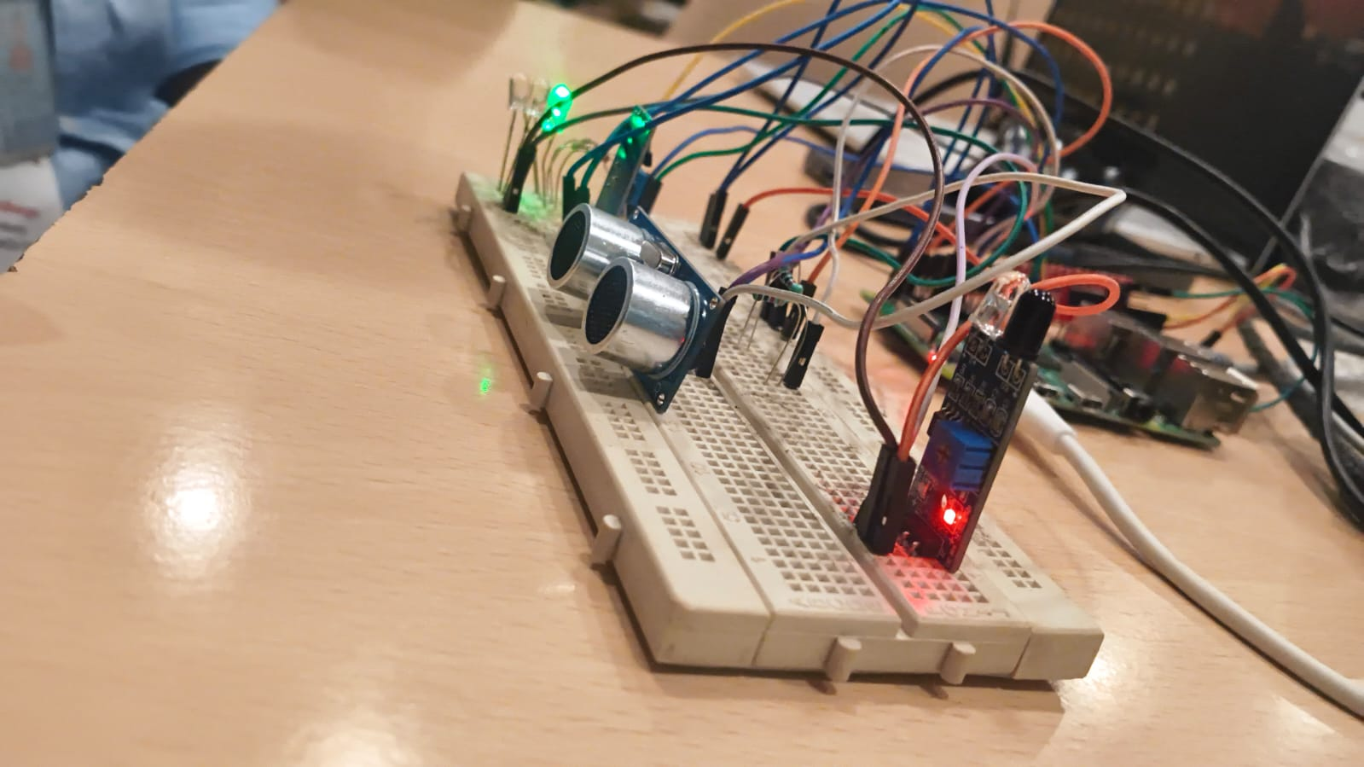
Technical Execution | QNX Runtime + Raspberry Pi
Design and Execution
End-to-end runtime path
QNX primitives used
IPC
name_attach / name_open
MsgSend / MsgReceive / MsgReply
Vehicle
I/O
Safety
Task
Control
Task
Resource
Monitor
Infotainment
Scheduling
SCHED_FIFO + SCHED_SPORADIC
SchedSet / SchedGet
inputs
30 / HIGHEST
25 / HIGH
10 ms budget
policy engine
10 / LOW
20→5→0 ms
timer_create + SIGEV_PULSE
clock_gettime
Timing
ControlTask reports timing → ResourceMonitor evaluates → policy is pushed to ControlTask and Infotainment.
Fault path
shm_open + mmap
consistent shared-memory snapshot
Fault path
Policy path
Evidence path
FaultInjector
→ shm_open/mmap
→ FaultReader
Status messages
→ timing checks
→ MCTM mode
tracelogger
→ .kev
→ System Profiler
Trace
tracelogger → .kev → System Profiler
Bench I/O validation
Ultrasonic + Hall inputs
GPIO status LEDs
VehicleIO abstraction keeps the scheduling test deterministic.
QNX SDP 8.0 API references: name_attach • timer_create • clock_gettime • shm_open
04

Slide 5
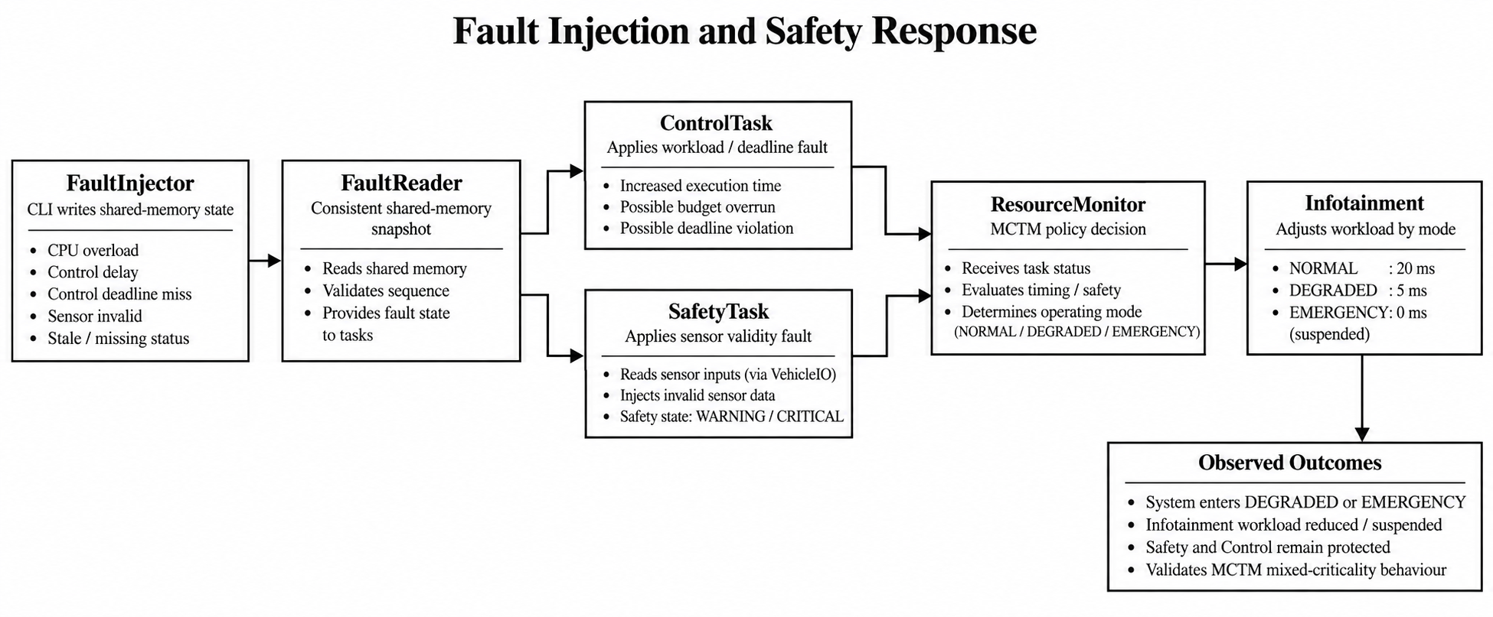
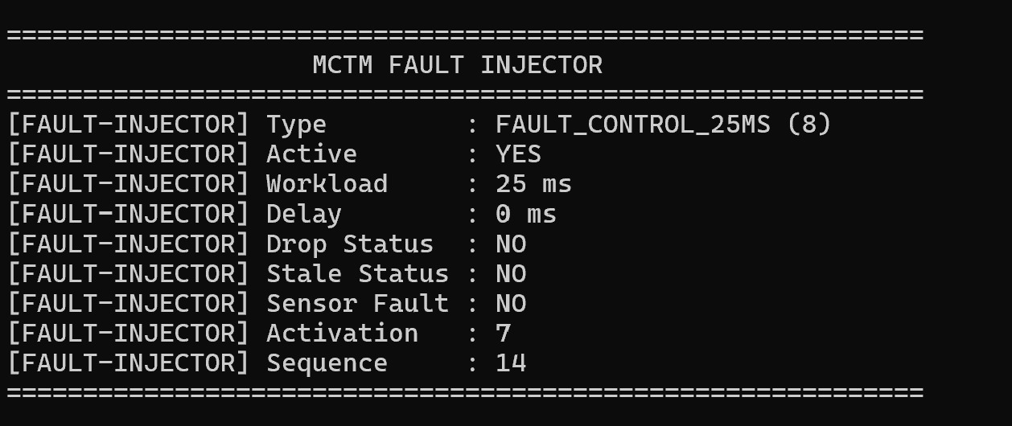
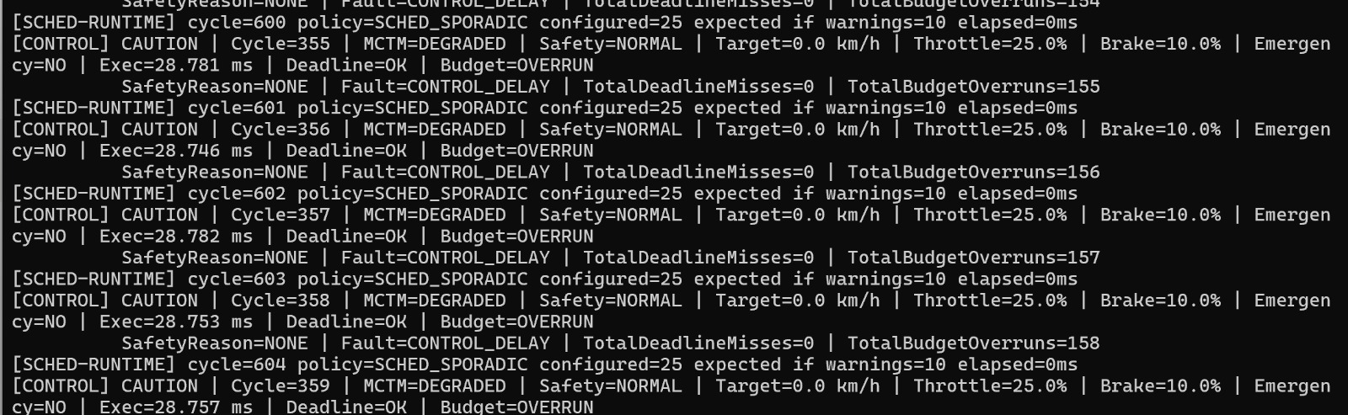
Resilience & “The Hack” Response
Design and Execution
Stress input
CONTROL_25MS • workload = 25 ms
Observed control response
MCTM=DEGRADED • Exec ≈ 28.8 ms • BUDGET=OVERRUN • DEADLINE=OK
Stress path: FaultInjector → FaultReader → Control/Safety → ResourceMonitor → Infotainment
05

Slide 6
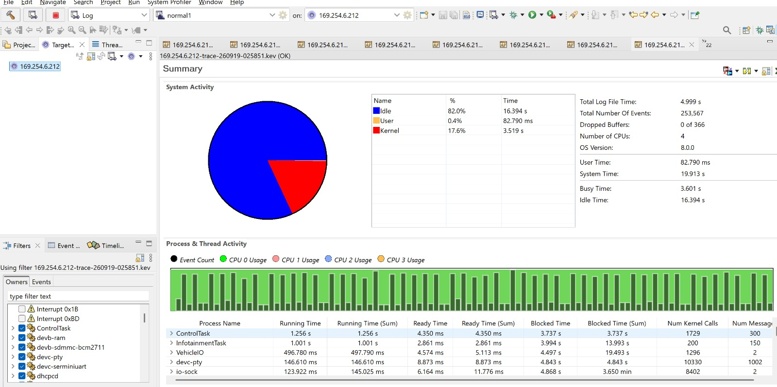
Performance Proof | System Profiler
Demonstration
Observed trace
Trace duration
4.999 s
Kernel events
253,567
Dropped buffers
0 / 366
CPUs
4
ControlTask running
1.256 s
ControlTask blocked
3.737 s
What it proves
QNX System Profiler exposes CPU activity and per-process run/blocked timing for the stressed scenario; no dropped trace buffers were reported.
Mandatory evidence • QNX .kev kernel-event trace opened in Momentics System Profiler
06

Slide 7
Future Scalability & Conclusion
Demonstration
Industrialization path
What the prototype proves
48-hour challenge solved
• Replace VehicleIO simulator with production CAN/UART/GPIO services
• Add CPU affinity / partitioning where justified
• Automate HIL + fault campaigns
• Integrate health management and service recovery
• Build traceable safety evidence around the workload policy
• Explicit criticality hierarchy
• QNX-native IPC and scheduling
• Budget/deadline monitoring
• Deterministic fault injection
• Adaptive low-criticality degradation
• Kernel-level trace evidence
Coordinating multiple QNX processes, IPC contracts, real-time scheduling, fault injection, timing measurement and profiler evidence into one reproducible system.
PROTECT THE CRITICAL. DEGRADE THE OPTIONAL. MAKE THE TIMING VISIBLE.
MCTM turns CPU pressure into an explicit operating-state decision instead of allowing low-criticality workload to consume the same execution envelope as safety and control.
QNX SDP 8.0 references: Microkernel • Message Passing • SCHED_SPORADIC • TimerCreate • Shared Memory • System Profiler
QNX microkernel • Message passing • SCHED_SPORADIC • System Profiler
QNX SDP 8.0 documentation
07

